Slide 1
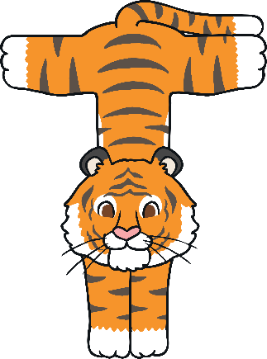
T

Slide 2

The Letter T Looks like This…
T
t
Can you draw it with your finger?

Slide 3
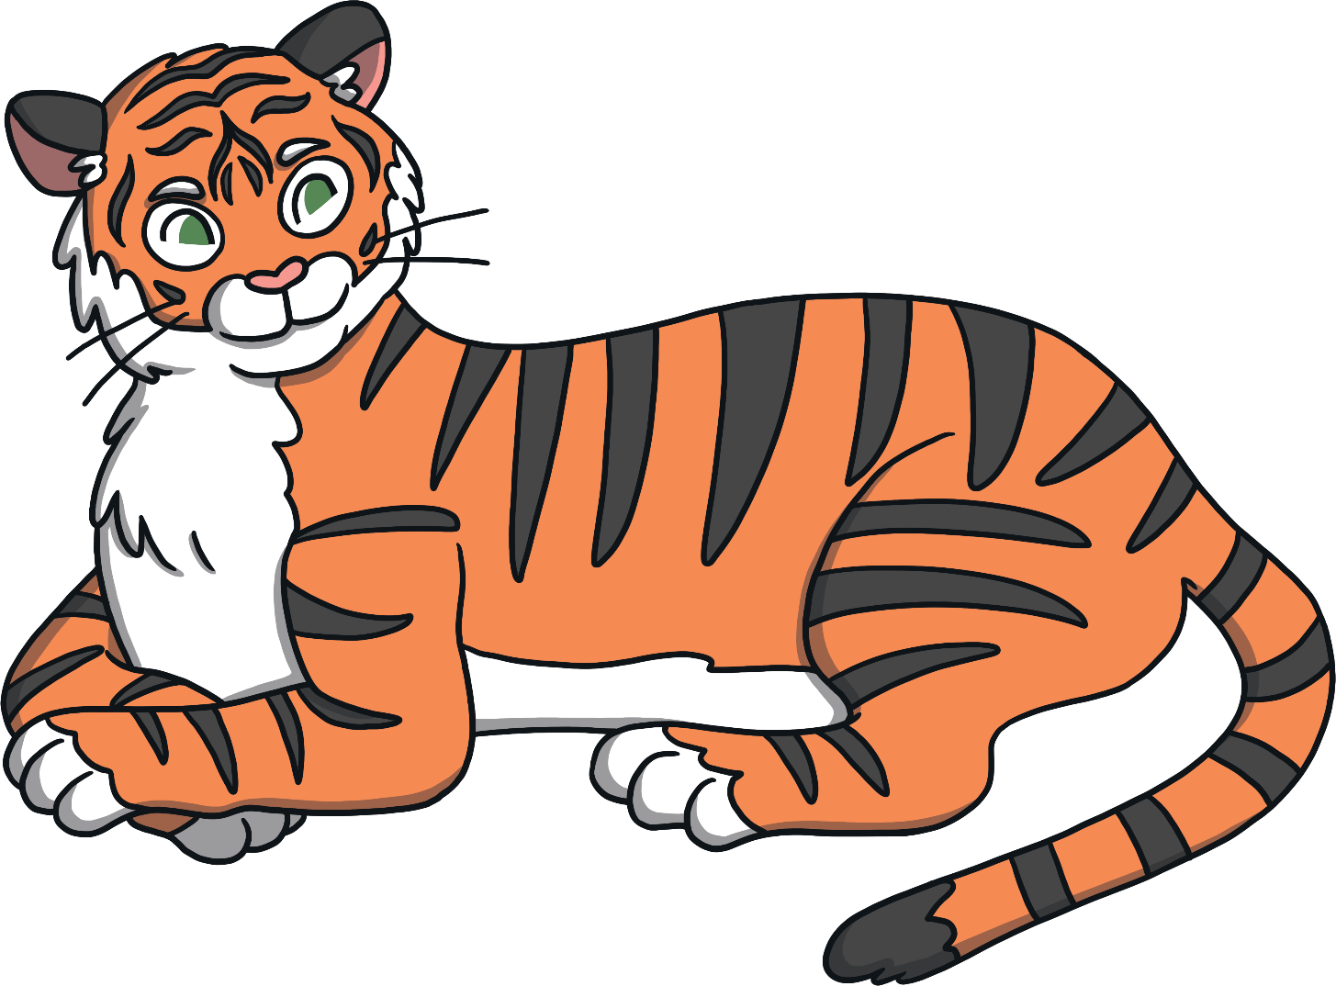
The Letter T Sounds like This…
T, T, T
Notes:
Say the sound /t/ and have children repeat it back multiple times.

Slide 4






It Can Also Look like This…

Slide 5
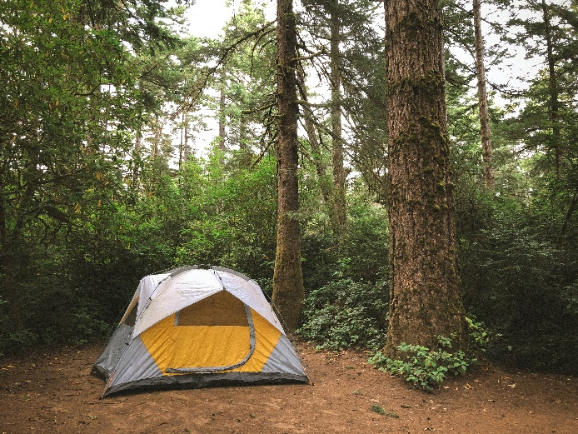
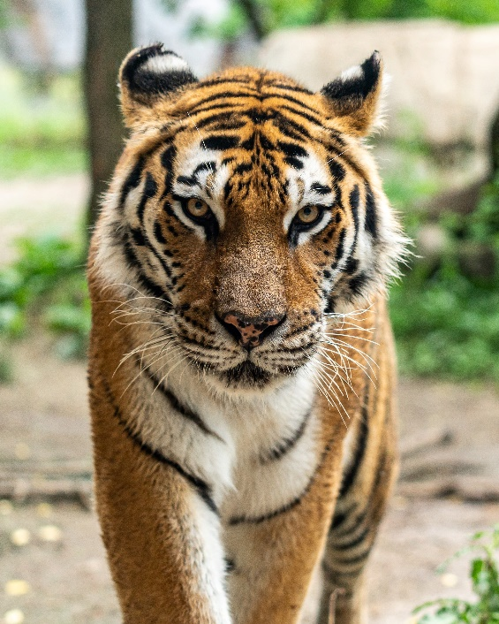
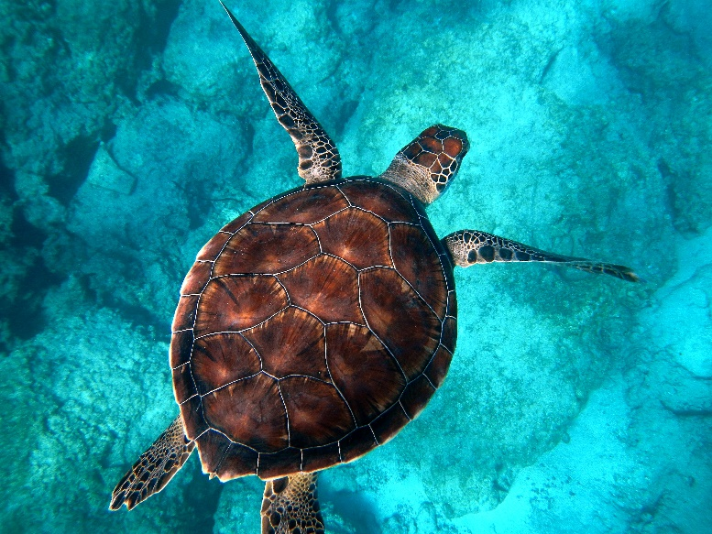
Some Things That Start with T Are…
Notes:
Tiger, tent, turtle

Slide 6
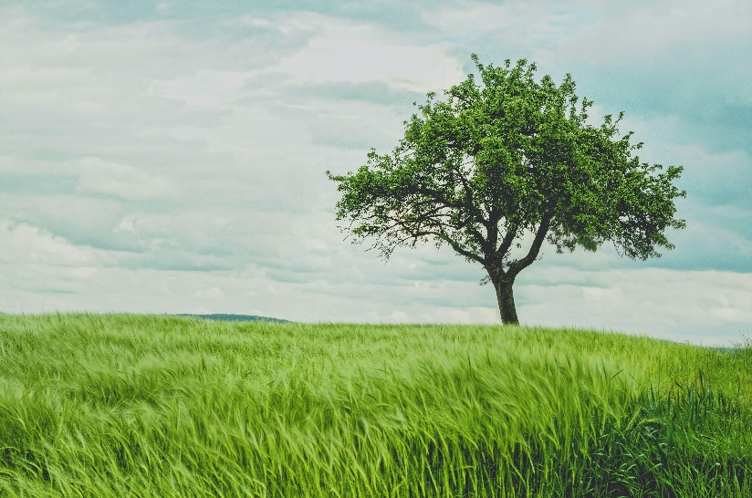
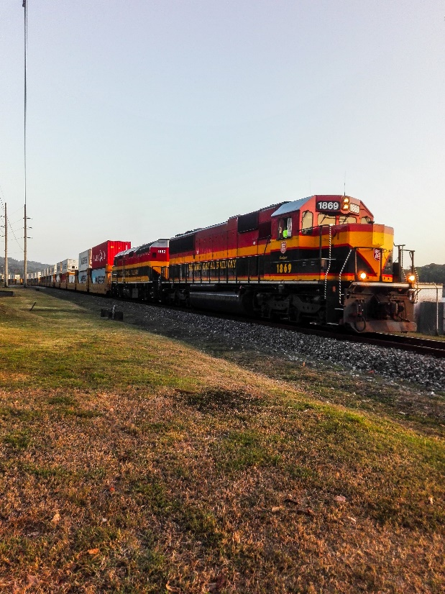
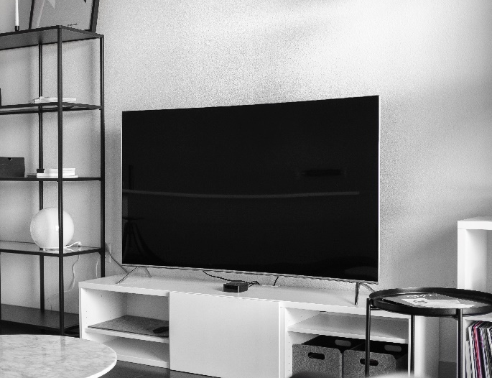
Some Things That Start with T Are…
Notes:
Tree, train, television

Slide 7
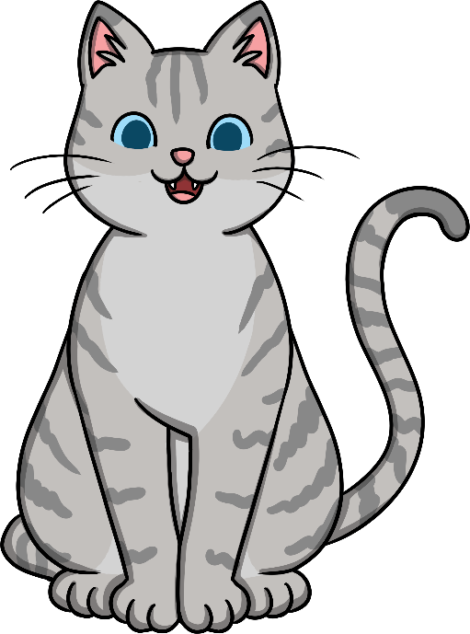

Which of These Start with T?
Notes:
Pause briefly after the initial sound of each word to assist students to identify the sounds.

Slide 8
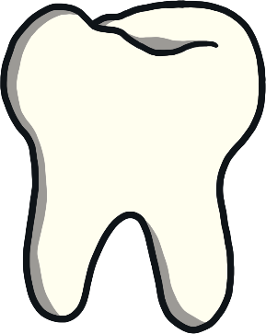
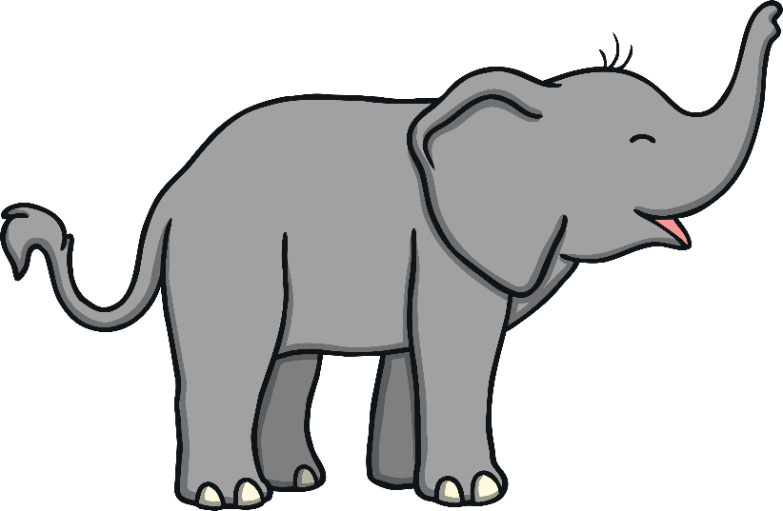

Which of These Start with T?
Notes:
Teeth, elephant

Slide 9
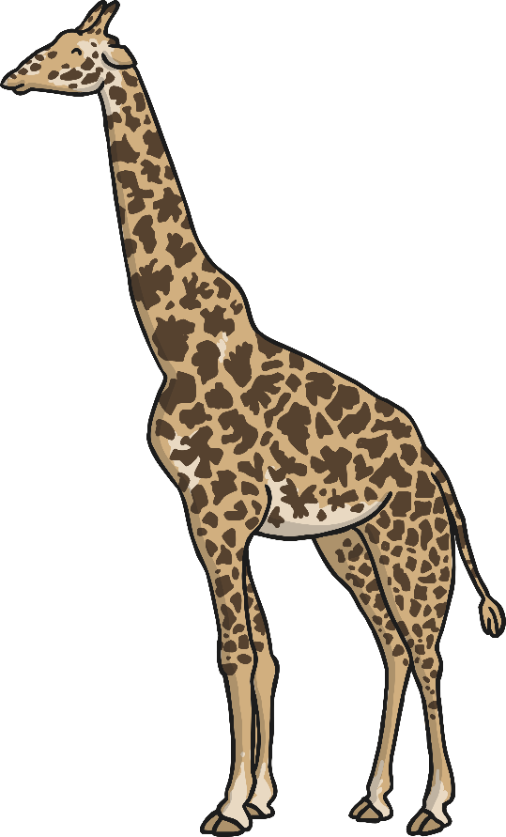

Which of These Start with T?
Notes:
Giraffe, teddy bear

Slide 10
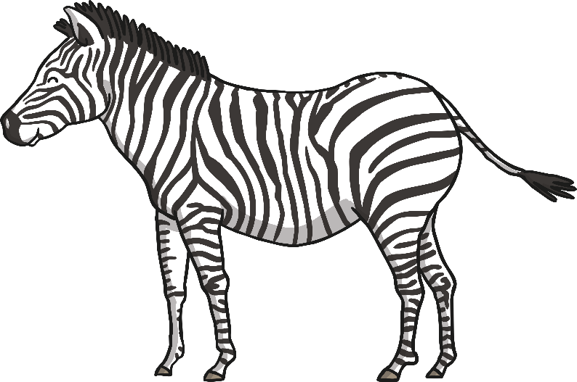
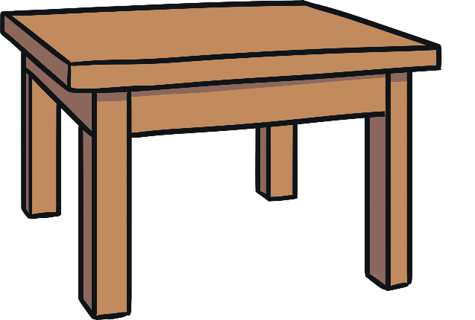
Which of These Start with T?
Notes:
Table, zebra

