Slide 1

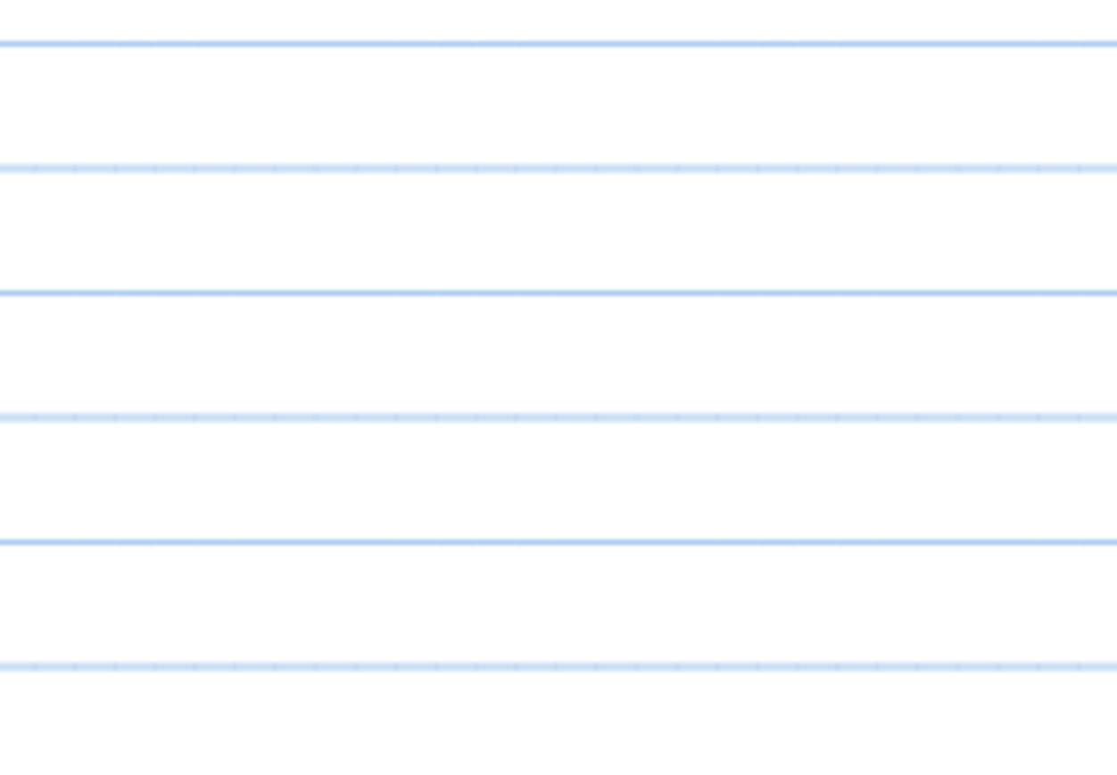
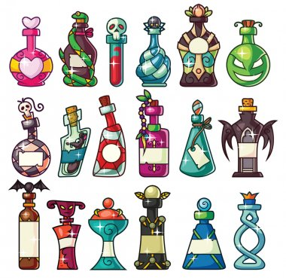
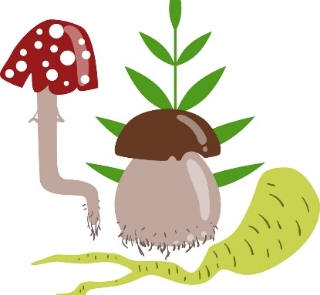
Half term
Writing LO; To hear initial sounds in all words
Write a list of ingredients that you can
see in the cauldron

