Slide 1
The Lord be with you…
…And also with you.

Slide 2
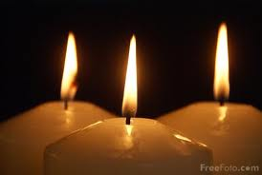
As we light our three candles,
we remember the Christian belief
that God has three persons:
God the Father
God the Son
And
God the Holy Spirit

Slide 3
And that our School motto
Also has three words…
DREAM
BELIEVE
ACHIEVE

Slide 4
Humility

Slide 5
Putting others first
Modesty
Being humble

Slide 6
Gloating
Selfishness
Arrogance
Self-indulgence

Slide 7
It’s about…
Being gracious
Showing modesty
Celebrating the achievements of others
Helping those less fortunate

Slide 8
It’s NOT about…
Showing off
Making fun of others
Gloating or over-celebrating
Being selfish

Slide 9
Join me in saying
our school prayer…
Oh God…

