Slide 2
The Lord be with you…
…And also with you.

Slide 3
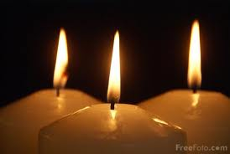
As we light our three candles,
we remember the Christian belief
that God has three persons:
God the Father
God the Son
And
God the Holy Spirit

Slide 4
And that our School motto
Also has three words…
DREAM
BELIEVE
ACHIEVE

Slide 5



Aim
To explore hopes and dreams and think about how to achieve them.
Our worship today combines our school motto with our weekly theme, ‘hope’.
How do you think ‘hopes’ are connected to ‘DREAM, BELIEVE, ACHIEVE’ ?
What about with our bible verse – “For nothing will be impossible with God.”?

Slide 6

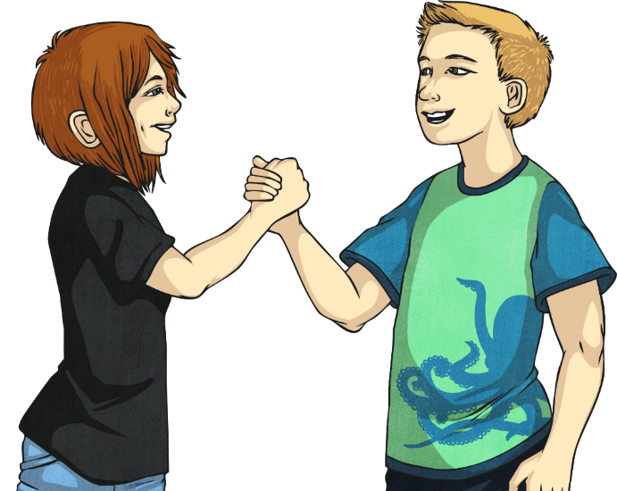
What Is Hope?
Think
Pair
Share
?
?
?

Slide 7

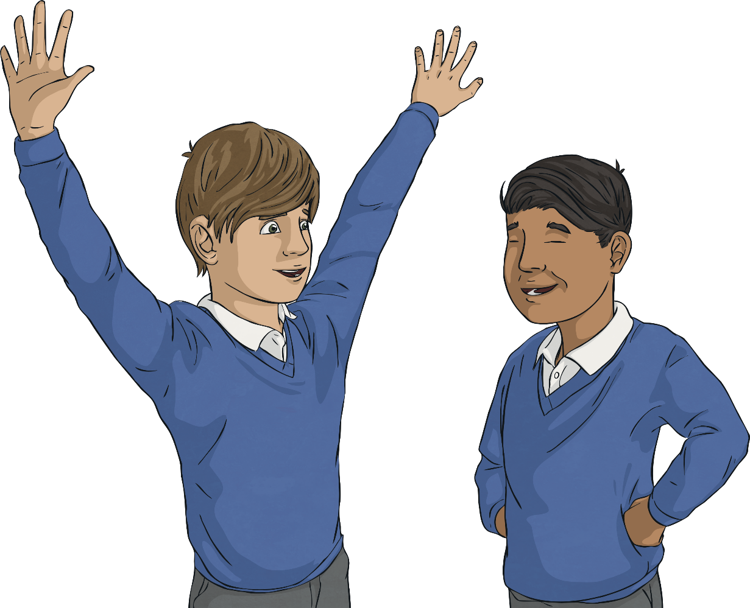
Hope is…
The feeling of wanting something good to happen and thinking that it could happen.

Slide 8
Why Is It Important to Have Hope?
Think
Pair
Share
?
?
?

Slide 9
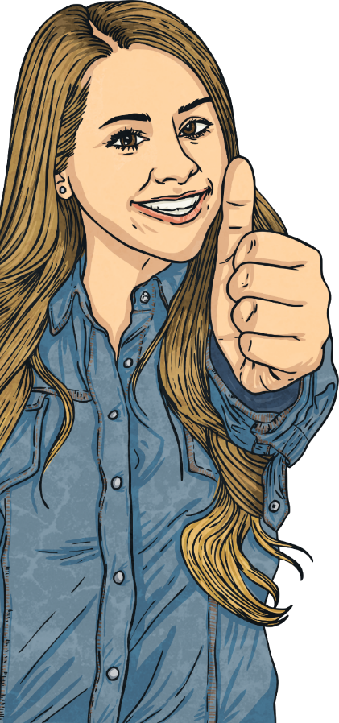


Why Is It Important to Have Hope?
1
Hope allows us to believe that anything is possible.
2
If we didn’t have hope, we would give up when things become difficult.

Slide 10
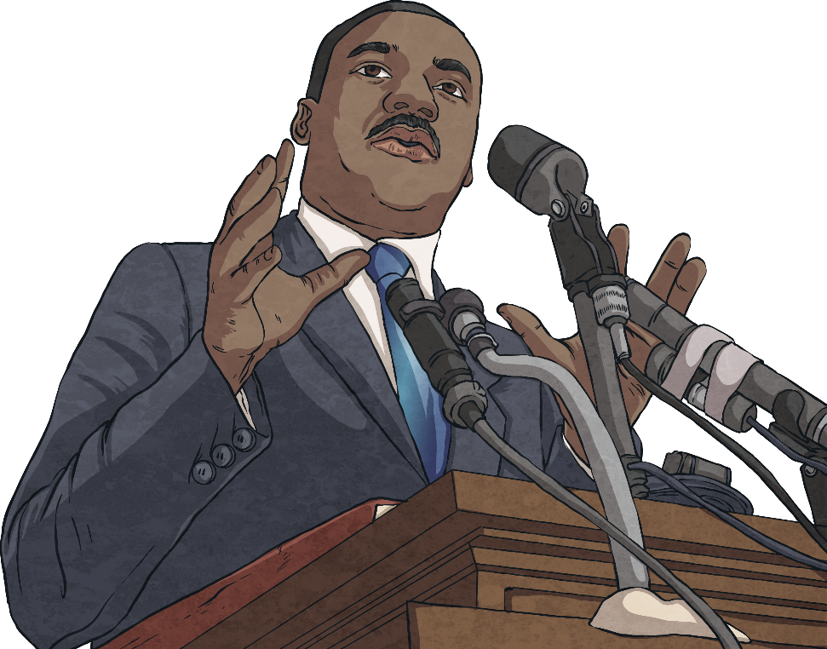
Hopes and Dreams
“I have a dream.”
This is part of a famous speech given by Martin Luther King Jr. in 1963.
His dream was that all people, regardless of race or colour, would be treated as equals.

Slide 11
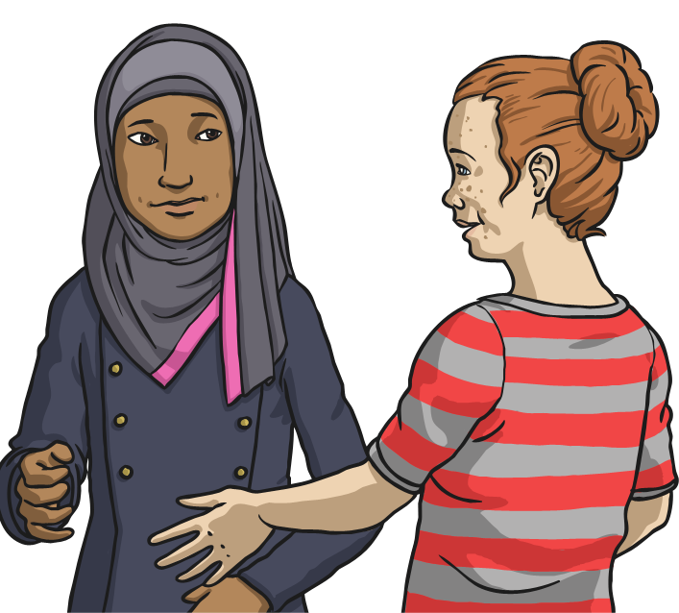
Hopes and Dreams
What are your hopes and dreams?
Perhaps you have a hope or dream for yourself or one for a wider group of people.
I hope that…
I like to think that…
I dream that one day…

Slide 12
How Will You Achieve Your Hopes and Dreams?
perseverance
hard work
practise
talent
patience
training
effort
time

Slide 13
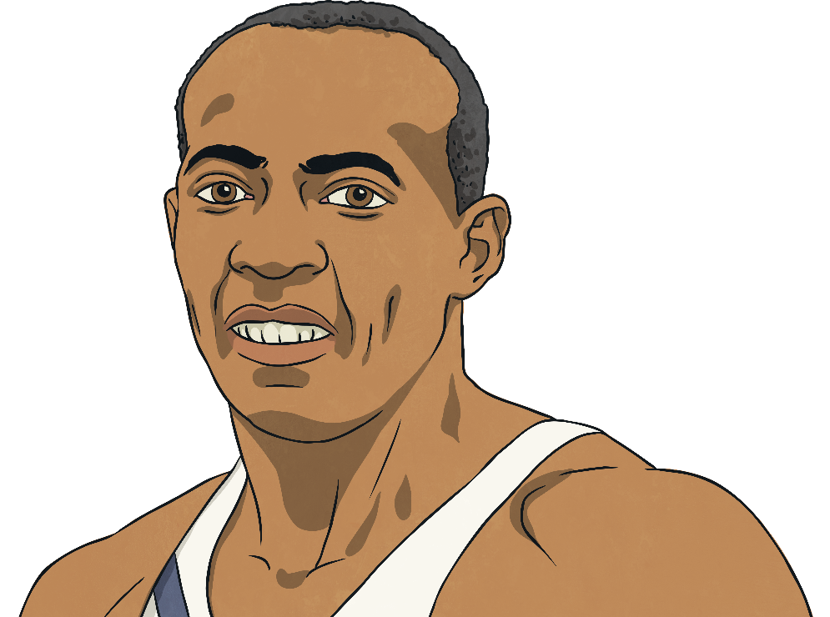
Achieving Your Hopes and Dreams
“We all have dreams. But in order to make dreams come into reality, it takes an awful lot of determination, dedication, self-discipline and effort.”
Jesse Owens, four time gold medallist in the 1936 Olympic Games.

Slide 14




Quotes
‘He who has health has hope; and he who has hope has everything.’
(Arabian proverb)
‘Once you choose hope, anything’s possible.’
(Christopher Reeve, Superman actor, paralysed in a horse-riding accident)
‘Hope is being able to see that there is light despite all of the darkness.’
(Bishop Desmond Tutu, human rights activist)
‘Hope is a waking dream.’
Aristotle

Slide 15
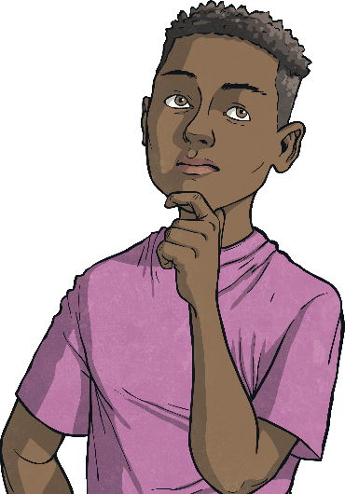
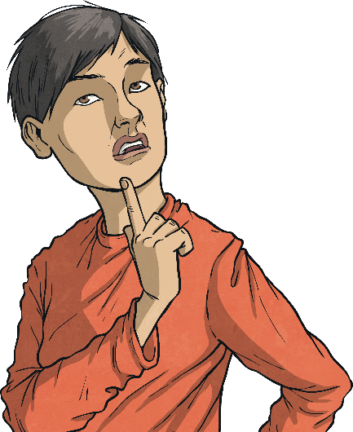
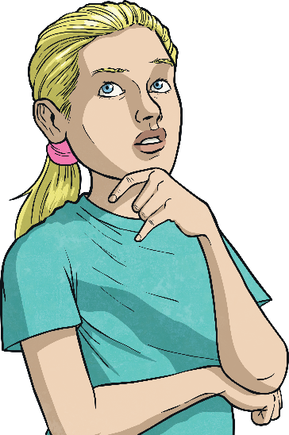
Let’s Think About Hope
Let me have the strength to work hard to fulfil my dreams.
Give me the ability to see all possibilities.
When things feel hopeless, give me hope.

Slide 16
Join me in saying
our school prayer…
Oh God…

