Slide 1
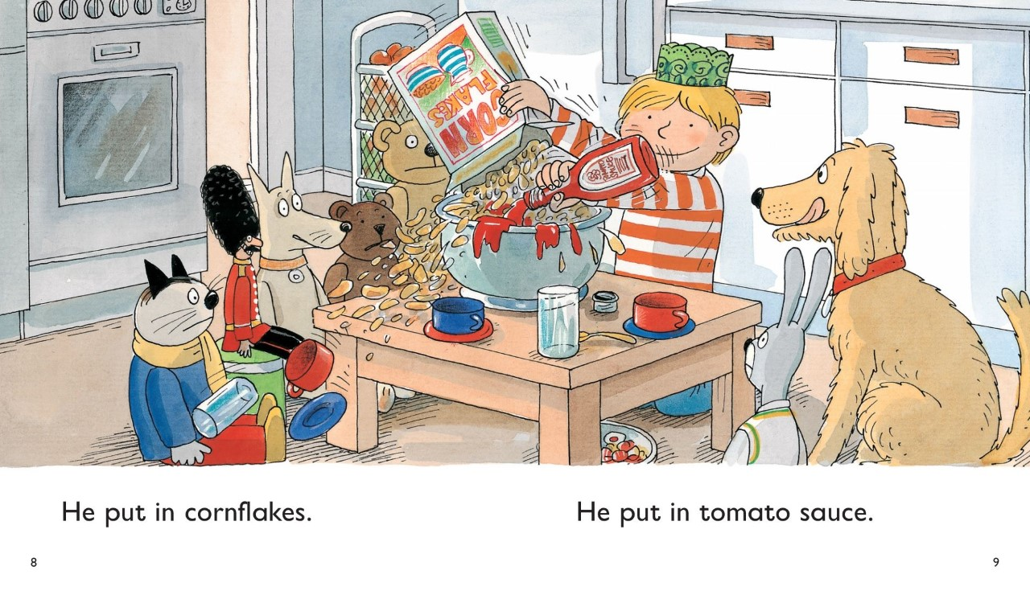
w.c. 22.11.2021
Writing LO; To hear initial sounds in all words – label the things you can see

Slide 2
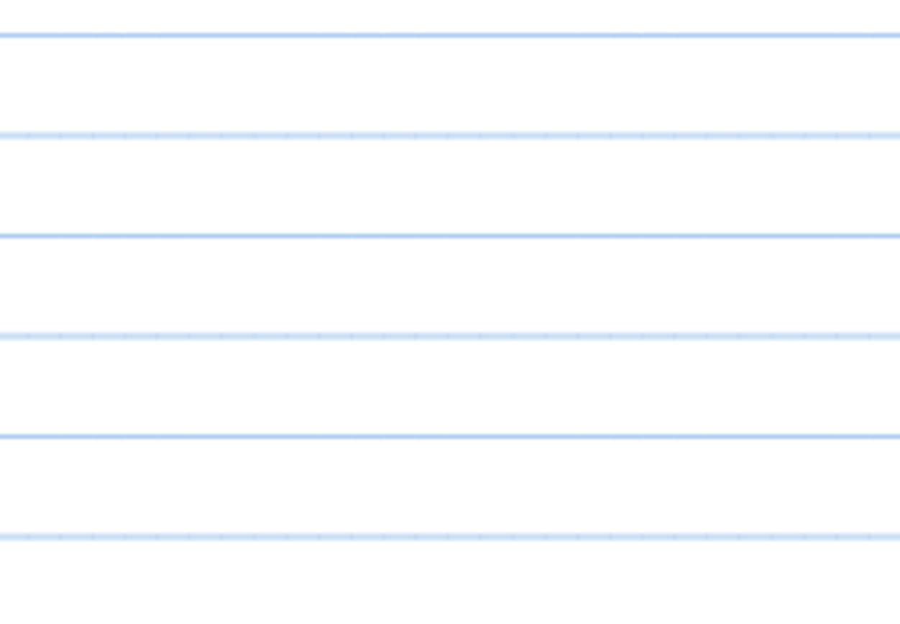

w.c. 22.11.2021
Writing LO; To hear initial sounds in all words – what are they saying?

Slide 3


