Slide 1
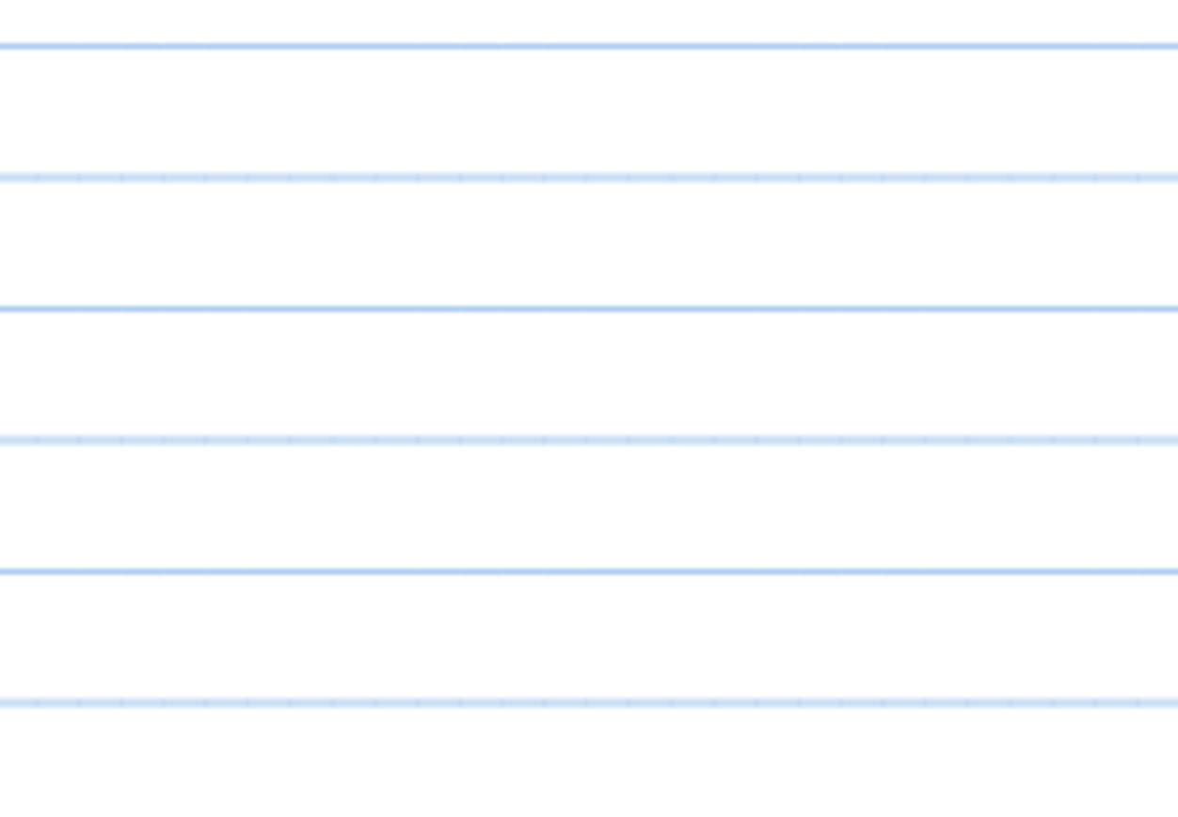
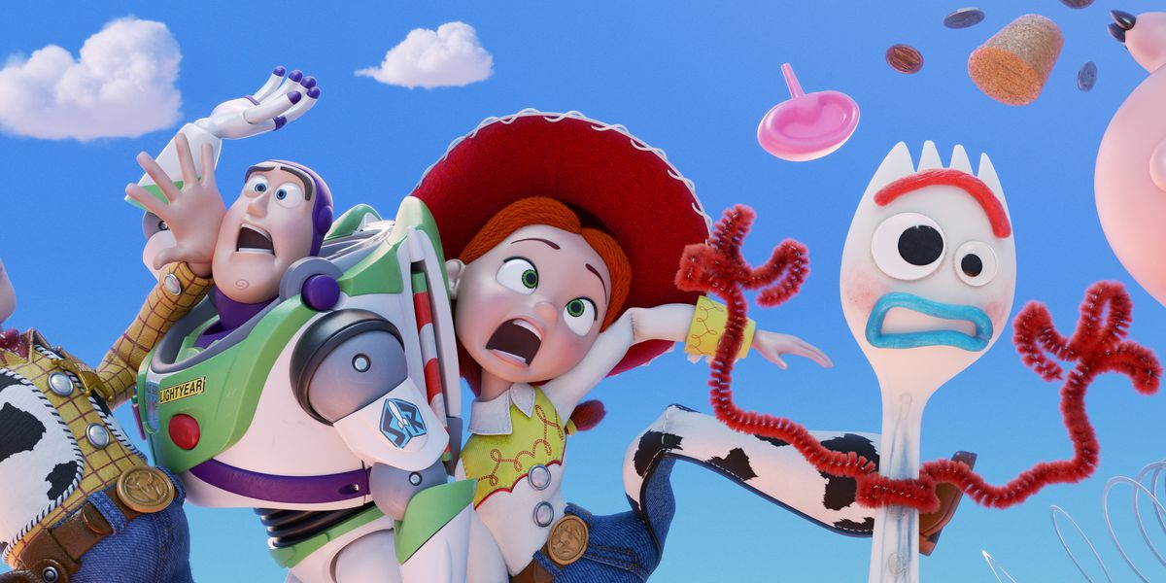
W.C. 8.11.2021
Writing LO; To hear initial sounds in all words – what are they saying?

