Slide 2
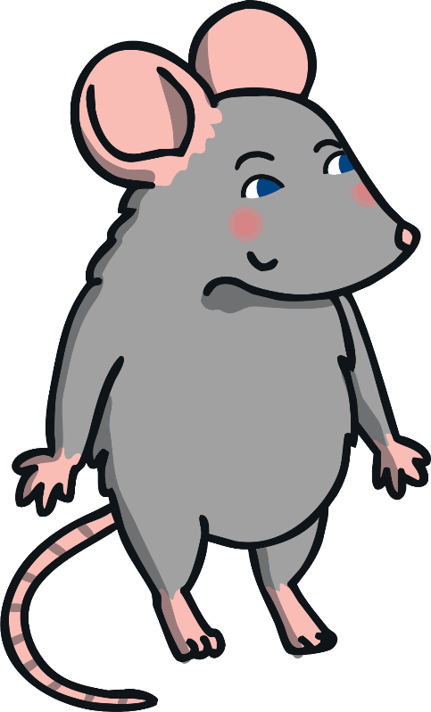
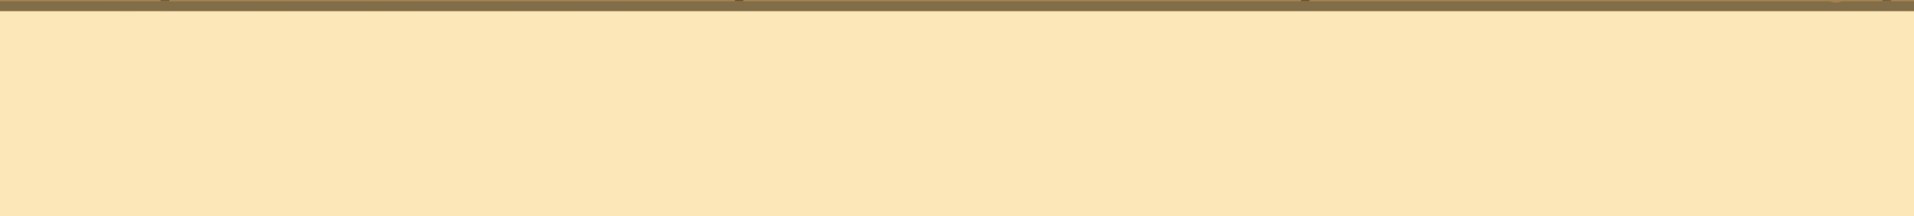
This is Megan.

Slide 3
Megan is a mouse.

Slide 4

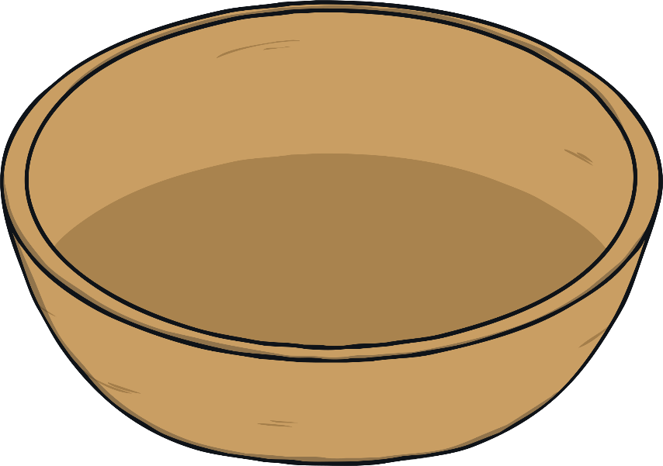
Megan the mouse makes a meal for her mum.

Slide 5
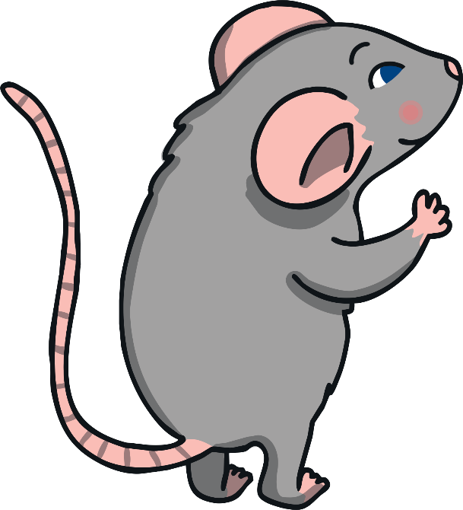



Megan mixes mashed potato…

Slide 6

…and mackerel

Slide 7
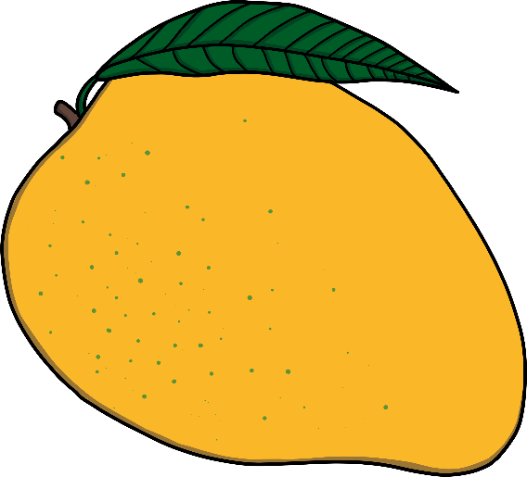
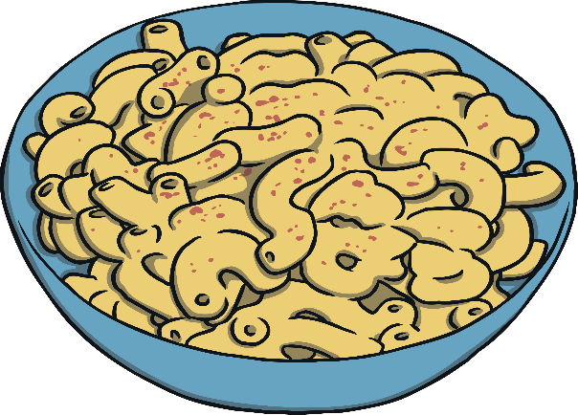
…and mango and macaroni!

Slide 8


Megan makes a
milkshake for her mum.

Slide 9

Megan mixes milk…

Slide 10
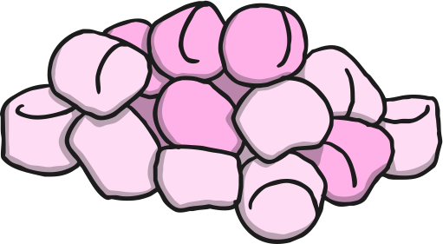
…and marshmallows

Slide 11


…and melon and mint

Slide 12
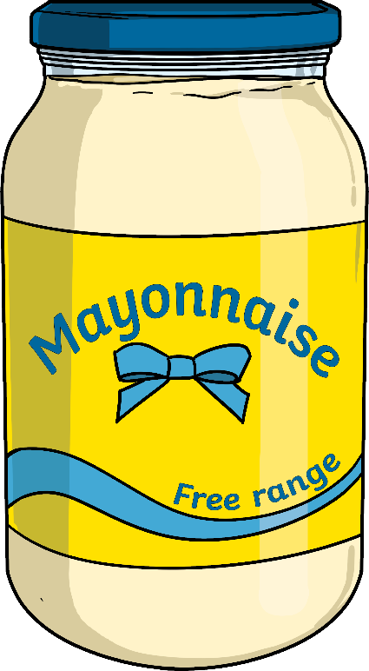
…and mayonnaise!

