Slide 1

M

Slide 2

The Letter M Looks like This…
M
m
Can you draw it with your finger?

Slide 3
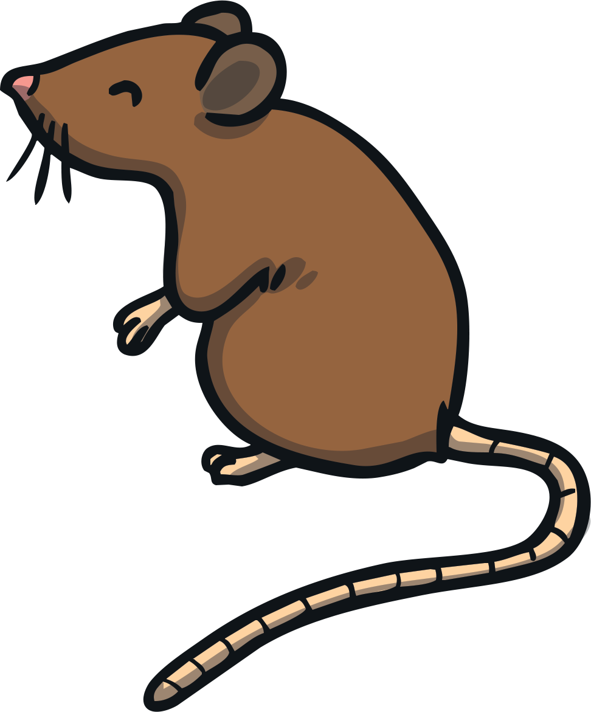
The Letter M Sounds like This…
M, M, M
Notes:
Say the sound /m/ and have children repeat it back multiple times.

Slide 4

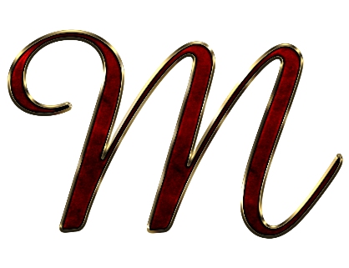



It Can Also Look like This…

Slide 5
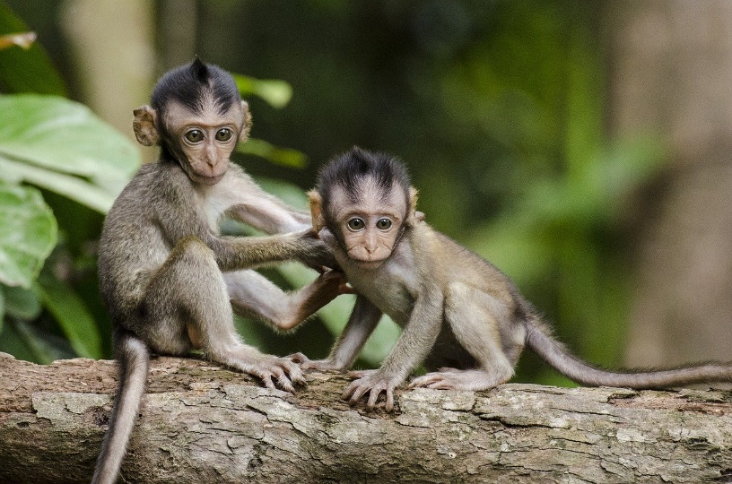
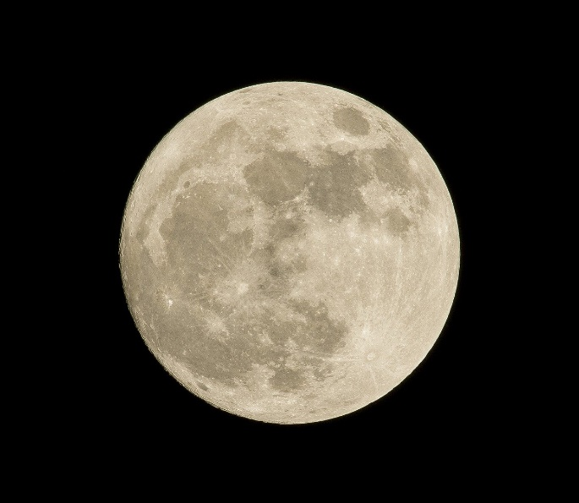
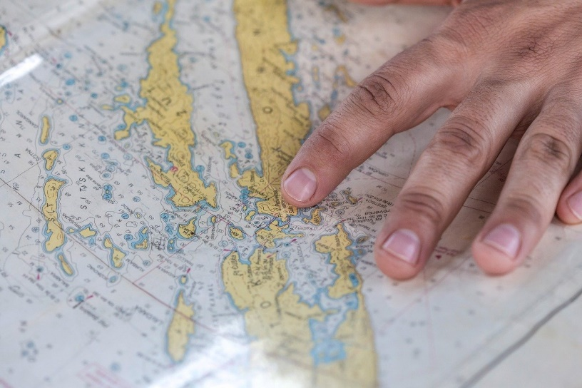
Some Things That Start with M Are…
Notes:
Monkey, moon, map

Slide 6
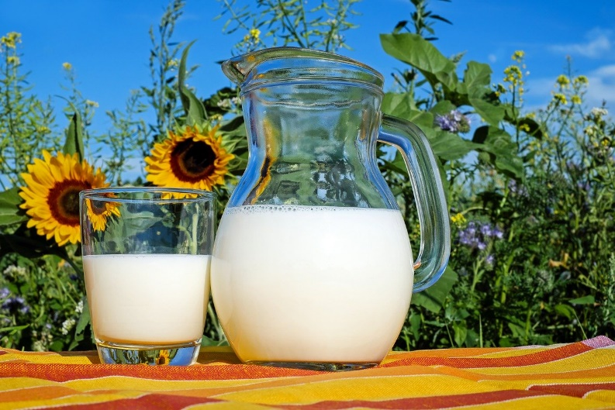

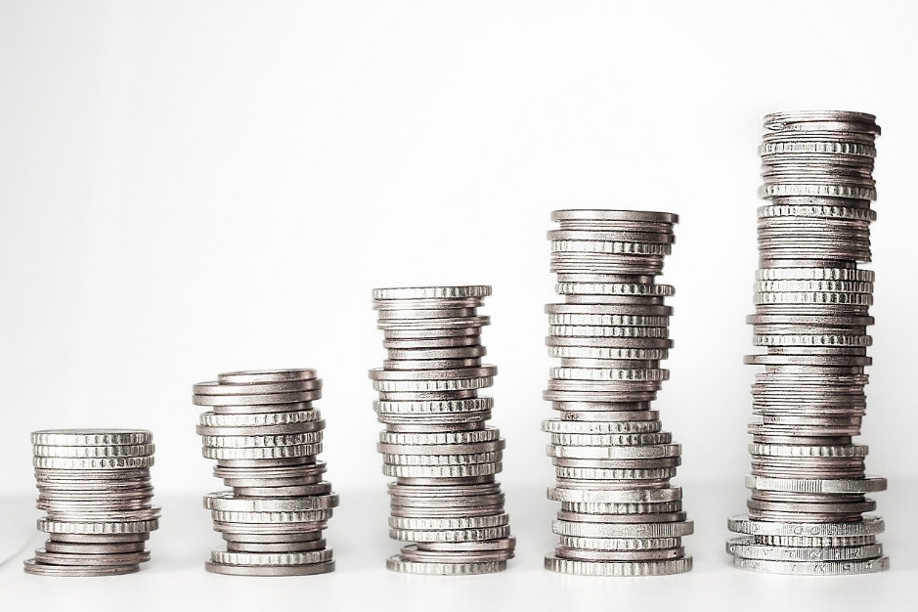
Some Things That Start with M Are…
Notes:
Milk, mop, money

Slide 7

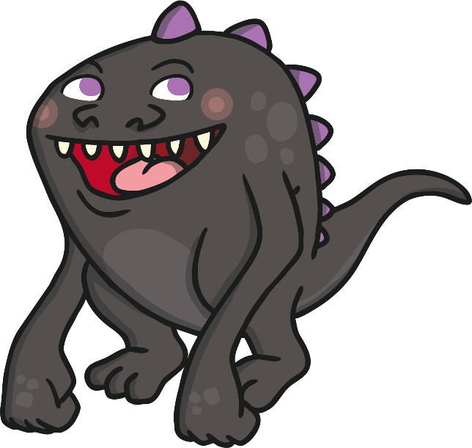

Which of These Start with M?
TRY AGAIN!
YES!
Notes:
Pause briefly after the initial sound of each word to assist students to identify the sounds.
Cat, monster

Slide 8
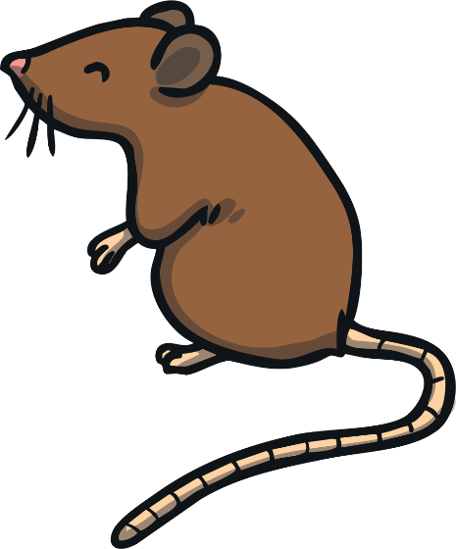

Which of These Start with M?
TRY AGAIN!
YES!
Notes:
Mouse, tent

Slide 9


Which of These Start with M?
TRY AGAIN!
YES!
Notes:
Mail box, shoe

Slide 10
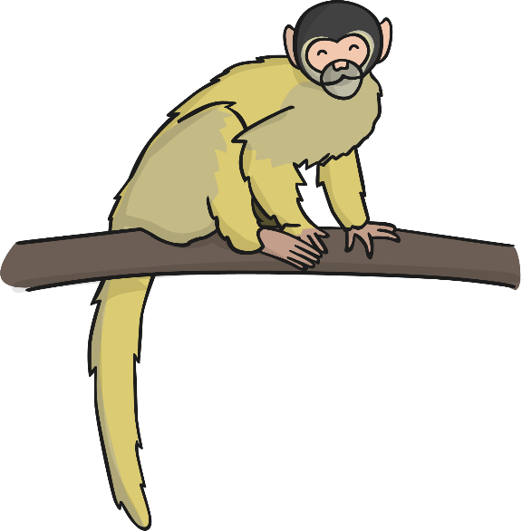
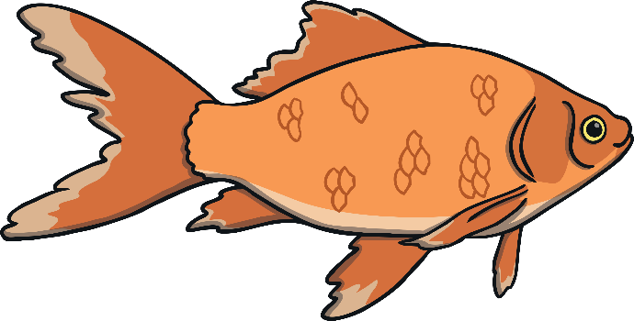
Which of These Start with M?
TRY AGAIN!
YES!
Notes:
Fish, monkey

