Slide 1






Guidance for Video/Audio in PowerPoints
1. Open the folder and copy all the files.
2. Paste the copied files into a new folder.
3. Open the PowerPoint file, enable editing and enter presentation mode (start the slide show).
Please note the embedded audio may not be compatible with early versions of PowerPoint.
You may wish to delete this slide before beginning the presentation.

Slide 3

Revisit and Review
Let’s revisit last week’s focus words…
I’ll say them and you write them down!

Slide 4


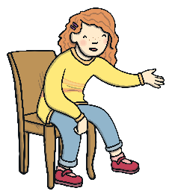

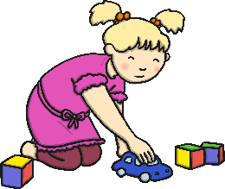
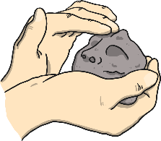





Revisit and Review

Slide 5

Teach
Here are this week’s focus words for reading:
would
want

Slide 6


Tricky Word Flags
Teach
Shout out the tricky words on the flags as they are raised up the flagpoles. Can you spot the words would and want?
would
would
want
want
should
could
would
could

Slide 7




Teach
Today, we are learning to read words that contain
oy saying /oi/.
X
The previously learned grapheme ‘oi’ is usually in the middle of words, such as ‘coin’. ‘Oy’ often comes at the end of a word, such as ‘joy’.
Click me for Kit’s teaching tips!

Slide 8
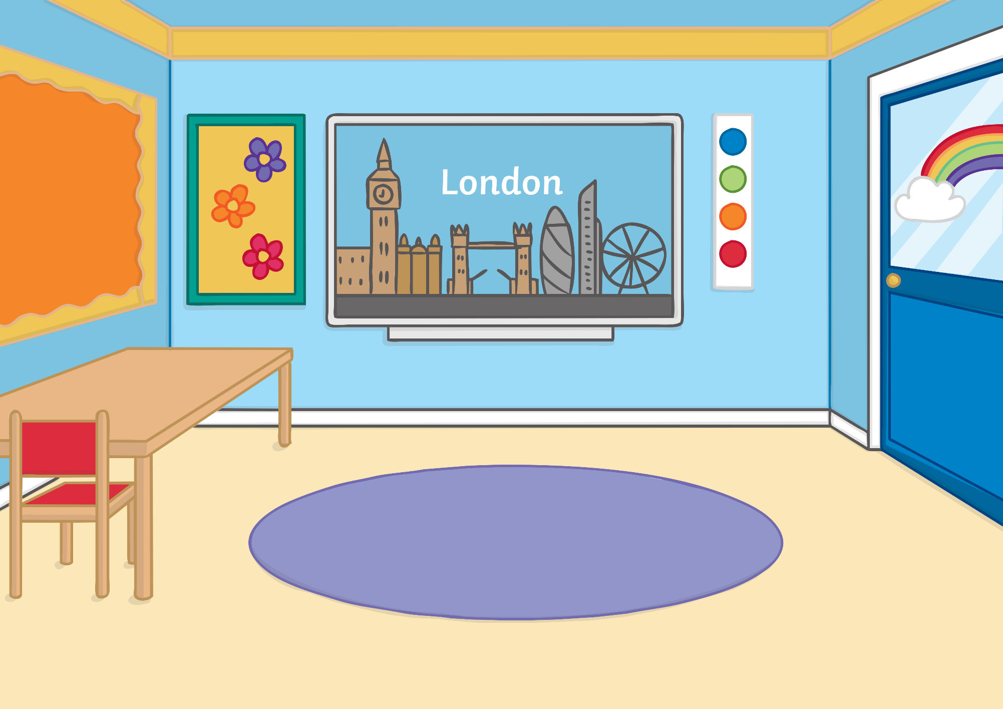


Teach
Kit and Sam were at school. They had their geography books out and were learning all about London.

Slide 9
Teach
Kit leaned over to Sam. “Would you enjoy going to Buckingham Palace?” he asked.
“Maybe,” said Sam. “Do you want to go?”
“Yes!” replied Kit.

Slide 10


Teach
All Kit and Sam talked about on the way home from school was London and Buckingham Palace. “Let’s look at a map to see where it is,” said Sam.

Slide 11

Street Names
Teach
On the map, Sam has spotted some street names. Can you help her to blend the sounds to read the words they make?

Slide 12
Teach
E
B
oy
street
n
j
T
J
oy
oy
oy
road
street
A
nn
road
D
e
s
oy
road
t
r
oy
street

Slide 13


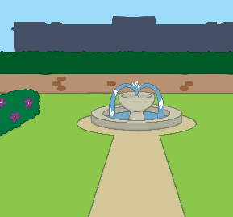
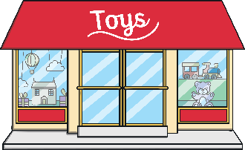




London Caption Match
Practise
Kit and Sam are thinking about what they would like to do if they visited London. Read the sentences in the speech bubbles and match them to the correct picture.
I enjoy going to visit the parks.
I want to see the queen.
There are some boys on a red bus.
The toy shops are so cool!

Slide 14

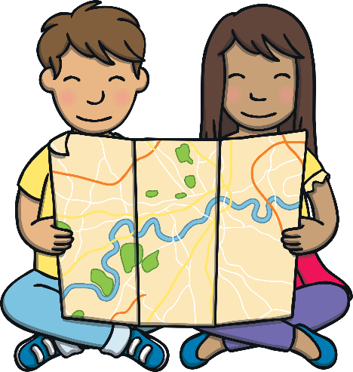
Apply
As they were looking at the map, Sam had a fantastic idea and jumped for joy. “Should we get the magic map and go to visit London?” she said.
“Yes! I’ll be two minutes,” said Kit. “I’ll go and look for it.”

Slide 15




Apply
“Do you think we could go and see the palace?” asked Sam.
“I’m sure we could,” said Kit excitedly. “There are lots of places I would enjoy seeing in London!

Slide 16


Sentence Time
Apply
Where did Kit find the map? Read the sentence to find out.

Slide 17

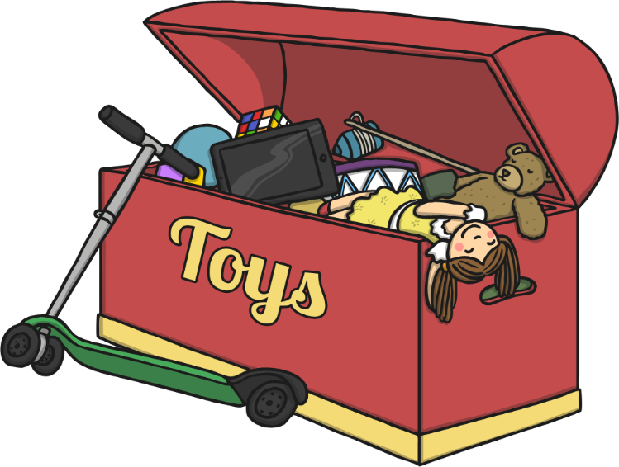
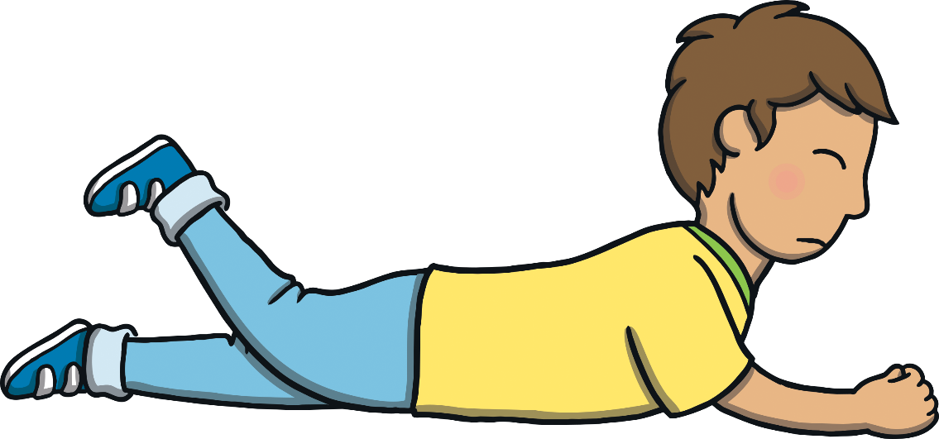


Apply
“The map should have been in the toy chest. I did not enjoy looking in the crayon tray.”
Sound Buttons On/Off
Show

Slide 18



Apply
“Let’s go then!” said Sam, jumping up and down for joy.
“Careful,” laughed Kit. “I would like to get there in one piece!”

Slide 19


Today, we have learnt…
oy
saying /oi/
The adventure continues next lesson!

