Slide 2



Revisit and Review
Let’s practise Sam’s Sounds and Common Exception Words!
oy
ay
could
would
should
want

Slide 3


Teach
Today, we are learning to read words that contain oy saying /oi/.

Slide 4

Teach
Let’s practise reading some of this week’s focus words that contain the oy sound.
boy
toy
joy
enjoy

Slide 5


Teach
boy
Play

Slide 6
Teach
toy
Play

Slide 7
Teach
joy
Play

Slide 8
Teach
enjoy
Play

Slide 9
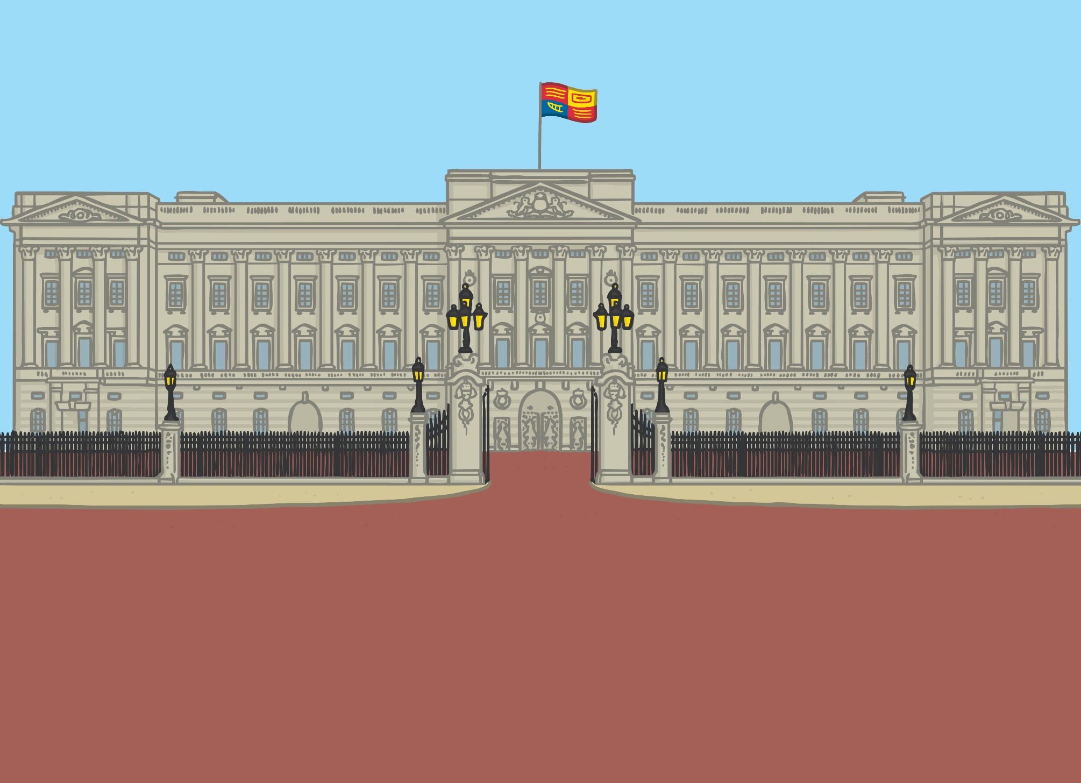


Teach
The magic map had taken Kit and Sam to London and they were standing outside Buckingham Palace.

Slide 10



Teach
“Wowee!” said Kit. “I cannot believe we are here!”
“But how do we get in?” asked Sam.
“I know!” said Kit. “We should ask the guards standing over there.”

Slide 11
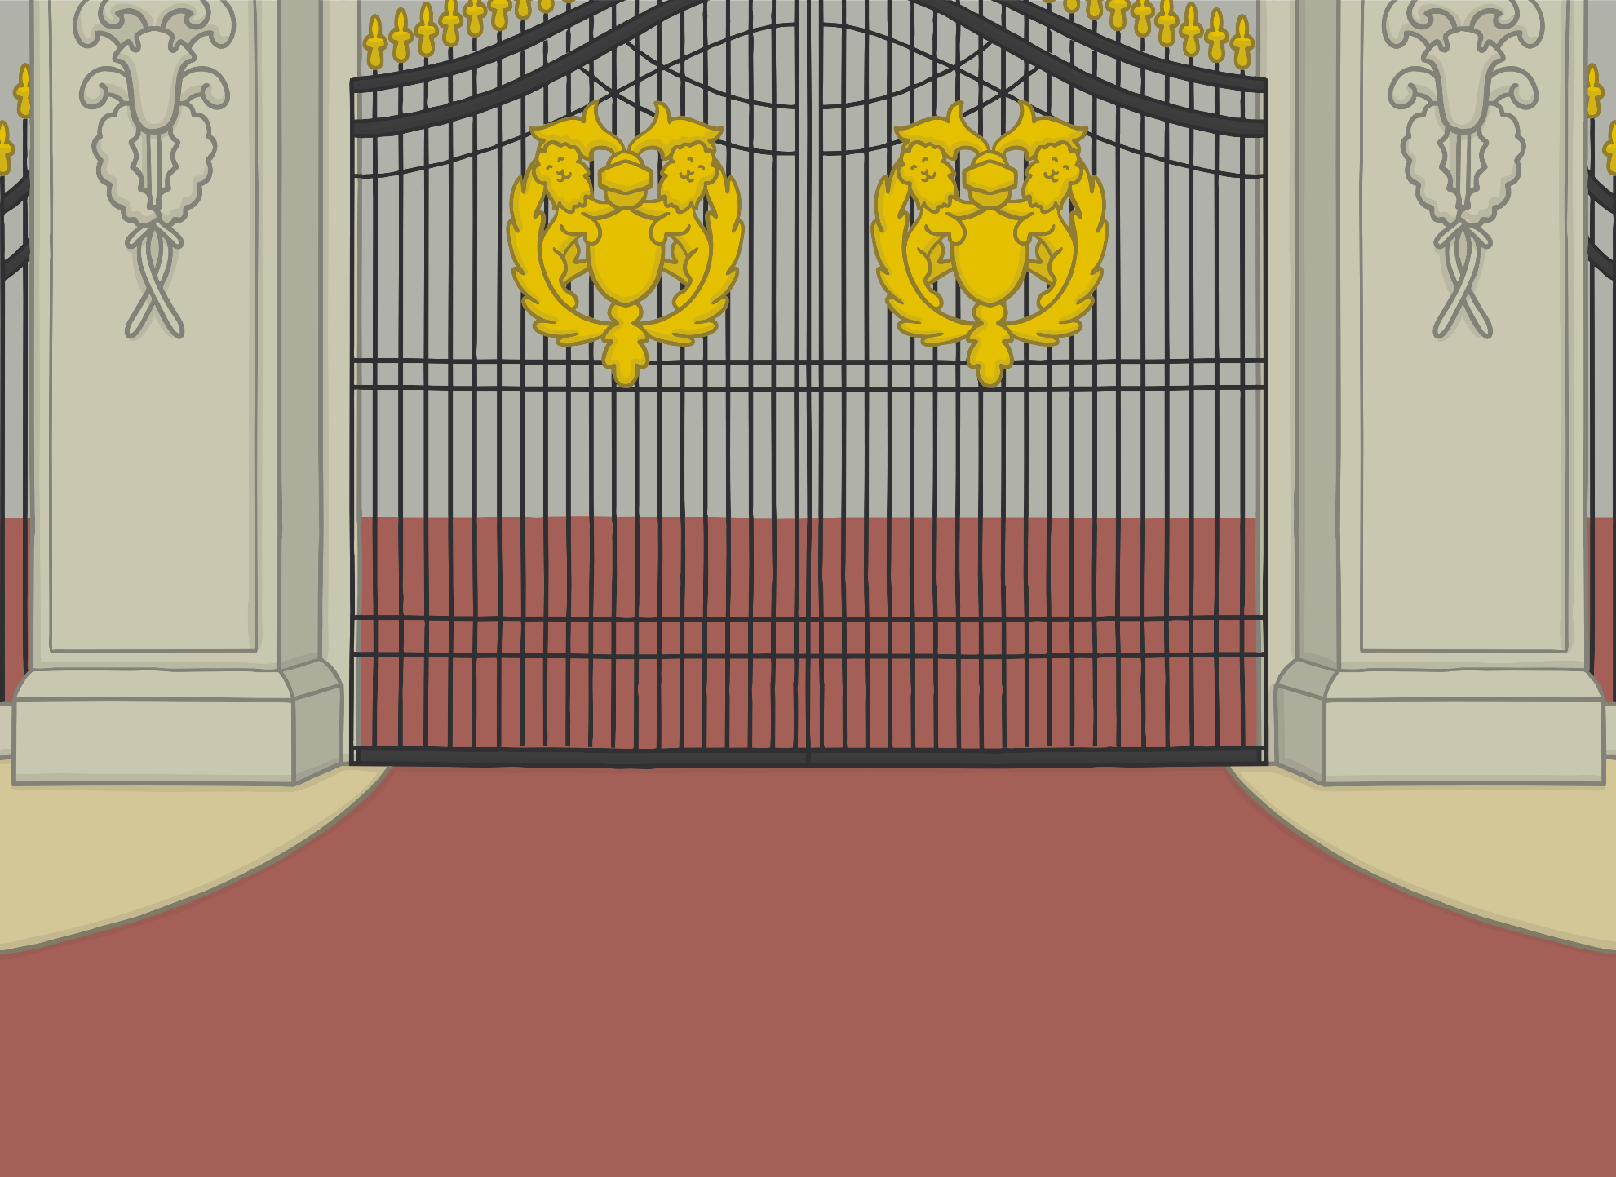
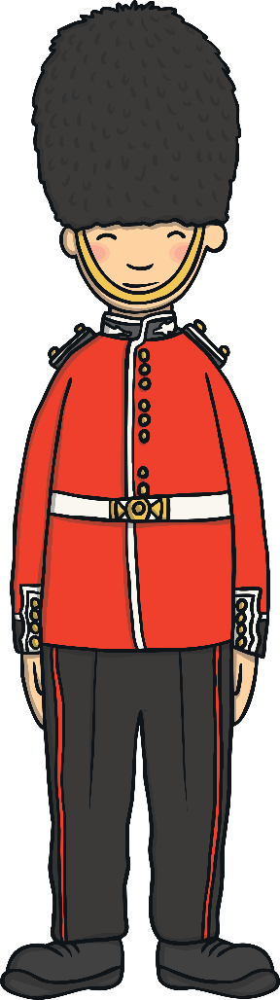


Teach
Kit and Sam leapt with joy at the thought that soon they could be inside the palace.

Slide 12

London Buses
Teach
There are lots of buses that go past Buckingham Palace. They have letters in the windows. Can you blend the letters in the windows to read the words?

Slide 13

Teach
b
oy
oy
oy
oy
t
r
j
l
s
n
p
m
oy
e
e
nn
oy
d
oy
e
a
j
t

Slide 14

Adverts on a Billboard
Practise
Kit and Sam are looking at some adverts on billboards around the palace. What are the adverts for? Match the correct billboard with the word.

Slide 15


Adverts on a Billboard
Practise
boy
destroy
joy
toy
enjoy
annoy

Slide 16
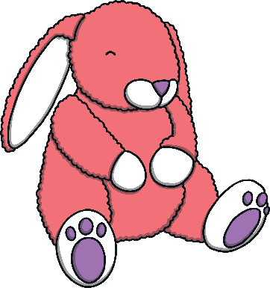
Adverts on a Billboard
Practise
boy
destroy
joy
toy
enjoy
annoy

Slide 17

Adverts on a Billboard
Practise
boy
destroy
joy
toy
enjoy
annoy

Slide 18
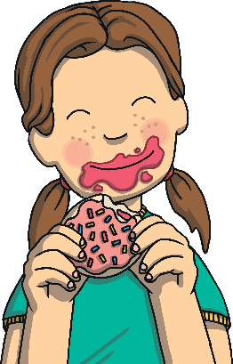
Adverts on a Billboard
Practise
boy
destroy
joy
toy
enjoy
annoy

Slide 19
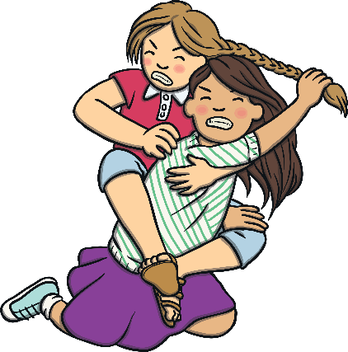
Adverts on a Billboard
Practise
boy
destroy
joy
toy
enjoy
annoy

Slide 20

Adverts on a Billboard
Practise
boy
destroy
joy
toy
enjoy
annoy

Slide 21


Apply
As they began to walk towards the guards, Sam saw something out of the corner of her eye. “I want to go and investigate,” she thought.

Slide 22

Sentence Time
Apply
What can Sam see? Read the sentence to find out.

Slide 23
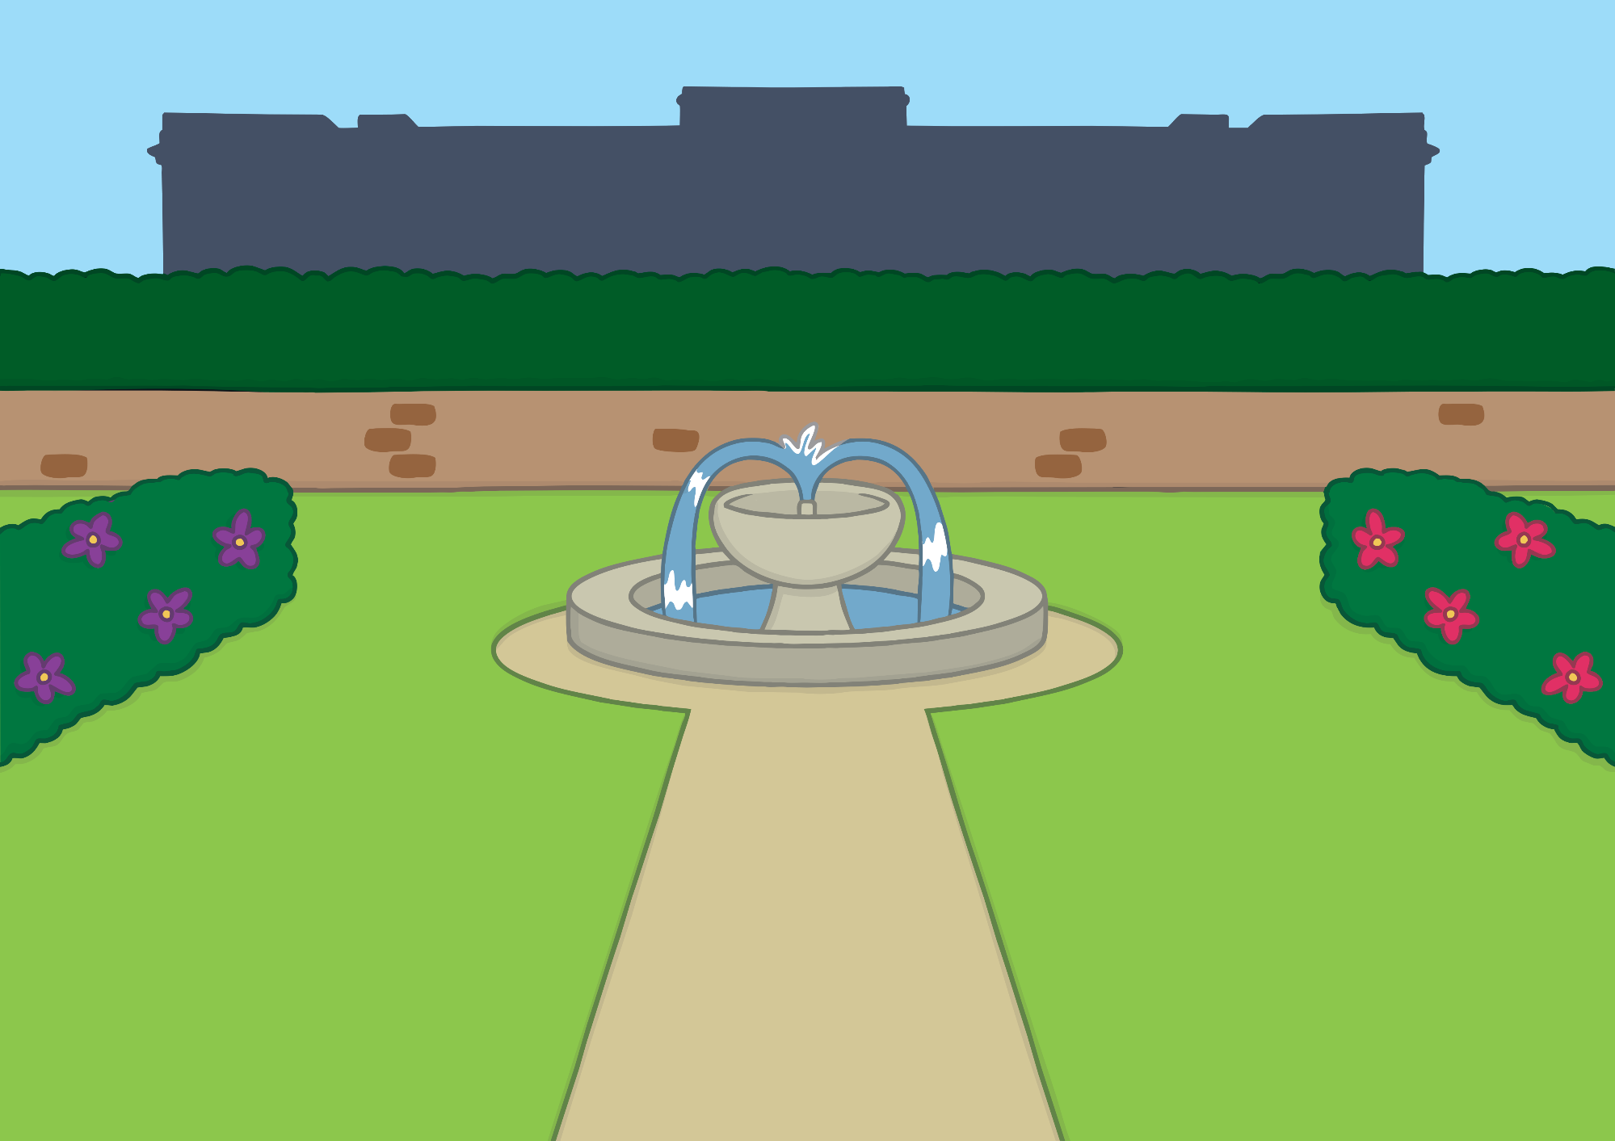

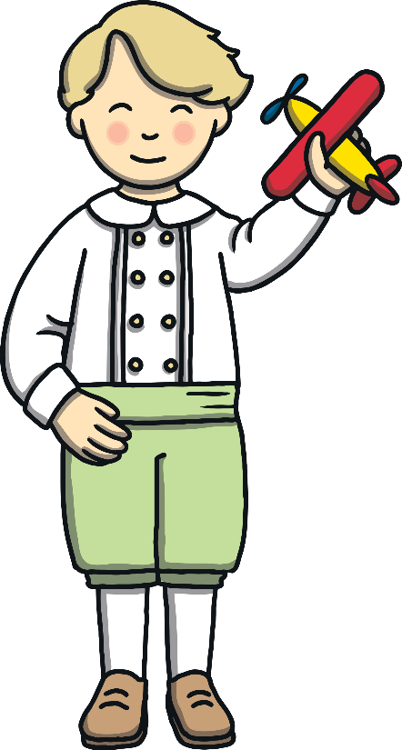

Apply
I can see children enjoying playing in the garden.
Sound Buttons On/Off
Show

Slide 24
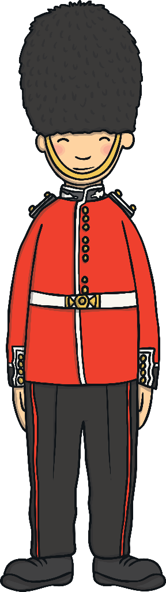
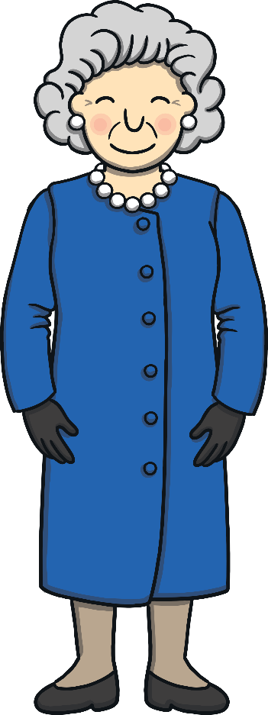
Apply
As they got closer to the guards, the queen herself came out of the Palace. “Roy! Troy!” she said, calling the guards. “Do let these fine youngsters in, please.”

Slide 25
Today, we have learnt…
oy
saying /oi/
The adventure continues next lesson!

