Slide 1






Guidance for Video/Audio in PowerPoints
1. Open the folder and copy all the files.
2. Paste the copied files into a new folder.
3. Open the PowerPoint file, enable editing and enter presentation mode (start the slide show).
Please note the embedded audio may not be compatible with early versions of PowerPoint.
You may wish to delete this slide before beginning the presentation.

Slide 3



Revisit and Review
Let’s practise Sam’s Sounds and Common Exception Words!
oy
ay
should
would
could
want

Slide 4

Revisit and Review
This week, we are learning to spell the common exception words have and like.
Watch the magic pencil write the words. Can you join in?

Slide 5


Teach
have
Play

Slide 6
Teach
like
Play

Slide 7
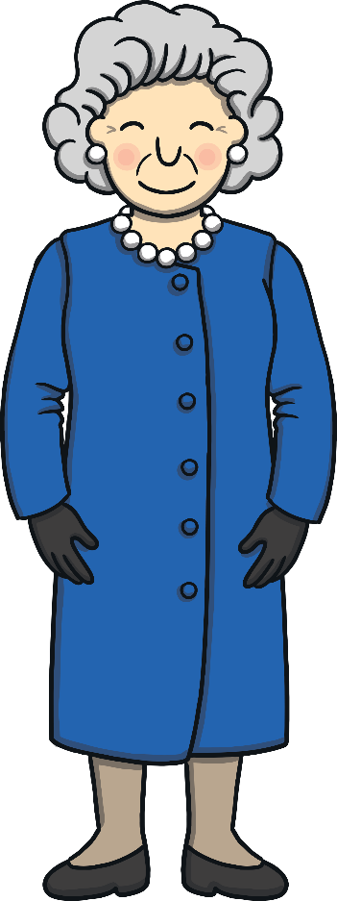

Teach
Today, we are learning to write words that contain
oy saying /oi/.

Slide 8
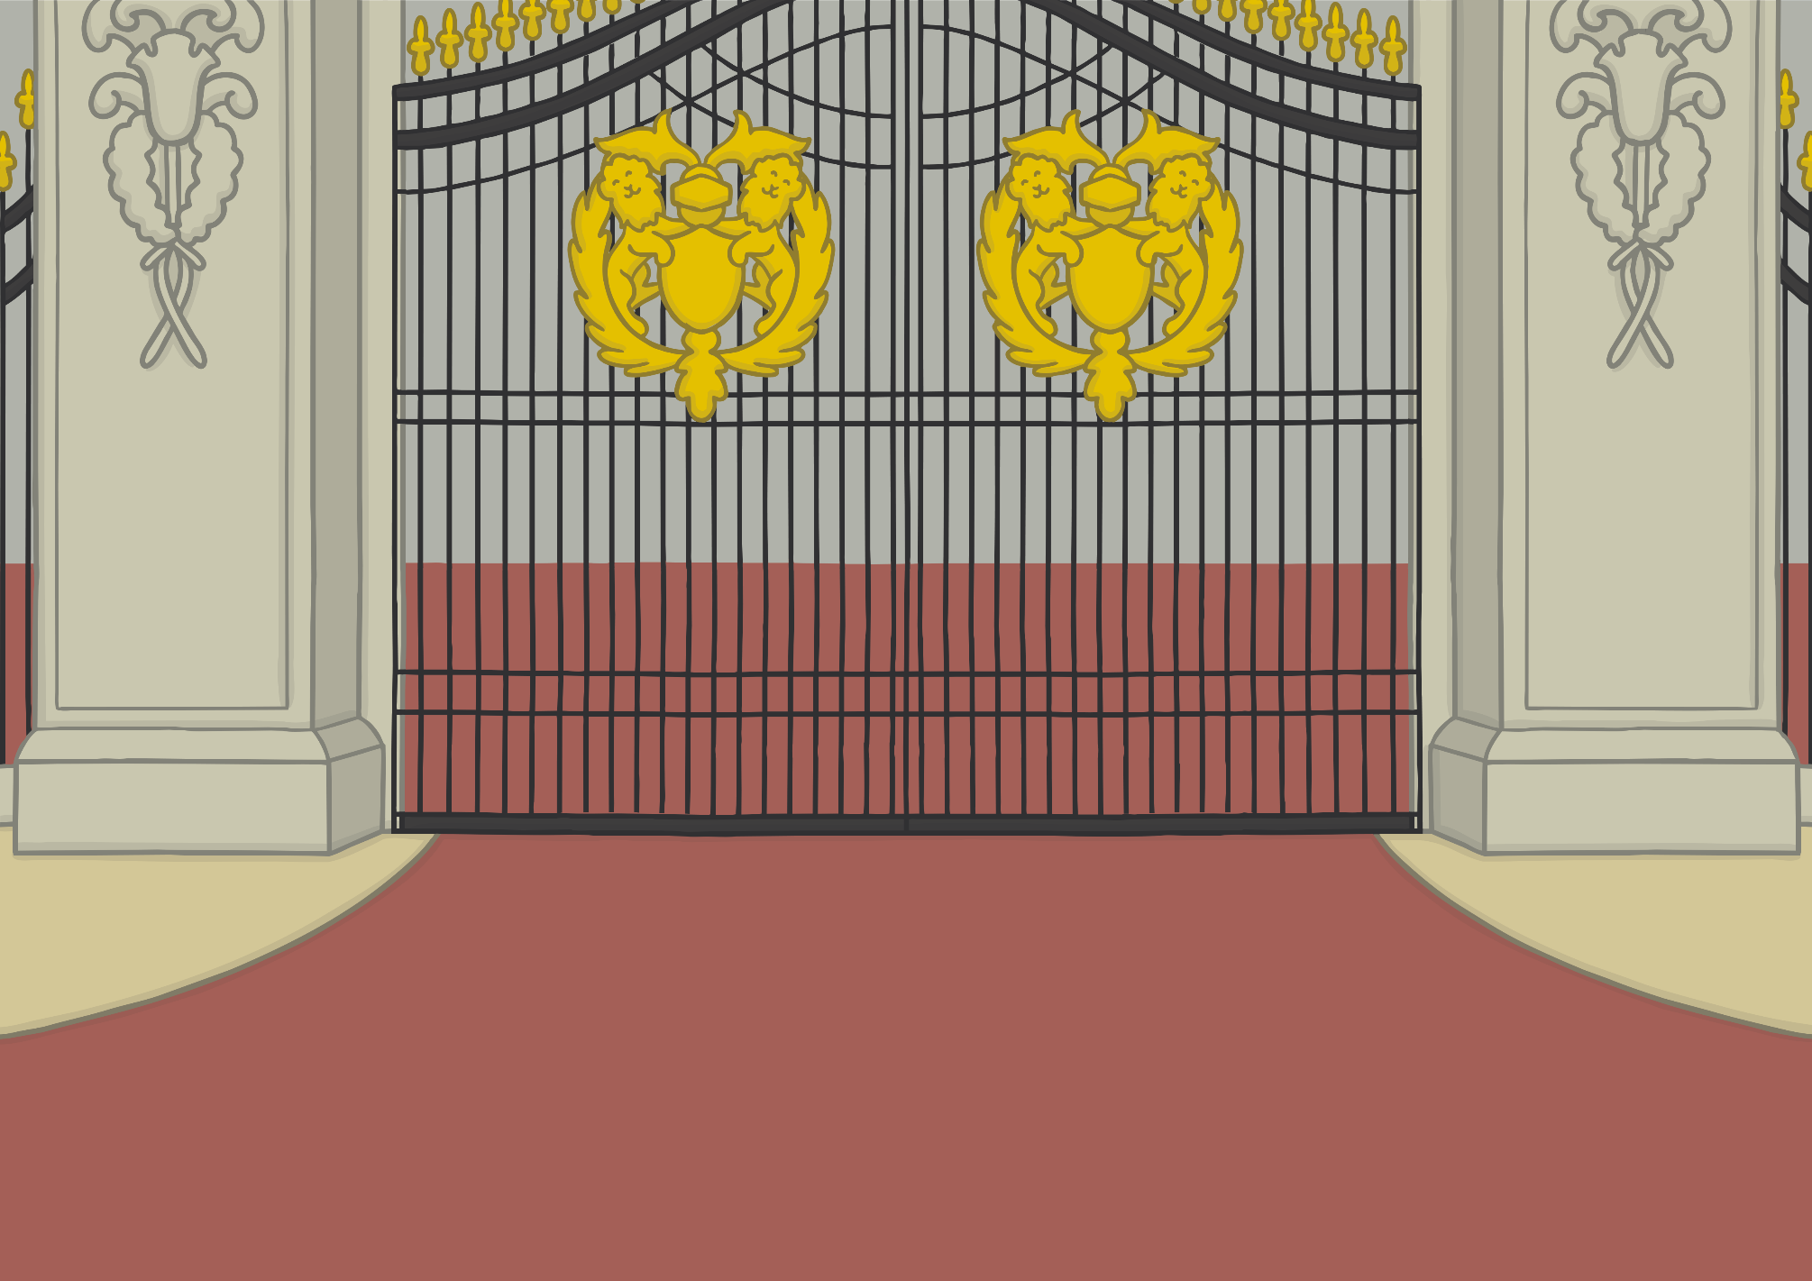



Teach
Kit and Sam were invited into Buckingham Palace by the queen, herself. They were very excited!

Slide 9
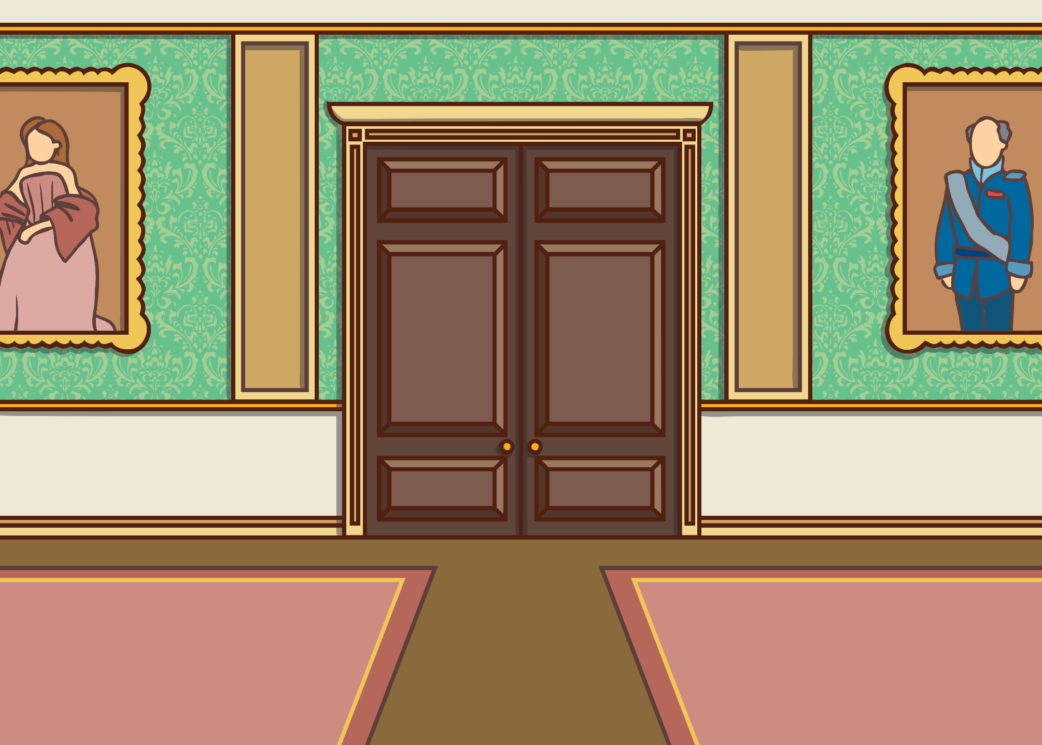


Teach
As they followed the queen through the long corridors, they heard lots of interesting sounds. “What’s that,” whispered Sam as they both stopped outside a big, wooden door.

Slide 10
Teach
Kit and Sam find the children playing with their alphabet blocks. The children invite Kit and Sam to join in. Can you guess the words that they are making with the blocks?

Slide 11




Teach
b
oy
b
Help
Show

Slide 12
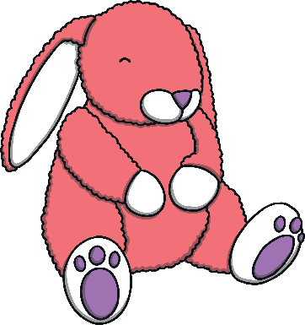
Teach
t
oy
oy
Help
Show

Slide 13
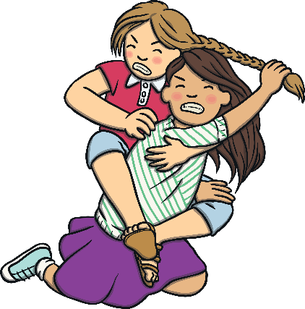
Teach
n
a
n
n
a
n
oy
Help
Show

Slide 14
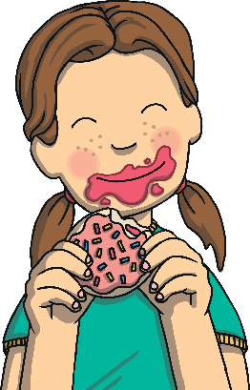
Teach
n
e
n
j
e
oy
oy
Help
Show

Slide 15

Teach
oy
e
m
p
oy
e
m
l
l
Help
Show

Slide 16

Practise
oi or oy?
Kit, Sam and the children have made a mess of the playroom. Can you help them tidy it? Write a list of the objects that should be in each toy box.
X
The grapheme ‘oi’ is often found in the middle of words, such as ‘coin’. ‘Oy’ often comes at the end, such as in ‘joy’. However, sometimes the ‘oy’ grapheme comes in the middle of words, such as ‘royal’ and ‘loyal’.
Click me for Kit’s teaching tips!

Slide 17
Practise
oy
oi
coins
X
This is a great whiteboard activity.
Click me for Kit’s teaching tips!

Slide 18
Practise
oy
oi
boy
coins
X
This is a great whiteboard activity.
Click me for Kit’s teaching tips!

Slide 19
Practise
oy
oi
boy
coins
coil
X
This is a great whiteboard activity.
Click me for Kit’s teaching tips!

Slide 20
Practise
oy
oi
boy
coins
toy
coil
X
This is a great whiteboard activity.
Click me for Kit’s teaching tips!

Slide 21
Practise
oy
oi
boy
coins
toy
coil
royal
X
This is a great whiteboard activity.
Click me for Kit’s teaching tips!

Slide 22
Practise
oy
oi
boy
coins
toy
coil
royal
tinfoil
X
This is a great whiteboard activity.
Click me for Kit’s teaching tips!

Slide 23
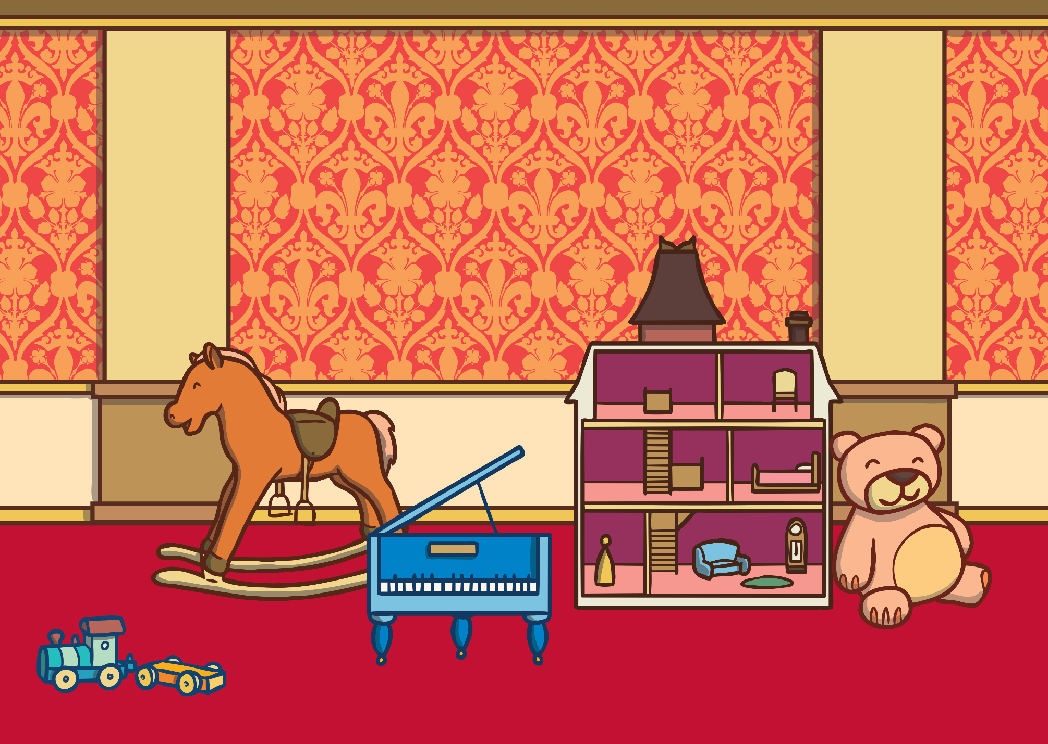

Teach
“Thank you for helping us tidy up,” said the children. “We should go for our afternoon tea now, but the queen will want to show you the rest of the palace.

Slide 24

Apply
Sentence Time
Uh-oh! What are Kit and Sam thinking?

Slide 25

Apply
We have lost the queen and might like her to return soon.
Sound Buttons On/Off
Show

Slide 26

Teach
Kit and Sam were left alone in the playroom. “Oh no,” said Kit. What shall we do now?”
“I have an idea,” said Sam. “Come on, let’s go.”

Slide 27

Today, we have learnt…
oy
saying /oi/
The adventure continues next lesson!

