Slide 1
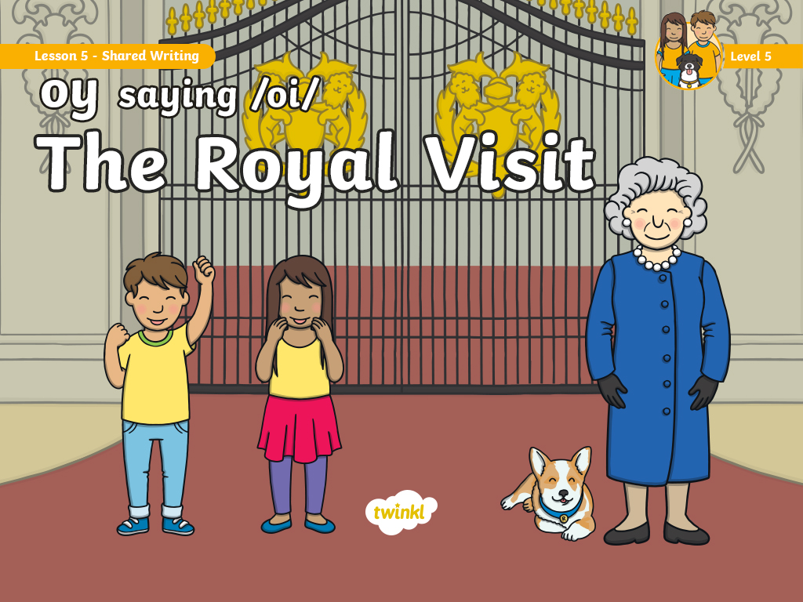

Slide 2

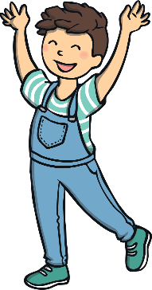

Revisit and Review
Let’s practise Sam’s Sounds and Common Exception Words!
ay
oy
should
want
would
could

Slide 3
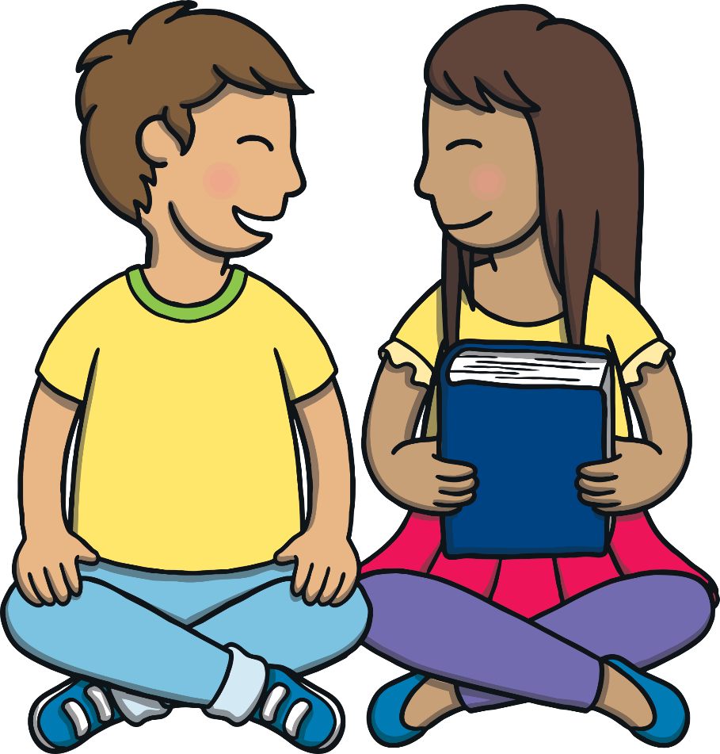

Teach
Today, we are learning to read and write words that contain oy saying /oi/.

Slide 4
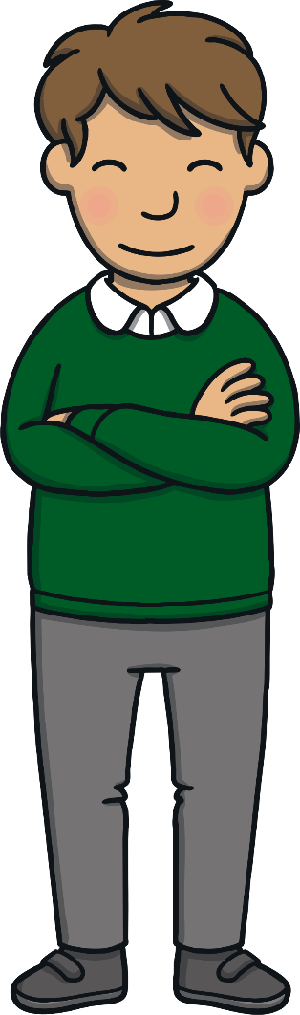

Teach
Let’s practise reading all of this week’s focus words.
would
joy
destroy
want
enjoy
royal
boy
annoy
like
toy
employ
have

Slide 5
Teach
Can you write them on a whiteboard or paper?
have

Slide 6
Teach
Can you write them on a whiteboard or paper?
like

Slide 7
Teach
Can you write them on a whiteboard or paper?
boy

Slide 8
Teach
Can you write them on a whiteboard or paper?
toy

Slide 9
Teach
Can you write them on a whiteboard or paper?
joy

Slide 10
Teach
Can you write them on a whiteboard or paper?
enjoy

Slide 11
Teach
Can you write them on a whiteboard or paper?
annoy

Slide 12
Teach
Can you write them on a whiteboard or paper?
employ

Slide 13
Teach
Can you write them on a whiteboard or paper?
destroy

Slide 14
Teach
Can you write them on a whiteboard or paper?
royal

Slide 15
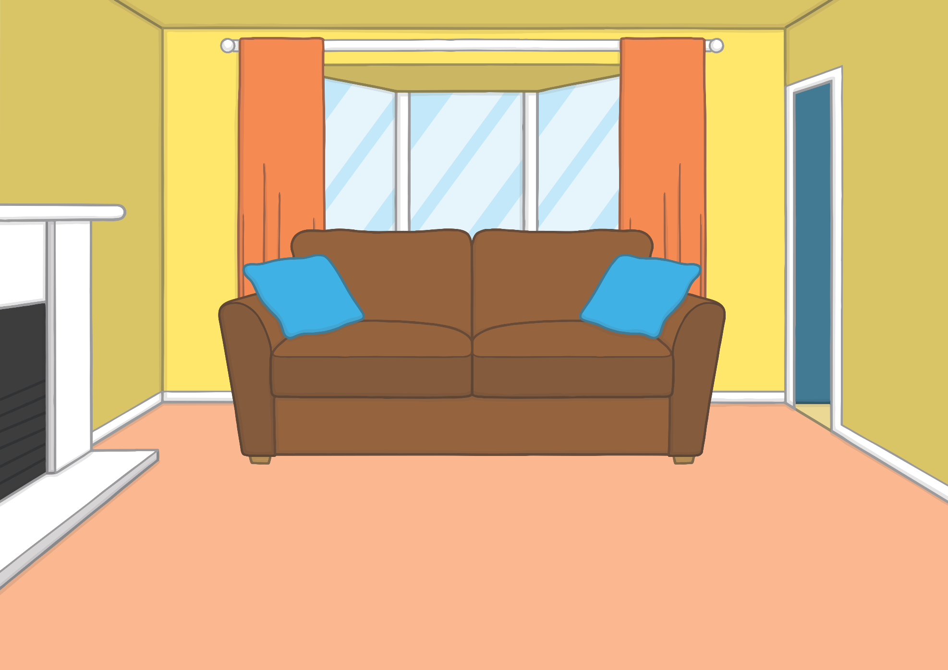
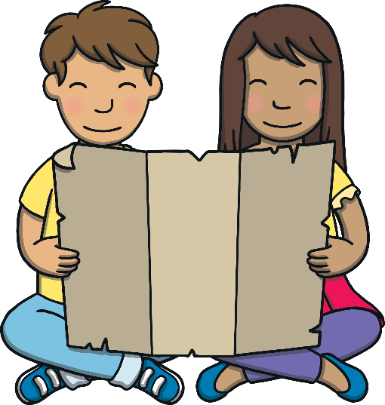
Teach
Kit and Sam were back at home after their royal adventure. They had a look at the magic map once more.

Slide 16

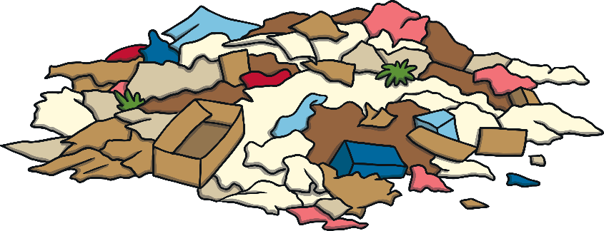
Teach
“I did enjoy meeting the queen,” said Sam.
“Yes,” said Kit, “I just wish that the dogs hadn’t destroyed the room.”

Slide 17
Teach
“Yes, it is a good job we didn’t annoy the Queen!” laughed Sam. “But I think she was just like us when she was young!”

Slide 18

The Queen’s Photo Album
Practise
Practise
The Queen is looking back at her old photo album. Unfortunately, she forgot to write captions to say what was happening in the pictures. Can you help?

Slide 19

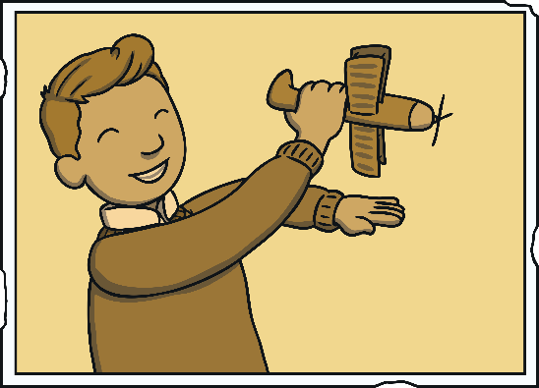

Practise
Practise
a boy with a toy
Suggest

Slide 20
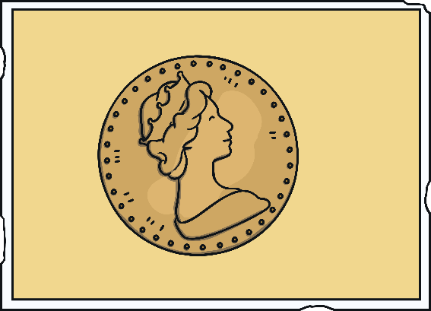
Practise
Practise
a royal coin
Suggest

Slide 21
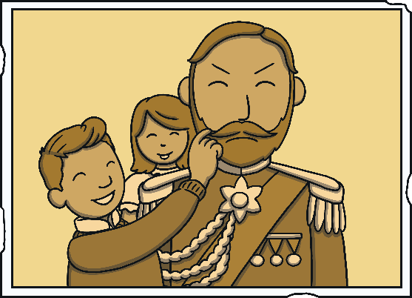
Practise
Practise
annoying the King
Suggest

Slide 22
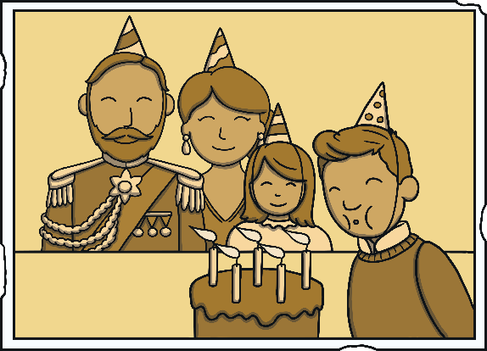
Practise
Practise
enjoying his birthday
Suggest

Slide 23
Apply
“I think so too,” said Kit, smiling. “Do you think she will remember us next time we are in London?”
“I have an idea,” said Sam. “Let’s make a book of our adventure and send it to her. Then she will!”

Slide 24
Apply
“I think so too,” said Kit, smiling. “Do you think she will remember us next time we are in London?”
“I have an idea,” said Sam. “Let’s make a book of our adventure and send it to her. Then she will!”

Slide 25
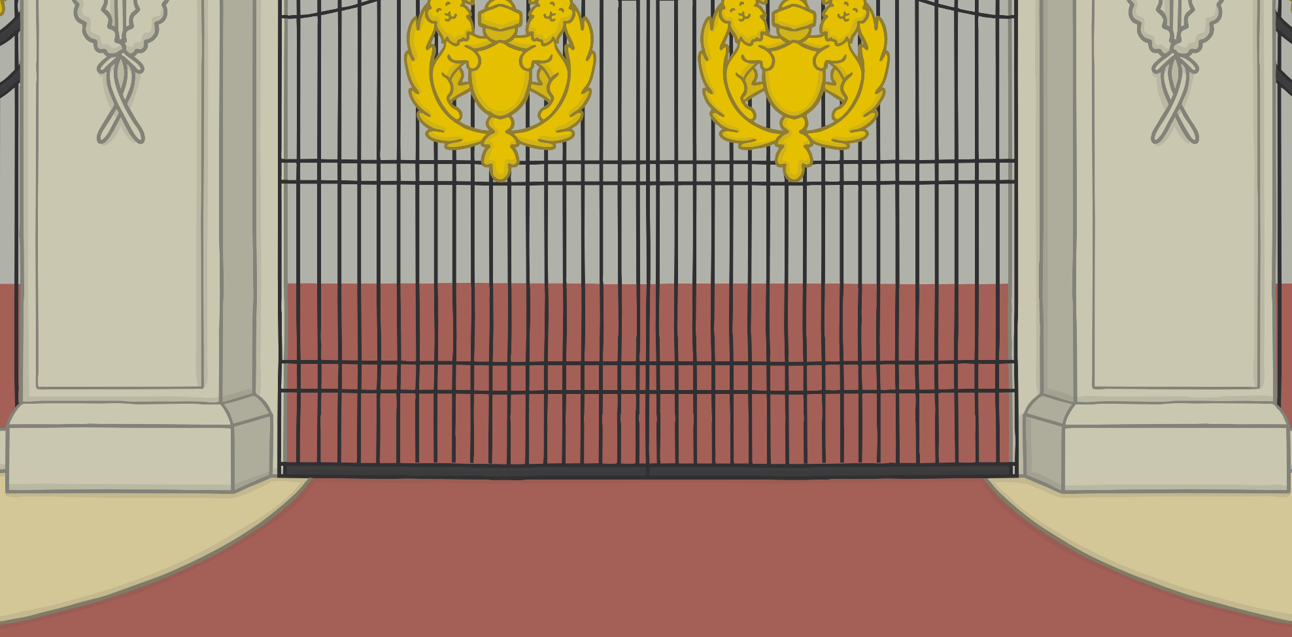
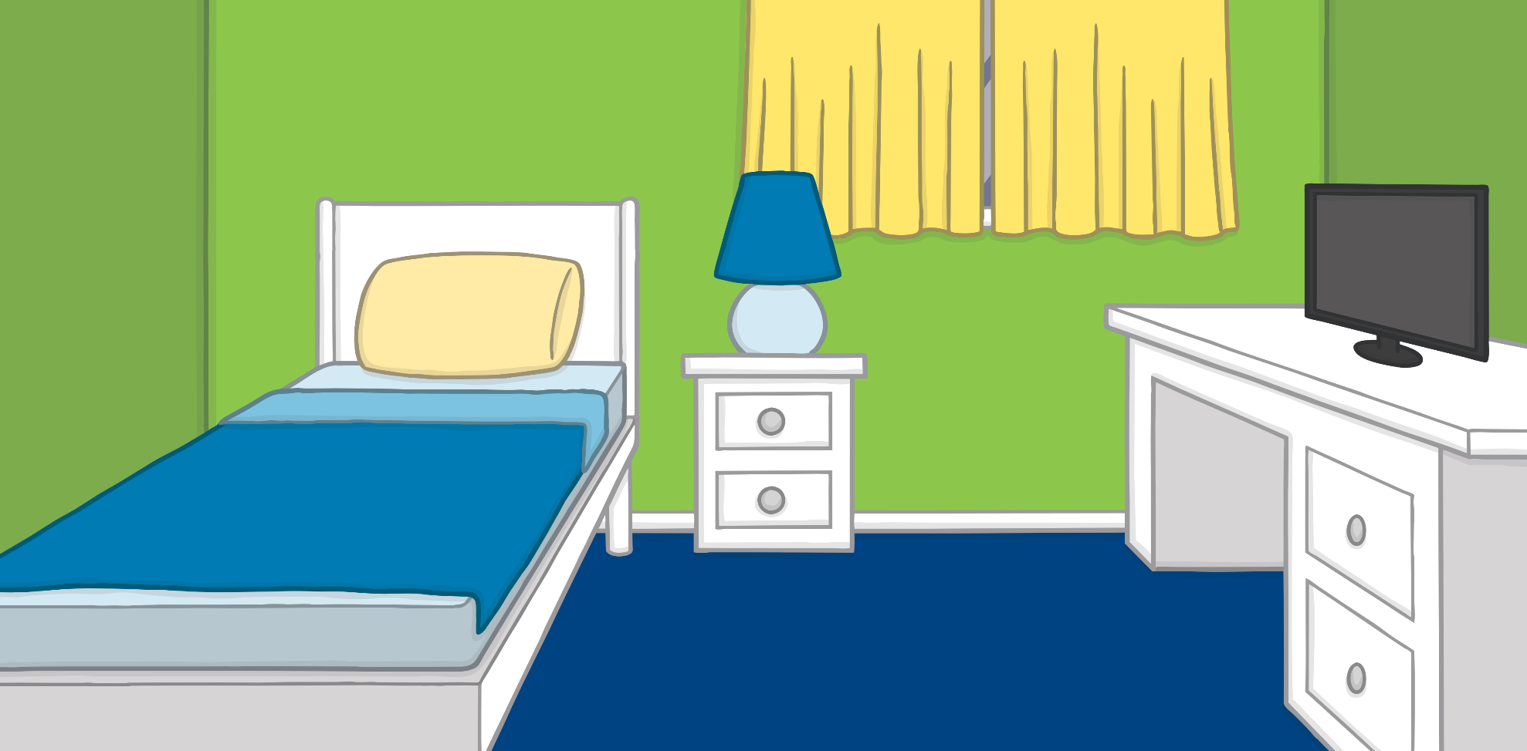
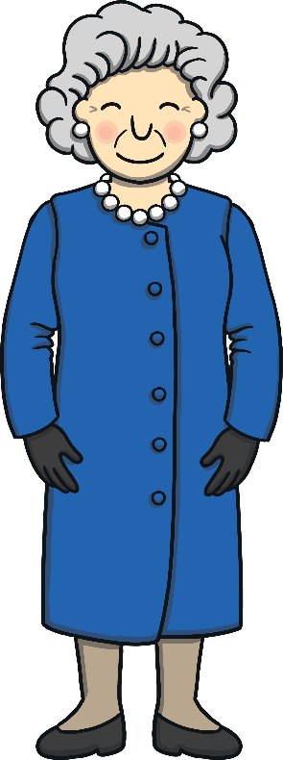


Apply
A Royal Visit
A ‘Let’s Read Together!’ Book

Slide 26
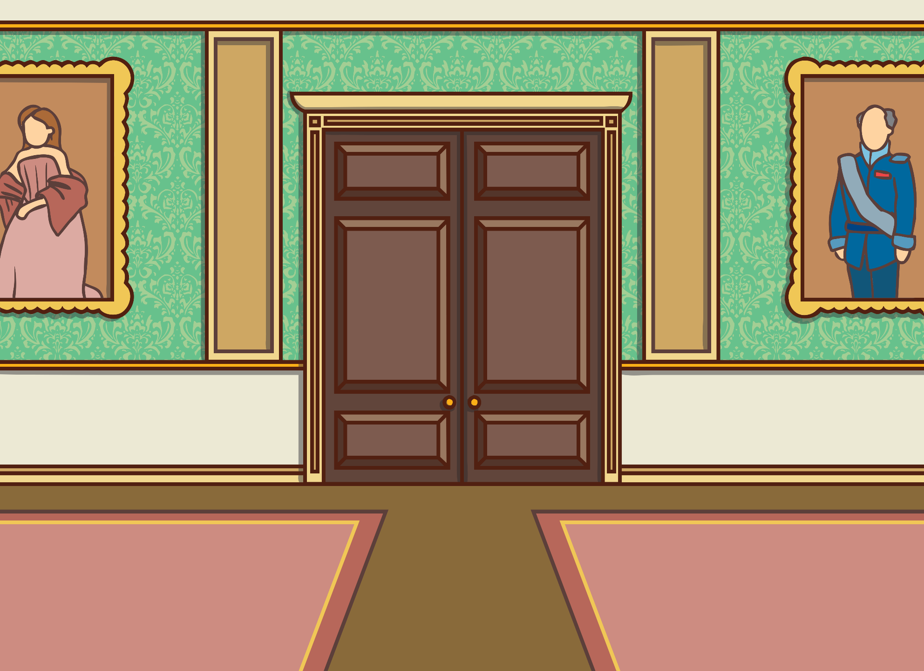



Apply
Show Suggestion
Kit and Sam went with the map to visit the Queen.

Slide 27
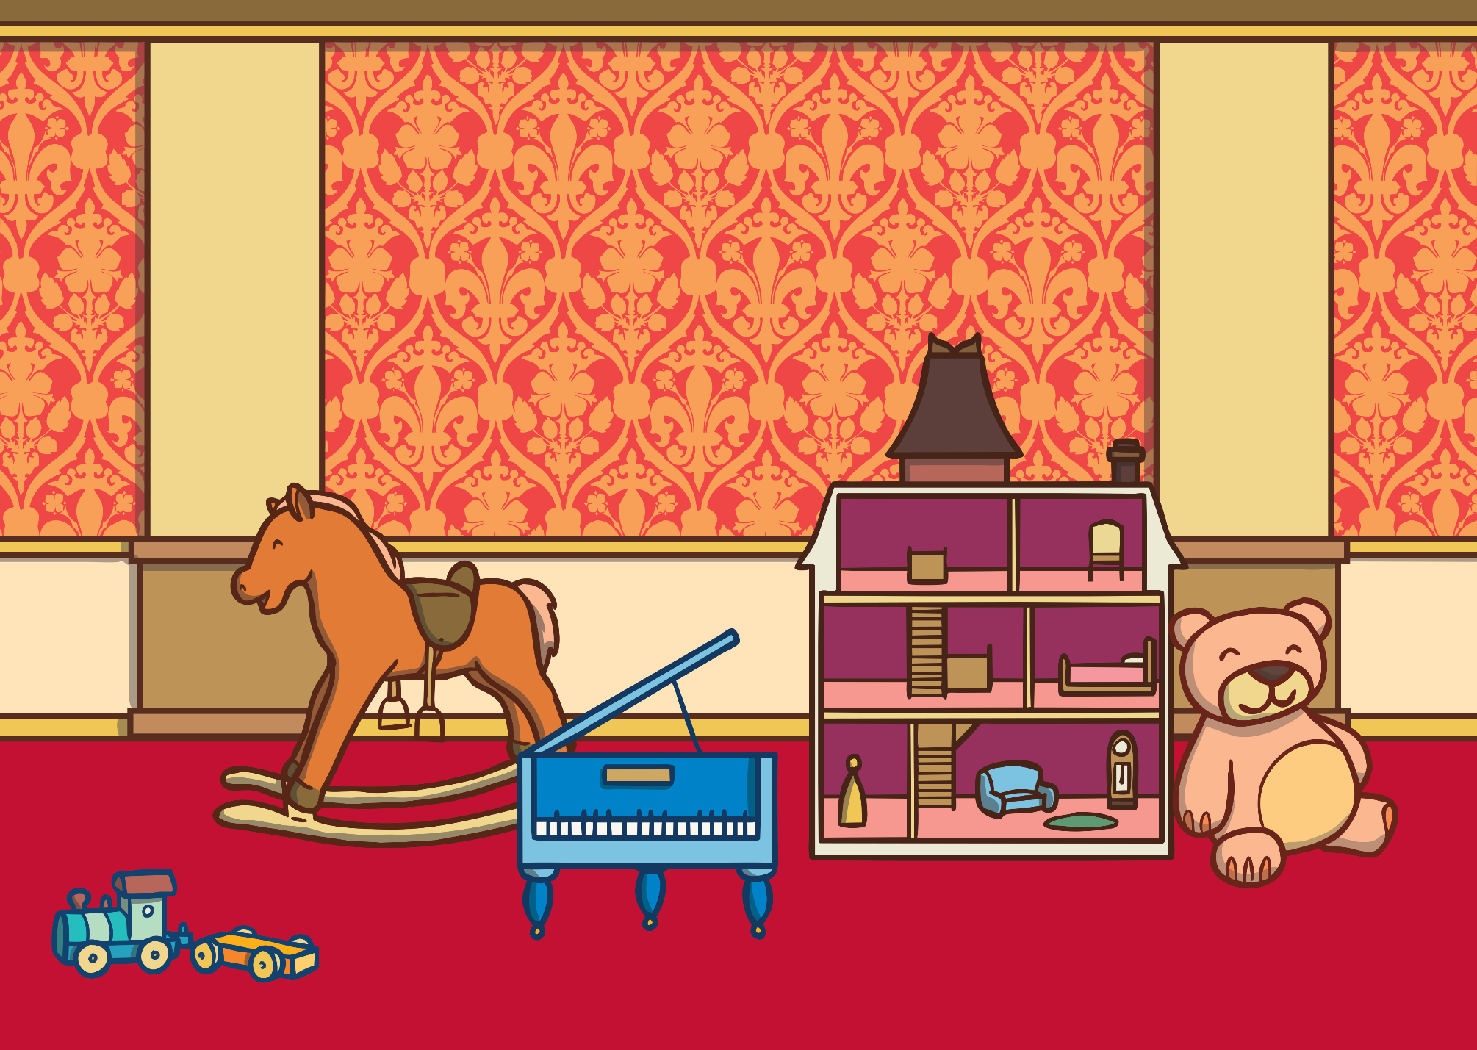

Apply
Show Suggestion
It was a joy to meet the royal children.

Slide 28


Apply
Show Suggestion
Kit and Sam did not like getting lost.

Slide 29
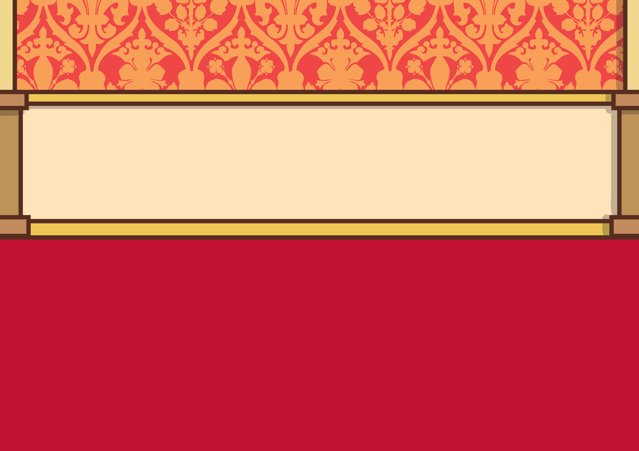




Apply
Show Suggestion
They had dog food for the loyal dogs to enjoy, but they did destroy the room!

Slide 30

Apply
Show Suggestion
The Queen went to see to the din. Kit and Sam were glad all the mess did not annoy her.

Slide 31
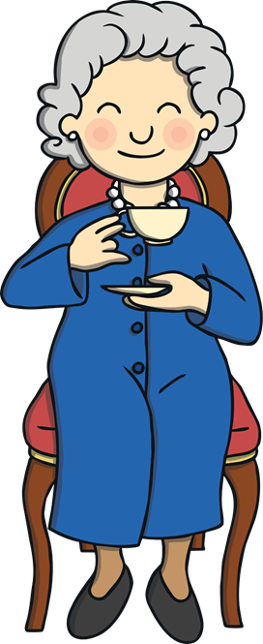
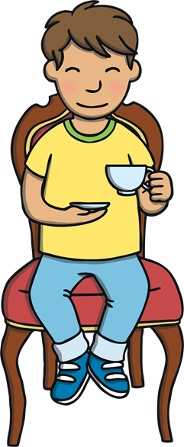
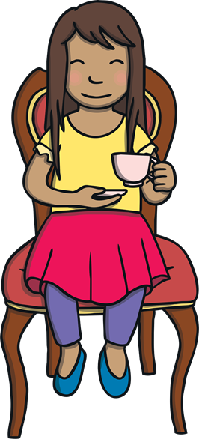
Apply
Show Suggestion
They got the dustpan and brush out. Then, they all had a drink.

Slide 32
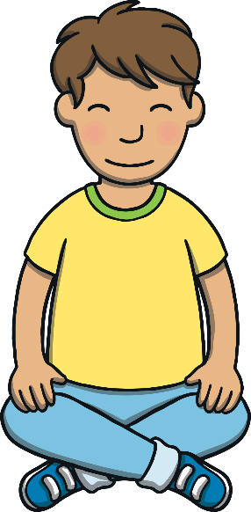

Apply
“I hope we can visit the Queen again, ” sighed Kit.
“I have a feeling that we will,” smiled Sam as she closed the book.

Slide 33


Today, we have written sentences to write a book together.

