Slide 2

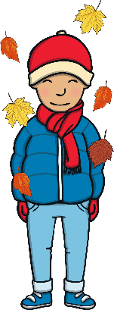

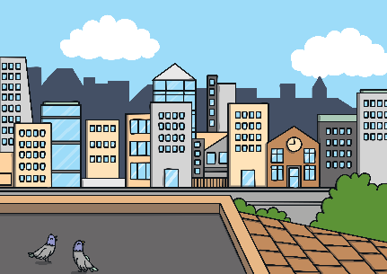









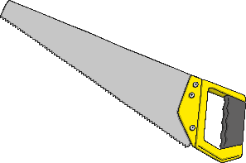
Revisit and Review
Let’s practise Sam’s Sounds and Common Exception Words!
y
au
c
ir
g
ow
oe
ph
ue
wh
aw
ew
ea
house
many
because
Monday
any
once
eyes
friends
different
please
Wednesday
laughed
Tuesday
lived
before
more
Thursday
lived
also
work

Slide 3


Teach
Today, we are learning to read words that
contain ea saying /e/.
X
‘ea’ saying /e/ is often found in the middle of words.
Click me for Kit’s teaching tips!

Slide 4
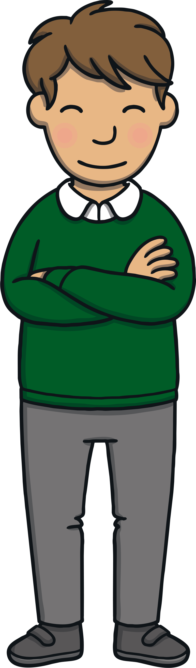
Teach
Let’s practise reading some of this week’s focus words that contain the ea saying /e/ sound.
head
bread
ready
deaf

Slide 5

Teach
Now, let’s write them with the magic pencil…

Slide 6


Teach
h
e
a
d
Play

Slide 7
Teach
b
r
e
a
d
Play

Slide 8
Teach
r
e
a
d
y
Play

Slide 9
Teach
d
e
a
f
Play

Slide 10

Teach
Dear all, Wednesday 5
On Friday, we will be going on a surprise trip with the children. Heather will be coming, too!
Please make sure that the children have had a good breakfast before they come, as it will be a long day. They will need coats as the weather is likely to be cold.
Please be ready to go by 8.30 a.m.
Thank you,
Mrs Tan
th
The following Wednesday in school, Mrs Tan gave the children a letter to take home to their parents. “How exciting,” said Sam, reading the letter. “We’re going on a surprise school trip on Friday and it says here that Heather is coming too!”

Slide 11
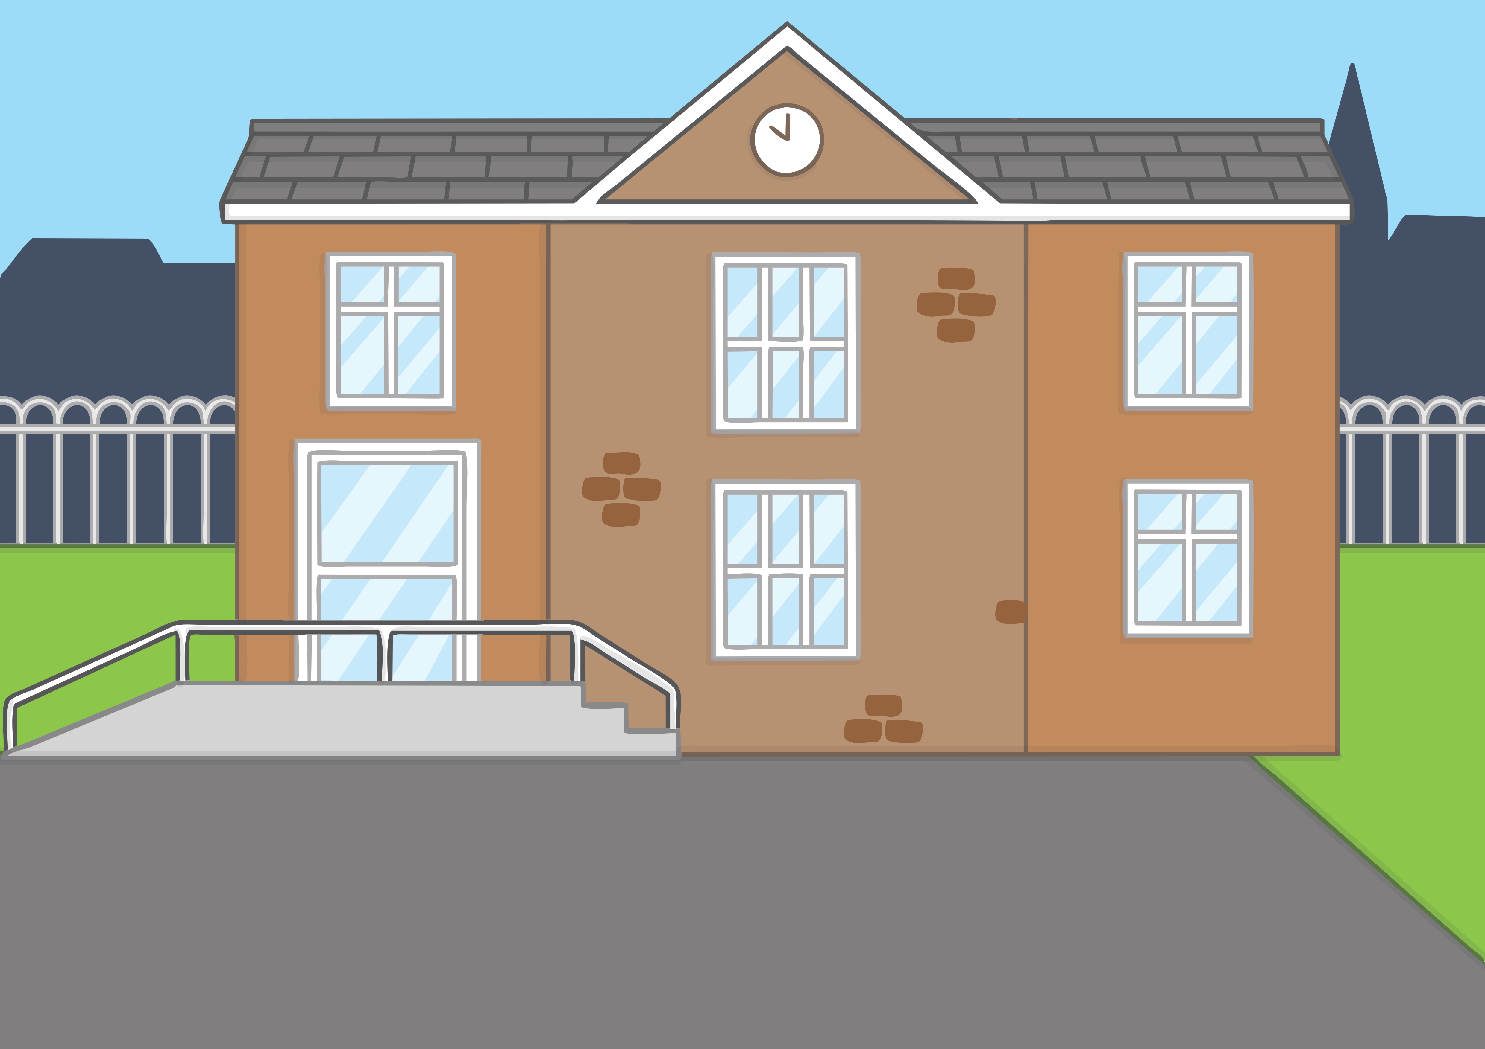
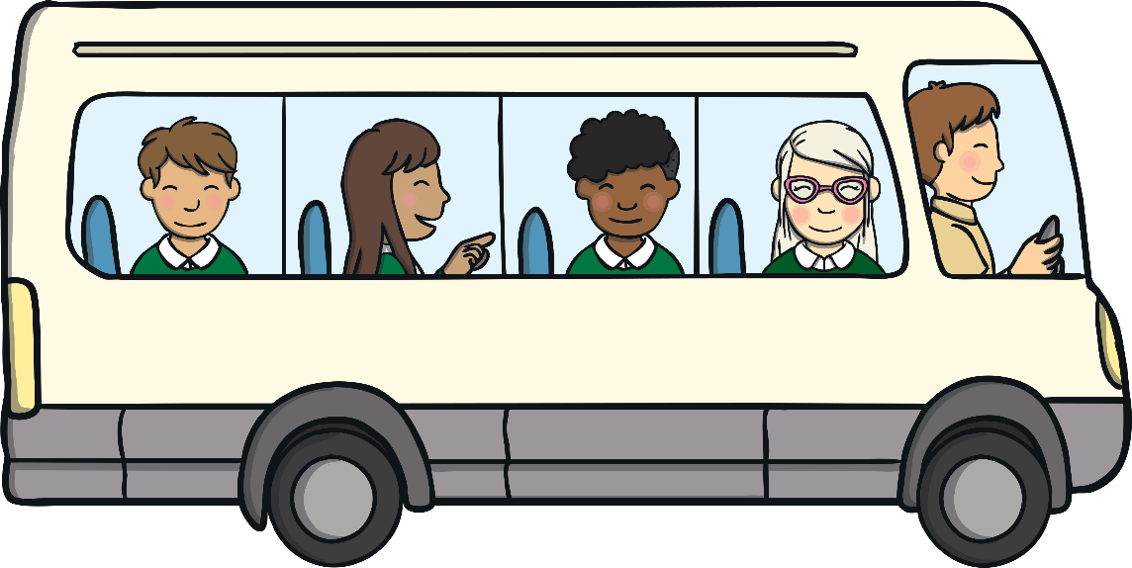
Teach
That Friday, the children arrived at school and got straight onto a coach that was waiting outside for them. “This is exciting!” said Jake. “I wonder where we are going.”

Slide 12
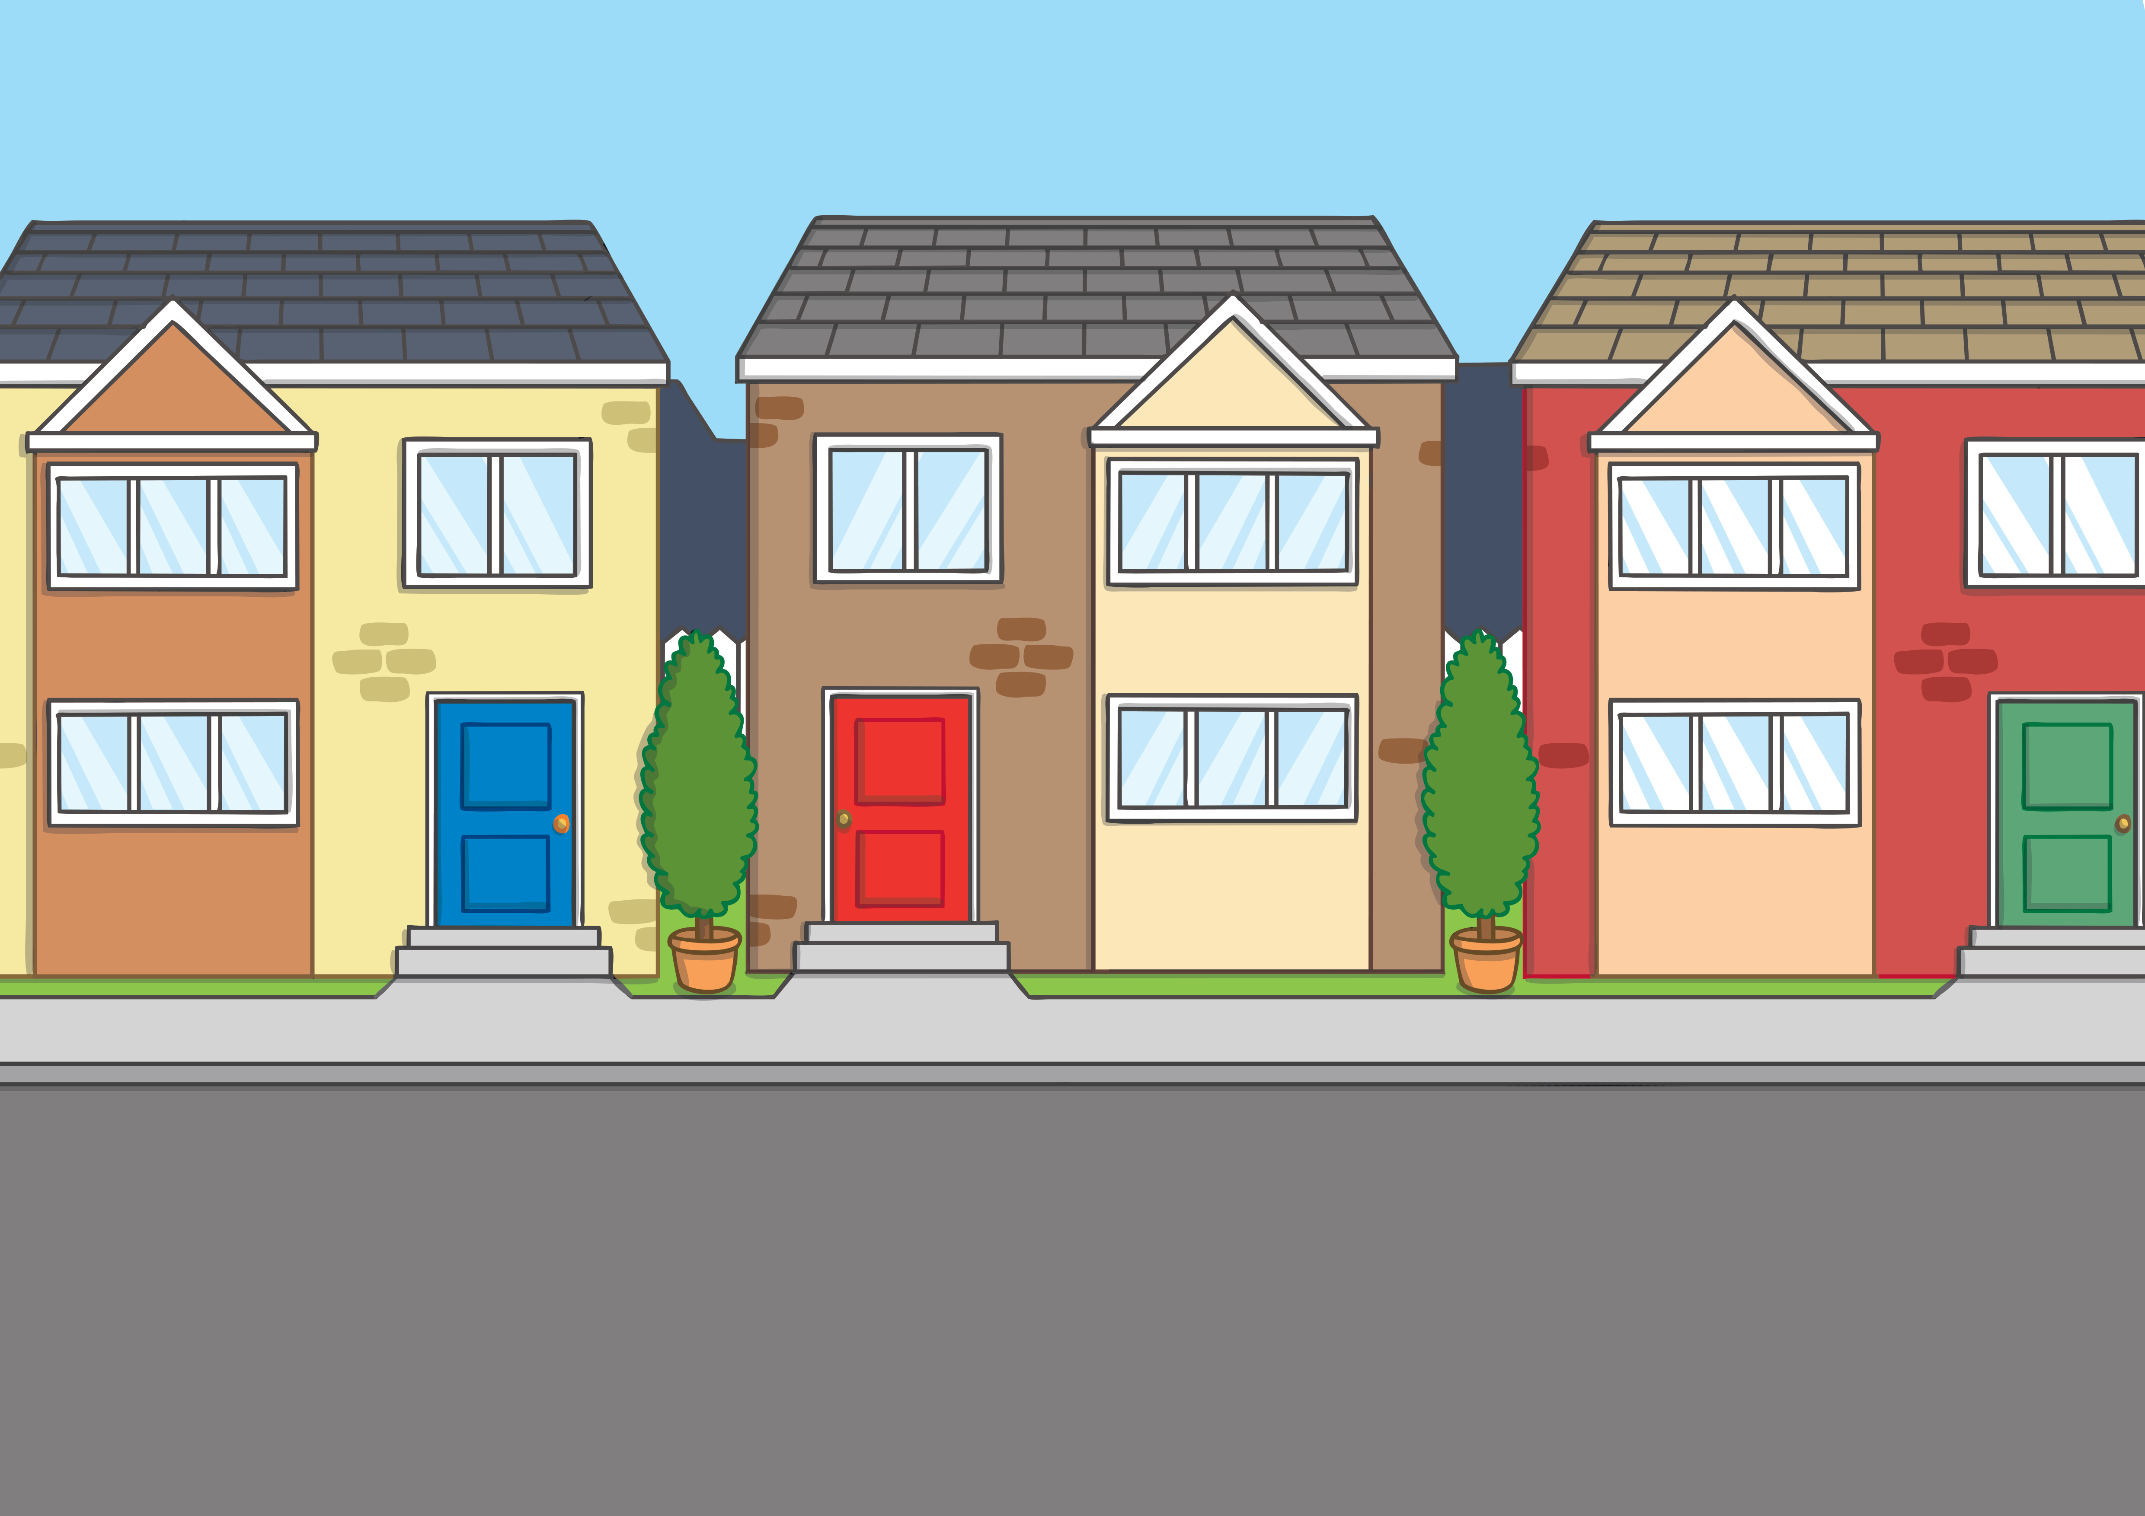

Teach
00
It was a long journey and the children soon began to get bored. “Let’s play a game,” suggested Lily. “I’ve brought one with me. It’s called Pairs”
“OK,” said Sam, “I’m ready!”

Slide 13
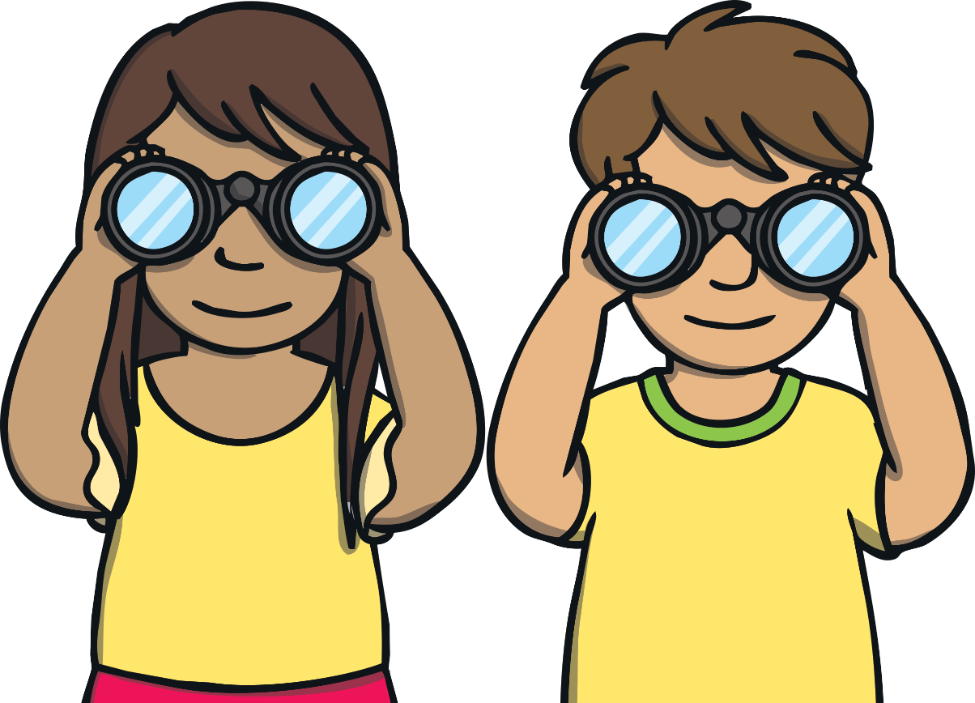
Pairs
Teach
Turn over 2 cards. If the word matches the picture, you get to keep the cards. If not, try again.
Hint: Each word has ea in it!
This is a great game to play as a class!
X
Click me for Kit’s teaching tips!

Slide 14


head
bread
weather
deaf
healthy

Slide 15
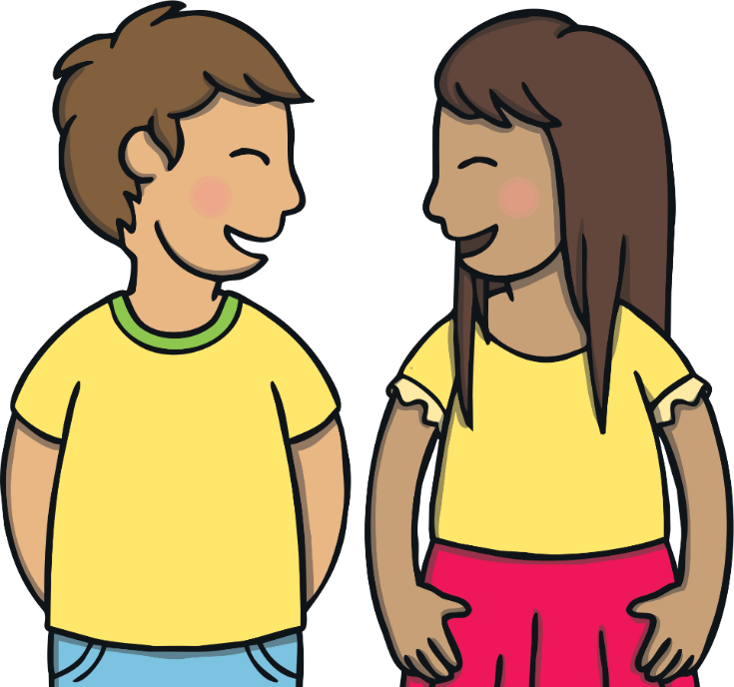
Rhyme Time
Practise
Next, Kit teaches everyone a new game. He writes a word at the top of the page and then writes a list of words underneath. Each player takes it in turns to read a word and decide whether it rhymes with the word or not. If they are correct, they score a point!
Why don’t you have a go?

Slide 16





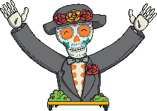
Practise
Does not rhyme
Rhymes
bread
head
lead
bead
dread
plead
dead

Slide 17
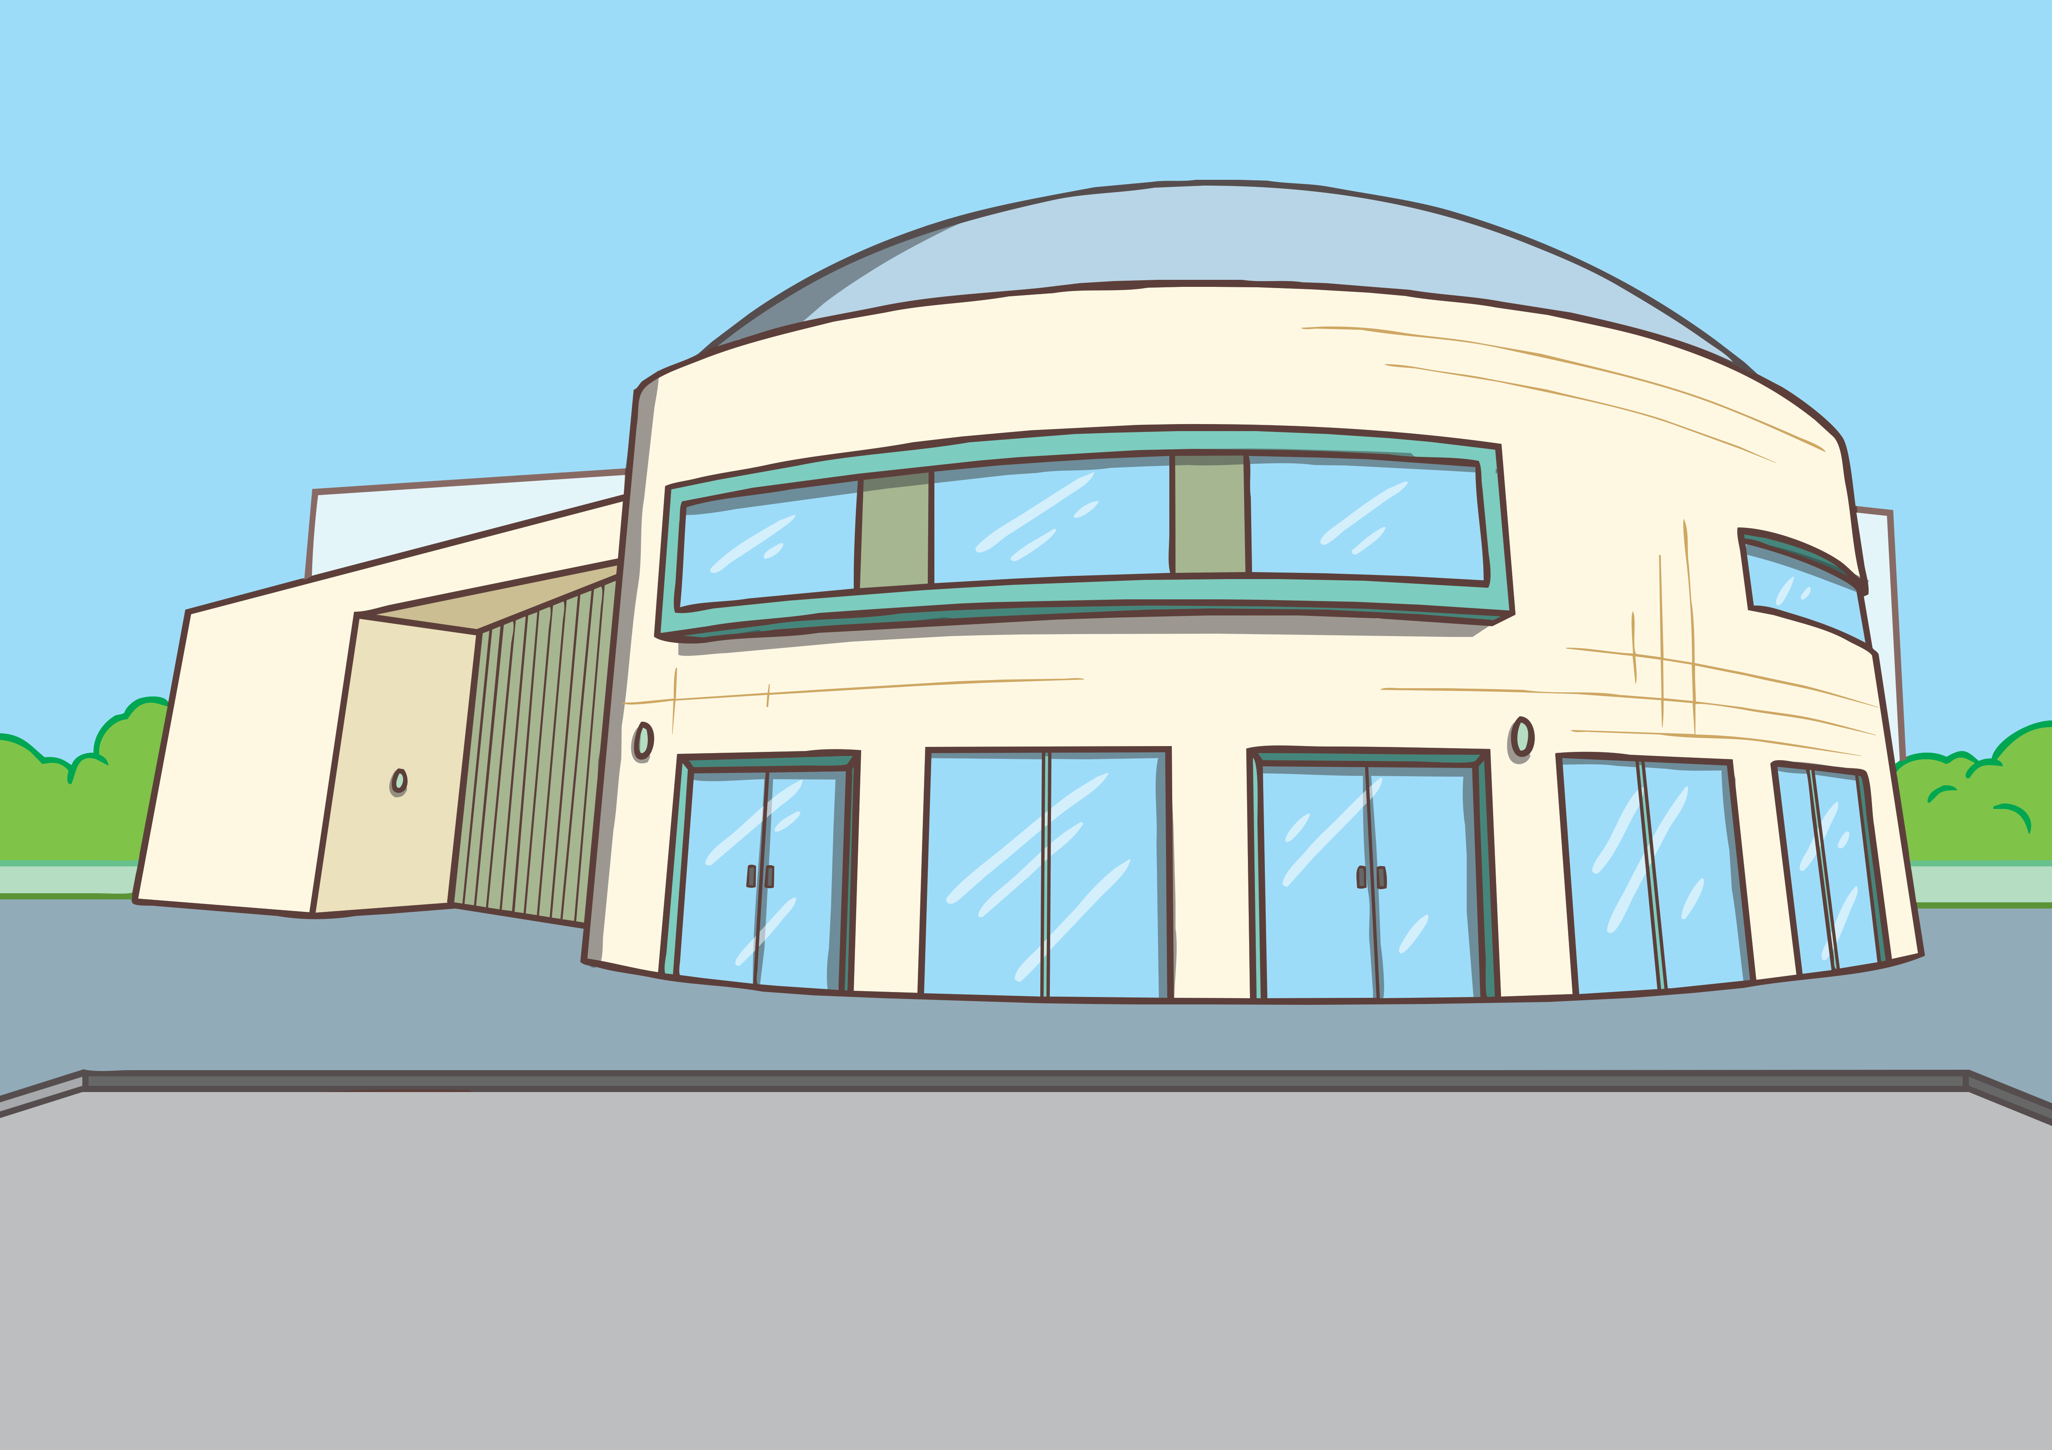
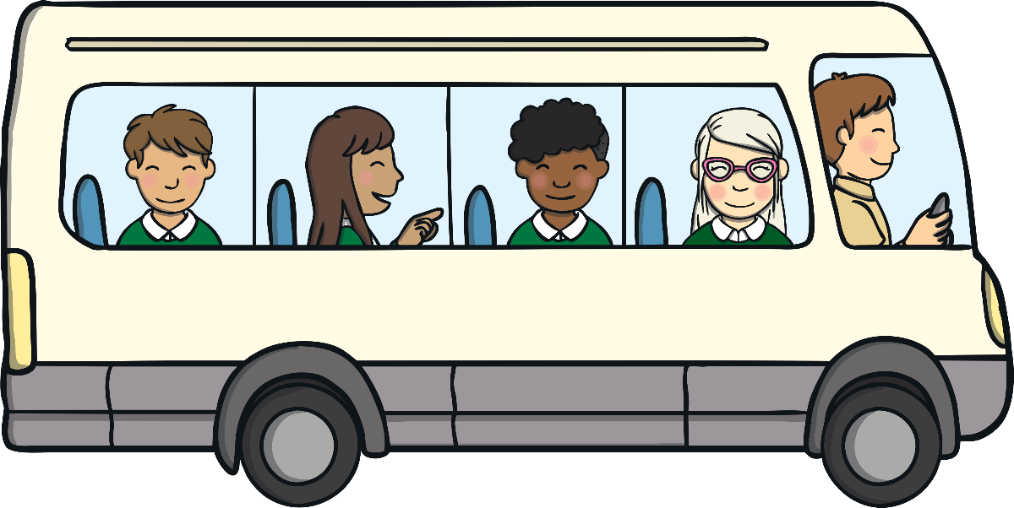
Apply
Eventually, the coach arrived outside a large stadium. “Welcome to the Cross-County Basketball Tournament,” said Heather, with an enormous grin. You were all so enthusiastic about last week’s PE lesson, I thought you would like to see some real games in action!”

Slide 18
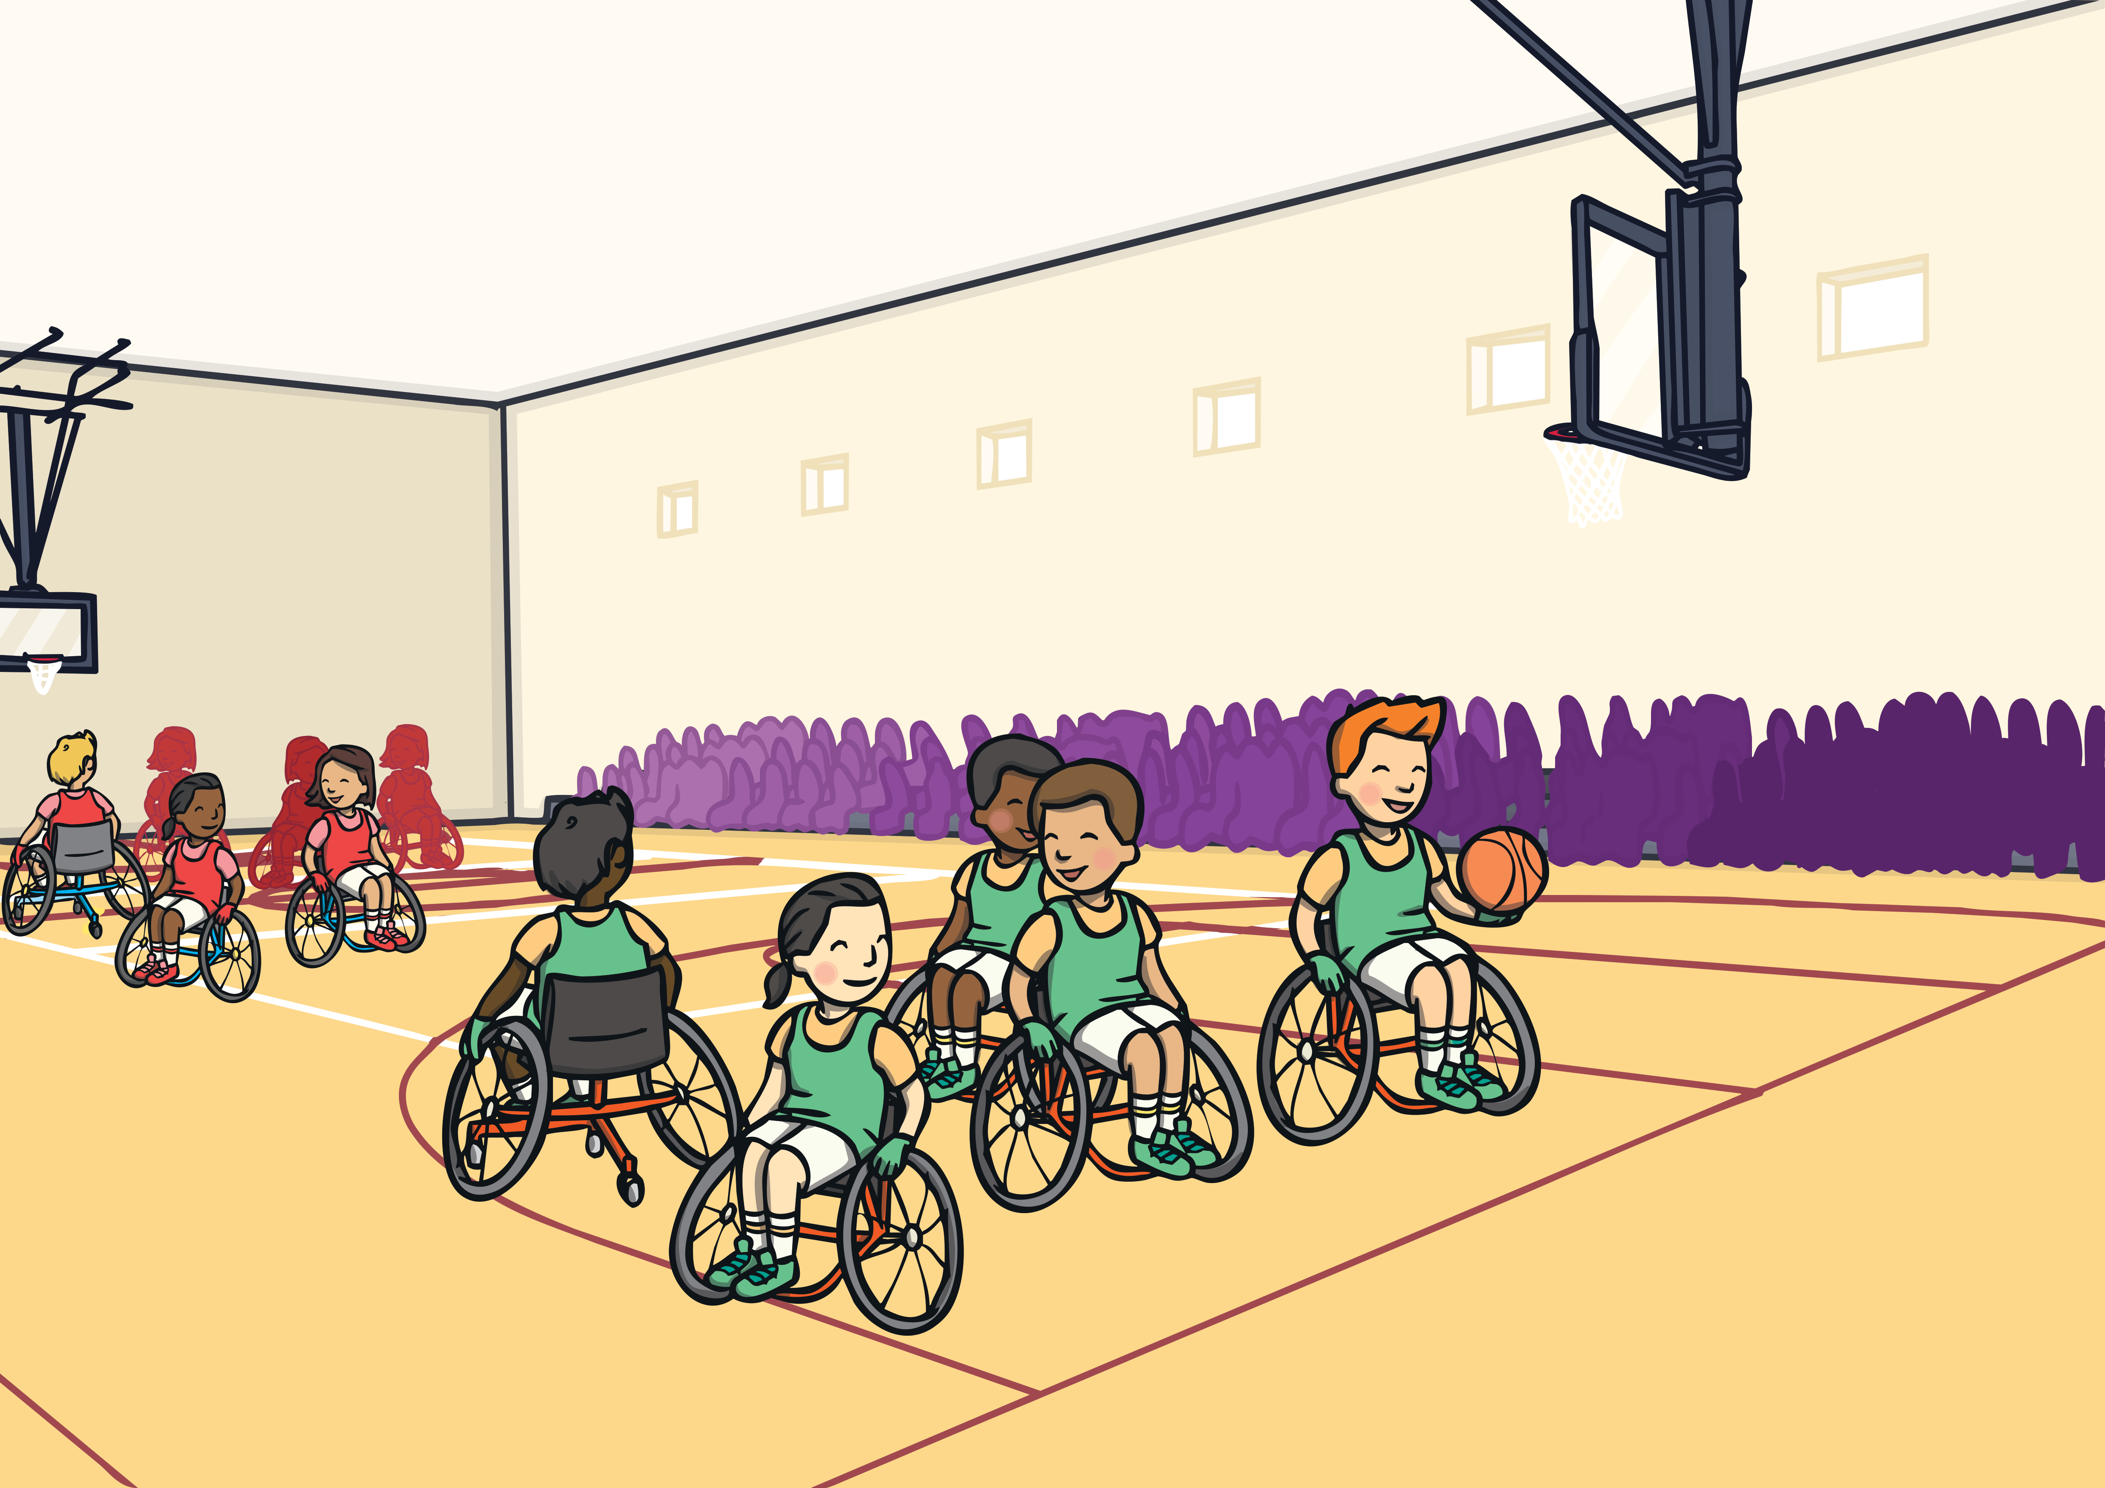
Apply
Inside the stadium, lots of different teams were getting ready to play. “Hey, look over there,” shouted Heather, waving. “That is my deaf basketball youth team getting ready to play. They have been working so hard. I hope they do well!”

Slide 19
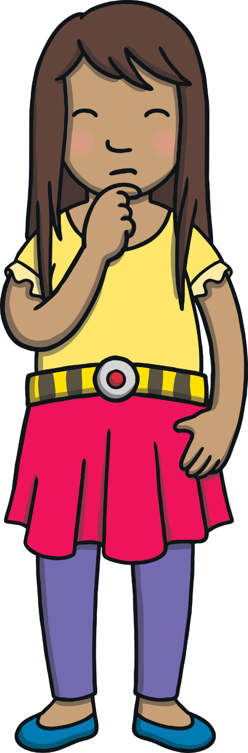
Sentence Time
Apply
What is Sam thinking as she looks at all the teams? Read the sentence below and then click ‘Show’ to reveal the picture.

Slide 20
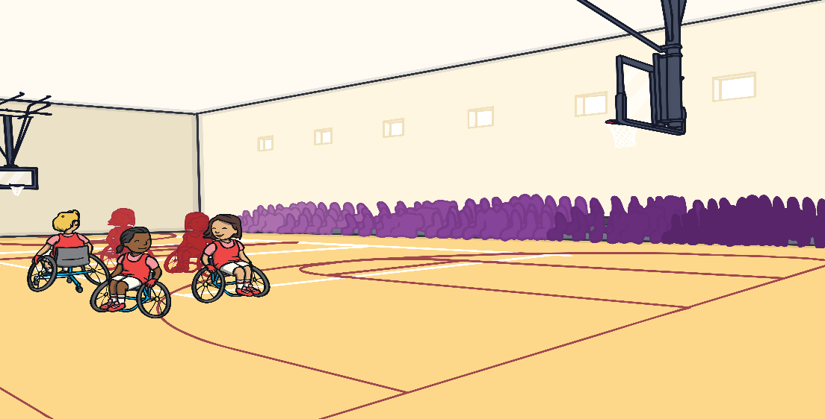
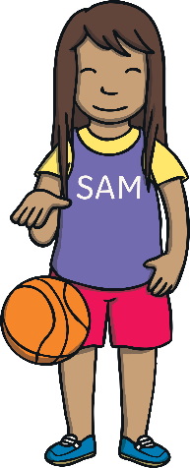

Apply
I wish I was on one of these teams getting ready to play!
Sound Buttons On/Off
Show

Slide 21
Apply
Just then, a whistle blew. “Quick, we will need to sit down before the tournament starts,” said Heather. “Be careful not to tread on people’s feet as you go to your seat.”
“Ouch, steady as you go!” hissed Sam, as Kit trod on her foot.

Slide 22
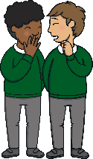
Apply
The first game to be played was between the Teatherton Tigers and the Readywell Rockets. “Wow,” whispered Lily. “I’ve never seen wheelchair basketball played live before. It is so exciting to watch!”
Jake suddenly nudged Kit hard in the ribs. “Do you want to have some more fun?” he asked.

Slide 23

Today, we have learnt…
ea
saying /e/
The adventure continues next lesson!

