Slide 2




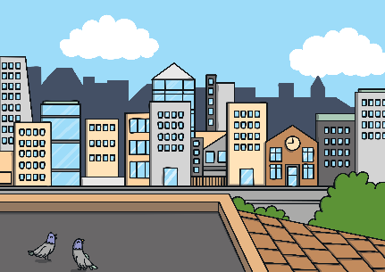










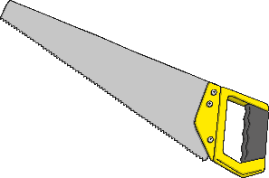

Revisit and Review
Let’s practise Sam’s Sounds and Common Exception Words!
y
au
c
ir
g
u_e
ow
oe
ph
ue
ue
wh
ew
aw
ew
ea
house
many
coming
because
Monday
any
once
lived
eyes
friends
different
please
Wednesday
Friday
laughed
Tuesday
horse
Thursday
also
work

Slide 3


Teach
This week, we are learning to spell the common
exception words any and eyes. Watch the magic pencil write the words. Can you join in?

Slide 4


Teach
any
Play

Slide 5
Teach
eyes
Play

Slide 6
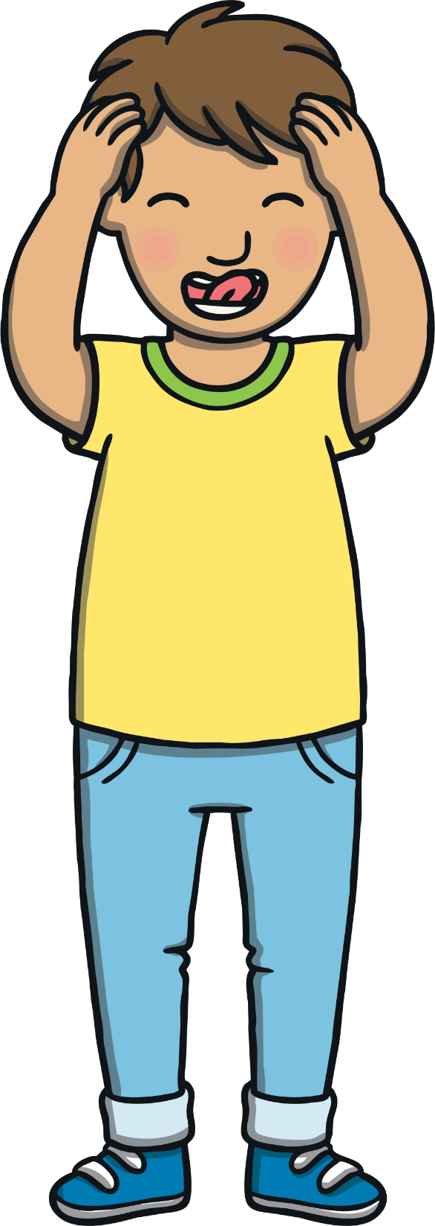
Teach
Today, we are learning to read words that
contain ea saying /e/.

Slide 7
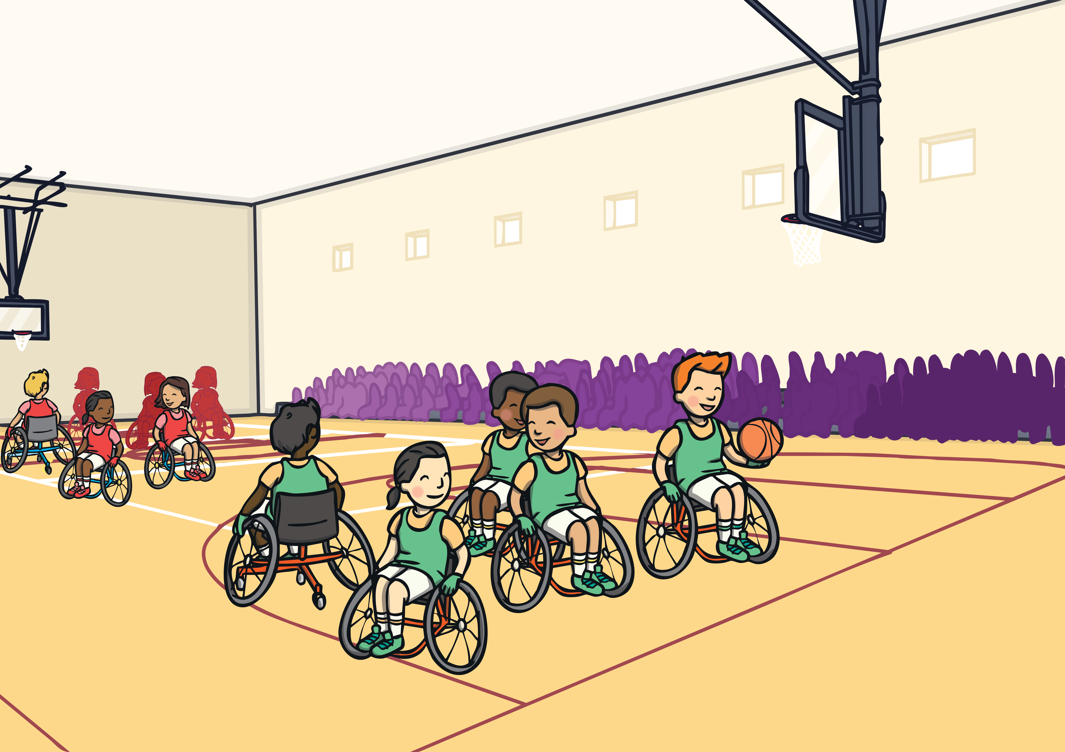


Teach
Jake and Kit were watching the start of the basketball game between the Teatherton Tigers and the Readywell Rockets. “Come on,” said Jake. “I’m fed up of just watching. I want to get more involved.

Slide 8
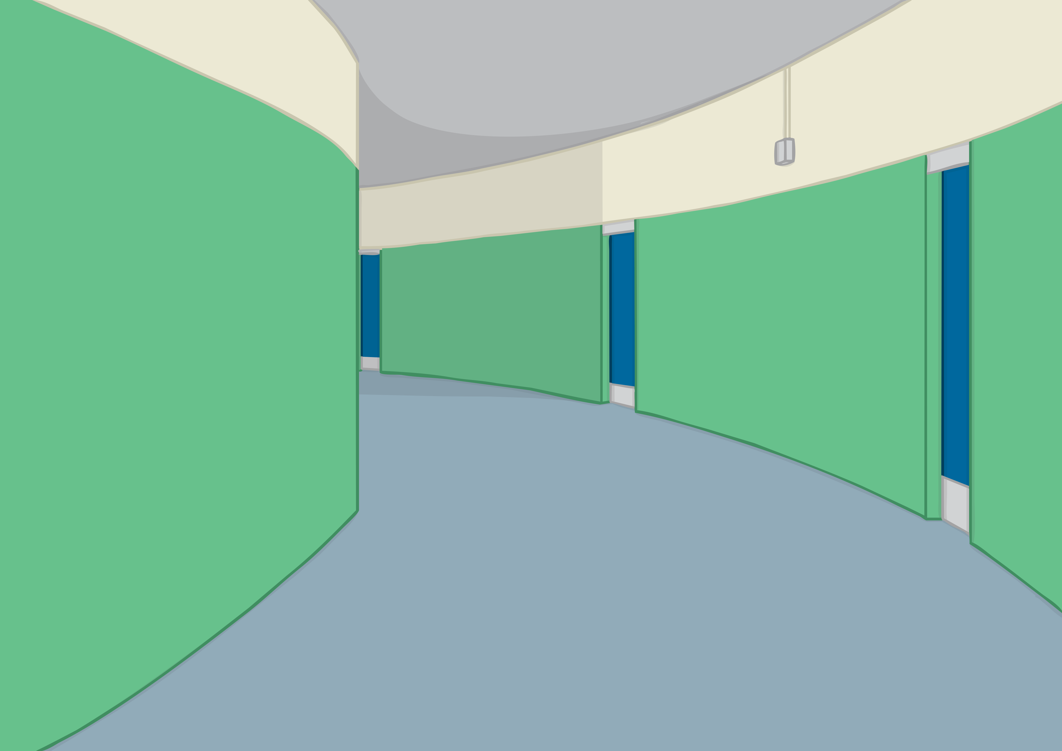


Teach
Jake and Kit slipped quietly past the rest of their class and went down some stairs. “Where are we going?” whispered Kit, looking worried.
“I’m not sure,” giggled Jake, pulling open a heavy door into a long corridor.

Slide 9
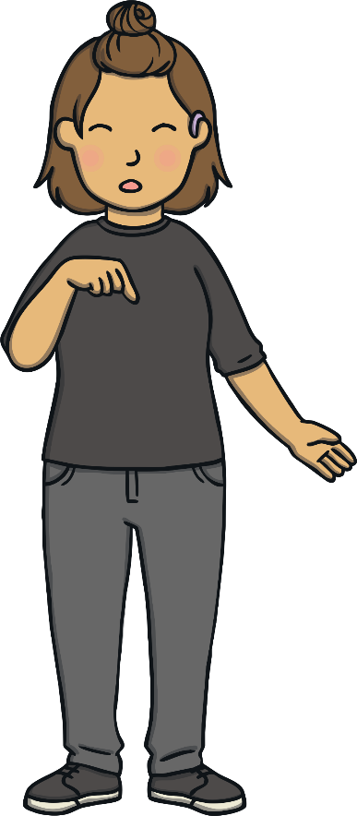
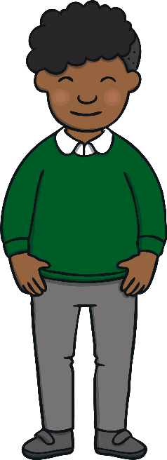

Teach
Jake and Kit found themselves in a corridor with lots of doors coming off each side. “I’m not sure I like this,” whispered Kit.
“Me neither,” said Jake.
Just then, a woman approached from down the corridor and ushered them into a dressing room.

Slide 10
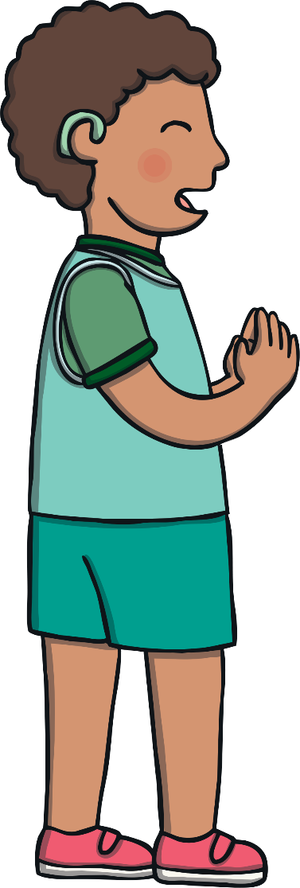
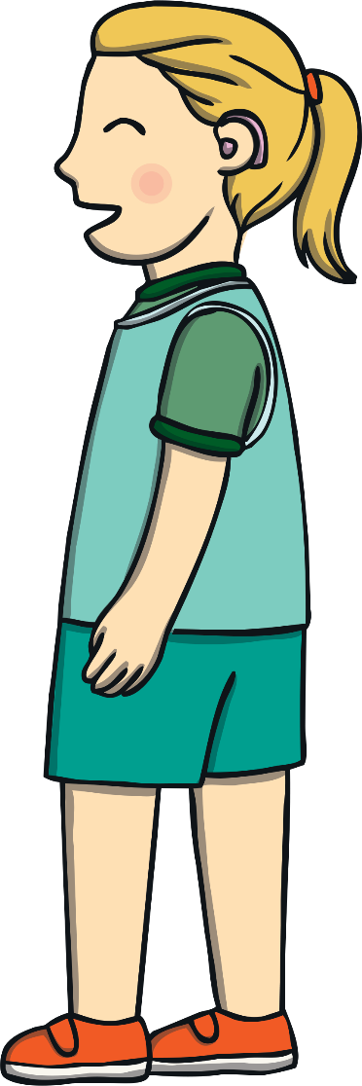

Teach
Kit and Jake find themselves in a dressing room with one of the basketball teams. Lots of the team are wearing hearing aids in one or both ears. Some of them are speaking in sign language. Fill in the missing letters and find out how to sign some words too!
X
Hint: They are all ‘ea’ saying /e/ words.
This can be done on whiteboards! Then, children can practise the signs!
Click me for Kit’s teaching tips!

Slide 11
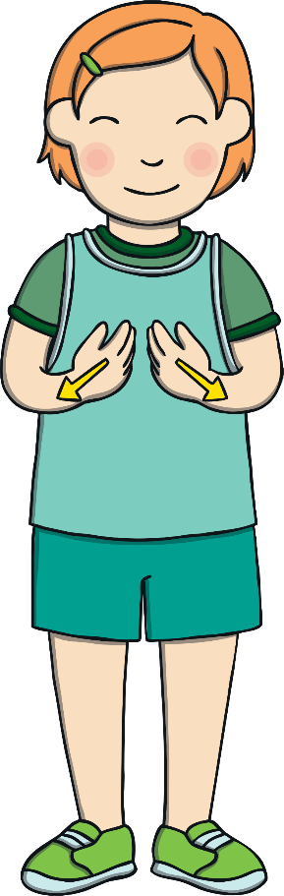
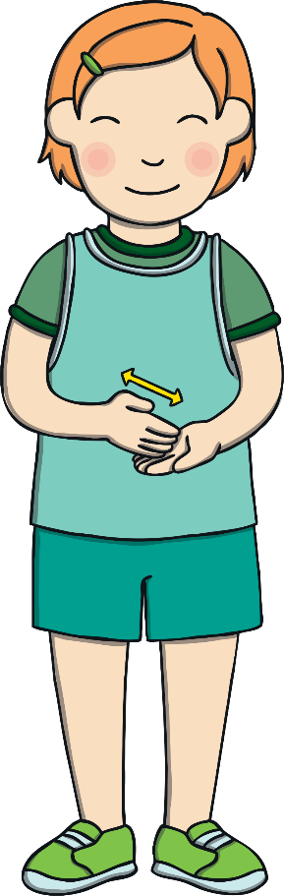
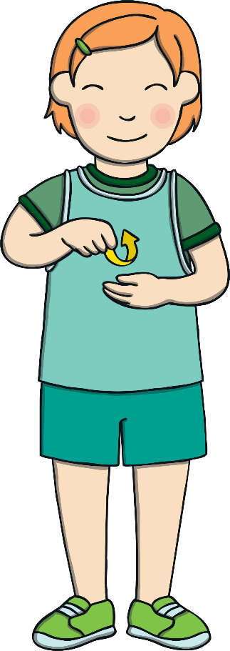
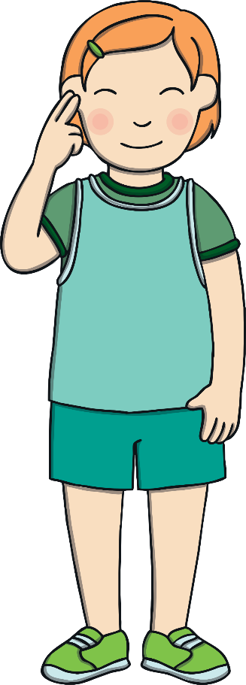

Teach
h__lthy
br__kfast
br__d
d__f
healthy
breakfast
bread
deaf
Check

Slide 12


Fingerspelling
Practise
In British Sign Language, fingerspelling can be used when there isn’t a sign for a word or if a person doesn’t know what the sign is.
Re-arrange these signs to spell some words and then practise fingerspelling the words.
X
All of the words are ‘ea’ saying /e/ words.
Click me for Kit’s teaching tips!

Slide 13




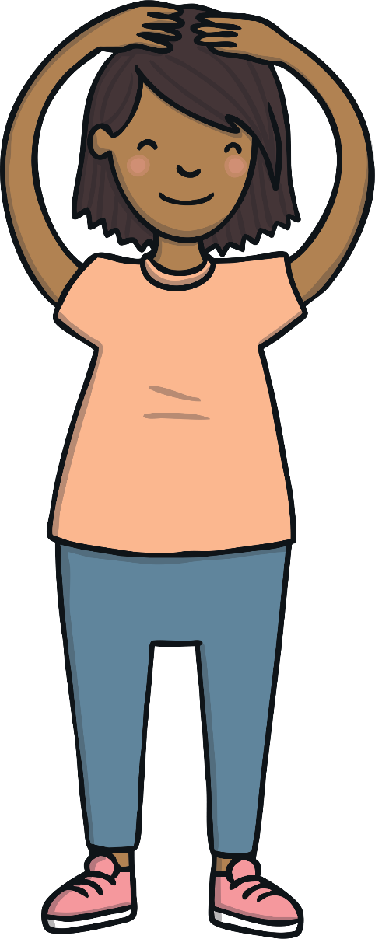
Practise
a
h
d
e

Slide 14






Practise
a
b
d
e
r

Slide 15

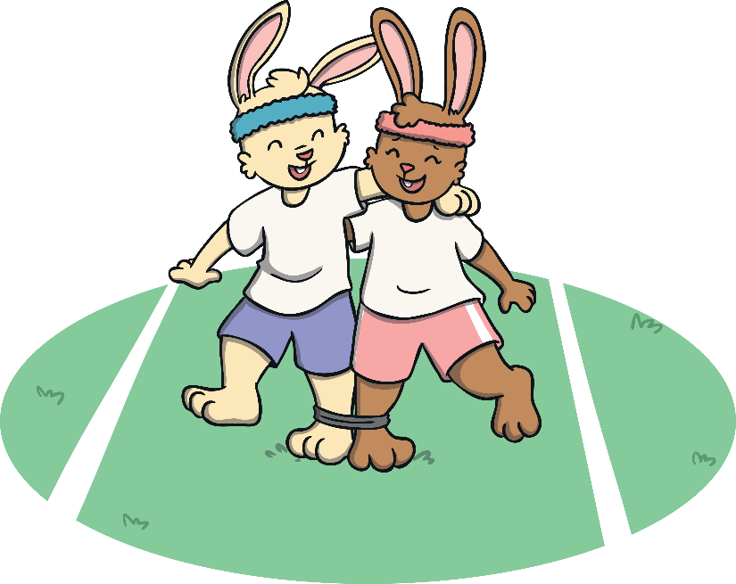
Practise
e
r
d
a
y

Slide 16


Practise
a
e
d
f

Slide 17







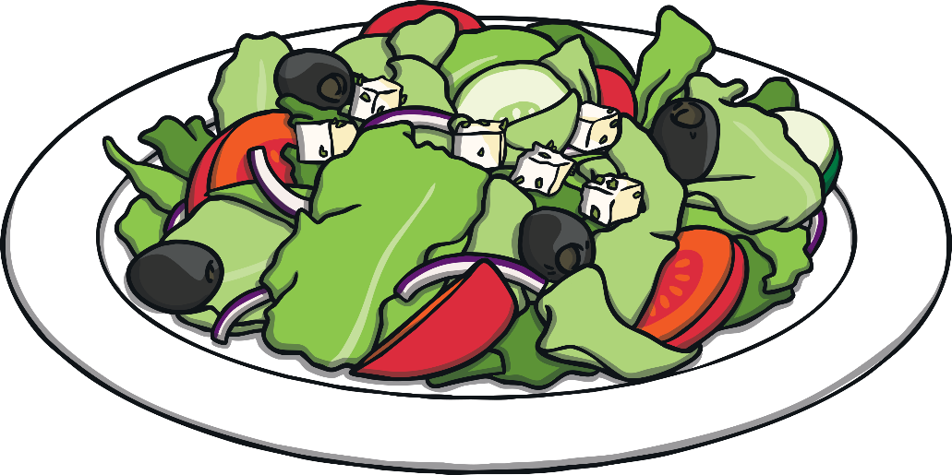
Practise
e
h
l
a
y
t
h

Slide 18




Practise
a
h
e
w
t
r
e

Slide 19









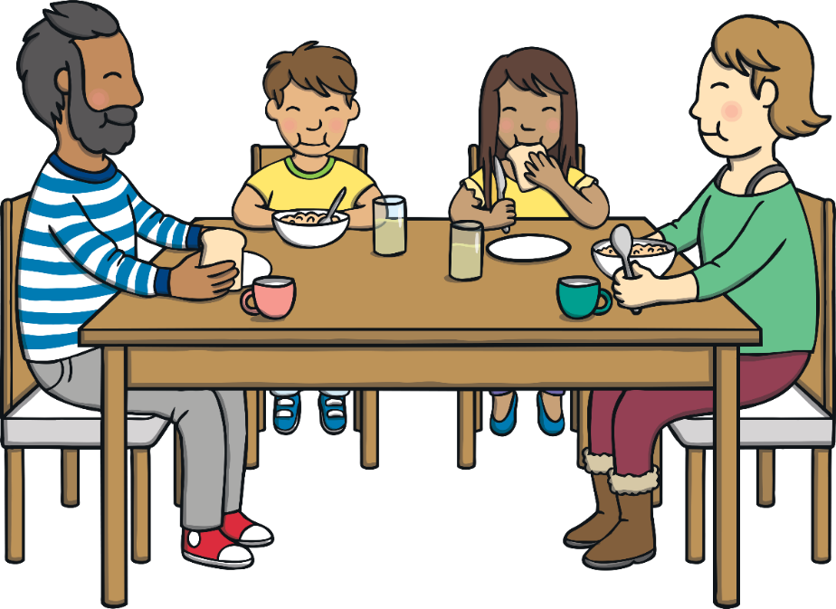
Practise
a
a
e
f
t
r
b
k
s

Slide 20
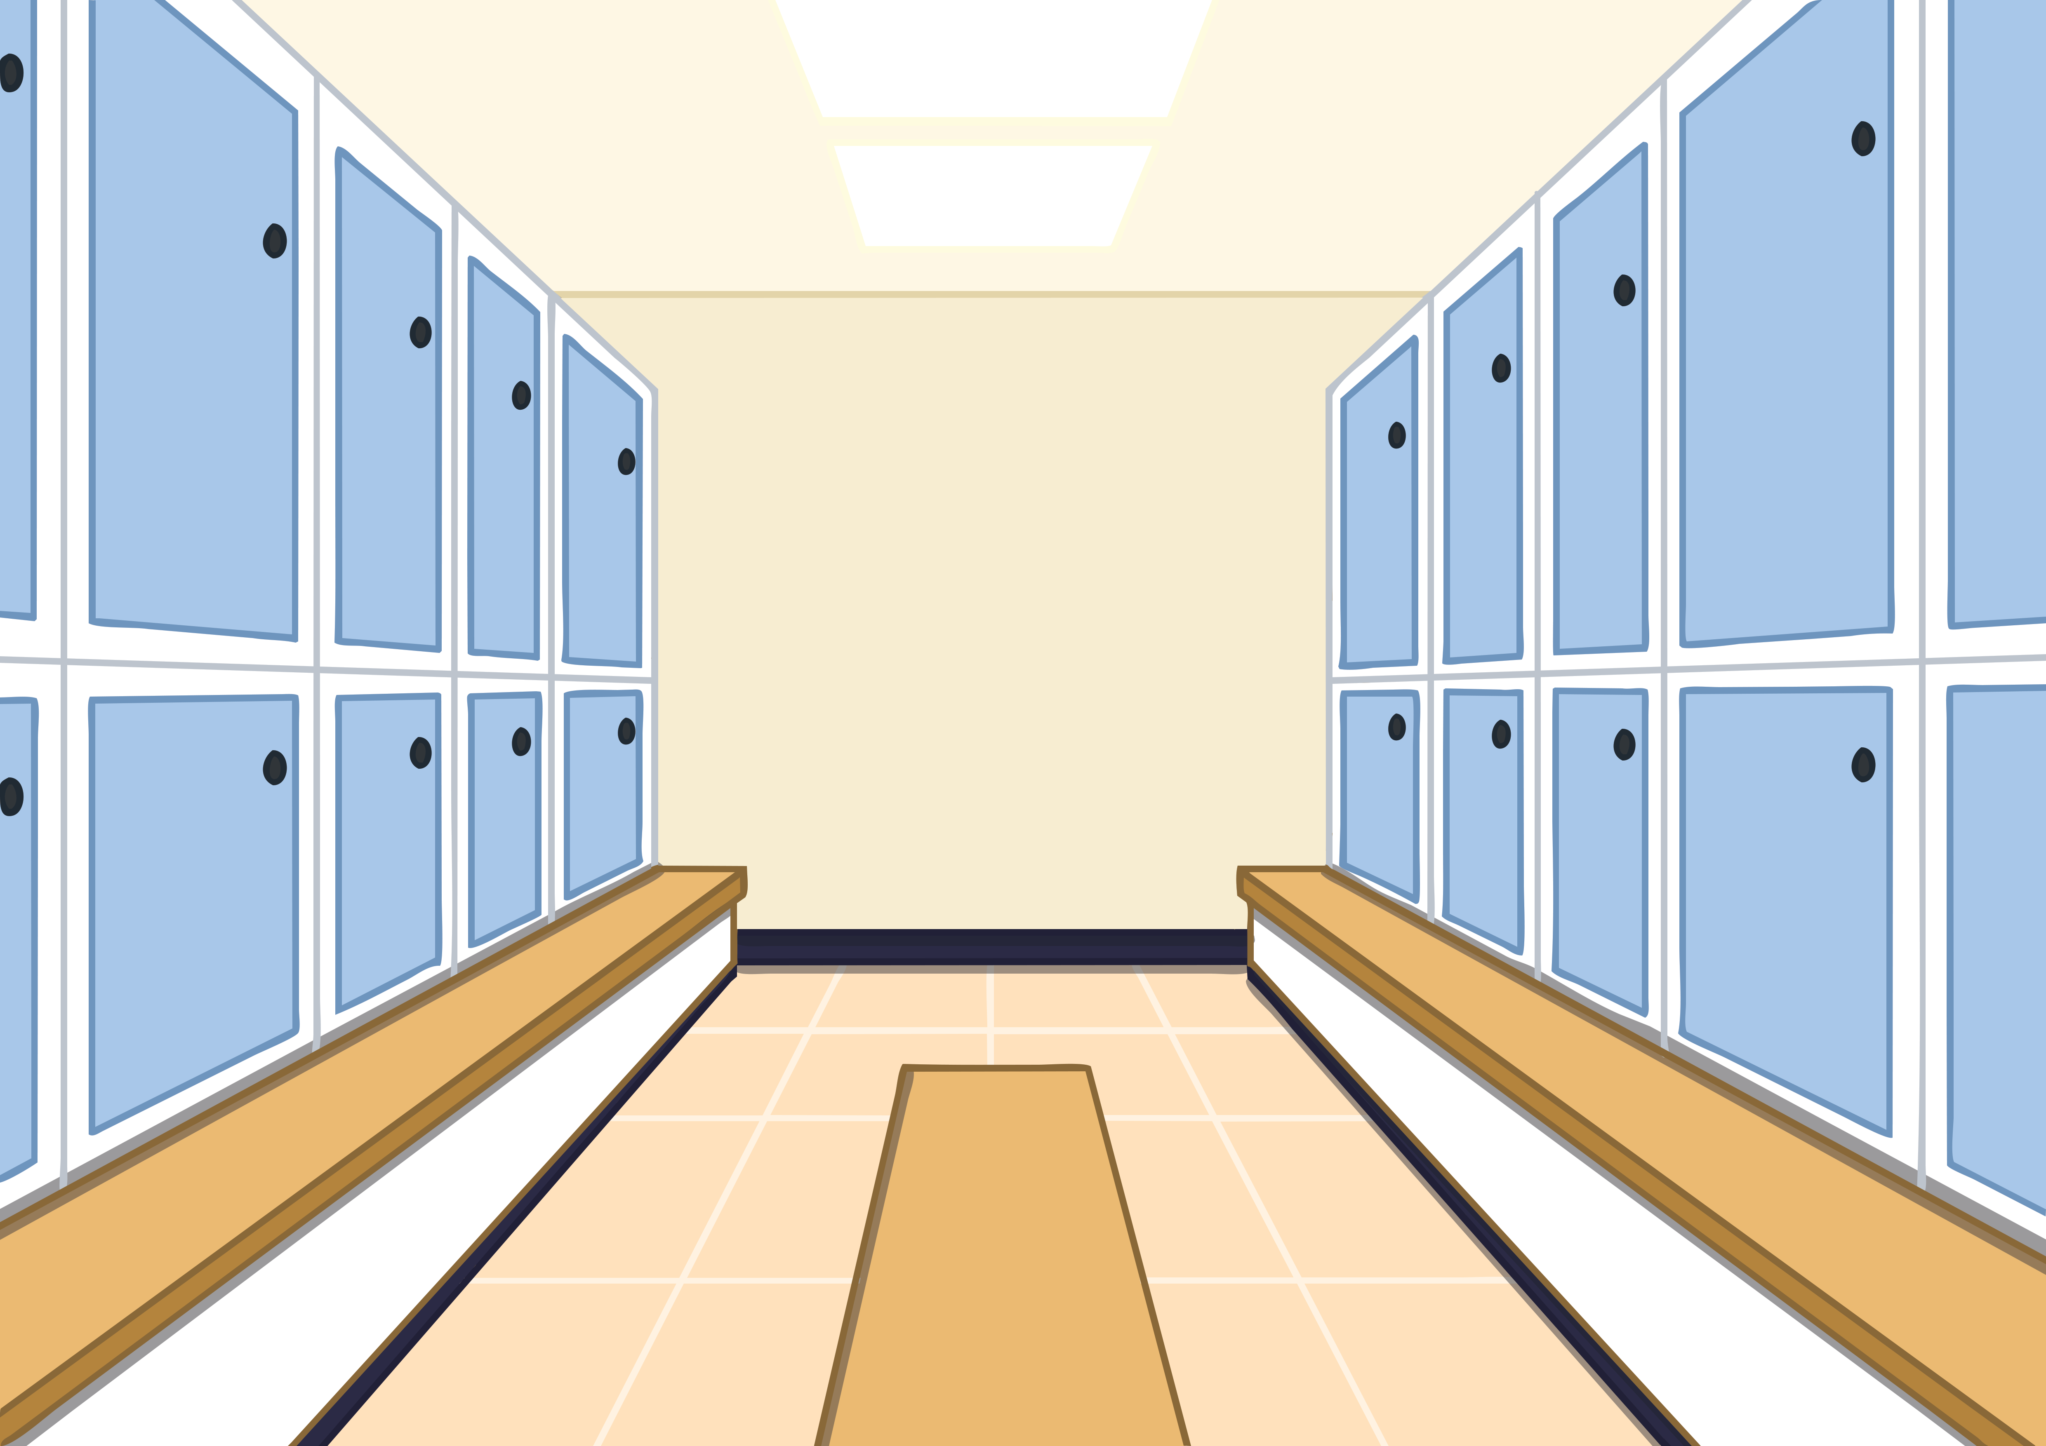
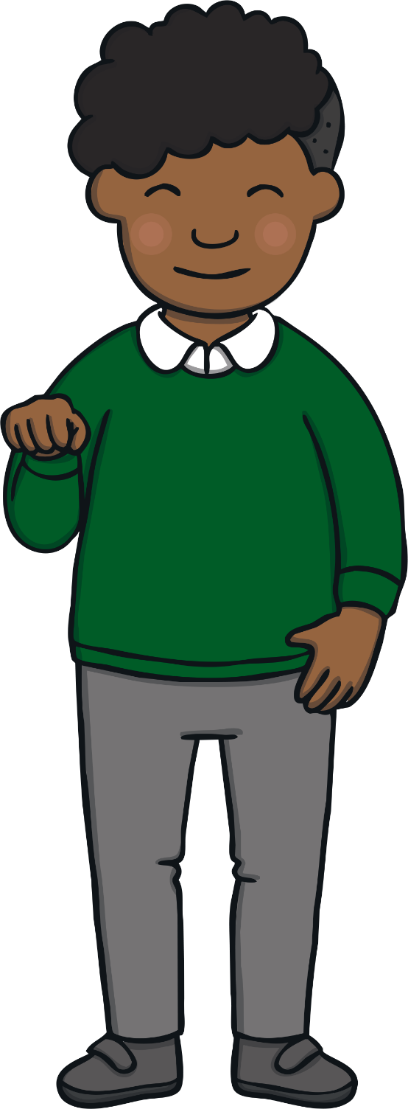
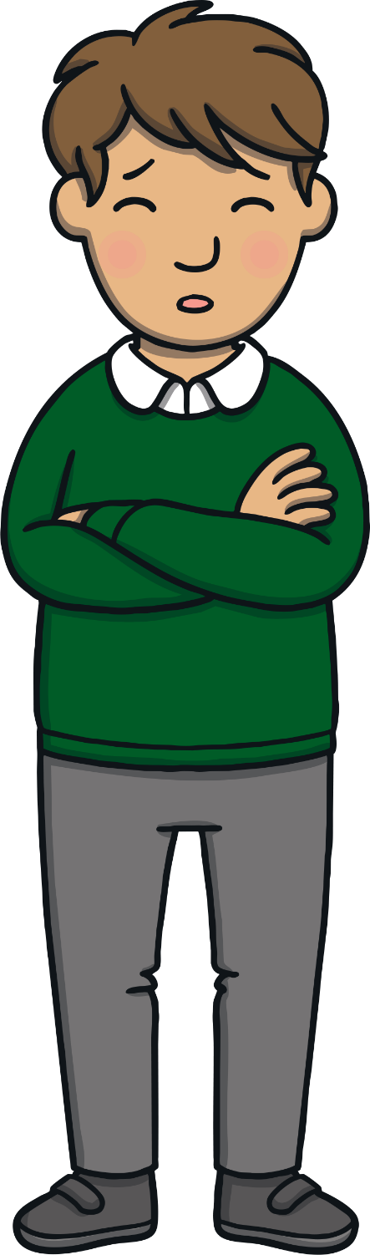
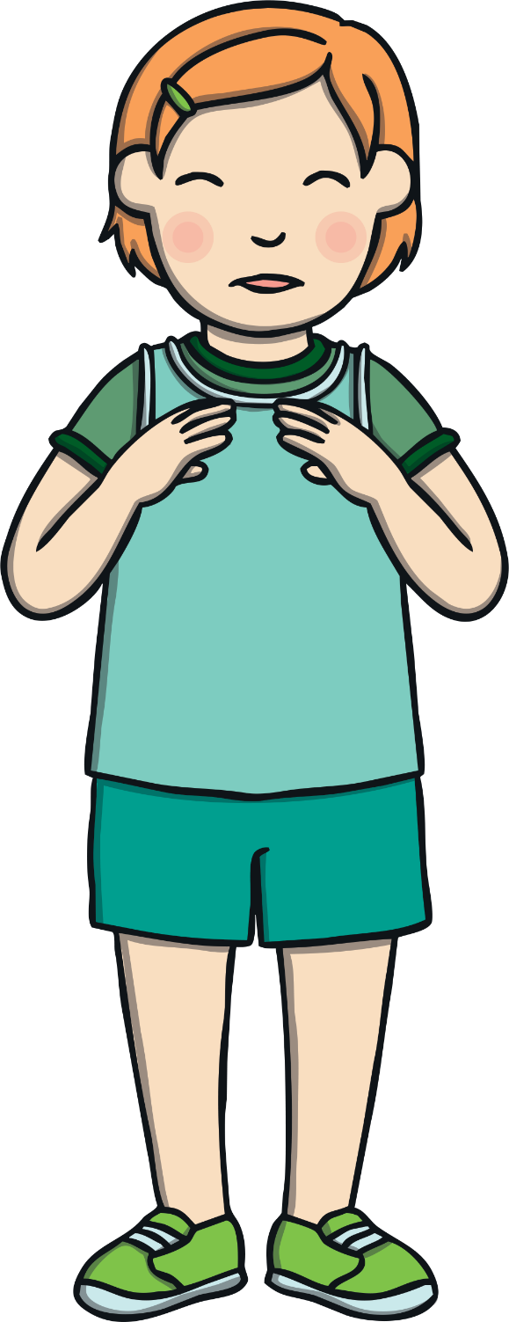

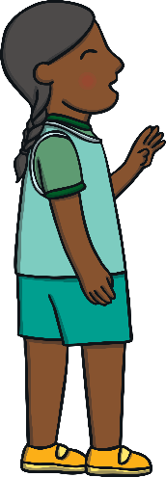

Apply
Kit and Jake filled with dread. “We are going to get in trouble now,” Kit whispered to Jake.
Just then, one of the team came over and started signing to Kit and Jake. Kit looked worried but then, to his amazement, Jake began to sign back.

Slide 21

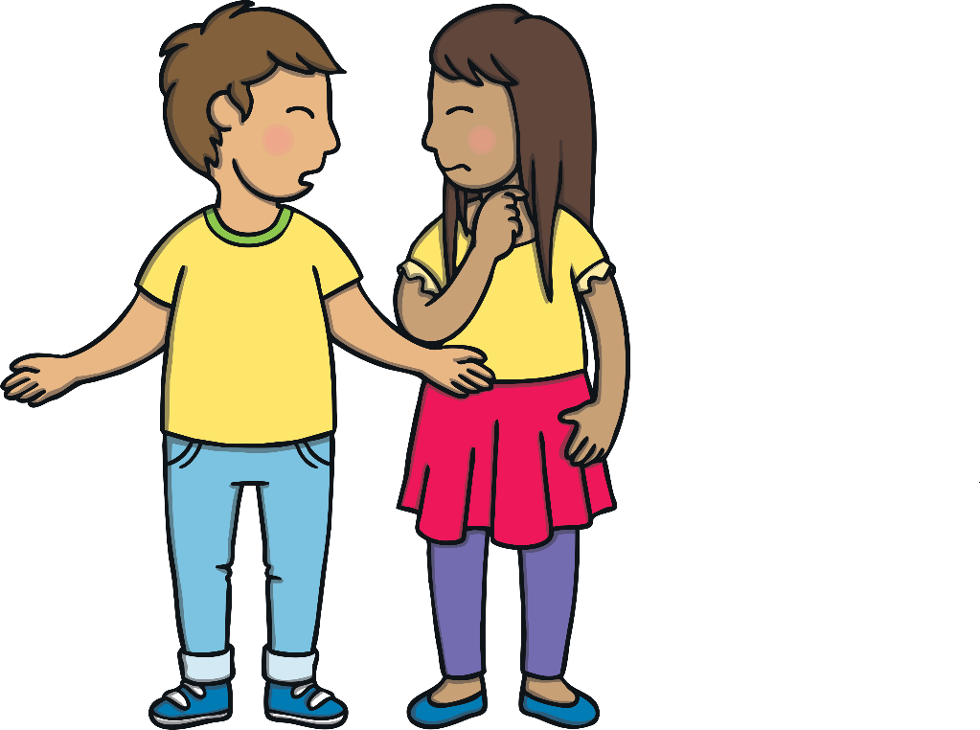
Sentence Time
Apply
What does the basketball player sign to Kit and Jake?

Slide 22
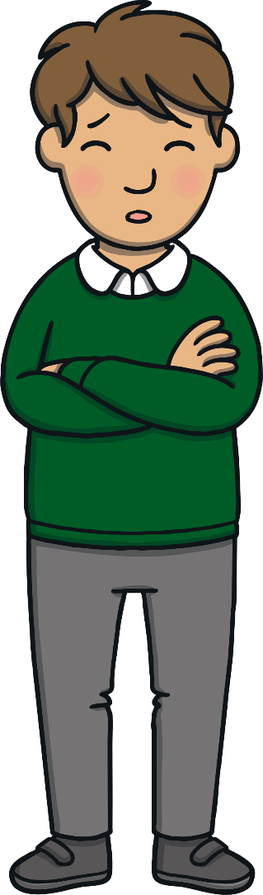

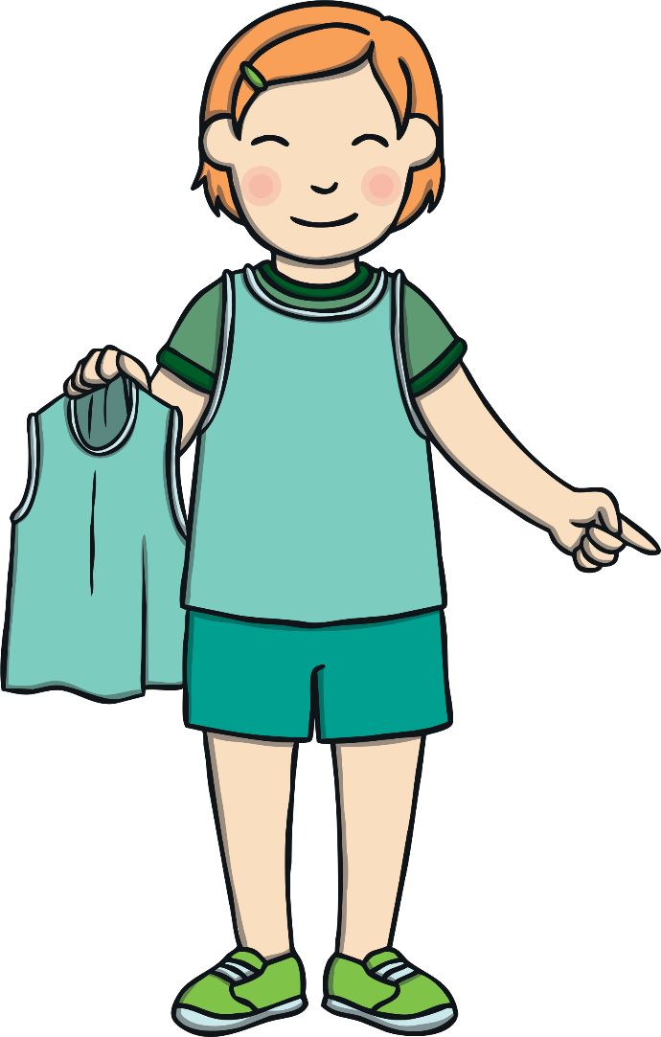
Apply
Quick, get ready! One of our players
is ill so we need you to play instead!
Sound Buttons On/Off
Show

Slide 23
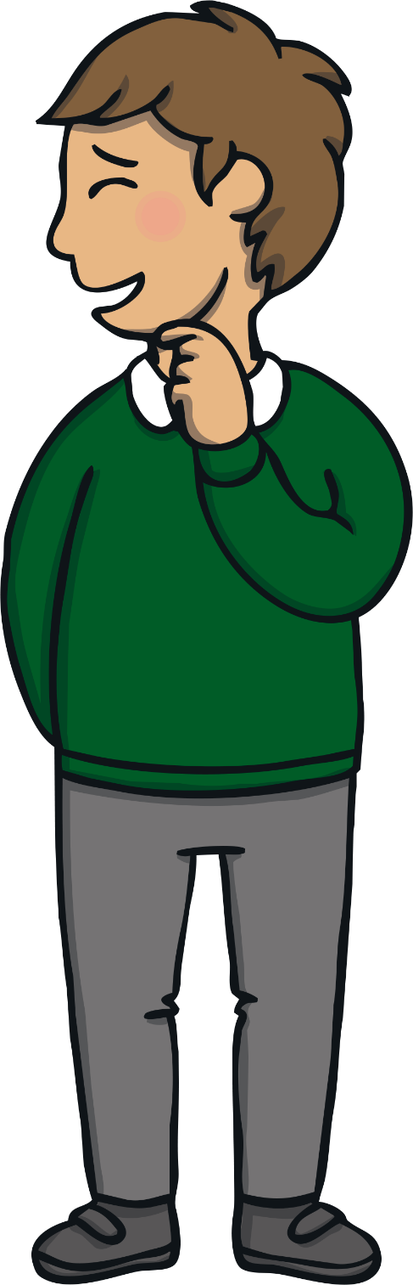

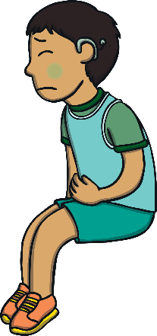
Apply
The basketball player left the kits for Kit and Jake and went over to look after his ill team mate. “You can tell me all about how you know sign language later,” smiled Kit, nervously.

Slide 24
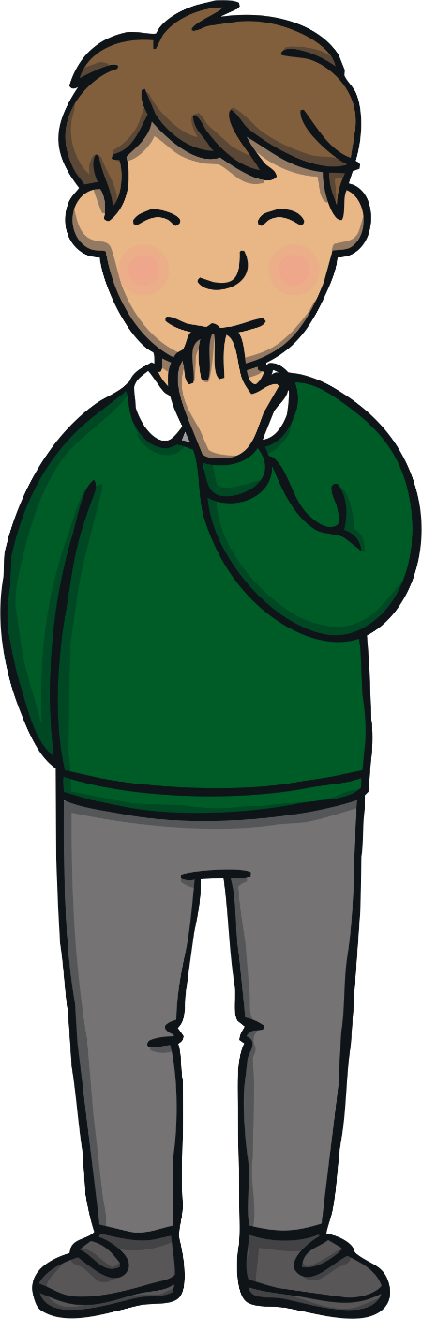
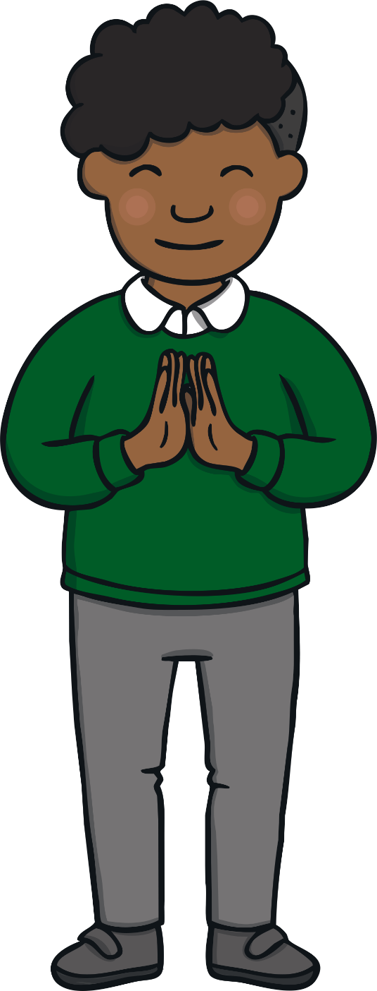
Apply
“But, for now, tell me what on Earth we are going to do.”
Jake giggled. “Let’s get ready and go and play some basketball!” he grinned.

Slide 25

Today, we have learnt…
ea
saying /e/
The adventure continues next lesson!

