Slide 1






Guidance for Video/Audio in PowerPoints
1. Open the folder and copy all the files.
2. Paste the copied files into a new folder.
3. Open the PowerPoint file, enable editing and enter presentation mode (start the slide show).
Please note the embedded audio may not be compatible with early versions of PowerPoint.
You may wish to delete this slide before beginning the presentation.

Slide 3












Revisit and Review
Let’s practise Sam’s Sounds and Common Exception Words!
c
ir
g
ow
oe
ph
ue
wh
aw
ew
ea
house
many
because
Monday
any
once
eyes
friends
different
please
Wednesday
laughed
Tuesday
before
more
Thursday
lived
also
work

Slide 4

Teach
Today, we are learning to write words that contain ea saying /e/.

Slide 5
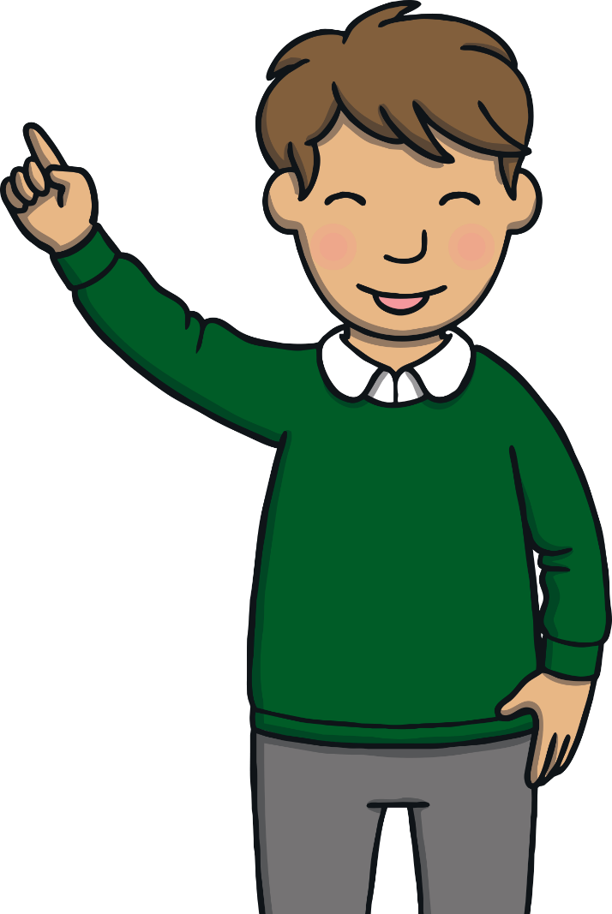
Teach
Let’s practise reading some of this weeks focus words that contain the ea saying /e/ sound.
healthy
weather
instead
breakfast

Slide 6

Teach
This week, we are learning to spell the common exception words because and different.
Watch the magic pencil write the words. Can you join in?

Slide 7


Teach
h
e
a
l
t
h
y
Play

Slide 8
Teach
w
e
a
t
h
e
r
Play

Slide 9
Teach
i
n
s
t
e
a
d
Play

Slide 10
Teach
b
r
e
a
k
a
s
t
f
Play

Slide 11
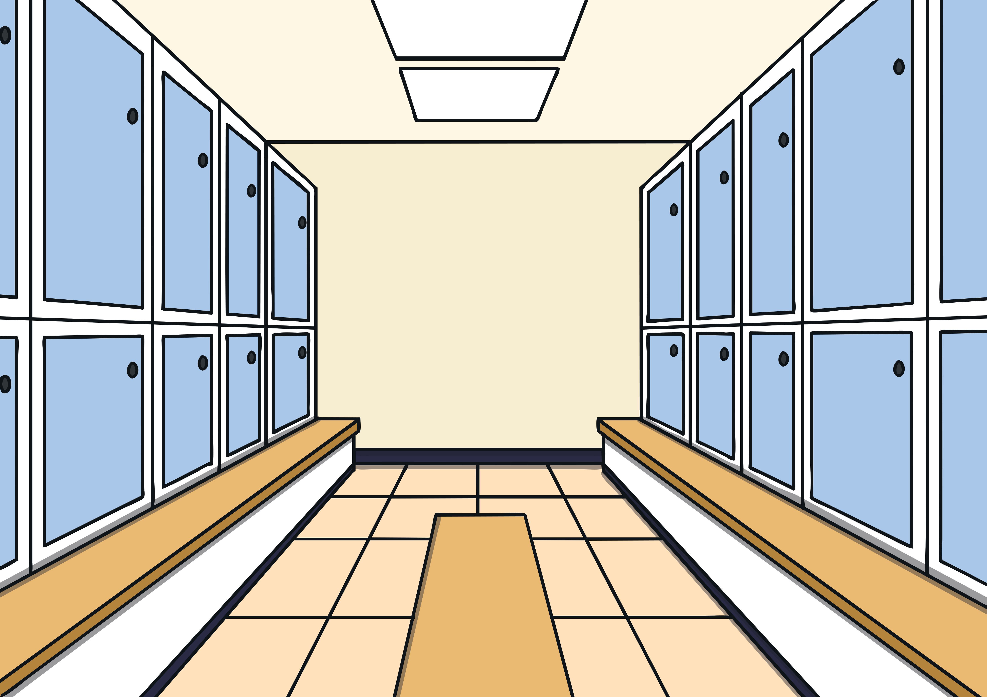



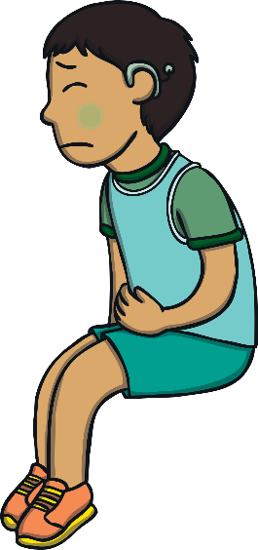
Teach
Kit and Jake had sneaked into the backstage area of the sports arena. They had found themselves being roped in to play a match with the youth deaf basketball team. Kit was so nervous that he had shivers spreading through his body.

Slide 12




Teach
“What are we going to do?” asked Kit, again. “I don’t know British Sign Language.
“I do,” smiled Jake. Kit looked puzzled. “My cousin, Eleanor, is deaf. She can lipread now, but we all learnt a bit more sign language to help her out. It was actually really good fun!”

Slide 13

Teach
Kit smiled. “Okay, you have to promise to tell me what is going on though,” he said, relaxing a little.
“You have my word,” said Jake. “I’ll teach you a few signs now too and then you can use them if you need to. What words would you like to learn?”

Slide 14



Teach
Kit tells Jake some of the words that he would like to learn. Click on Kit and write down the words that he says.
X
This is a great whiteboard activity.
Click me for Kit’s teaching tips!

Slide 15



Teach
head, bread, ready, deaf, healthy, weather, instead, breakfast
Check

Slide 16
Team Talk
Practise
The youth deaf basketball team have their team talk before the match. Jake doesn’t understand some of what they are signing.
Read the sentences. Write an ea word or one of this week’s focus spelling words in the spaces that Jake has left.
X
This is a great whiteboard activity.
Click me for Kit’s teaching tips!

Slide 17

Practise
I hope that you all ate a healthy _________ this morning.
Greg is ill, so Jake and Kit will play _______.
breakfast
instead
Is everyone _____ to play?
___ problems, come and talk to me.
Any
ready
Keep your ____ on the ball at all times.
eyes
If you need a snack, there is some _____ in the kitchen.
bread
Check

Slide 18


Apply
After the team talk, everyone began filing out of the dressing room. “Good luck!” said Kit.
“Good luck,” Jake signed back.

Slide 19


Sentence Time
Apply
There is a notice on the door that leads through to the basketball courts. What does it say?

Slide 20
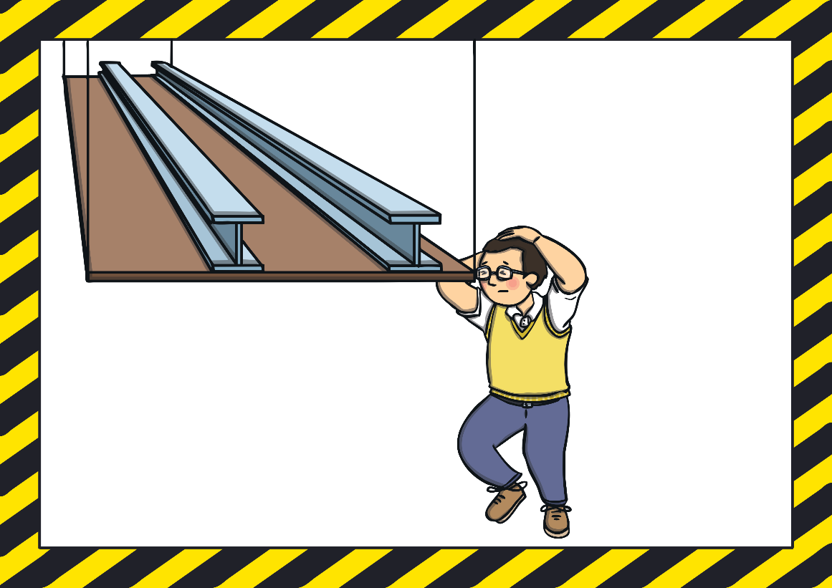
Apply
Health and Safety: Mind your head on the low beams.
Sound Buttons On/Off
Show

Slide 21
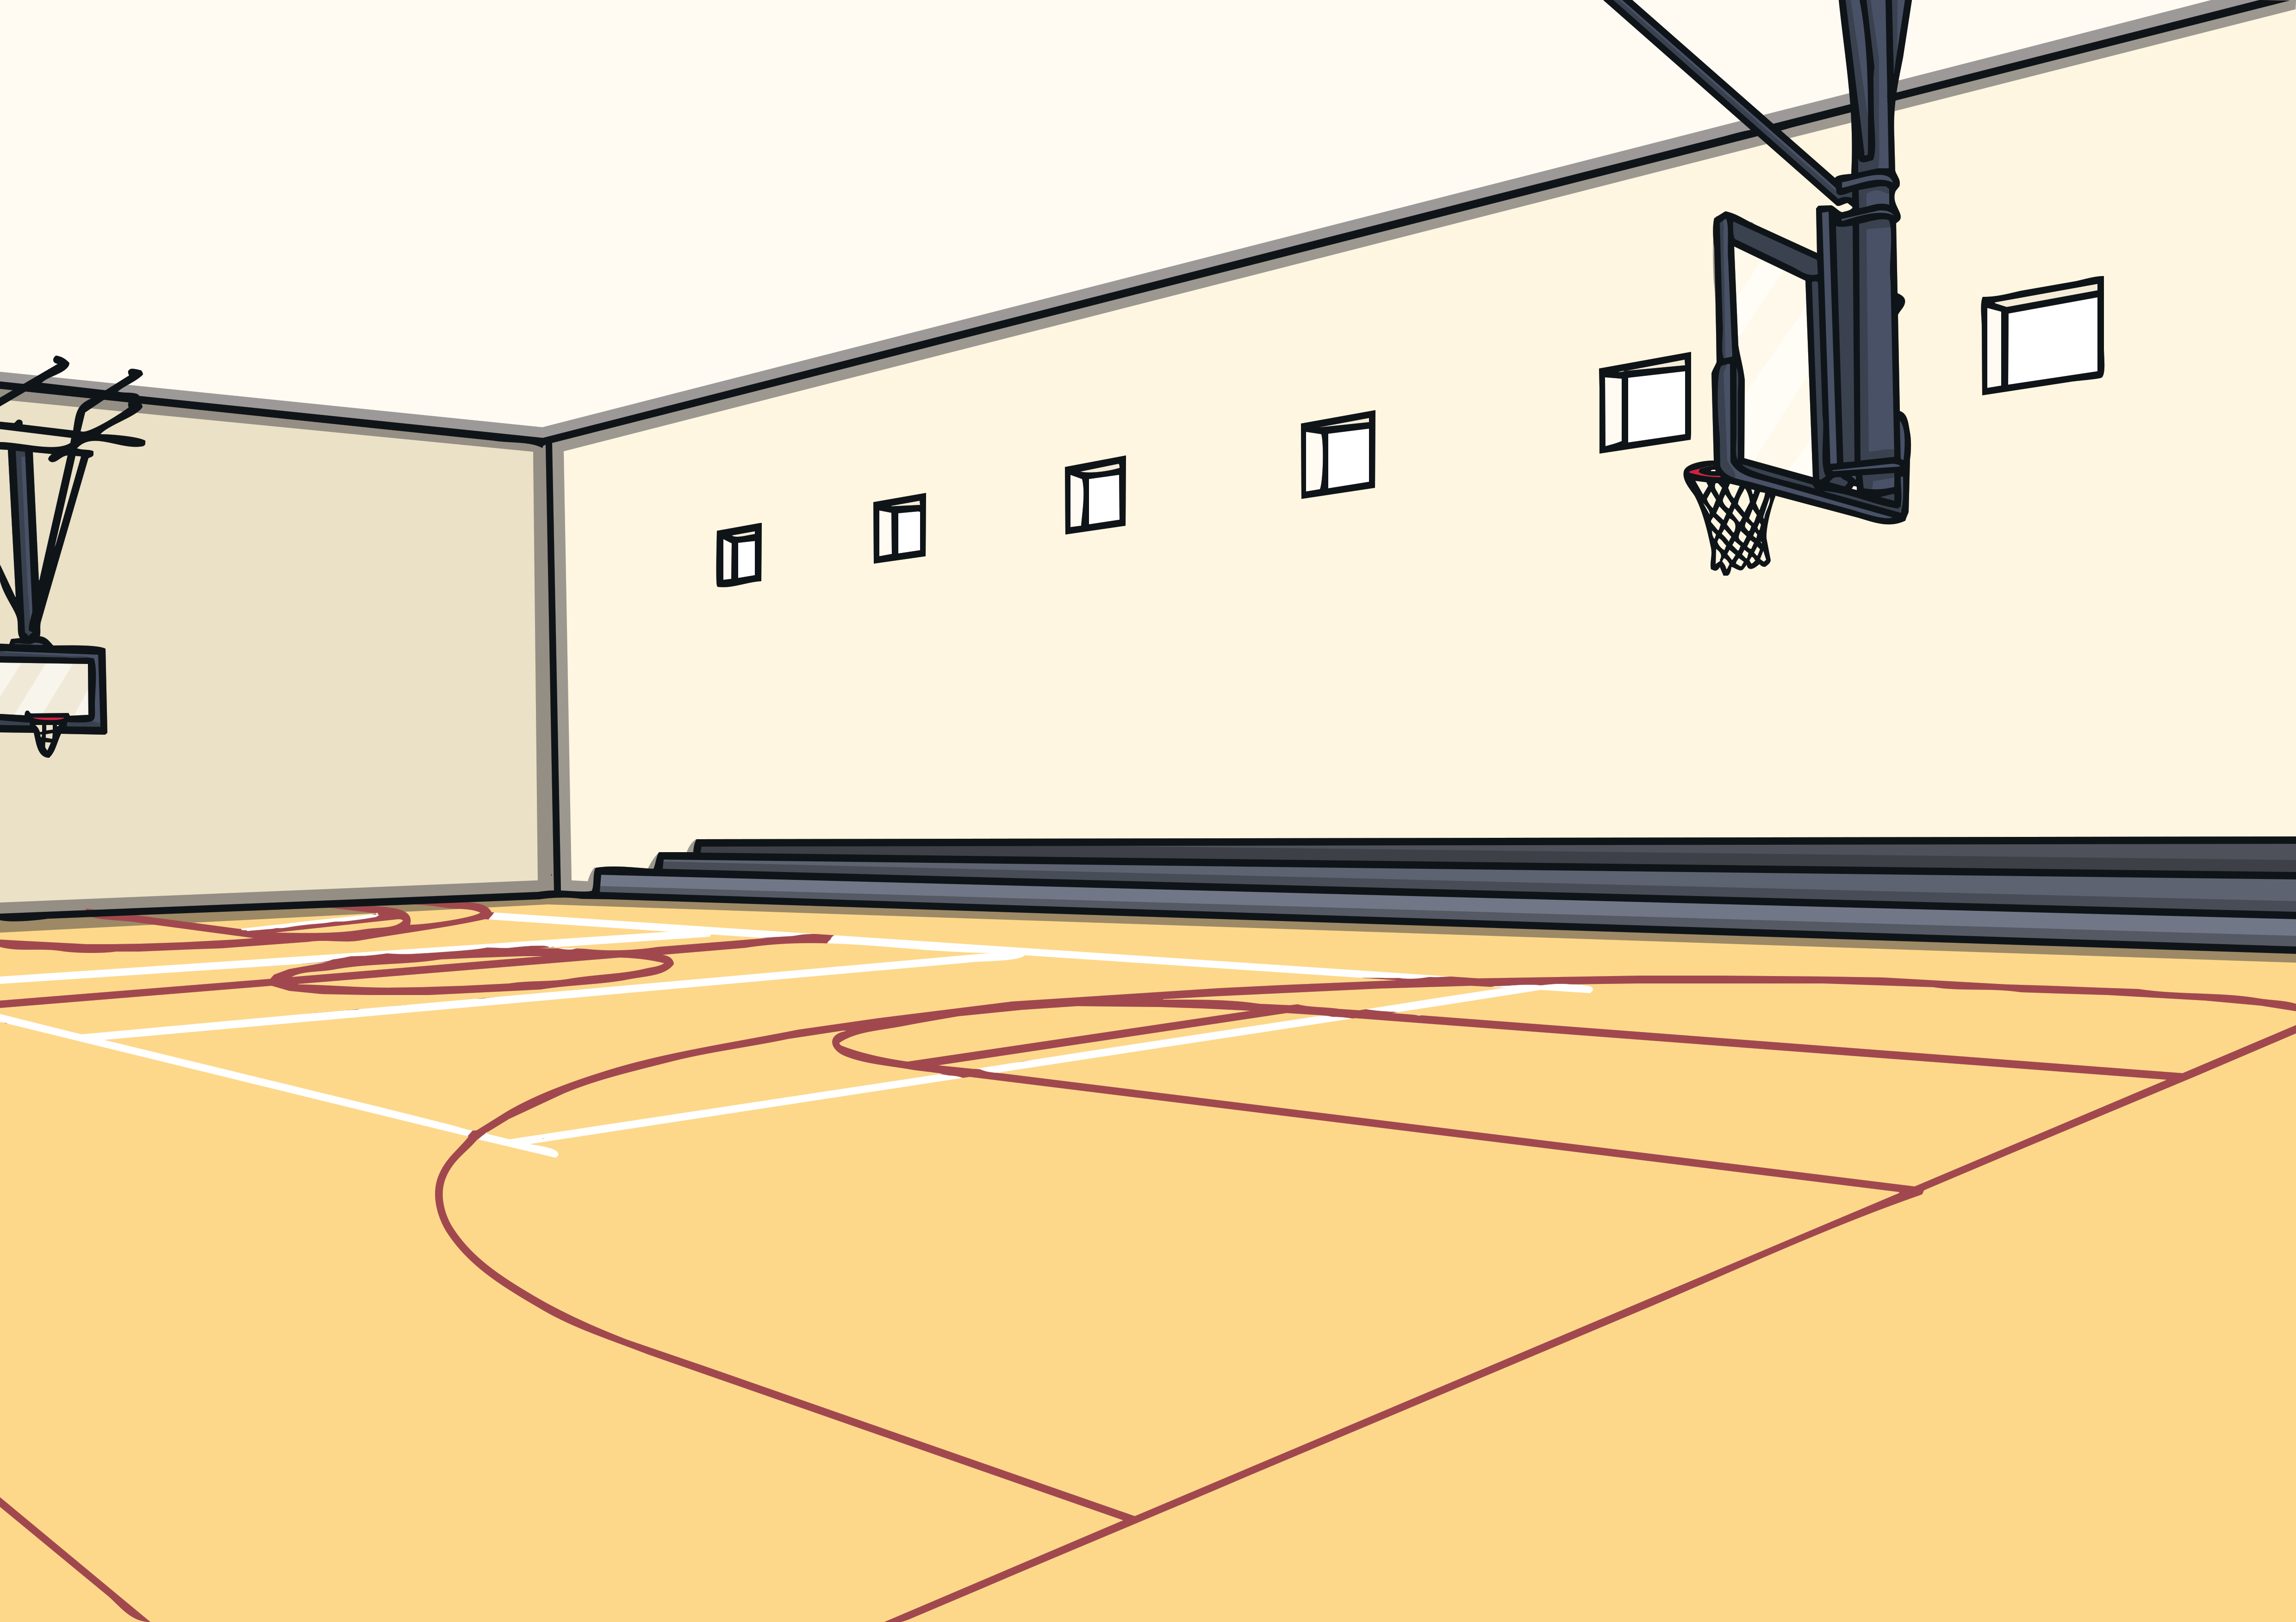
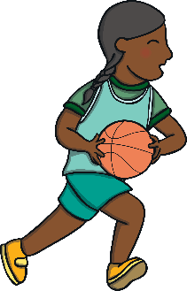
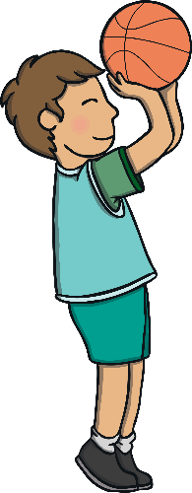
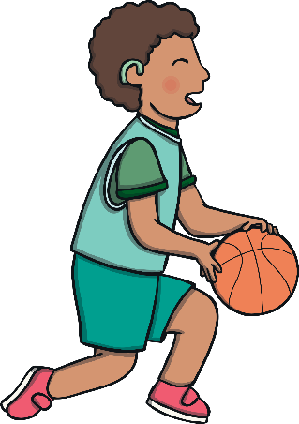
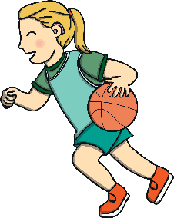
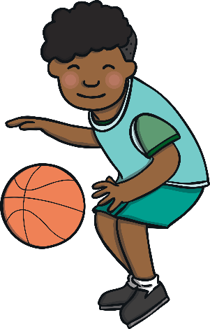
Apply
Kit, Jake and the rest of the basketball team went out onto the basketball court. “It’s healthy to do a warm-up before we start to play,” said Jake. “Let’s do a few stretches.”

Slide 22



Apply
Just then, the referee blew her whistle. The teams went to their starting positions and the game began. Kit and Jake were enjoying themselves enormously when, all of a sudden, they heard a voice over the cheering. It was Heather’s! “Kit? Jake? What on Earth are you doing on the basketball court?!” she boomed.

Slide 23
Today, we have learnt…
ea
saying /e/
The adventure continues next lesson!

