Slide 2
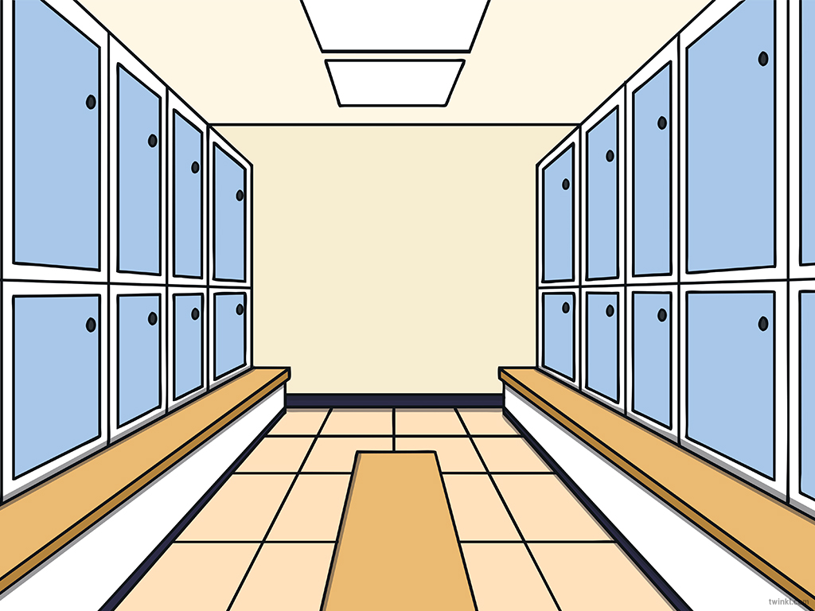

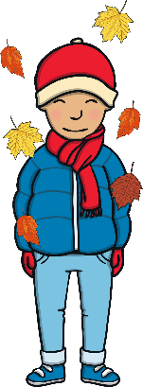

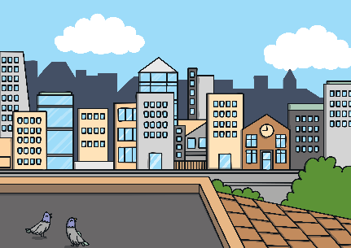










Revisit and Review
Let’s practise Sam’s Sounds and Common Exception Words!
y
au
c
ir
g
ow
oe
ph
ue
wh
aw
ew
ea
house
many
because
Monday
any
once
eyes
friends
different
please
Wednesday
laughed
Tuesday
before
lived
more
Thursday
lived
also
work

Slide 3

Teach
Today, we are learning to read and write words that contain ea saying /e/.

Slide 4
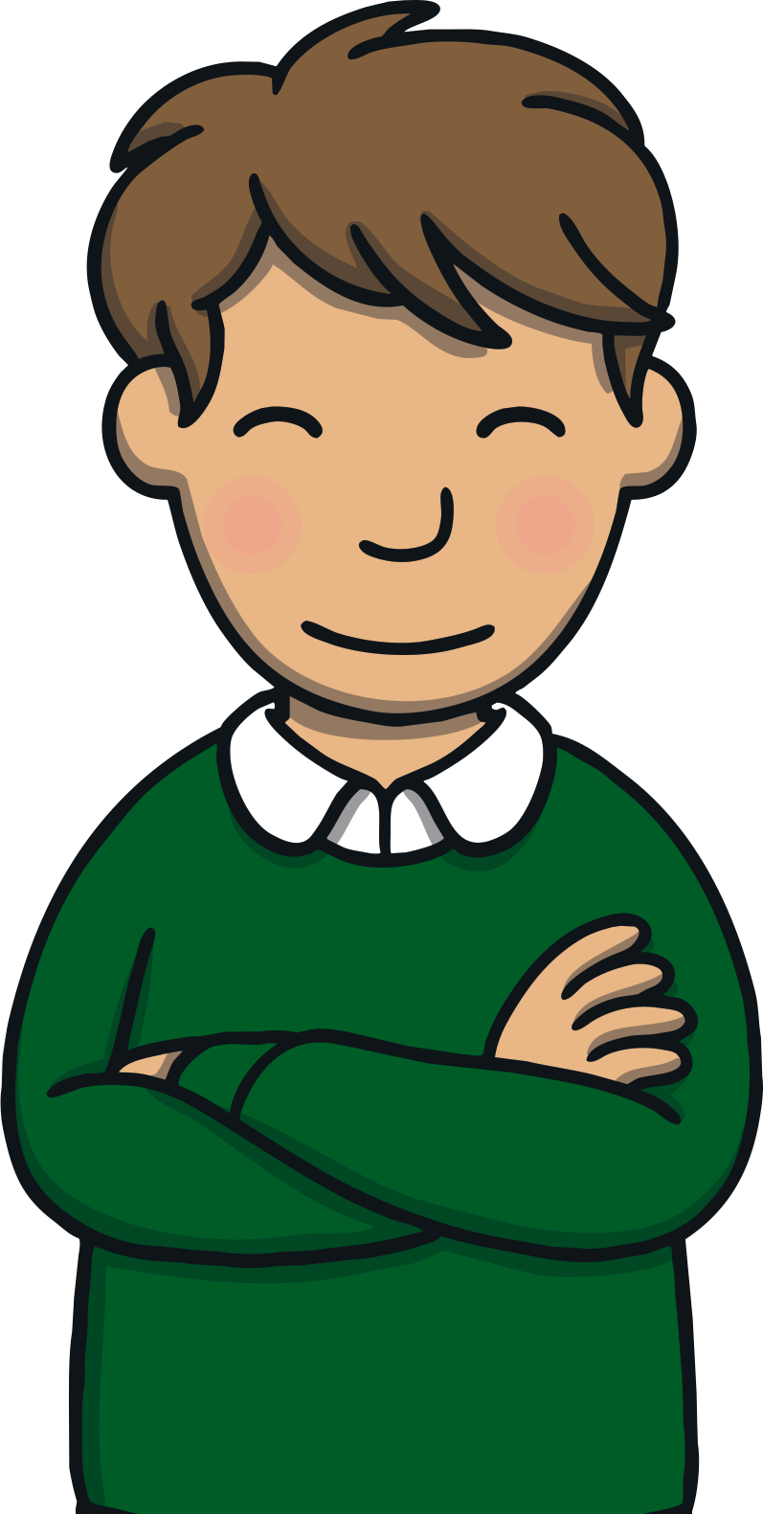
Teach
Let’s practise reading all of this weeks focus words.
head
weather
bread
instead
ready
breakfast
deaf
more
healthy
before

Slide 5

Teach
Now, let’s write them with the magic pencil…

Slide 6


Teach
h
e
a
d
Play

Slide 7
Teach
b
r
e
a
d
Play

Slide 8
Teach
r
e
a
d
y
Play

Slide 9
Teach
d
e
a
f
Play

Slide 10
Teach
h
e
a
l
t
h
y
Play

Slide 11
Teach
w
e
a
t
h
e
r
Play

Slide 12
Teach
i
n
s
t
e
a
d
Play

Slide 13
Teach
b
r
e
a
k
a
s
t
f
Play

Slide 14
Teach
e
y
e
s
Play

Slide 15
Teach
a
n
y
Play

Slide 16
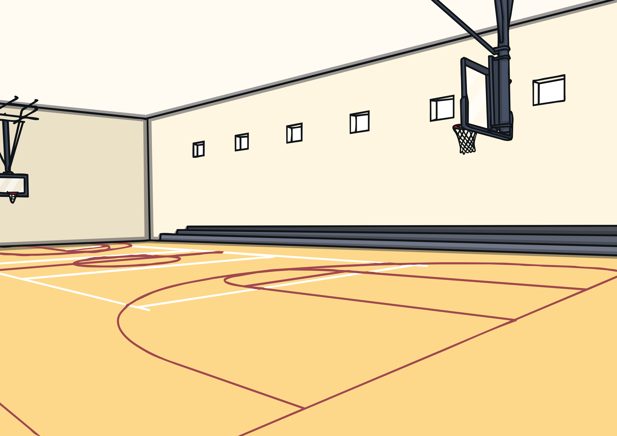


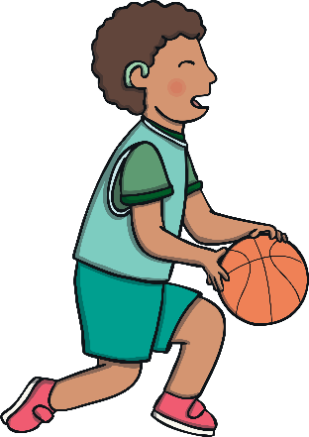
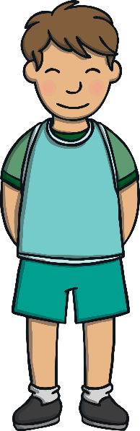
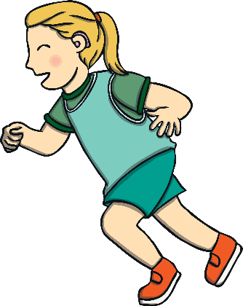
Teach
Heather had noticed Kit and Jake on the basketball court. They had been having lots of fun and playing really well but now they were worried that they would be in trouble. They were about to leave the basketball court, when all of a sudden, the ball got
passed to Jake!

Slide 17
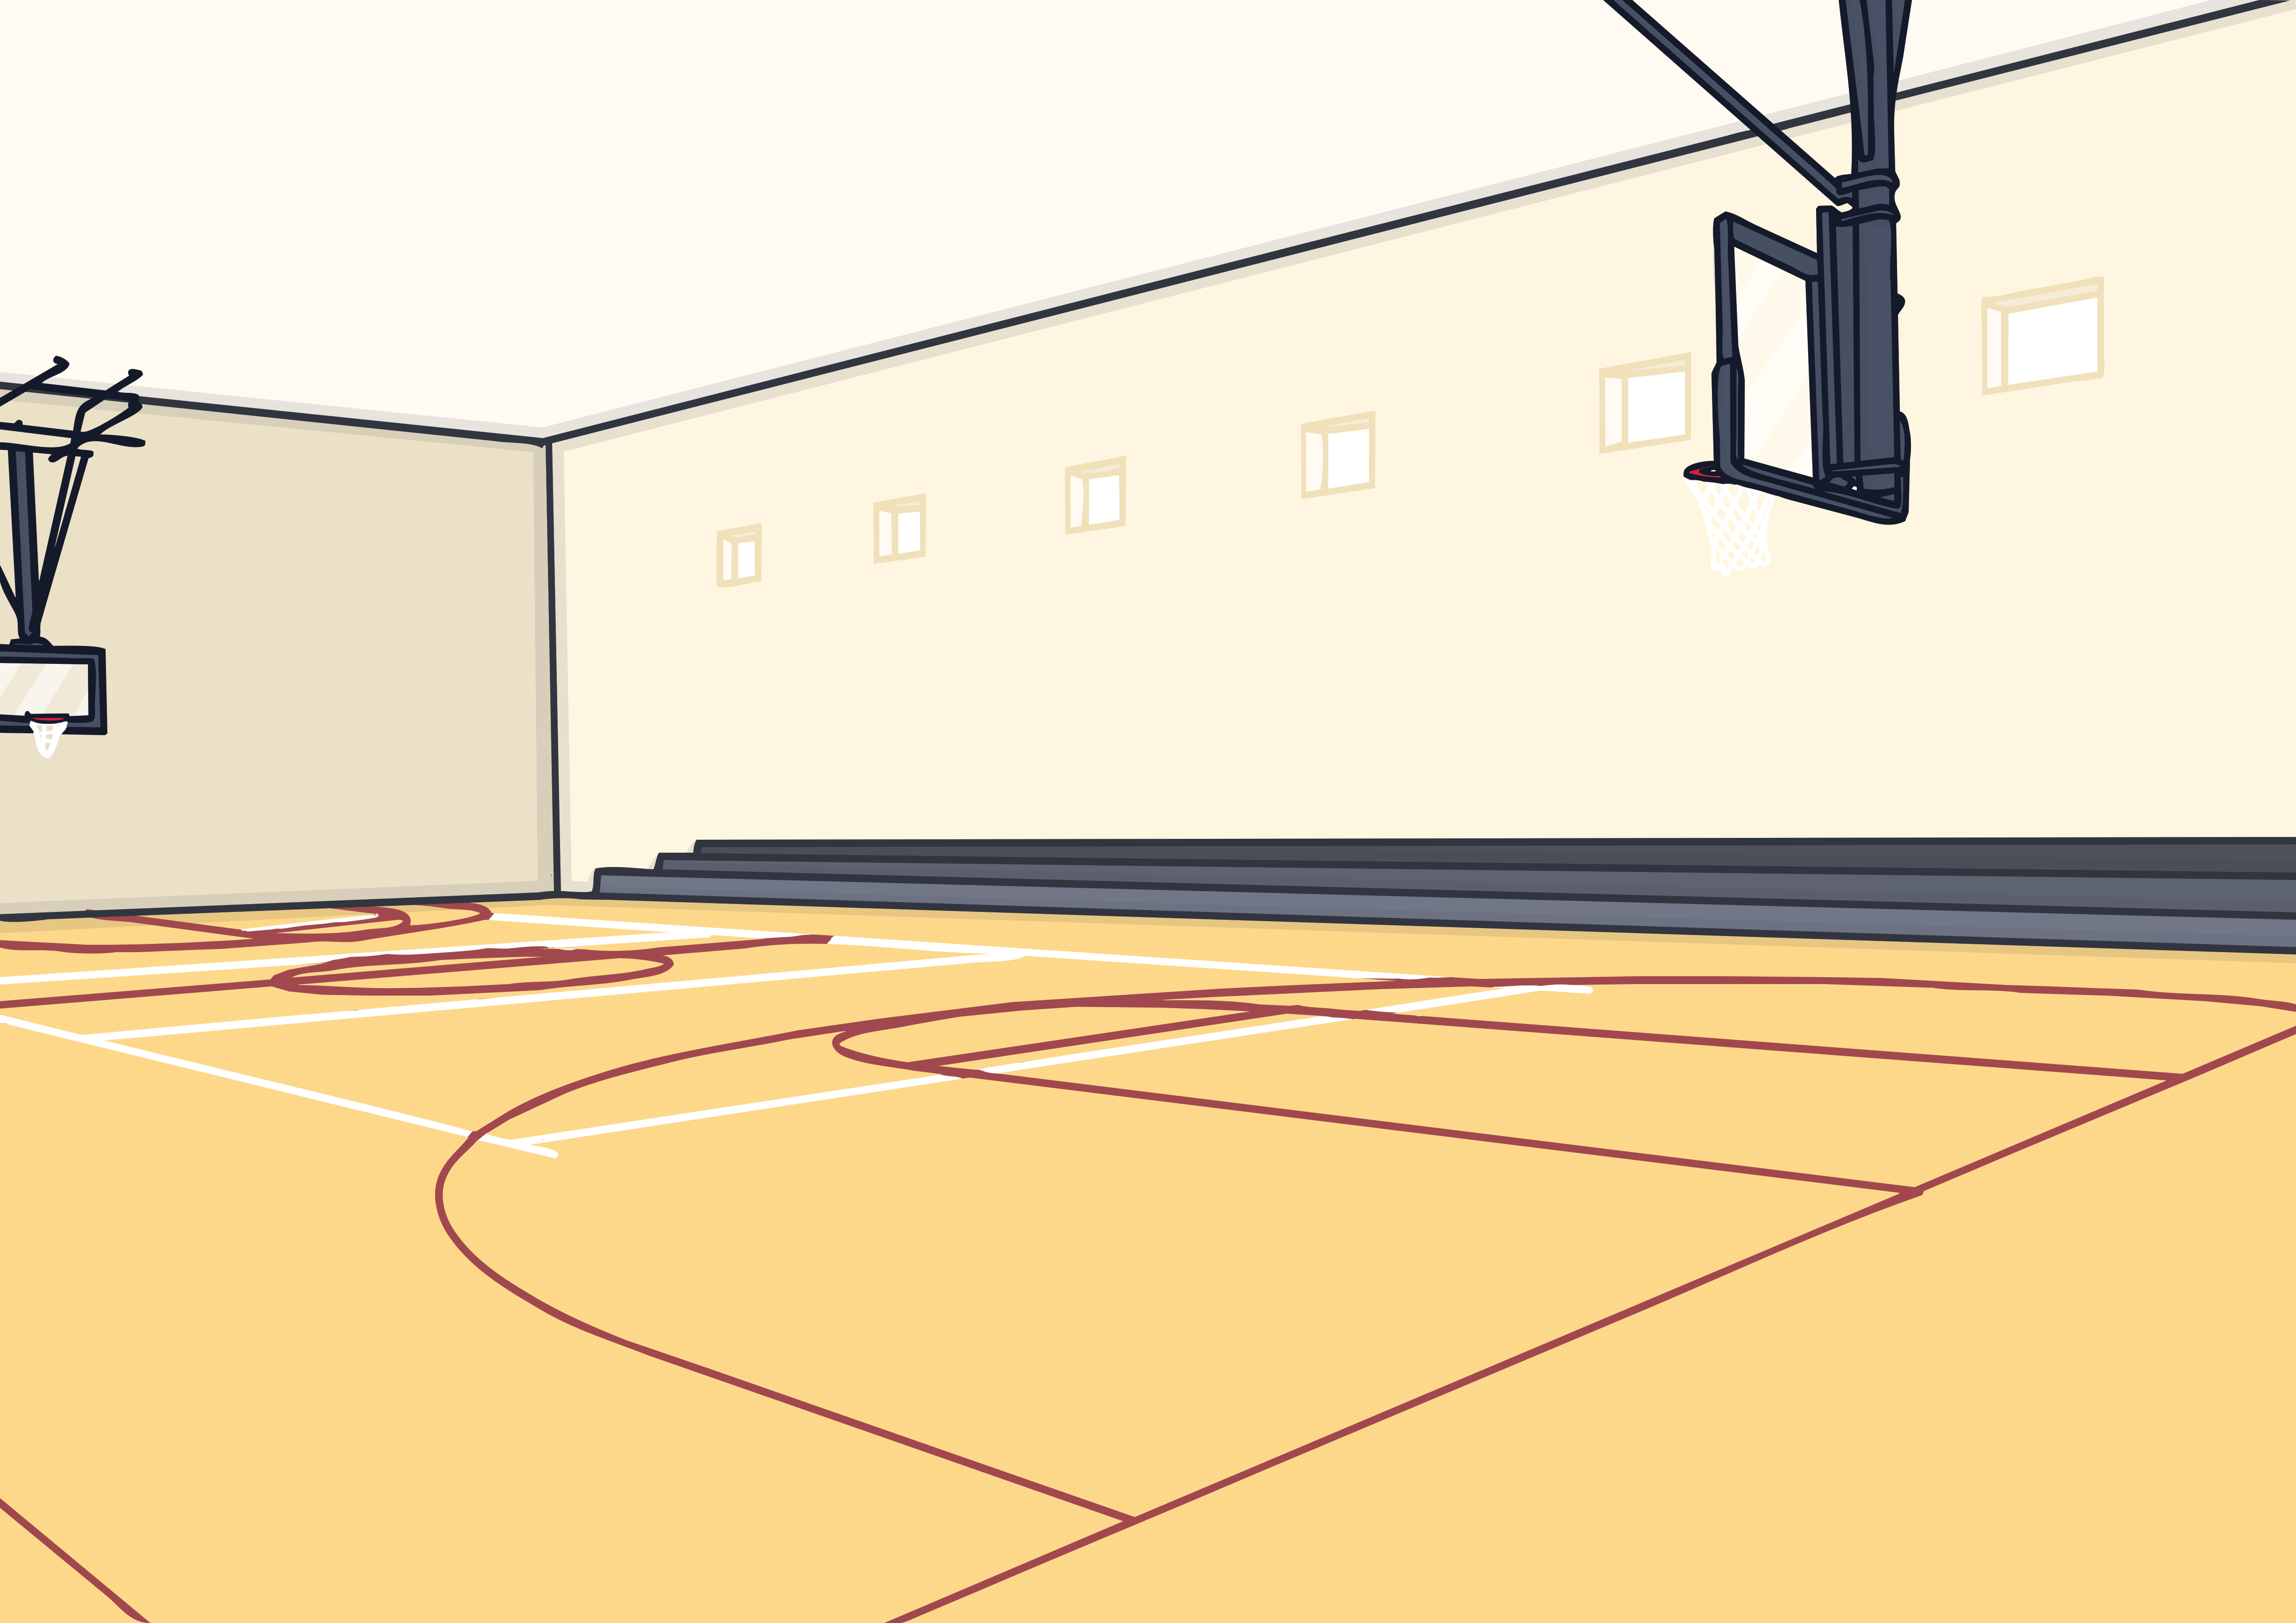
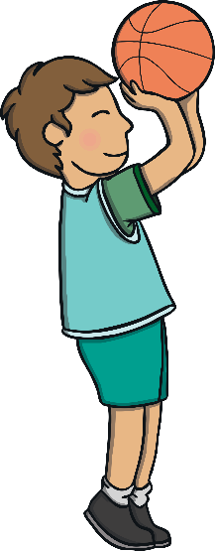

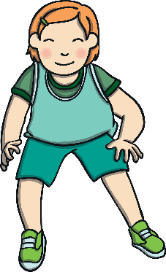
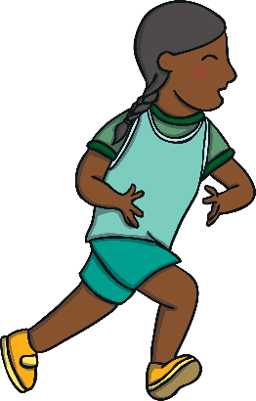

Teach
Without thinking, Jake dribbled the ball to the net, took a shot and scored! He had won just enough points to win the game for his team. The crowd erupted and Jake beamed from ear to ear. He glanced over at Hea th er, who smiled widely at him and beckoned him over.

Slide 18


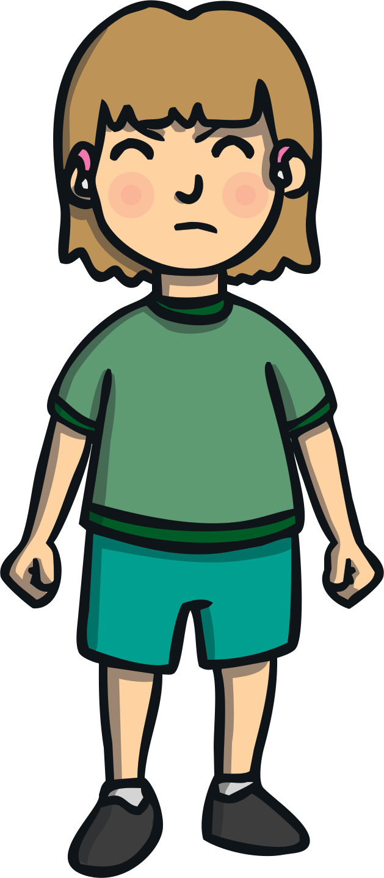
Teach
Jake and Kit went to talk to Heather. “I’m very disappointed that you wandered off before. Anything could have happened to you!” she said, crossly. “However, you boys did play an incredible game of basketball,” she said with a wink.

Slide 19
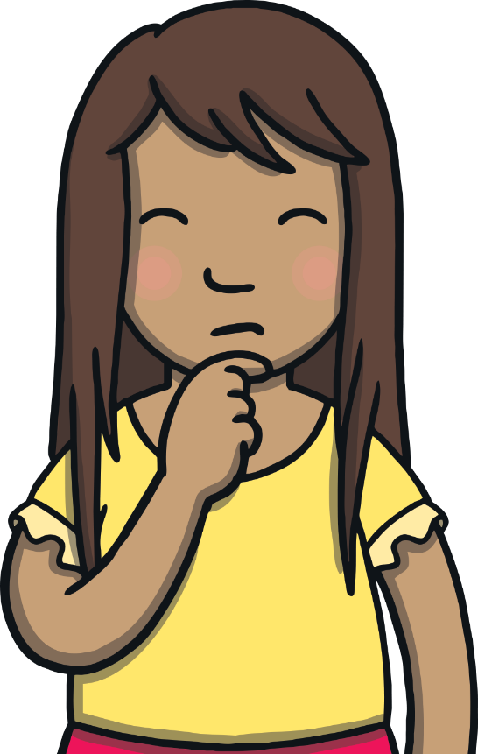

The Punishment
Practise
Kit and Jake are in big trouble for wandering off during their school trip. They are asked to write a letter to the headteacher to apologise. Can you spot and correct their mistakes?
X
This is a great
whiteboard activity!
Click me for Kit’s teaching tips!

Slide 20


Practise
Dear Headteacher,
We are very sorry for not staying with our class on our school trip. We should have asked Heather if we could go instead of just leaving. (We did have a good time with the youth deaf basketball team!)
We don’t have any excuse. We are ready to accept our punishment.
From Kit and Jake
Dear Hedteacher,
We are very sorry for not staying with our class on our school trip. We should have asked Hether if we could go insted of just leaving. (We did have a good time with the youth def basketball team!)
We don’t have eny excuse. We are redy to accept our punishment.
From Kit and Jake
Check

Slide 21
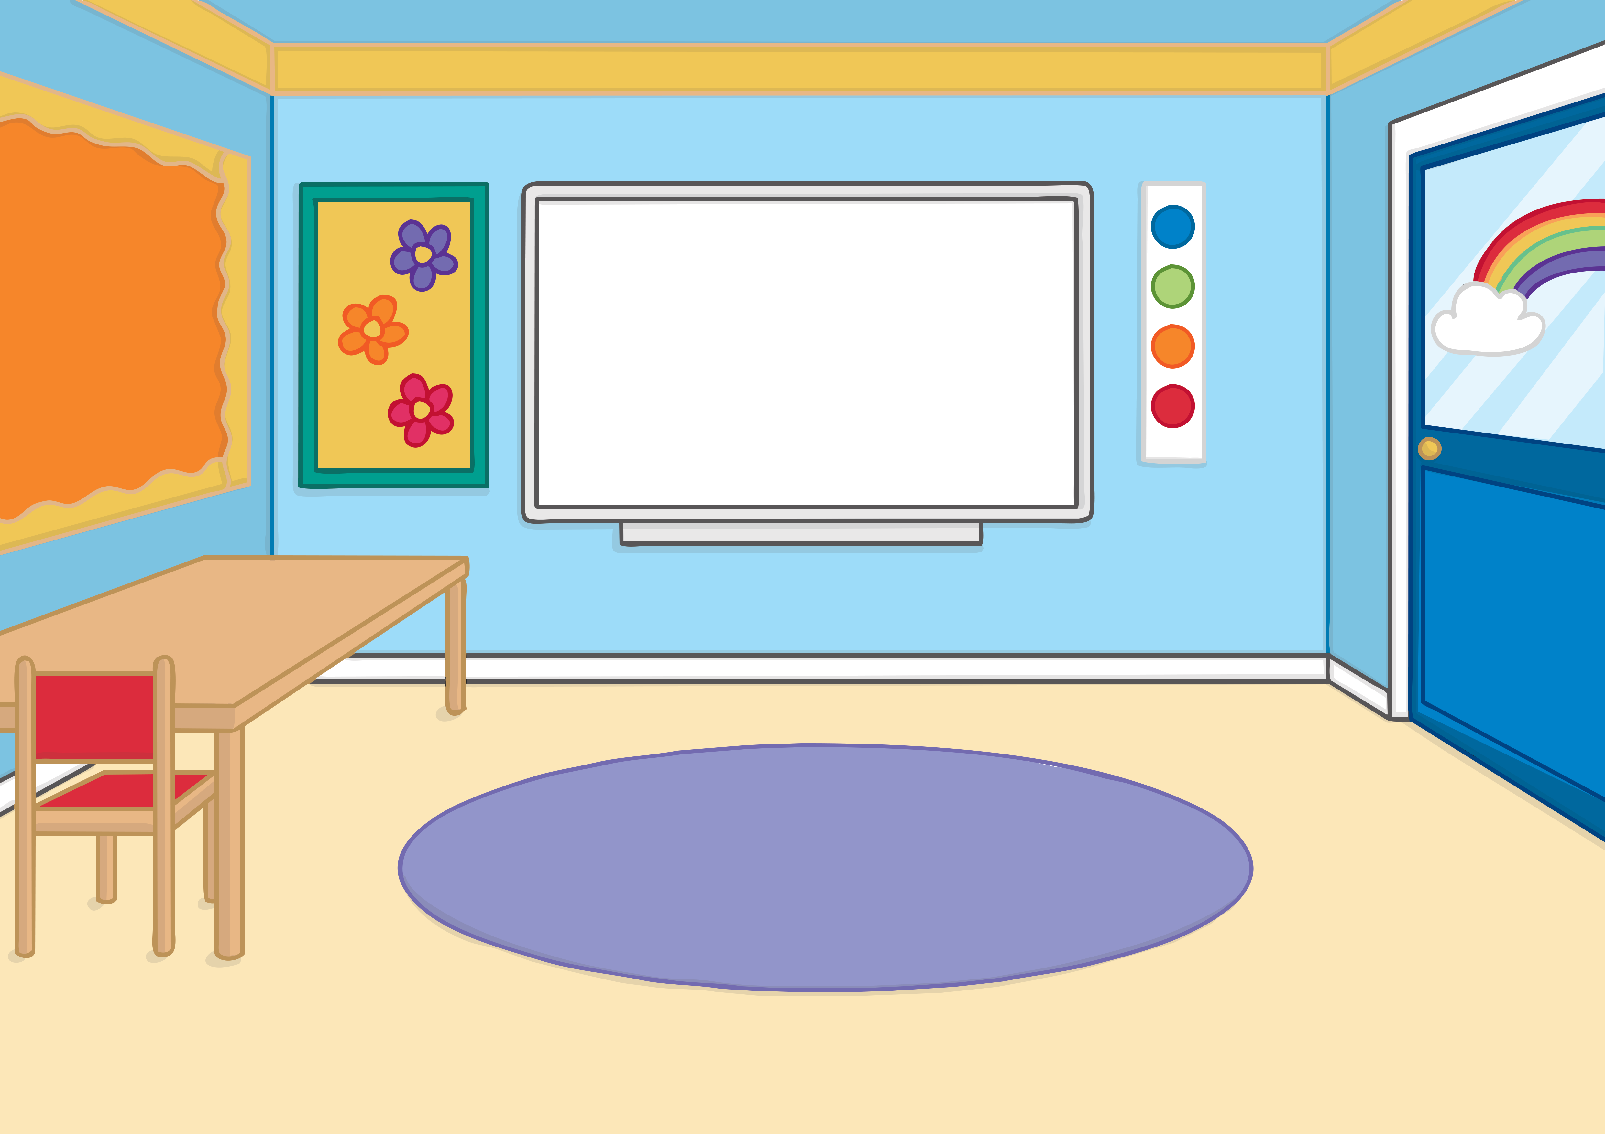
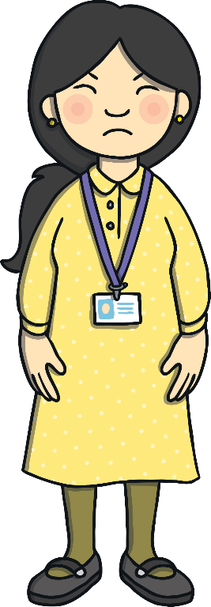


Apply
As part of their punishment, Kit and Jake were told that they should spend their lunchtimes for the next few days preparing to give an assembly all about their experience. They didn’t mind and had quite a lot of fun writing their presentation.

Slide 22
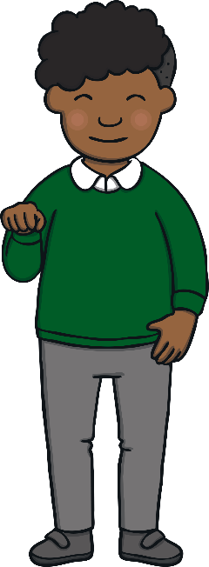


Apply
“Hmm,” said Kit. “What about doing part of our presentation in sign language? We could teach everyone in the school a little bit. That way, if they ever meet anyone who is hearing impaired or deaf, they’ll be ready to speak with them!”

Slide 23
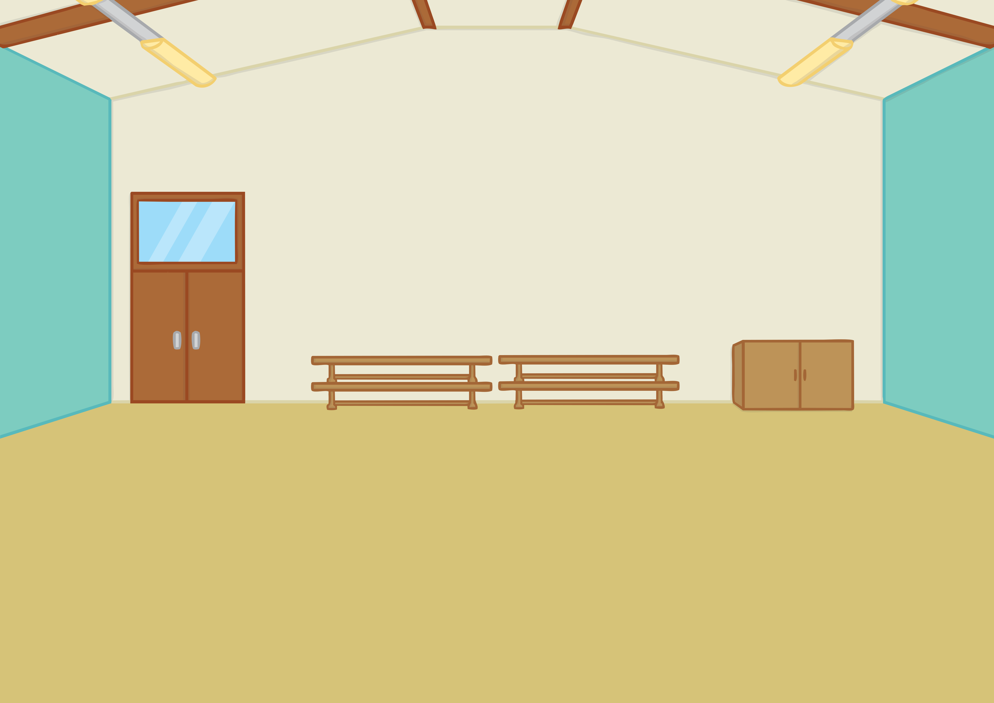
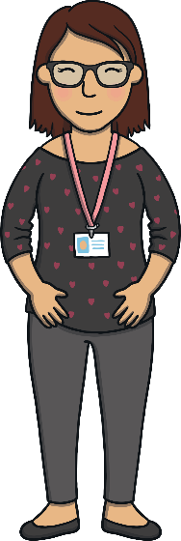


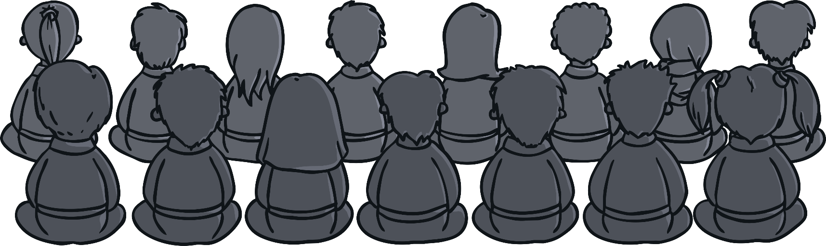
Apply
Everyone loved Kit and Jake’s assembly. They told the entire
school what they had learnt about the youth deaf basketball team and about sign language. Afterwards, Heather came to talk to them. “What you did was wrong but thank you for giving such a wonderful assembly! It was so interesting!”

Slide 24
Basketball Misadventures
Apply
A ‘Let’s Write Together!’ Book

Slide 25
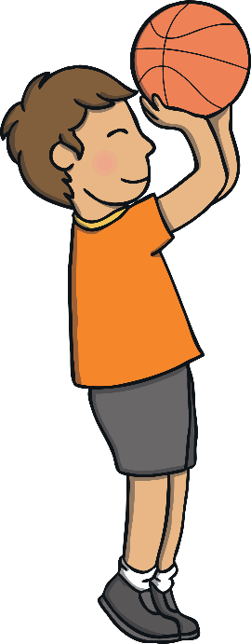
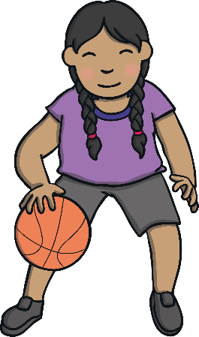
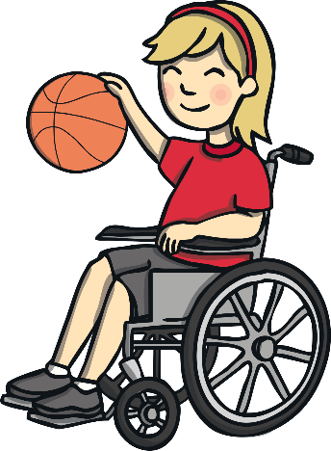
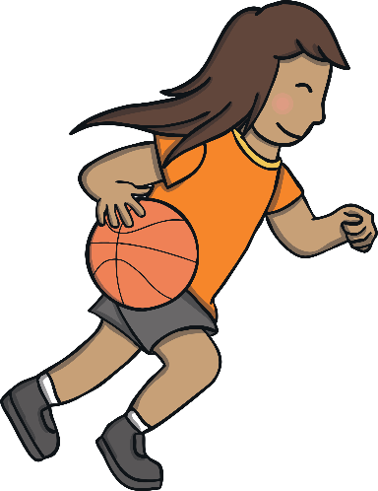
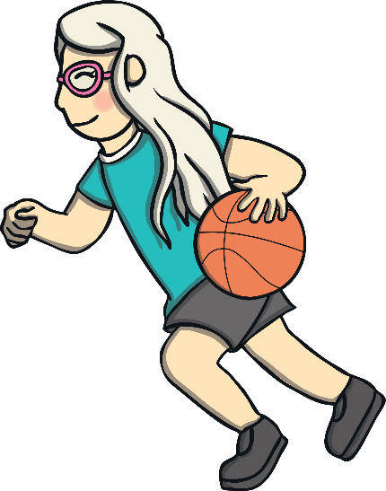
Apply
Show
Our class likes any sport because we like to be healthy. One day, Heather came in to school to teach our class how to play basketball. She plays for the British Deaf Basketball Team.

Slide 26
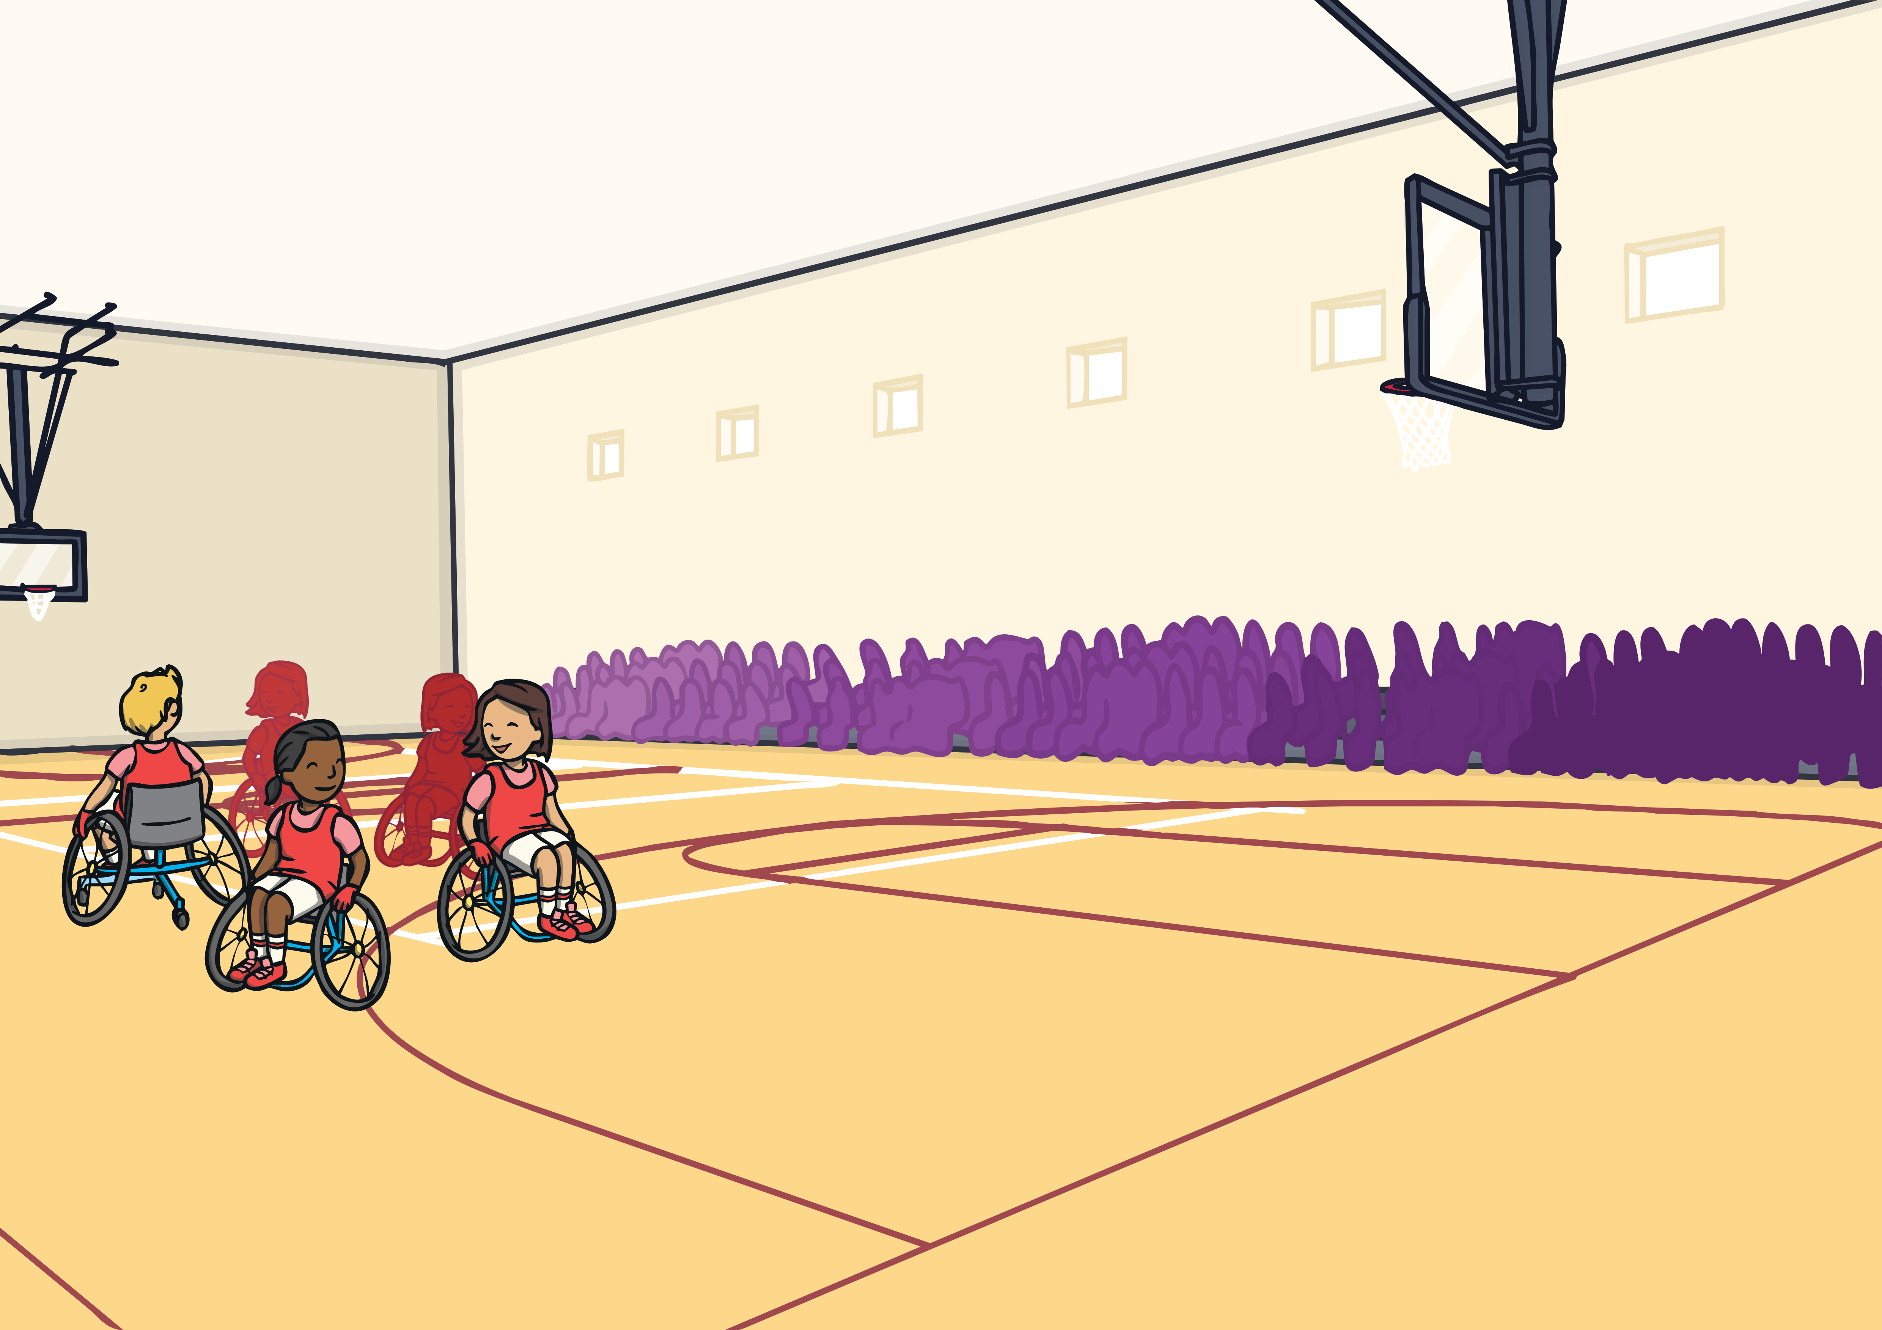
Apply
Show
She was so happy with our class that, instead of our usual PE lesson, she took us to see some basketball games.
We saw her deaf basketball team getting ready to play. There were many other teams too!

Slide 27
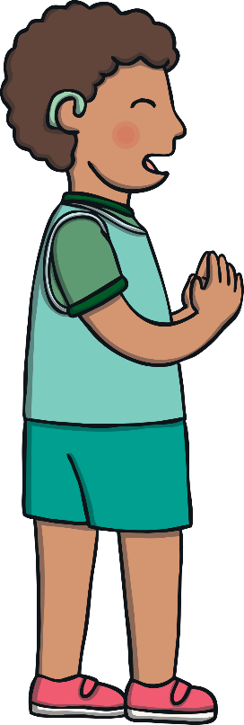
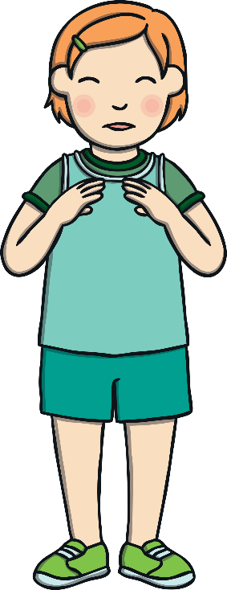
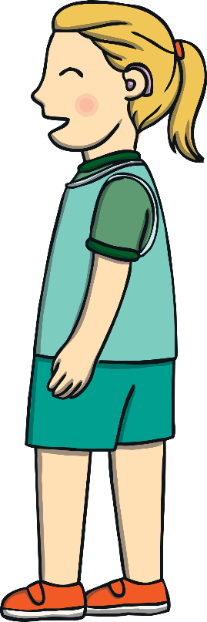
Apply
Show
Jake and I went backstage and found the deaf basketball team. We were mistaken for team members and told to get ready to play. I felt dread but Jake was cool.

Slide 28
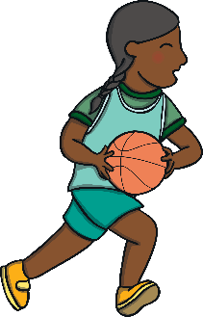


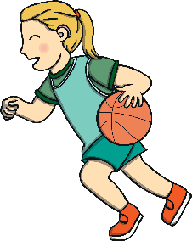
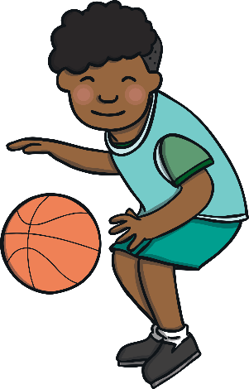
Apply
Show
We had lots of fun playing with the basketball team but then we saw Heather. Instead of looking happy, she looked very cross.

Slide 29

Apply
Dear Headteacher,
We are very sorry for not staying with our class on our school trip. We should have asked Heather if we could go instead of just leaving. (We did have a good time with the Youth Deaf Basketball Team!)
We don’t have any excuse. We are ready to accept our punishment.
From Kit and Jake
Show
We had to explain what we did to the headteacher. We could see in her eyes that she was not happy! She said that we should take an assembly to tell people what we found out.

Slide 30
Apply
Show
Even Heather liked our assembly but we won’t be sneaking off on school trips anymore. That is for sure!

Slide 31
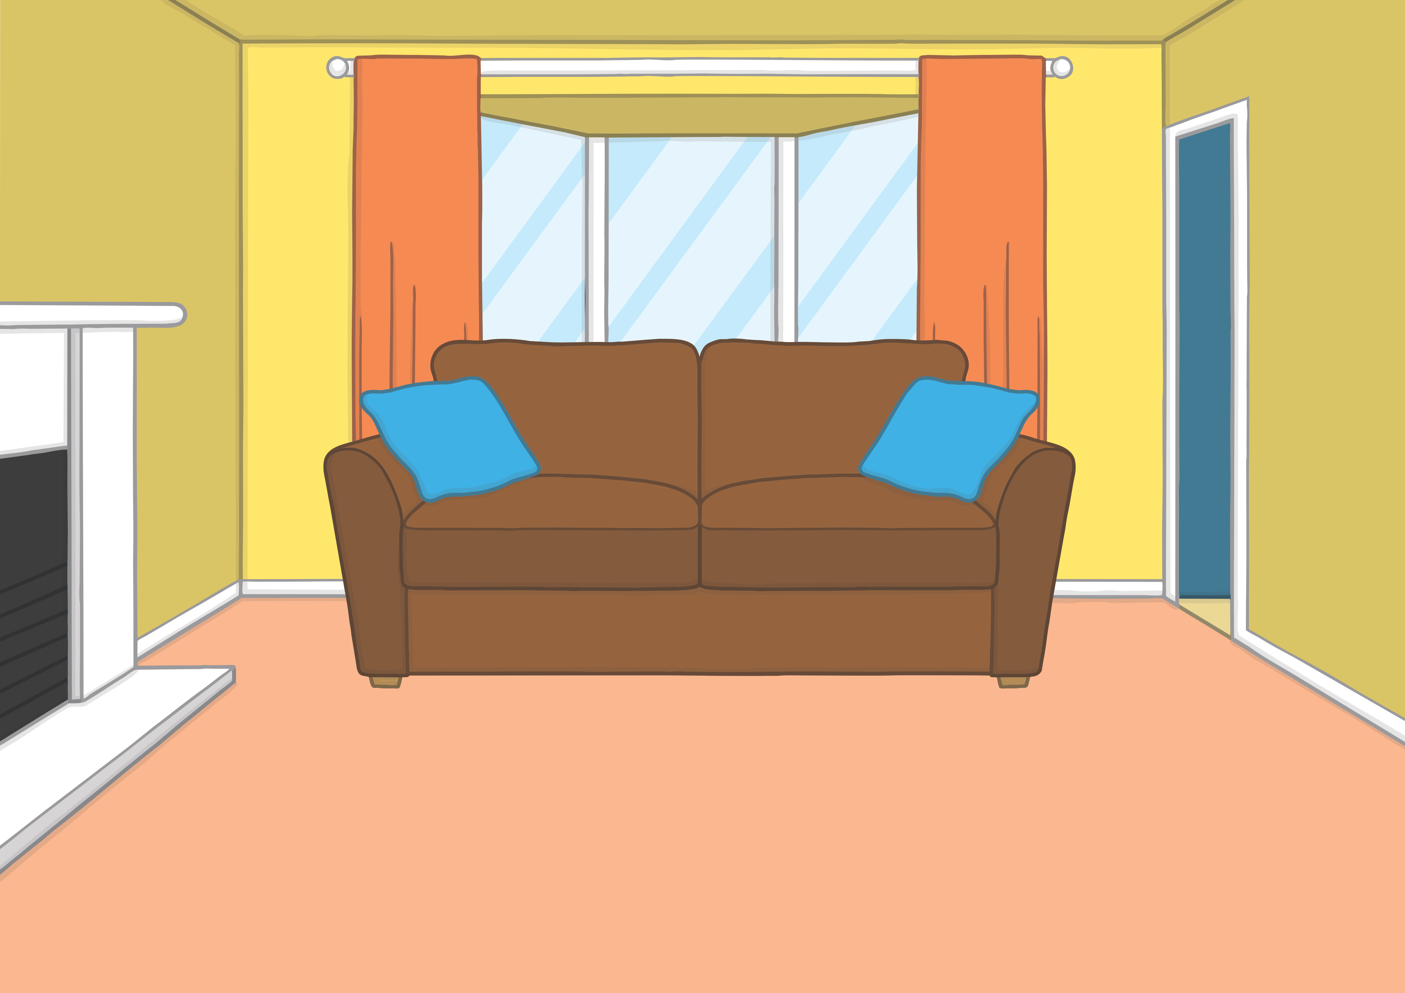

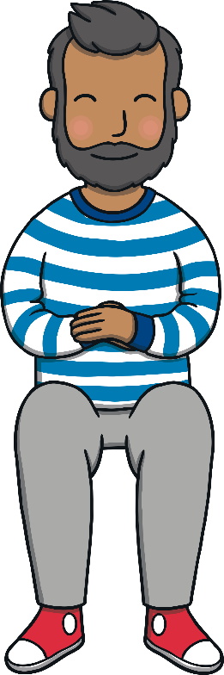

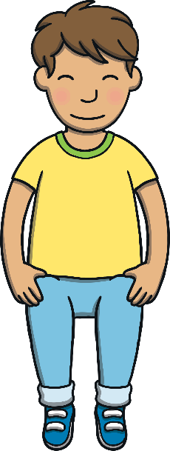

Apply
That night, Kit and Sam were talking to Mum and Dad about what had happened. “I hope you learnt your lesson,” said Dad to Kit.
“I certainly did,” replied Kit. “It was good fun playing with the youth deaf basketball team but we never meant to worry so many people.”
Sam looked at Kit and smiled. “I was secretly quite proud of you,” she said. “You played really well!” Then they all laughed together.

Slide 32

Today, we have read ‘Basketball Misadventures’ together.

