Slide 2

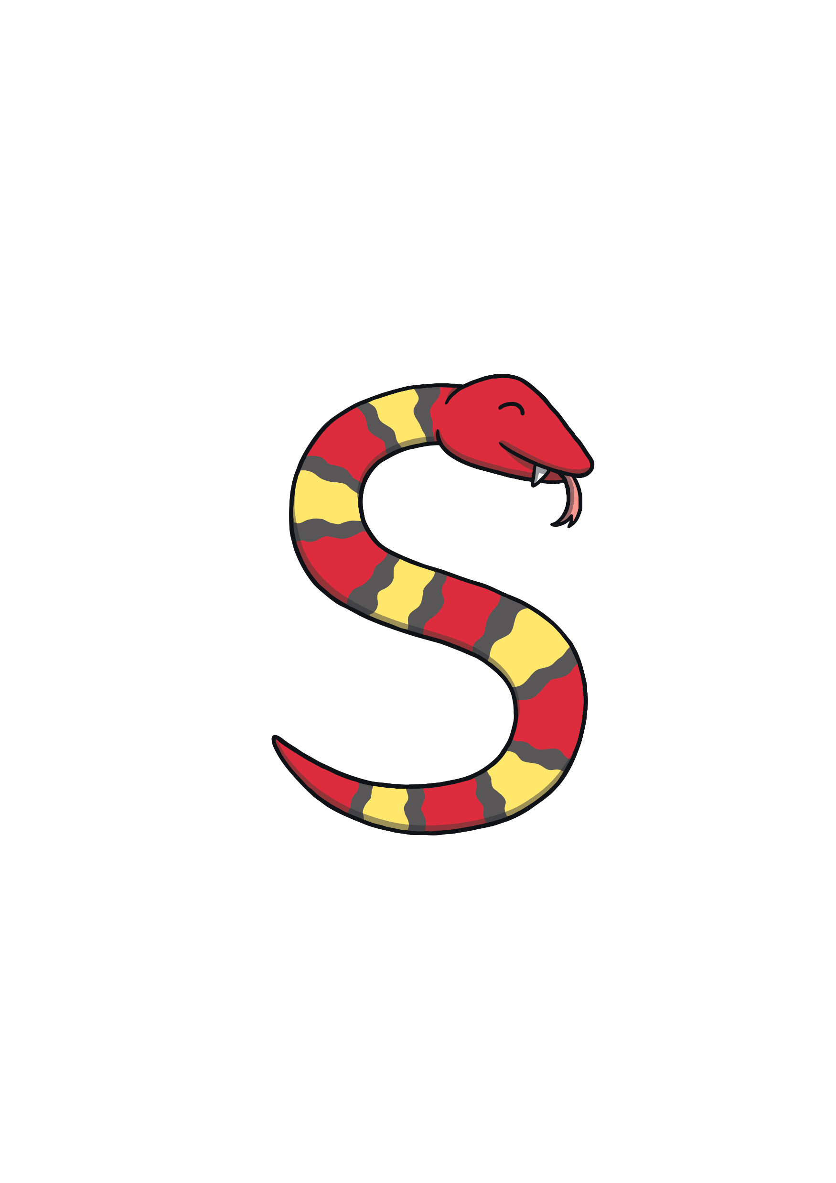
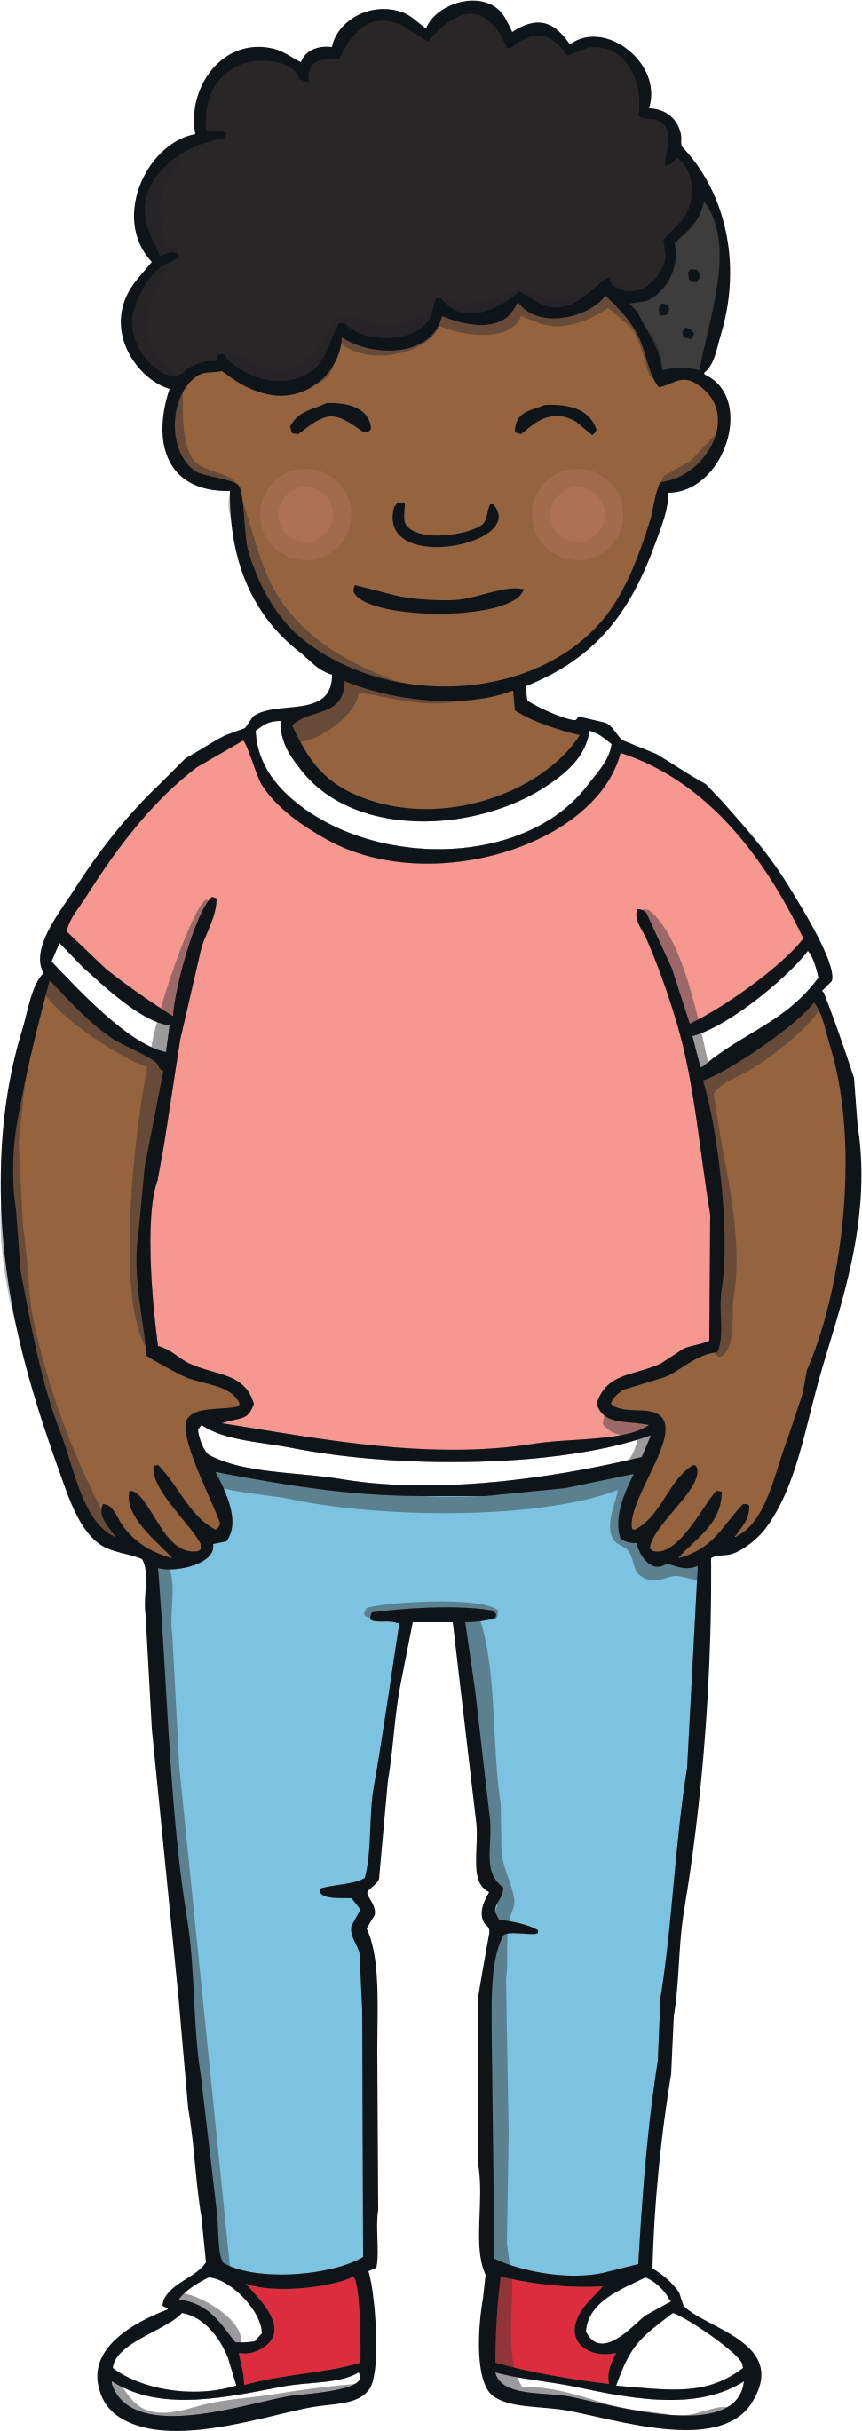


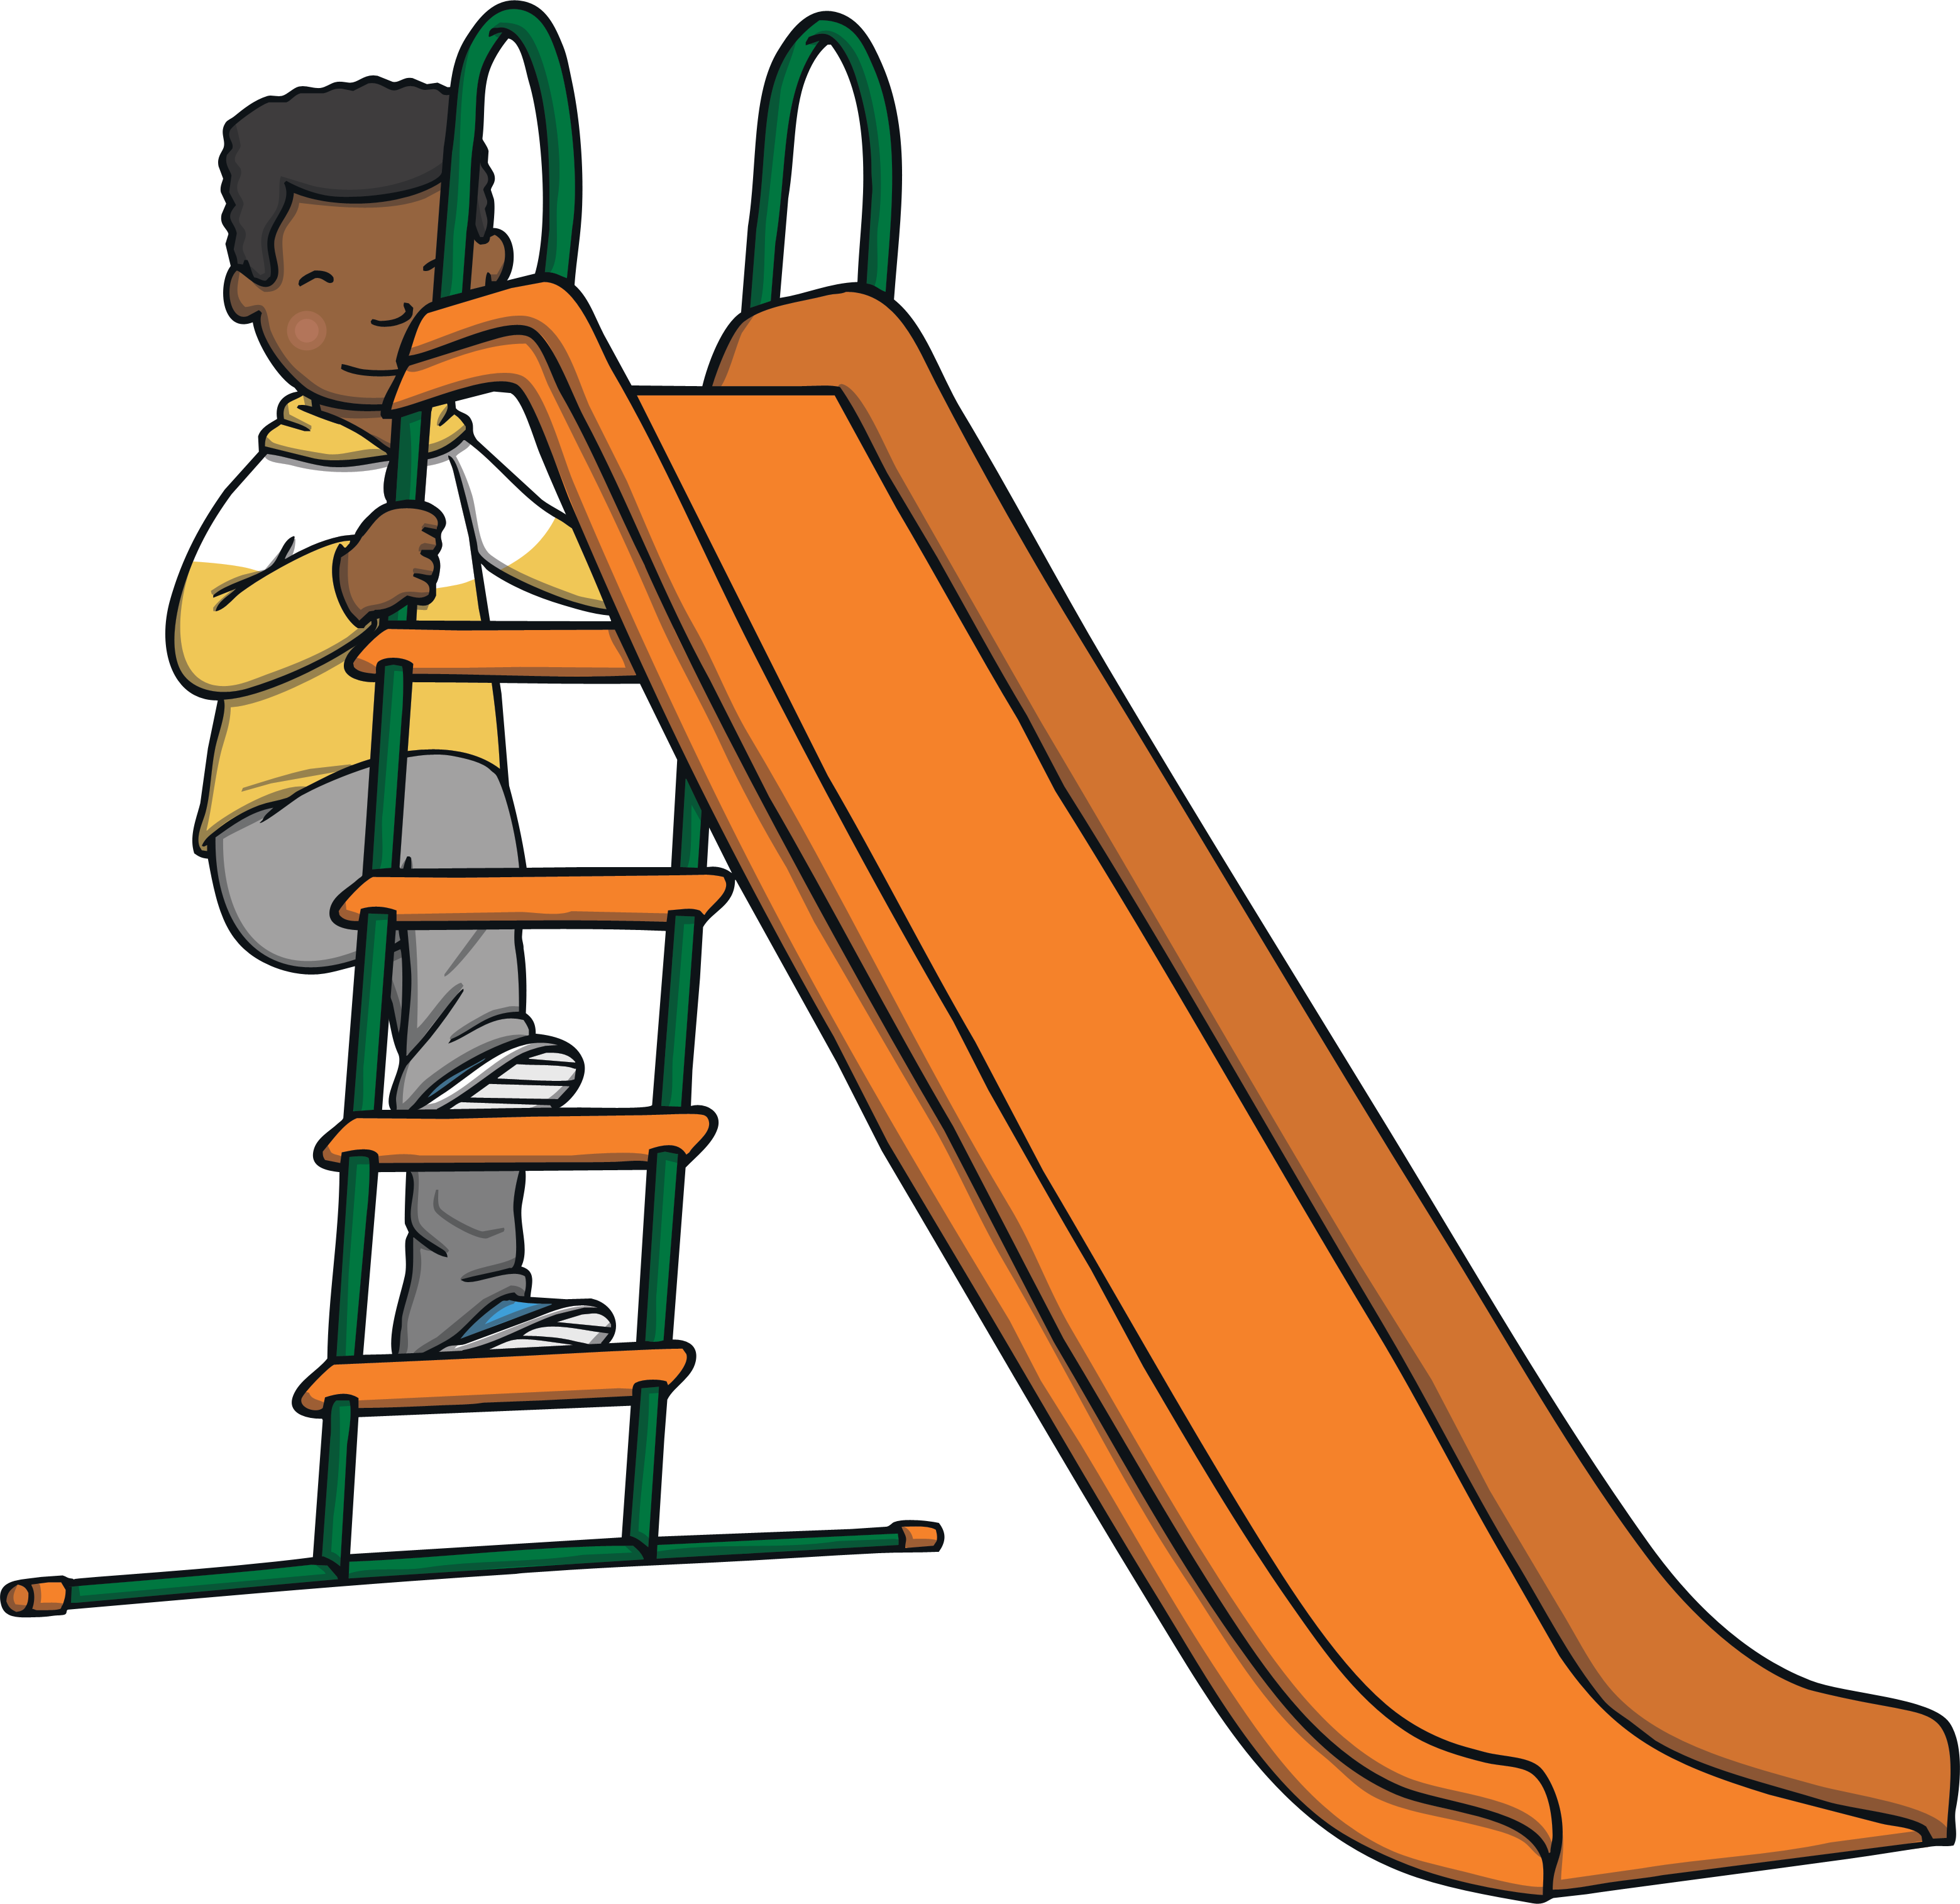




Revisit and Review
Let’s practise Sam’s Sounds and Common Exception Words!
oy
e_e
i_e
o_e
ay
u_e
a_e
ie
ea
oh
would
should
your
their
two
Mr
people
could
Mrs
love
looked
asked
called

Slide 3
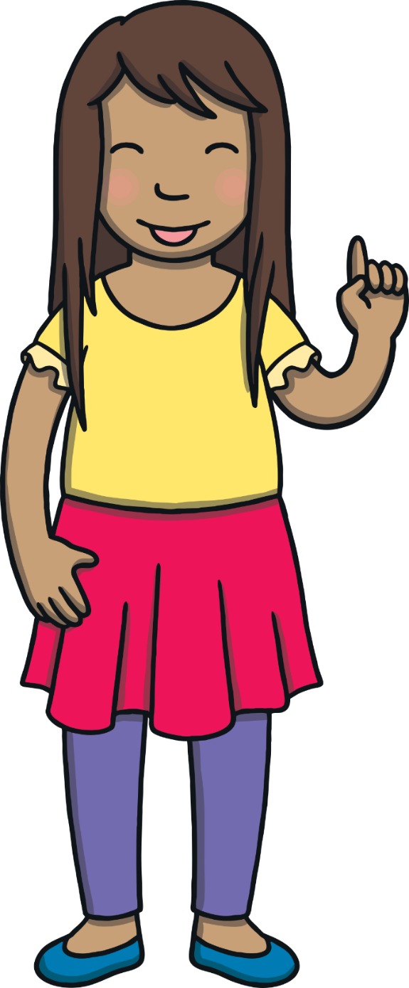
Today, we are learning to read and write words that contain u_e saying /yoo/ and e_e saying /ee/.

Slide 4
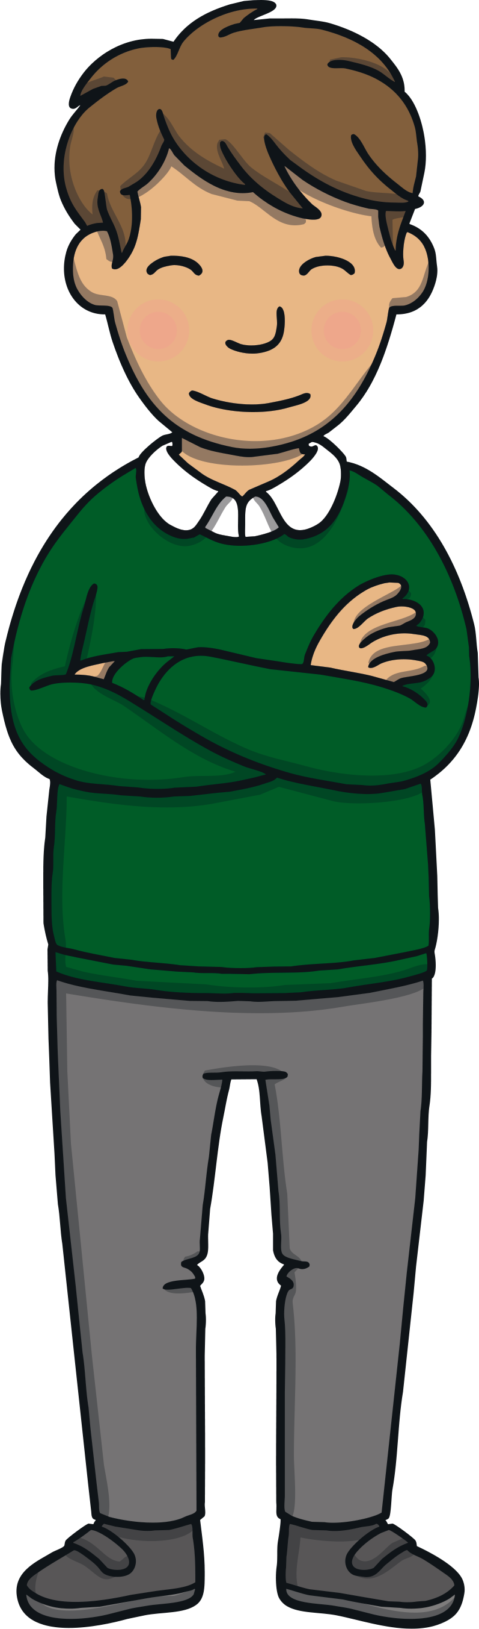
Teach
Let’s practise reading some of this week’s focus words that contain the u_e and e_e sound.
use
theme
cube
even
fume
complete
tube
what
these
could

Slide 5
Teach
Let’s practise reading some of this week’s focus words that contain the u_e and e_e sound

Slide 6


Teach
use
Play

Slide 7
Teach
cube
Play

Slide 8
Teach
fume
Play

Slide 9
Teach
tube
Play

Slide 10
Teach
these
Play

Slide 11
Teach
theme
Play

Slide 12
Teach
even
Play

Slide 13
Teach
complete
Play

Slide 14
Teach
what
Play

Slide 15
Teach
could
Play

Slide 16
Teach
Kit and Sam were back at home after their visit to Albert Einstein. “What a trip!” sighed Kit happily. “And we have instructions to complete an experiment for our science project!”

Slide 17
Teach
“I know it is not a competition,” laughed Sam. “But imagine if we were to compete – we would surely win! We have one of Einstein’s own experiments on the theme of time.” Kit and Sam grinned at one another.

Slide 18
Teach
“I wonder what he would do if he knew he’d just met two real live time travell ers,” said Kit. “I’m sure he would want to complete a little time travel himself if he knew,” said Sam with a chuckle.

Slide 19
Teach
The Equation
Einstein had realised that there was something funny about Kit and Sam. Their clothing and the way they spoke was all wrong. He is hard at work in his office, trying to work out of they could possibly be time travellers. What u_e or e_e words can you make from the letters
on his chalk board?

Slide 20


s
u
e
use
Check

Slide 21
e
c
u
b
cube
Check

Slide 22
f
e
m
u
fume
Check

Slide 23
u
b
e
t
tube
Check

Slide 24
t
e
s
e
h
these
Check

Slide 25
t
m
e
e
h
theme
Check

Slide 26
e
e
v
n
even
Check

Slide 27
m
o
e
l
p
c
e
t
complete
Check

Slide 28
“I guess we’ll never know,” laughed Kit.
“Why don’t we write a ‘story’ to go alongside our science project?” asked Sam. “Mrs Tan would never believe it was real and we might get some extra marks for creativity.”

Slide 29
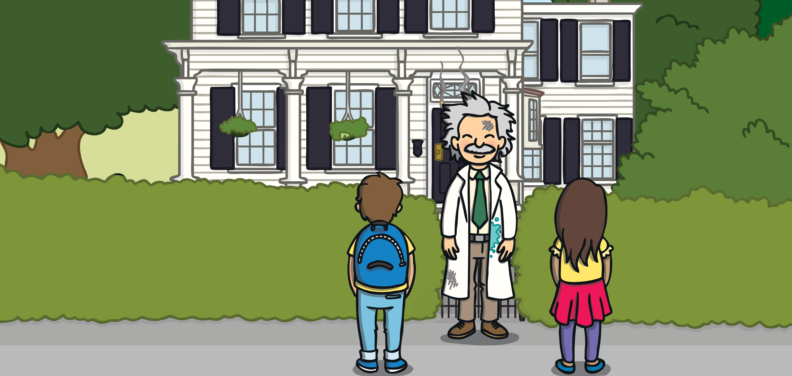
A Visit to Albert
A Let’s Read Together! Book

Slide 30
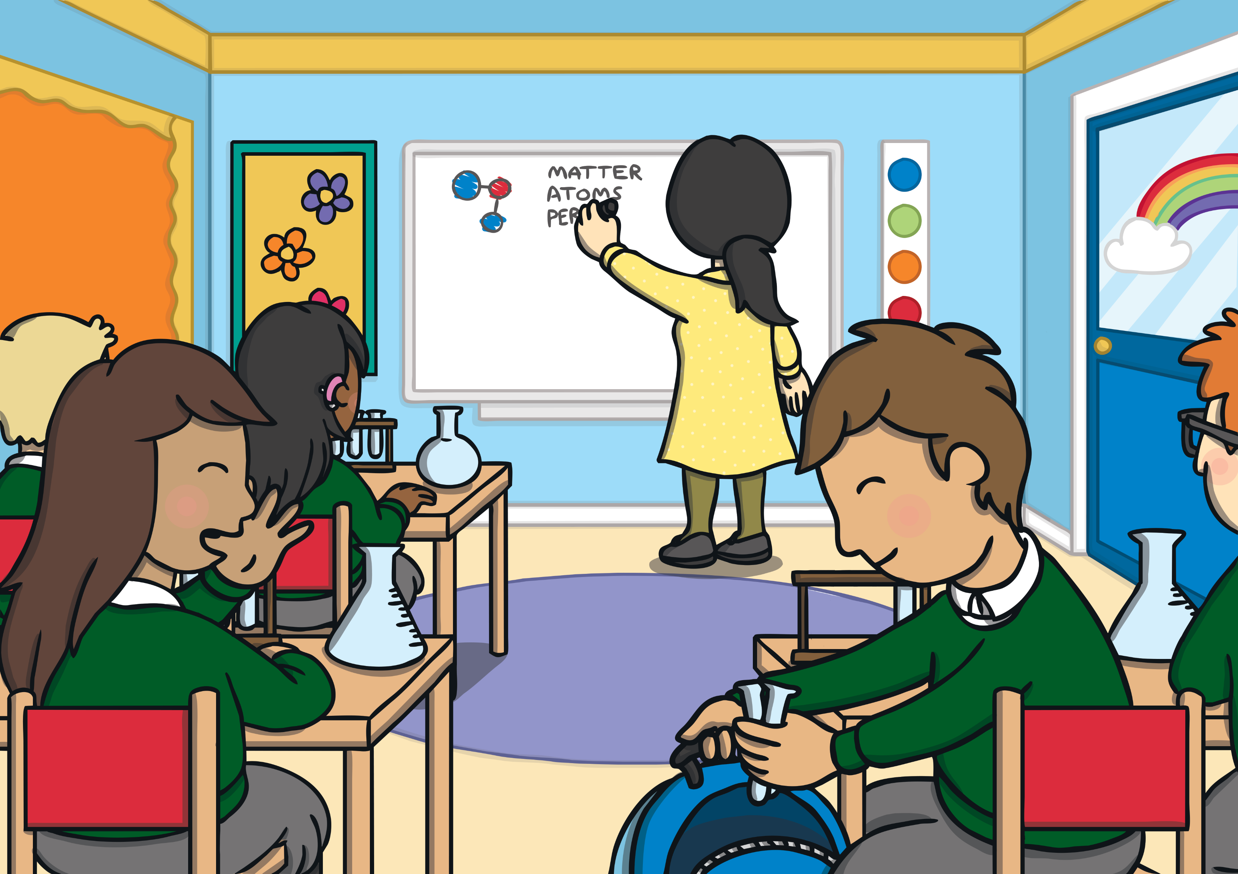
Kit and Sam had to complete a project for Mrs Tan. They went back in time to ask for help.
A Let’s Read Together! Book

Slide 31
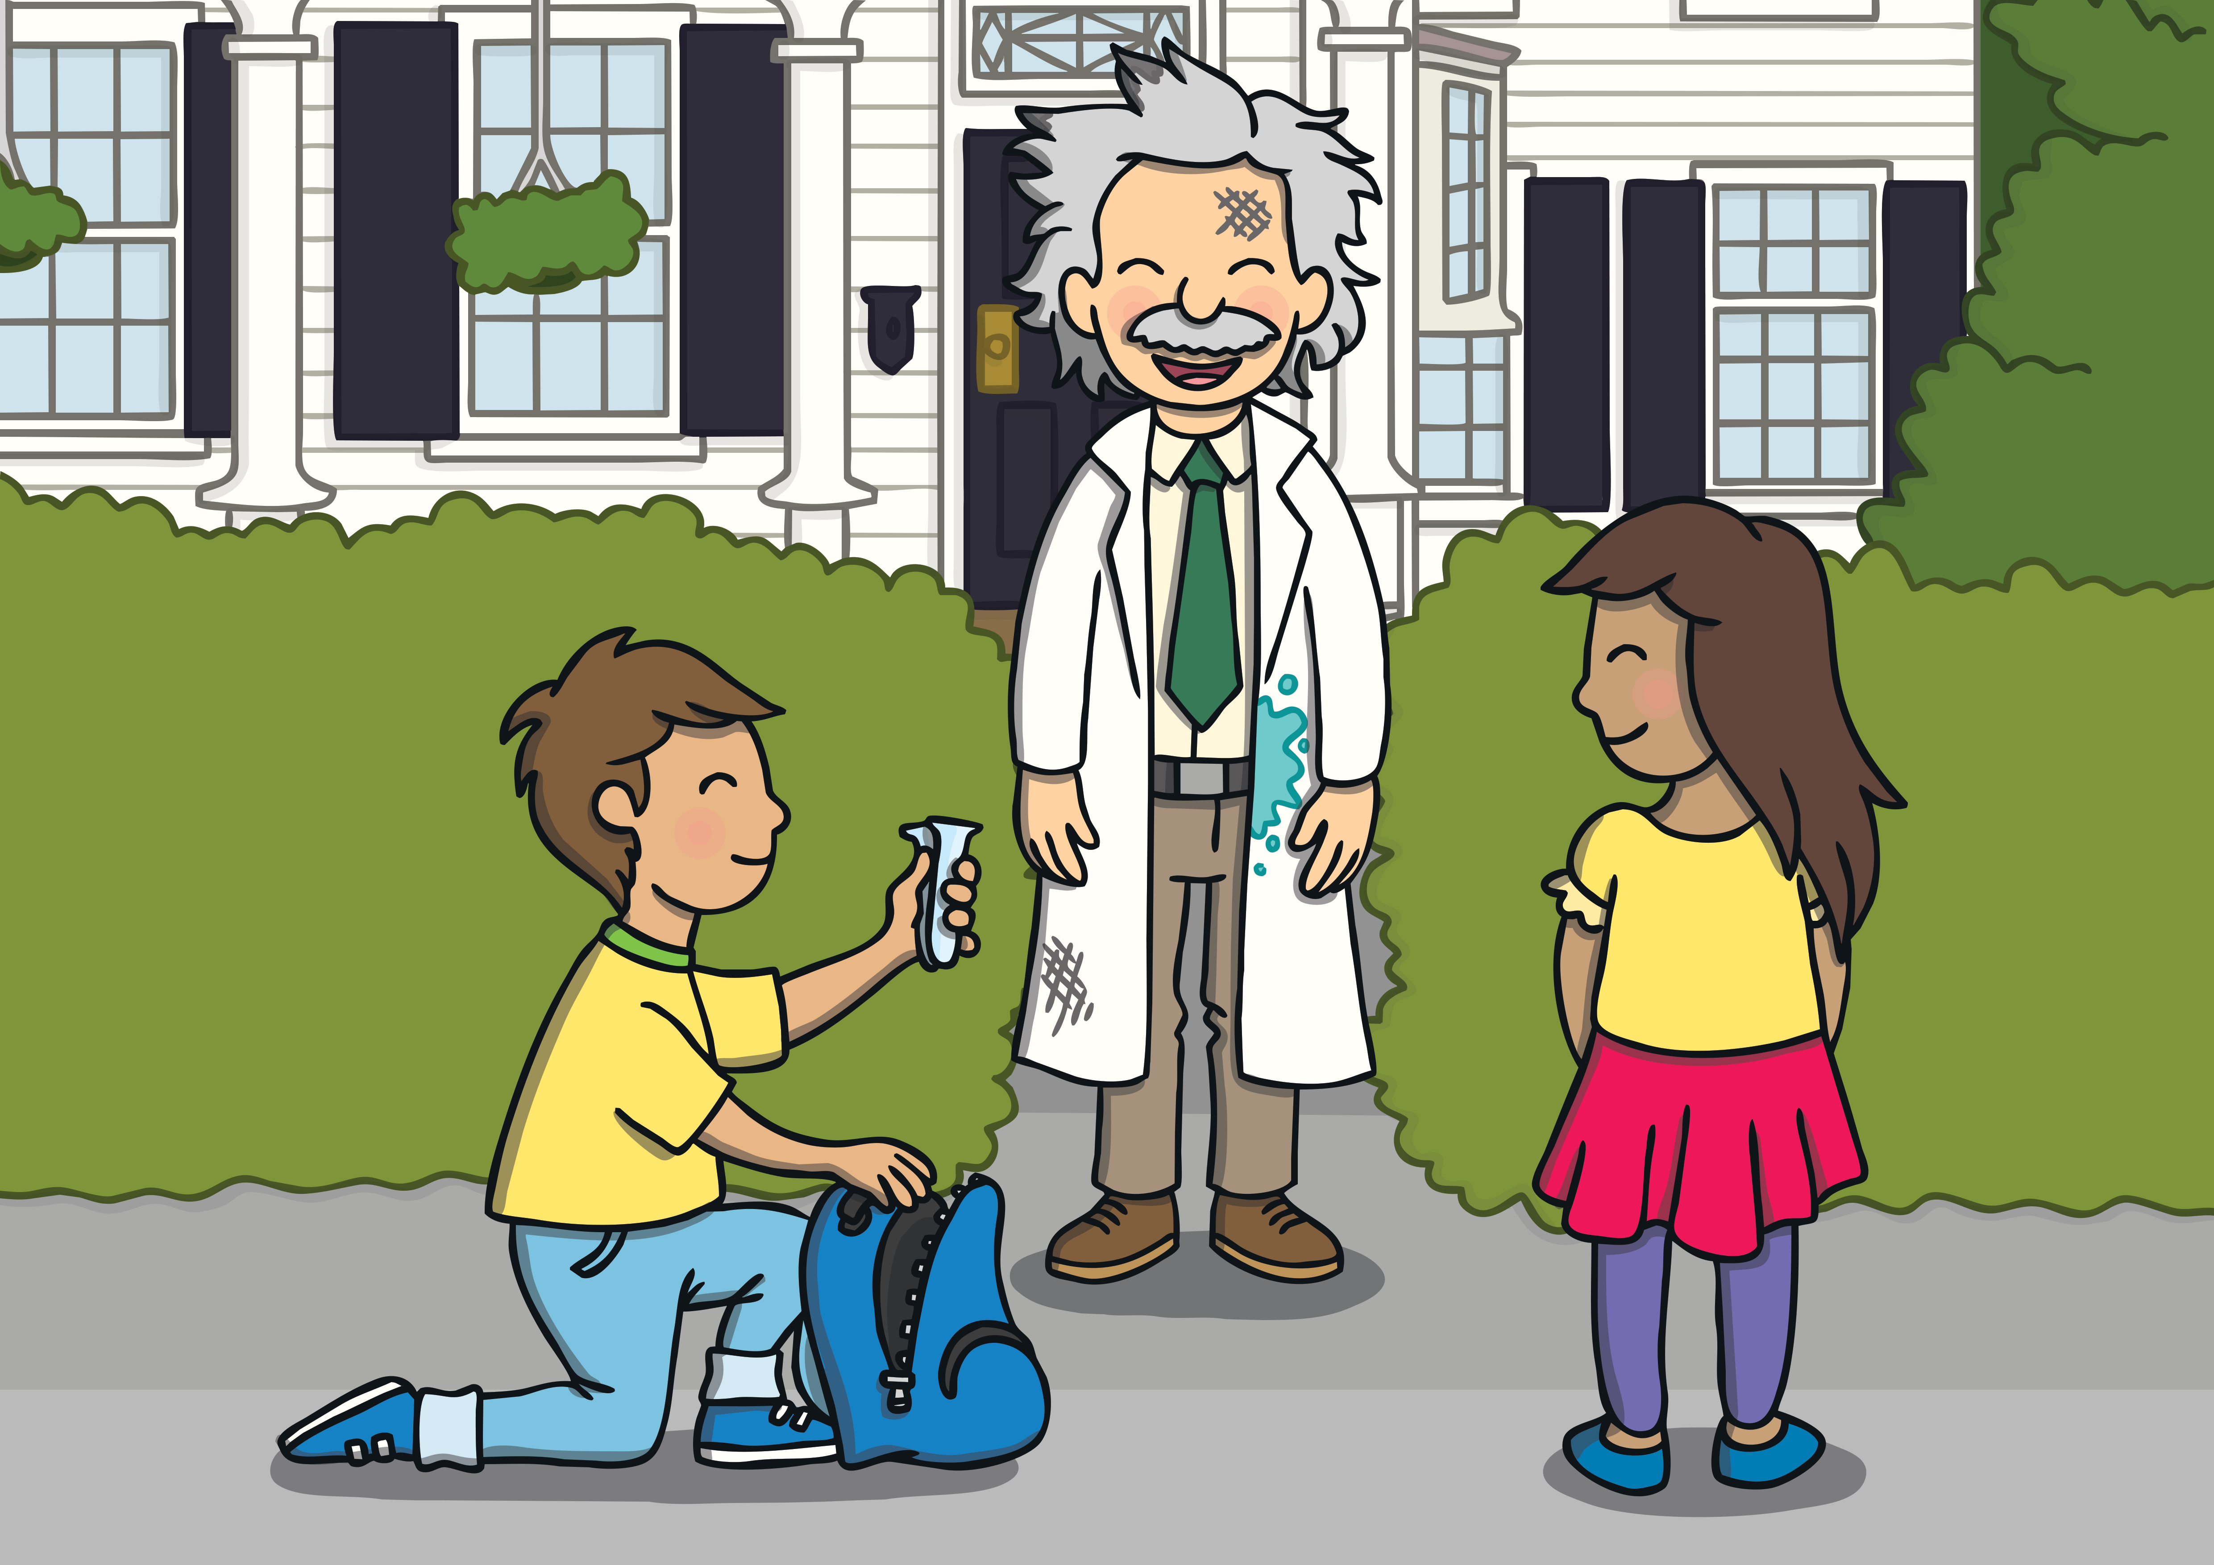
When they got there, Albert was in need of test tubes to complete an experiment. “Take these, I took them for the project,” said Kit, handing them to him.
A Let’s Read Together! Book

Slide 32
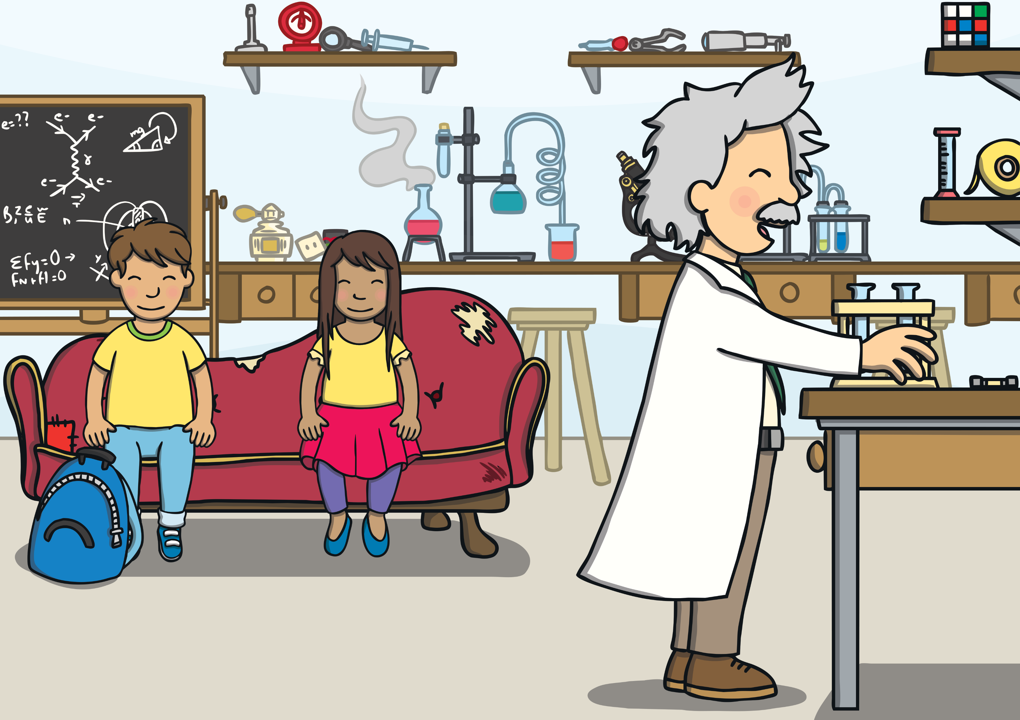
Kit and Sam liked seeing the experiment. There was a big bang and lots of fumes.
A Let’s Read Together! Book

Slide 33
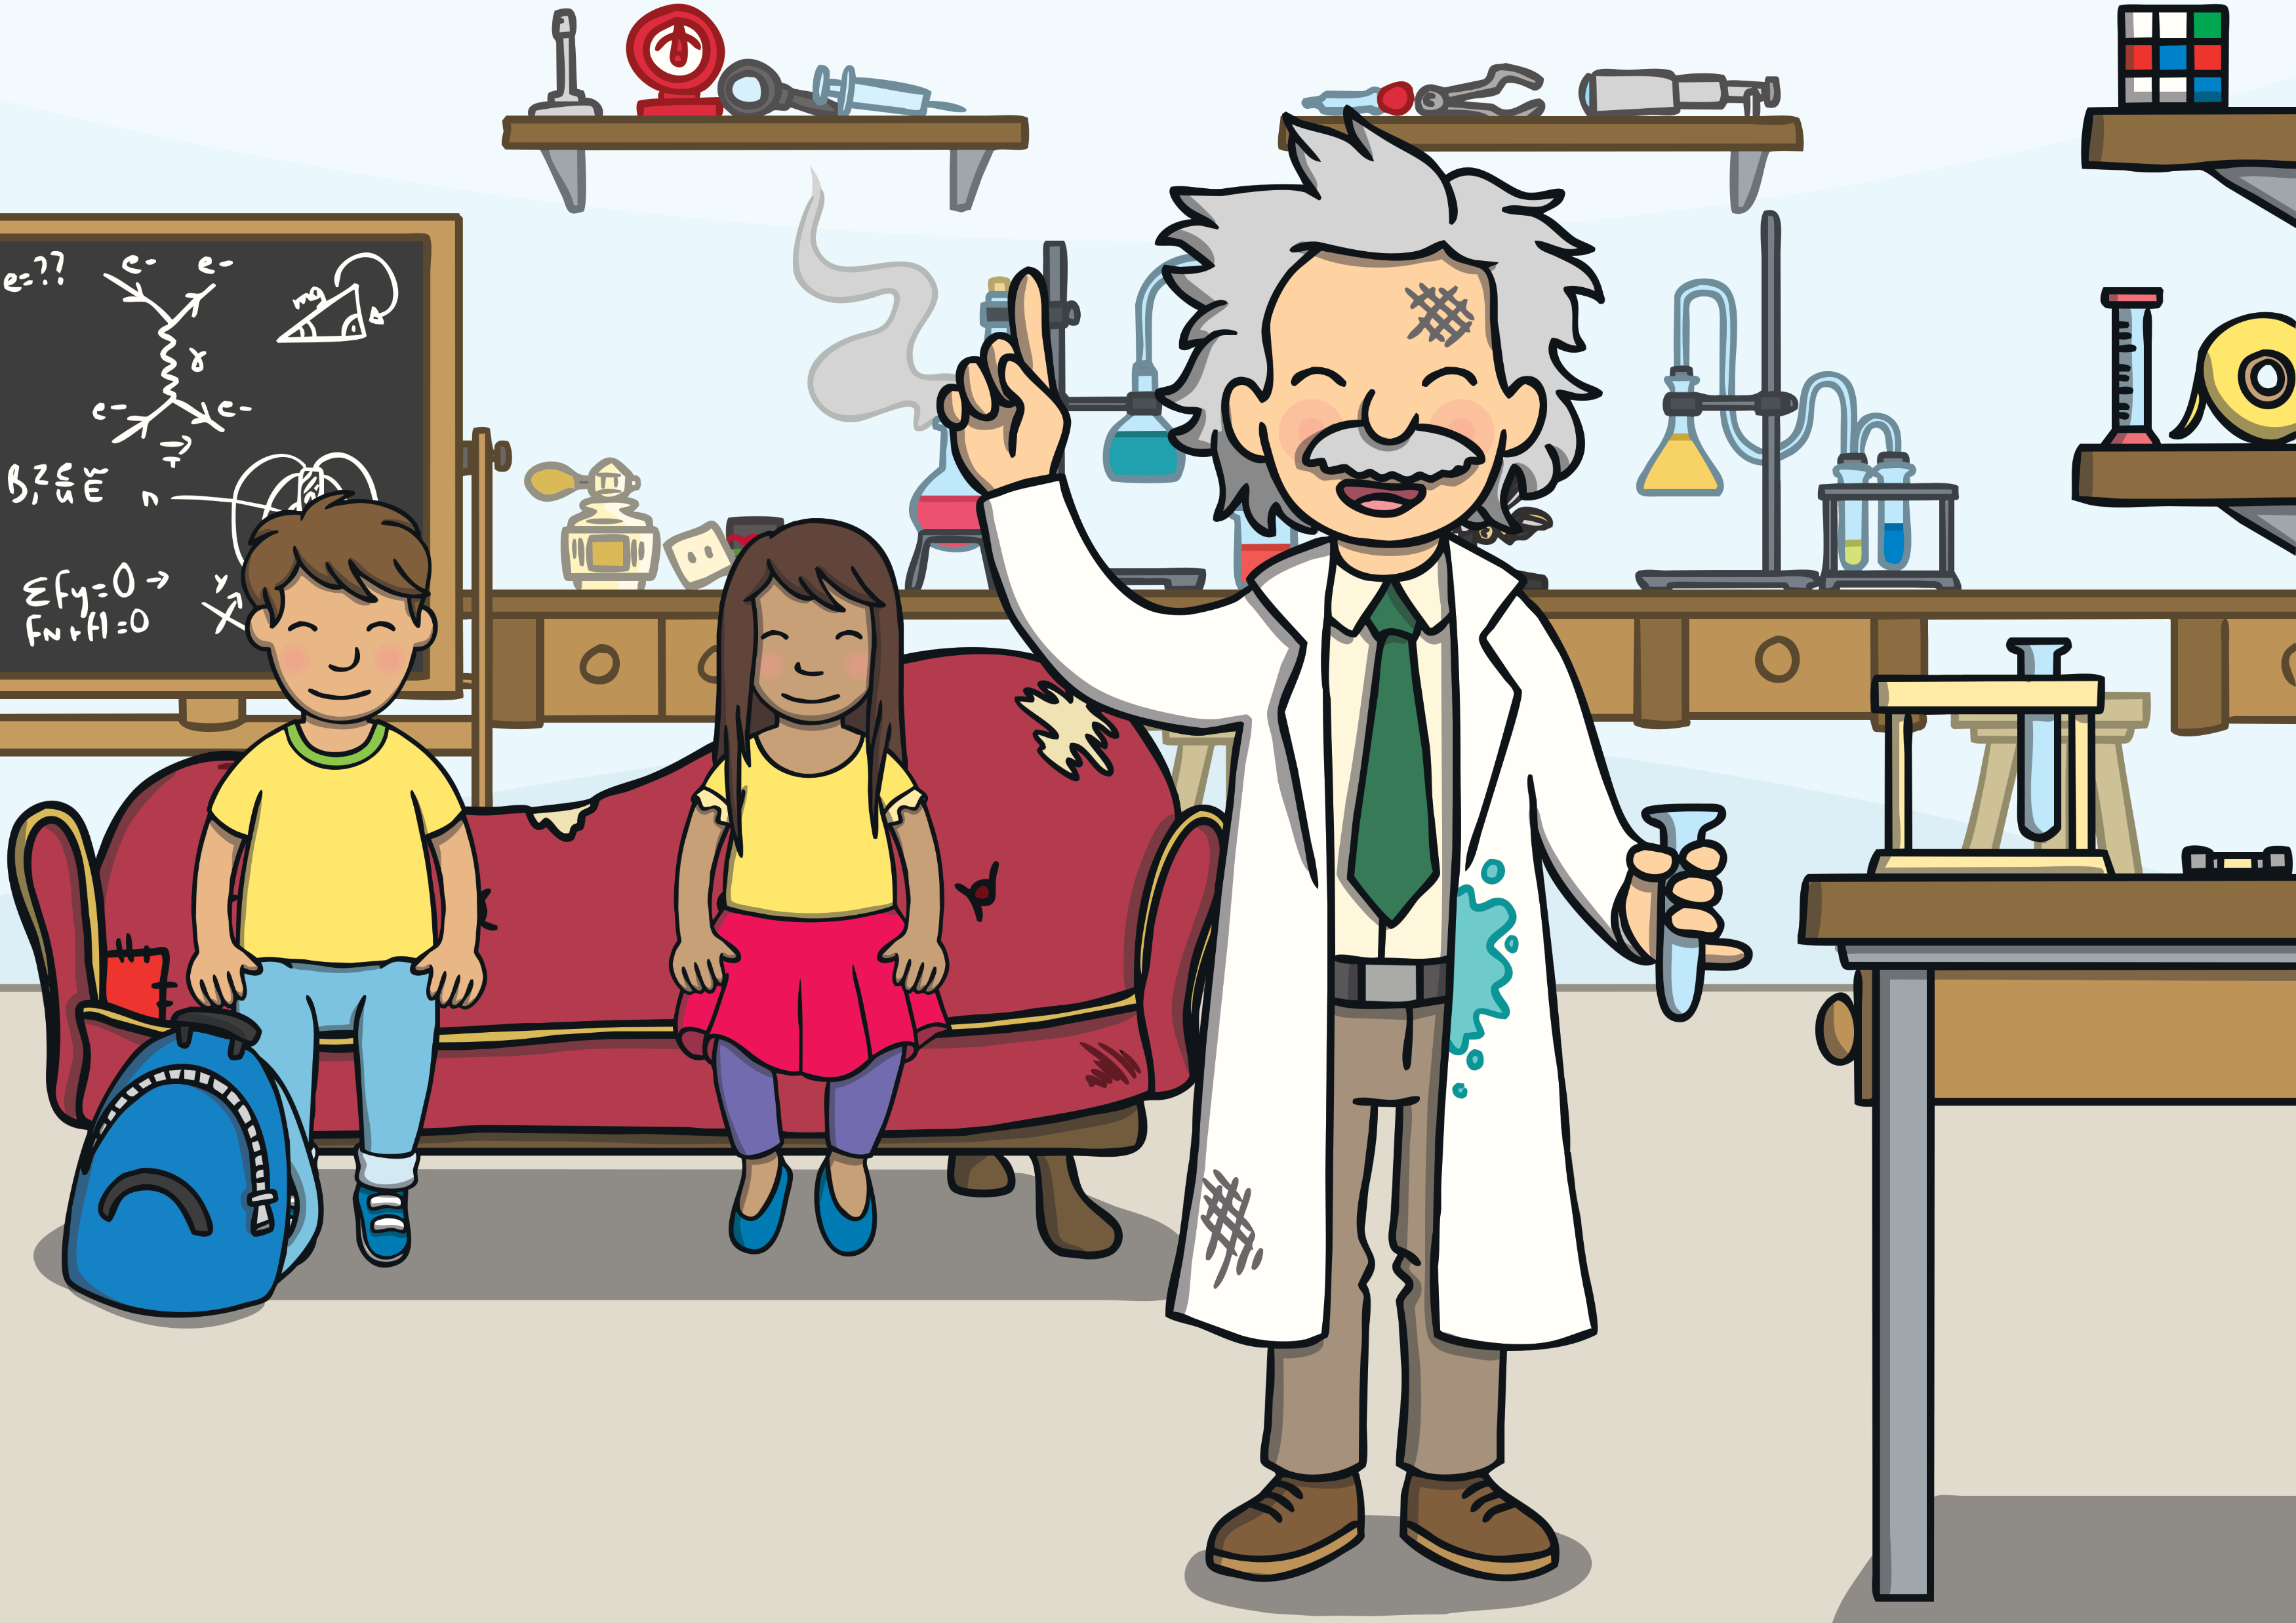
They had to think of a theme for their project. Albert let them look at some of his things to help. He said he was not good in class when he was little!
A Let’s Read Together! Book

Slide 34
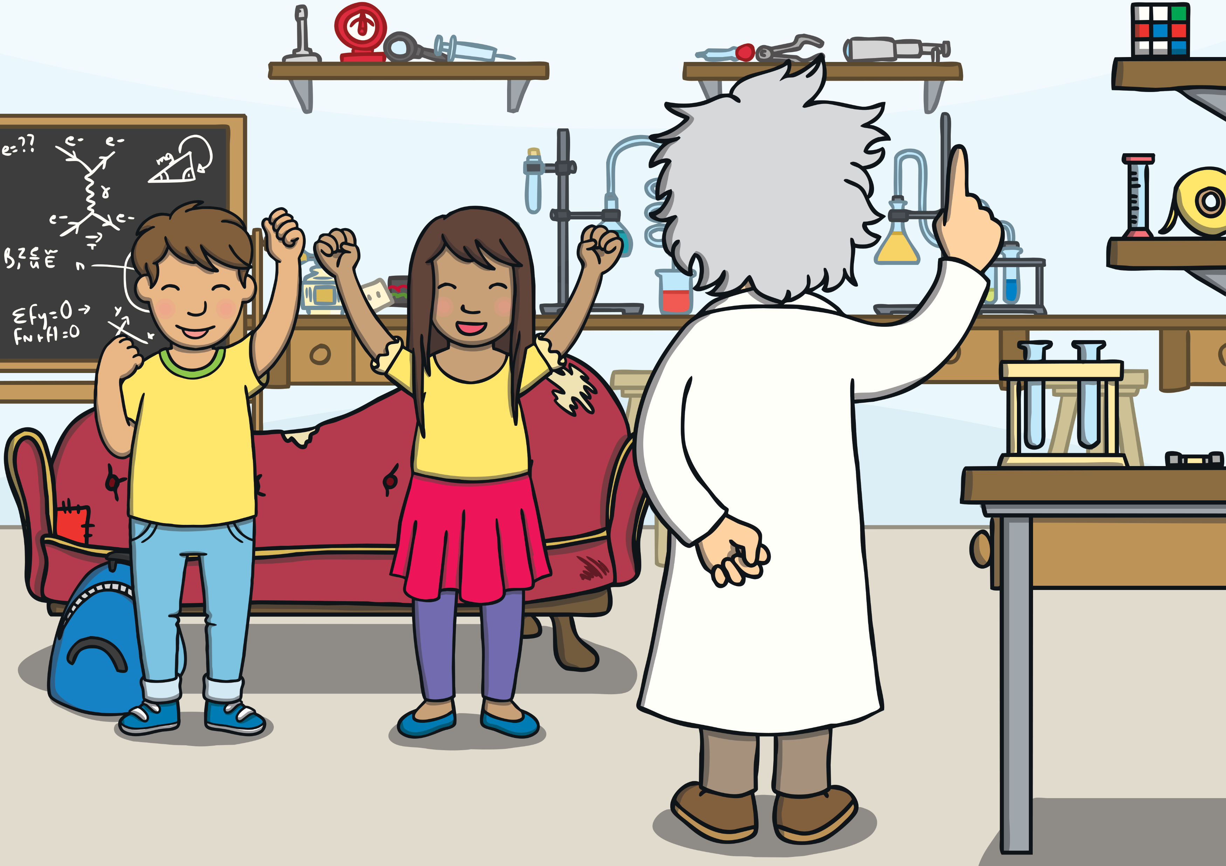

They came up with a plan. They would do their project on the theme of time. Albert liked this!
A Let’s Read Together! Book

Slide 35
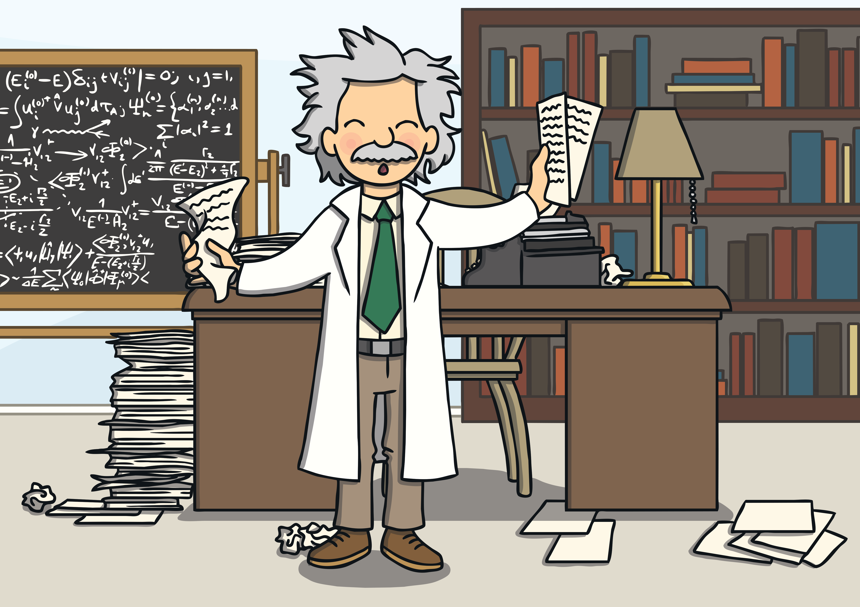
Albert was a big help. He even gave them a sheet on how to complete the experiment.
A Let’s Read Together! Book

Slide 36
“Wouldn’t it be exciting if we could have let Albert time travel,” mused Sam. “I’m sure, if anyone ever figures it out, he’ll be the first person they go to visit,” said Kit.
“I do hope so,” sighed Sam.

