Slide 2

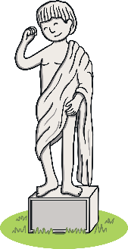



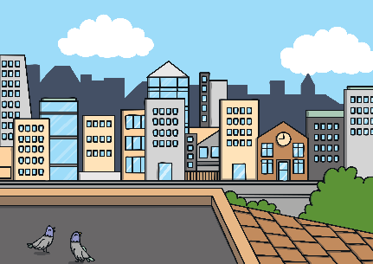






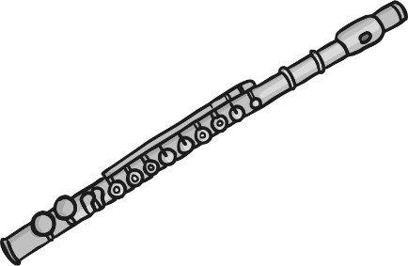
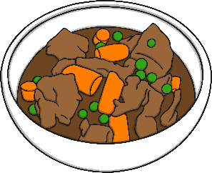


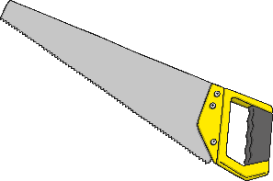
Revisit and Review
Let’s practise Sam’s Sounds and Common Exception Words!
y
ue
c
ir
g
u_e
ew
ow
oe
au
u_e
ue
wh
ew
ph
aw
house
many
coming
because
Monday
any
once
eyes
friends
different
please
Wednesday
laughed
Tuesday
lived
Thursday
also
work

Slide 3

Teach
Today, we are learning to read words that
contain ph saying /f/.

Slide 4

Teach
Let’s practise reading some of this week’s focus words that contain the ‘ph’ sound.
phone
dolphin
elephant
alphabet

Slide 5

Teach
Now, let’s write them with the magic pencil…

Slide 6


Teach
phone
Play

Slide 7
Teach
dolphin
Play

Slide 8
Teach
elephant
Play

Slide 9
Teach
alphabet
Play

Slide 10
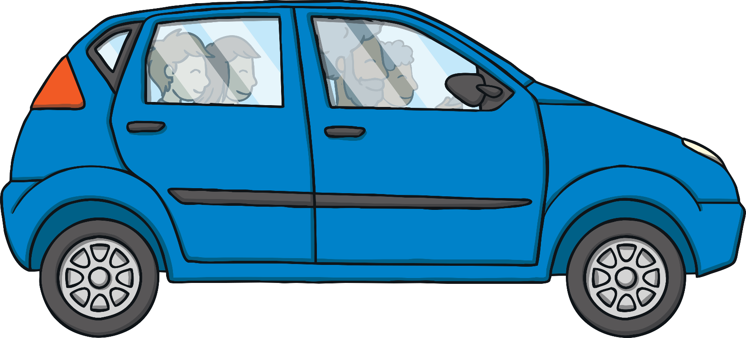
Teach
Kit, Sam, Jake and Jake’s dad, Philip, were in the car on their way to the zoo. “What would you like to see first?” asked Jake.
“I’d like to see the elephants and rhinos!” said Kit excitedly.

Slide 11
Teach
“And I’d like to see the dolphins,” said Sam. “I’m going to do my project on dolphins so it would be helpful to see them in real life. What about you, Philip?”
“I have just got a fantastic new camera,” said Philip. “I want to try to photograph as many of the animals as possible!”

Slide 12
Teach
It was a long journey to the zoo and Kit, Sam and Jake soon began to get bored. “How about a game of I Spy,” suggested Jake. “Pick a letter of the alphabet, then everyone has to try to guess what you have seen beginning with that letter.”

Slide 13


I Spy
Teach
Pick a letter of the alphabet to reveal what Jake, Kit or Sam have seen.
Hint: Each word has ph saying /f/ in it!
This is a great game to play as a class!
X
Click me for Kit’s teaching tips!

Slide 14

Teach
a
p
alphabet
photo
d
e
dolphin
elephant

Slide 15

Teach
p
g
phone
graph
t
telephone

Slide 16
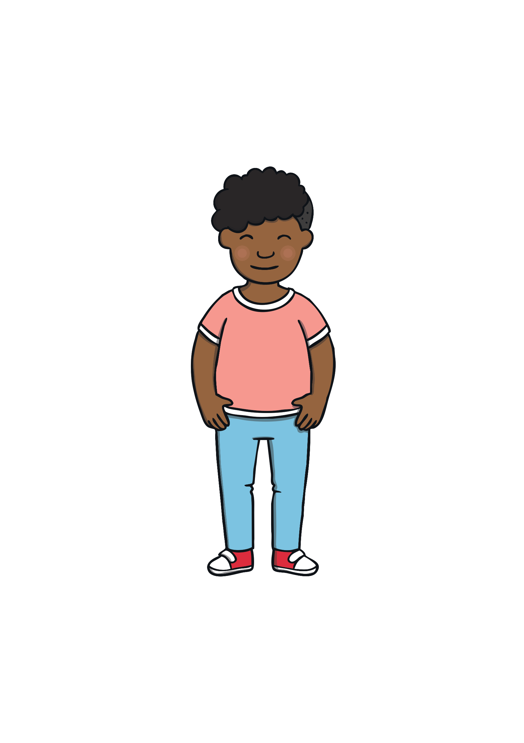
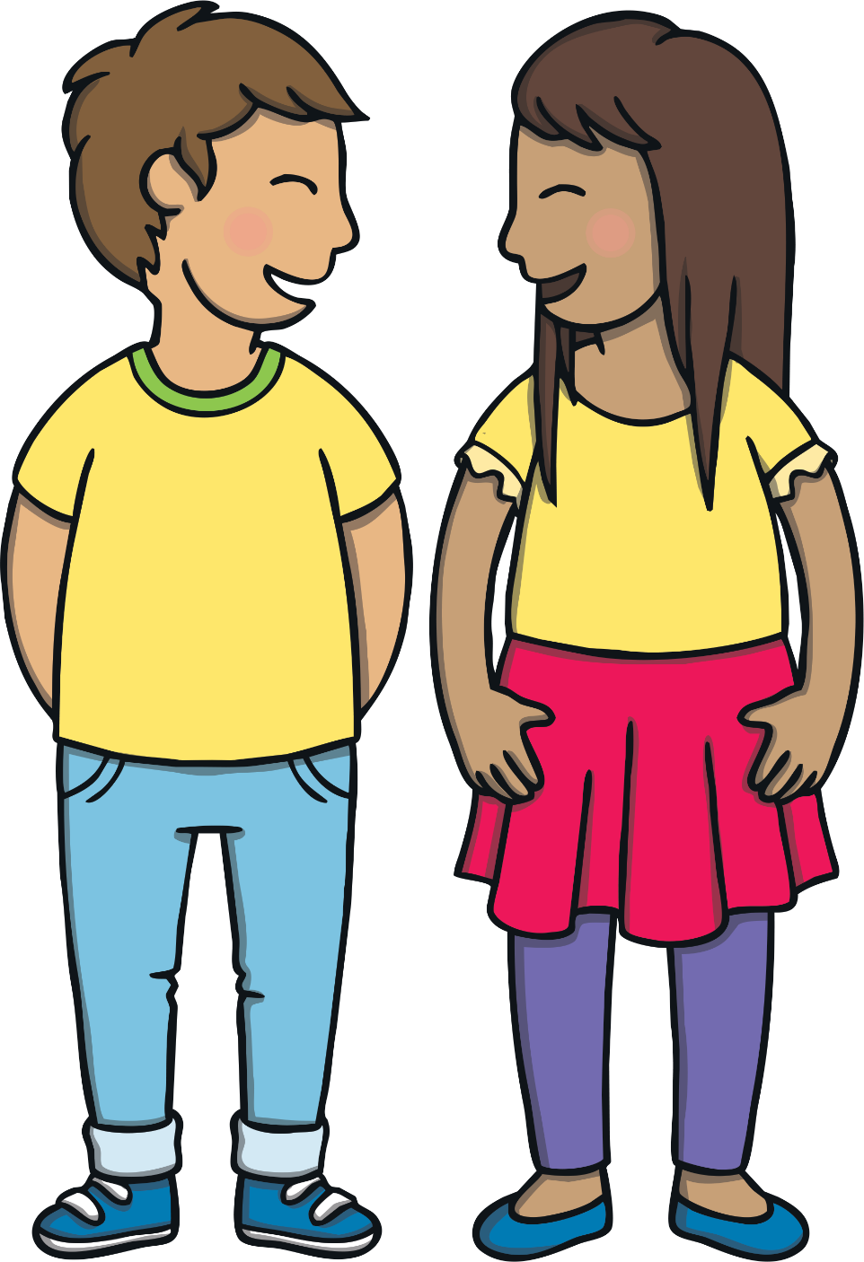
What’s My Word?
Practise
Jake teaches Kit and Sam a new game. He thinks of a word and writes a dash for each letter. Kit and Sam have to guess the missing letters for Jake to write in. The winner is the first person to guess the word.
Can you help?

Slide 17
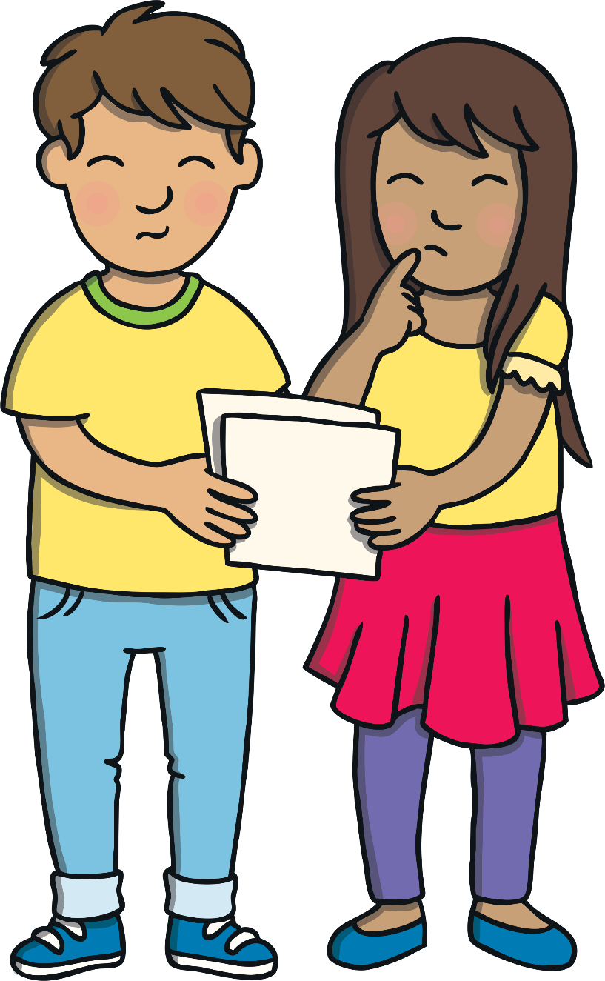

Practise
a
b
t
a
l
l
p
h
a
b
e
t
Help
Check

Slide 18
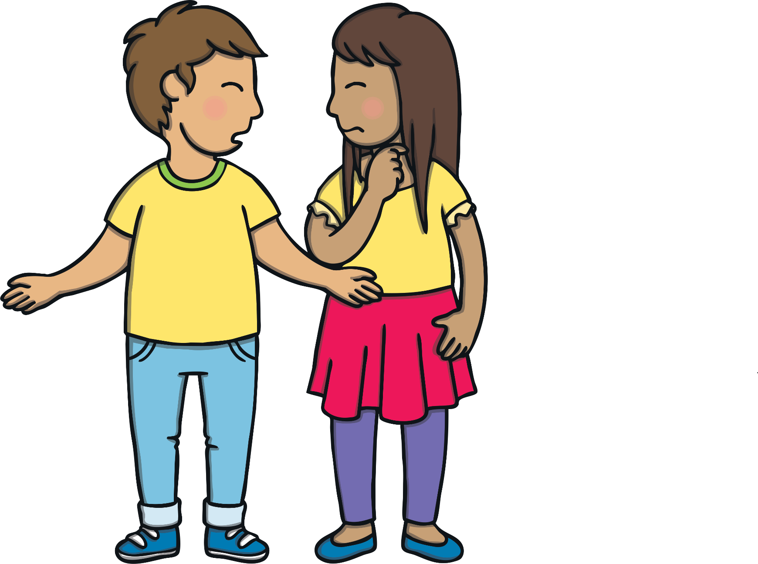
Practise
p
h
h
o
n
n
e
e
Help
Check

Slide 19
Practise
d
o
l
p
h
i
d
o
i
n
n
n
Help
Check

Slide 20
Practise
e
l
e
p
h
a
n
t
e
e
h
n
t
Help
Check

Slide 21
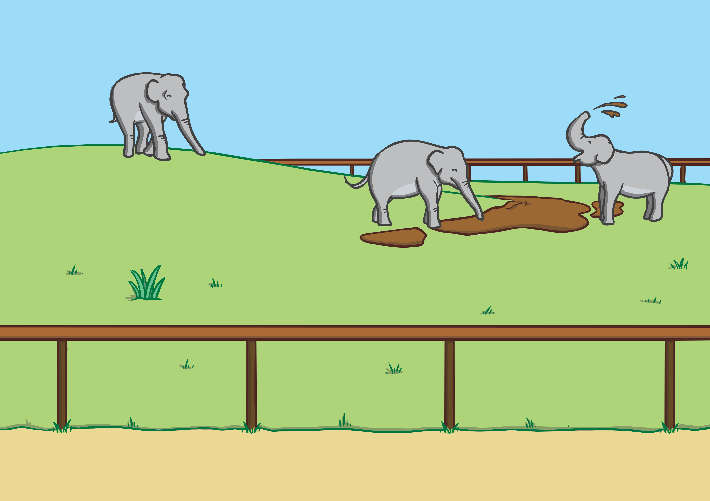


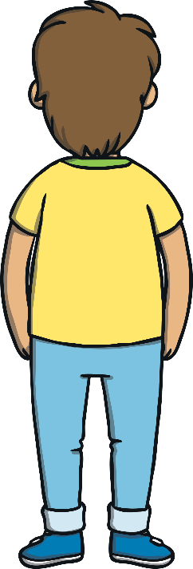
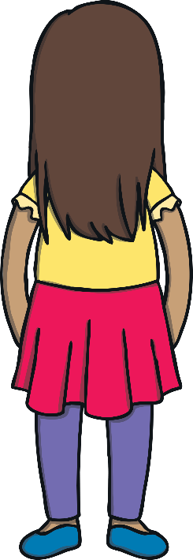
Apply
Eventually, they all arrived at the zoo. First of all, they went to see the elephants. Kit loved how they splashed water with their long trunks. “Phew! I’m glad that they are so far away or we would all be wet,” chuckled Kit.

Slide 22
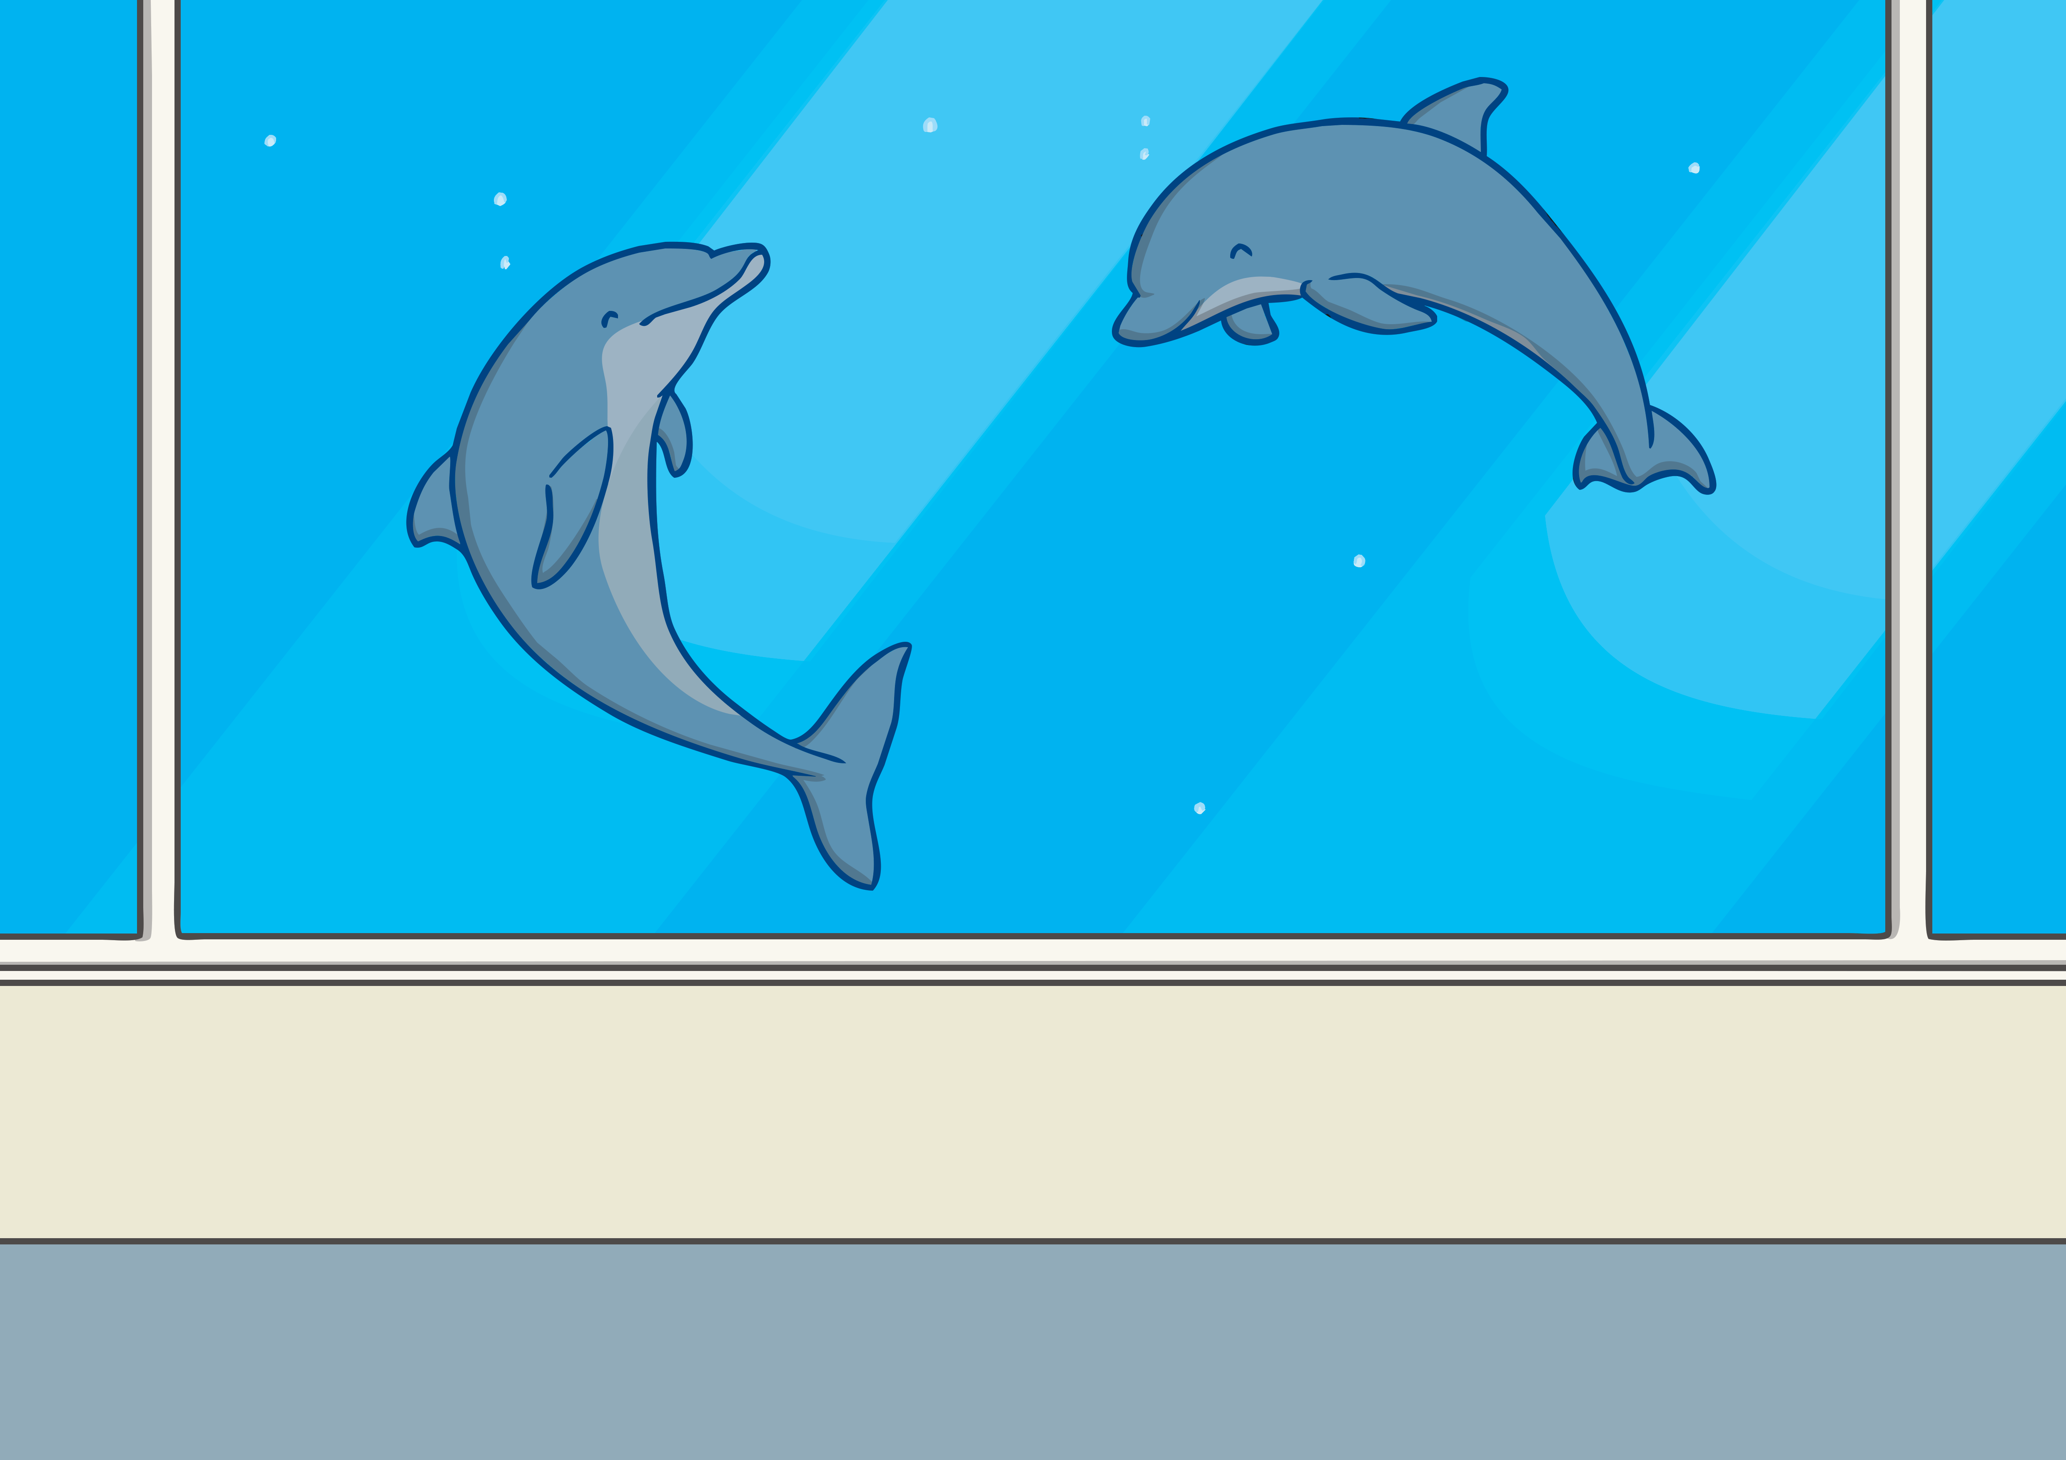
Apply
Then, they went to see the dolphins. “They are so beautiful,” said Sam. Philip took lots of photographs of them with his camera.
“Have you seen any animals you’d like to do your project on?” Jake asked Kit.

Slide 23
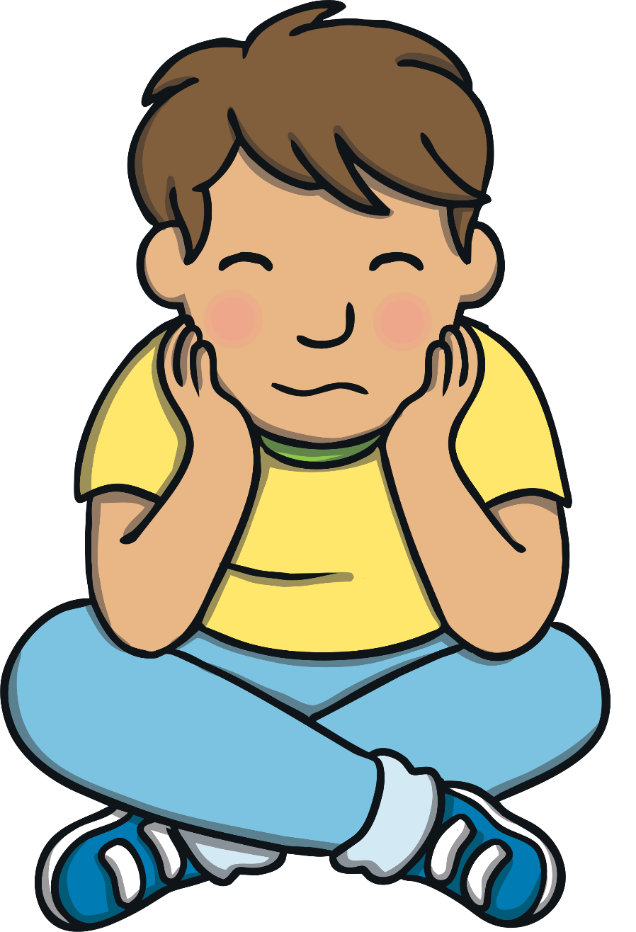
Sentence Time
Apply
What is Kit thinking about doing his project on?
Read the sentence then click ‘Show’ to reveal the answer!

Slide 24
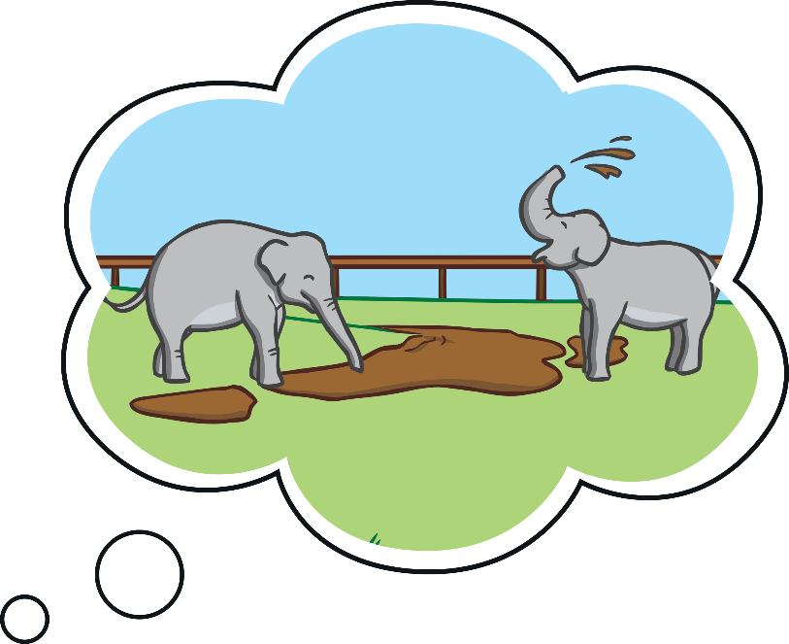

Apply
I would like to do a
project about elephants.
Sound Buttons On/Off
Show

Slide 25
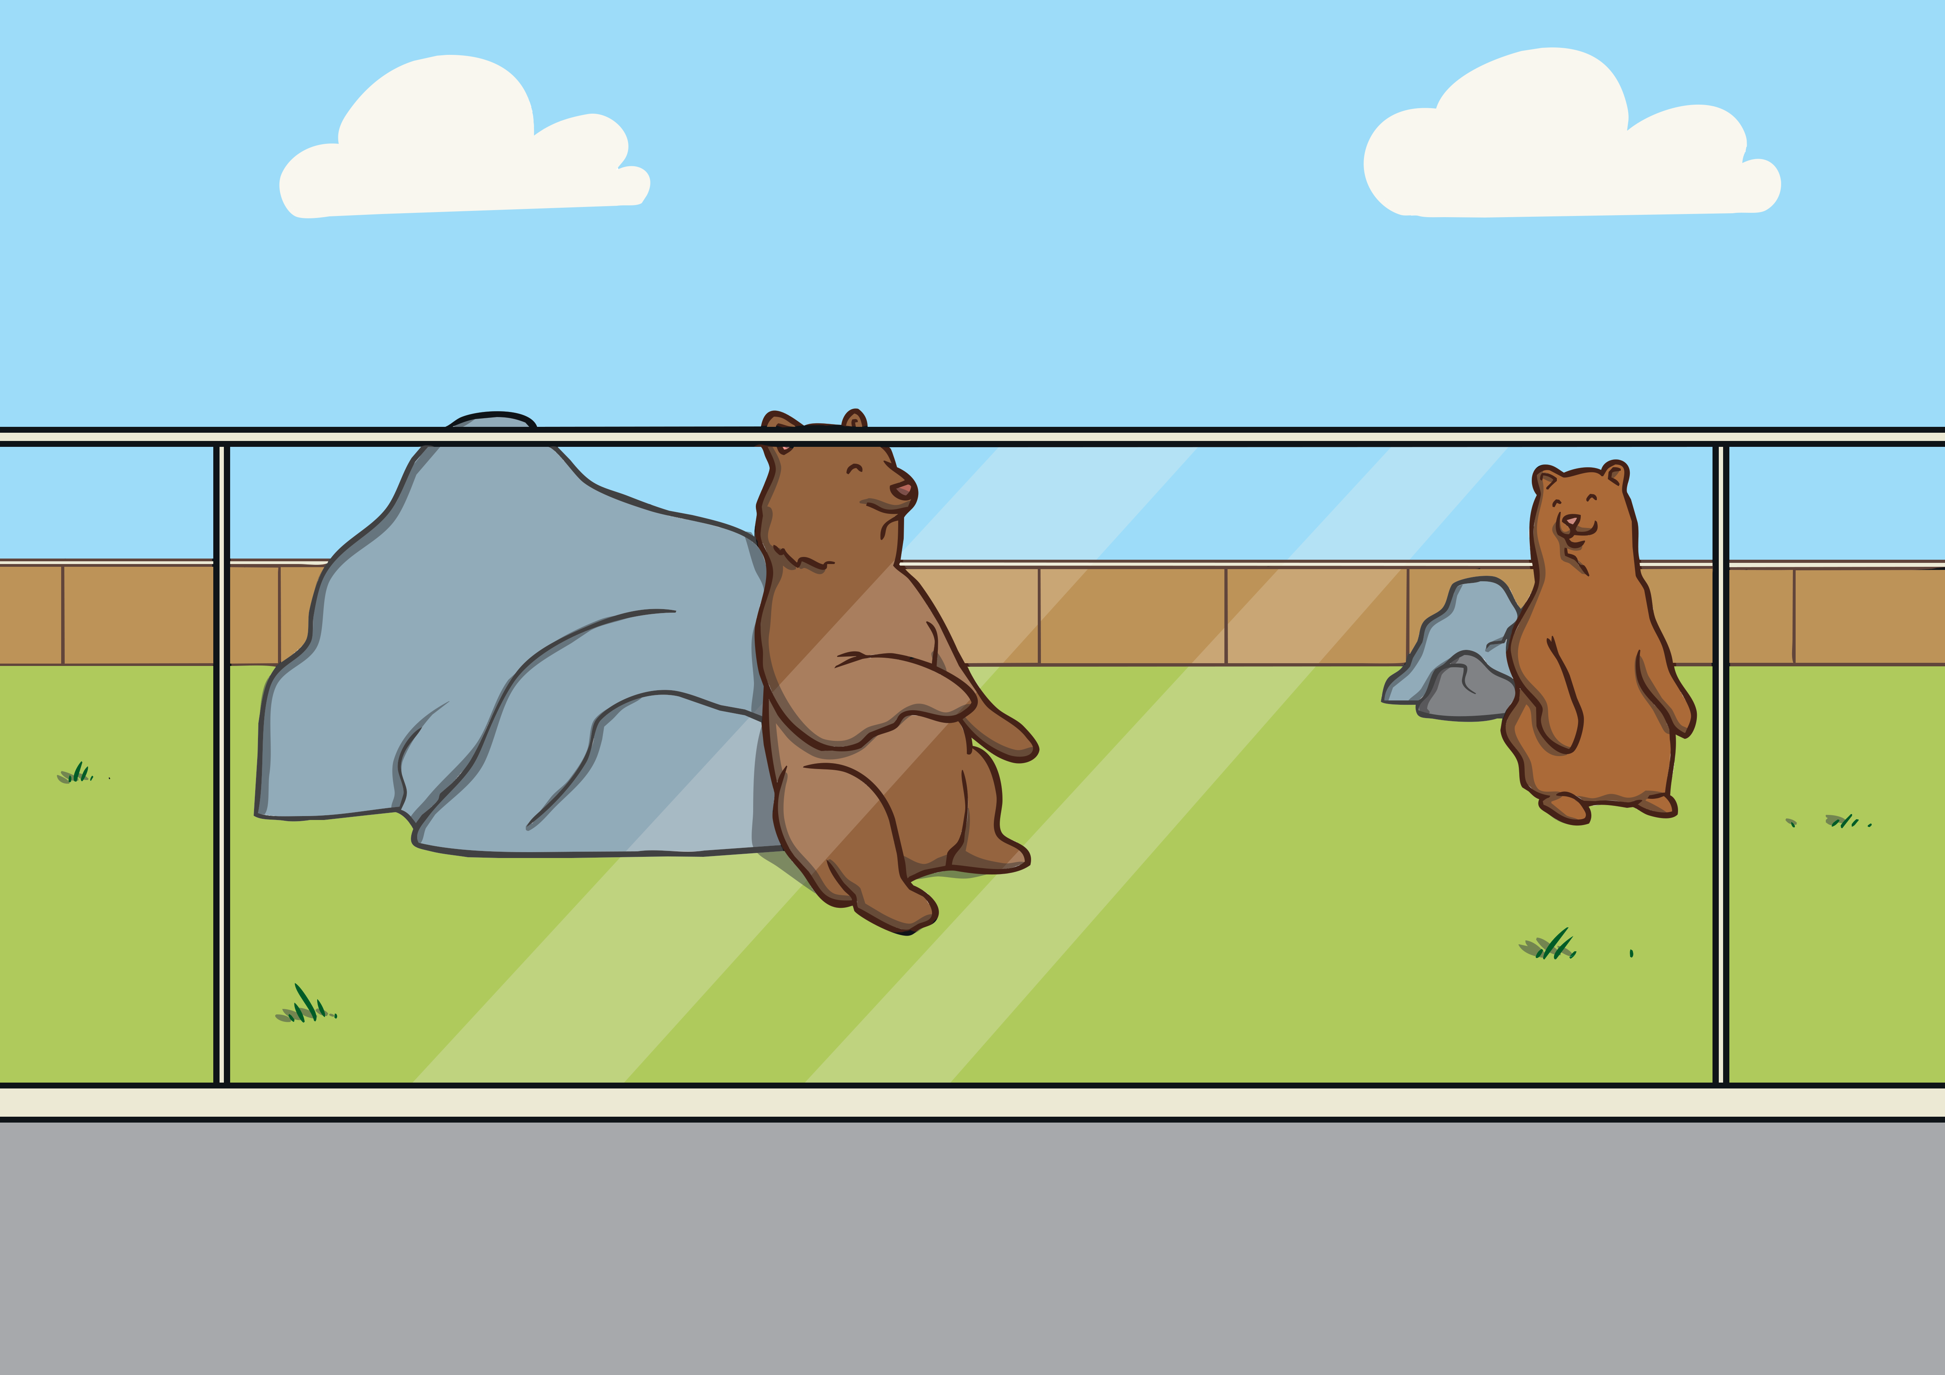
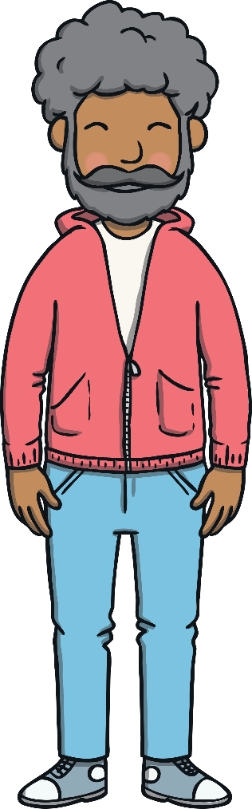



Apply
Kit, Sam, Jake and Philip enjoyed the rest of their day looking at lots of different animals in the zoo. “Is there anything that you would like to see before we have to go?” asked Philip.
“Could we go back to the dolphins please?” asked Sam. “I would like to have one last look before I start to write my project."

Slide 26
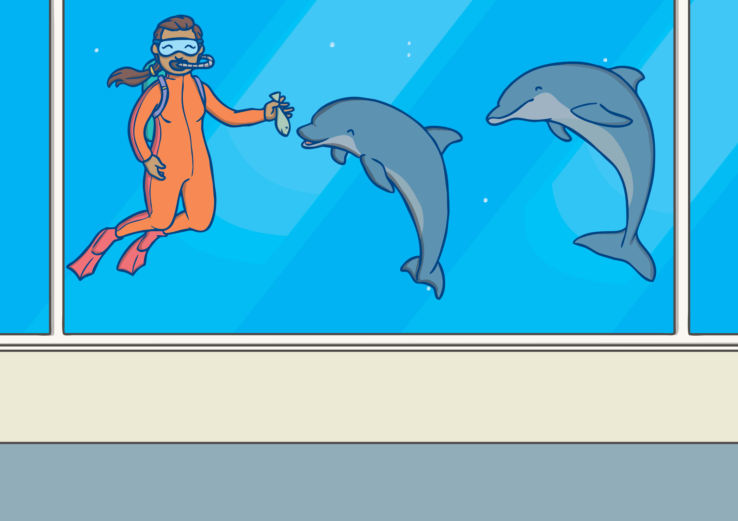
Apply
When they arrived back at the dolphin tank, they saw one of the keepers in the tank with the dolphins feeding them. “It would be great to get that close to the animals that we are going to do our projects on,” Kit whispered to Sam.

Slide 27
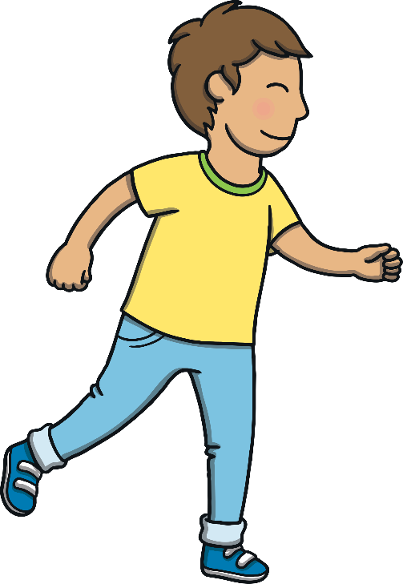

Apply
“Quick, come with me!” whispered Sam, pulling Kit around a corner and out of sight of the others.

Slide 28

Today, we have learnt…
ph
saying /f/
The adventure continues next lesson!

