Slide 1






Guidance for Video/Audio in PowerPoints
1. Open the folder and copy all the files.
2. Paste the copied files into a new folder.
3. Open the PowerPoint file, enable editing and enter presentation mode (start the slide show).
Please note the embedded audio may not be compatible with early versions of PowerPoint.
You may wish to delete this slide before beginning the presentation.

Slide 3

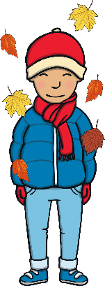








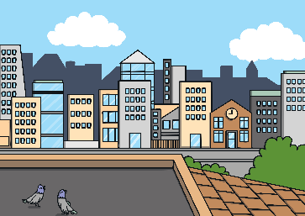
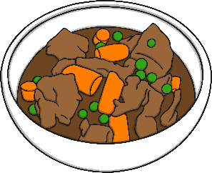



Revisit and Review
Let’s practise Sam’s Sounds and Common Exception Words!
ph
y
au
ir
c
oe
ue
ue
wh
ew
g
aw
ew
ow
lived
laughed
work
because
once
house
many
also
different
Thursday
horse
any
eyes
friend
please
Monday
Tuesday
Wednesday

Slide 4


Teach
This week, we are learning to spell the common exception words because and different.
Watch the magic pencil write the words. Can you join in?

Slide 5


Teach
because
Play

Slide 6
Teach
different
Play

Slide 7

Teach
Today, we are learning to write words that contain ph saying /f/.

Slide 8
Teach
Kit and Sam were by the dolphin tank when Sam pulled Kit around the corner. “Would you really like to get closer to the animals that we are doing our projects on?” asked Sam, pulling out the magic map from her bag.

Slide 9
Teach
“Yes! Let’s go!” cried Kit. With that, the room began to fade around them.

Slide 10
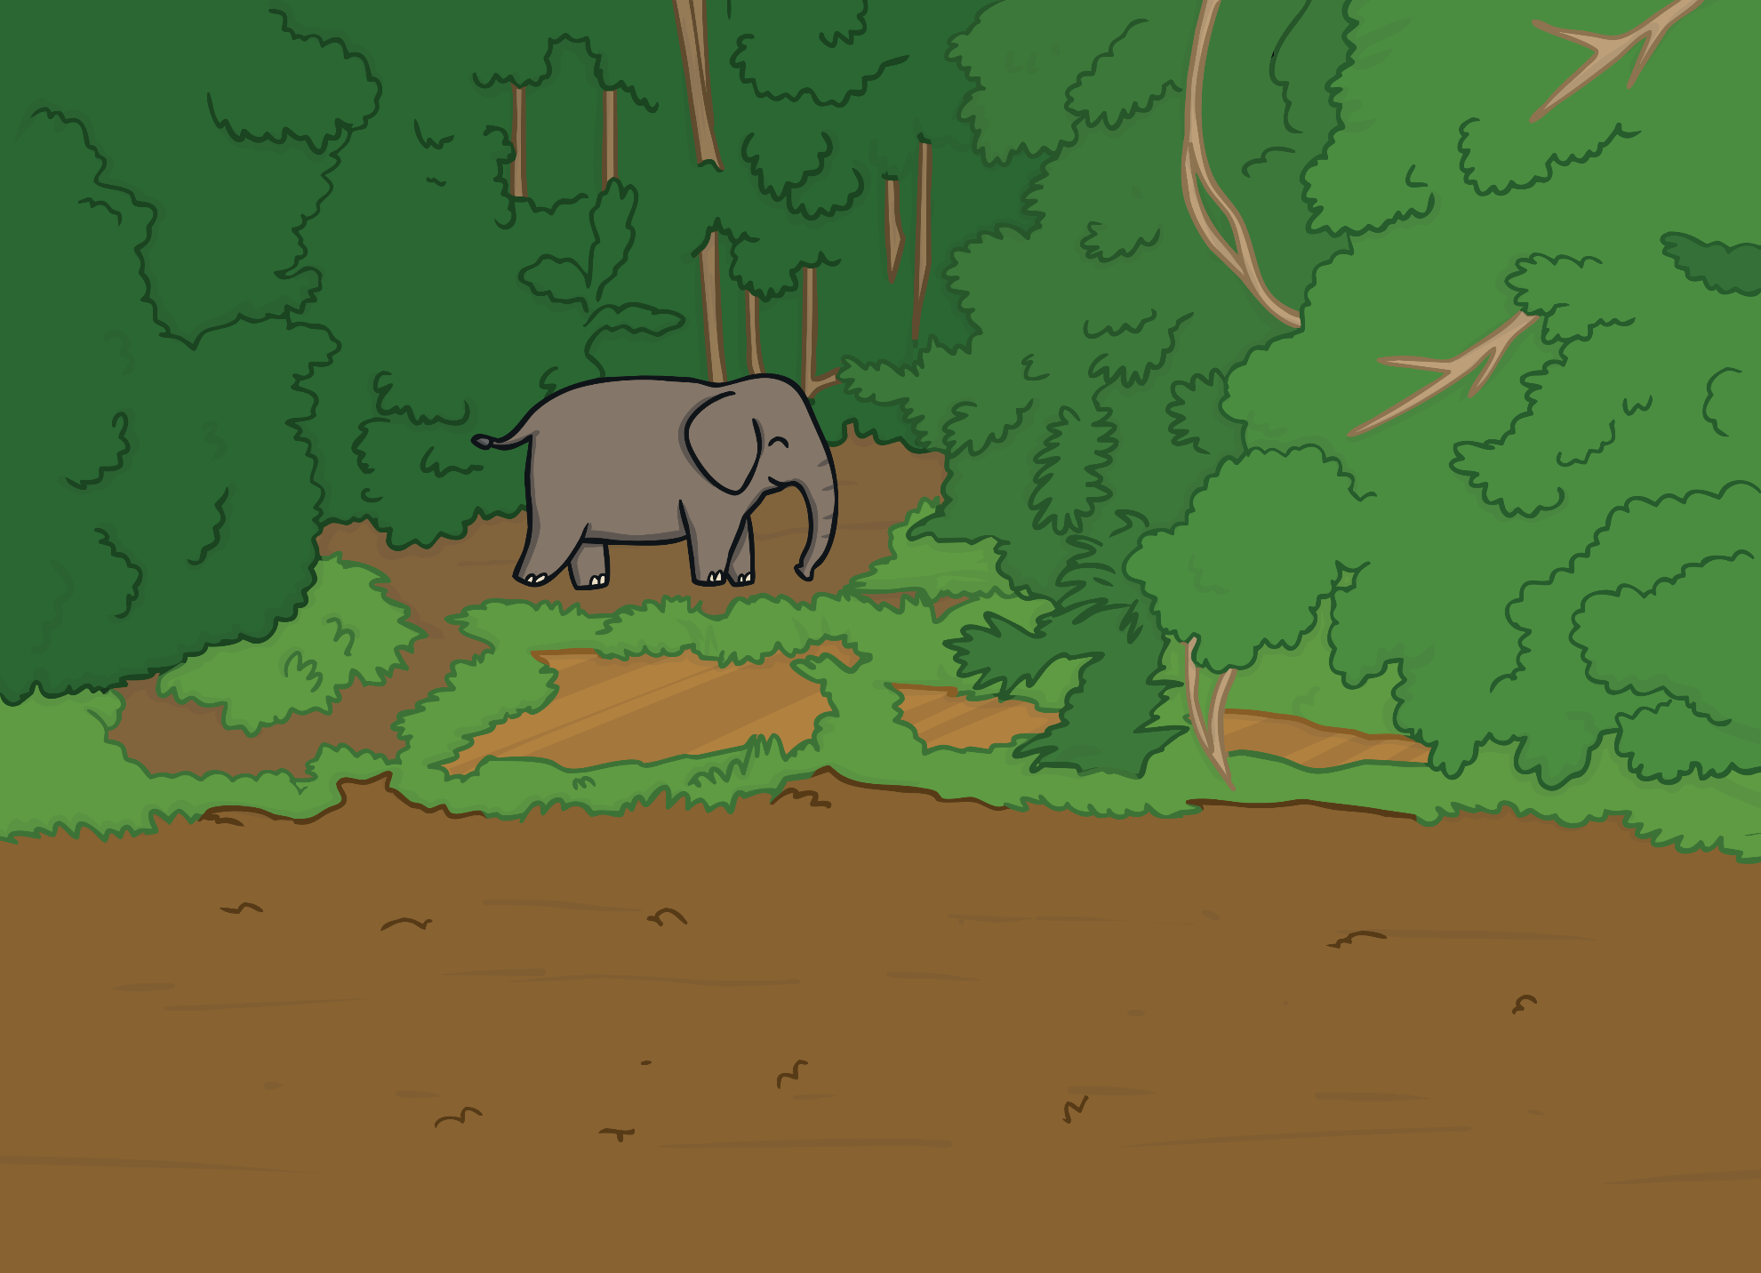
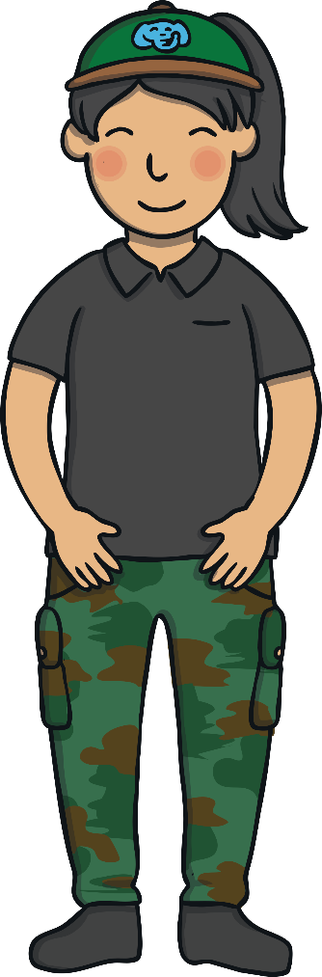

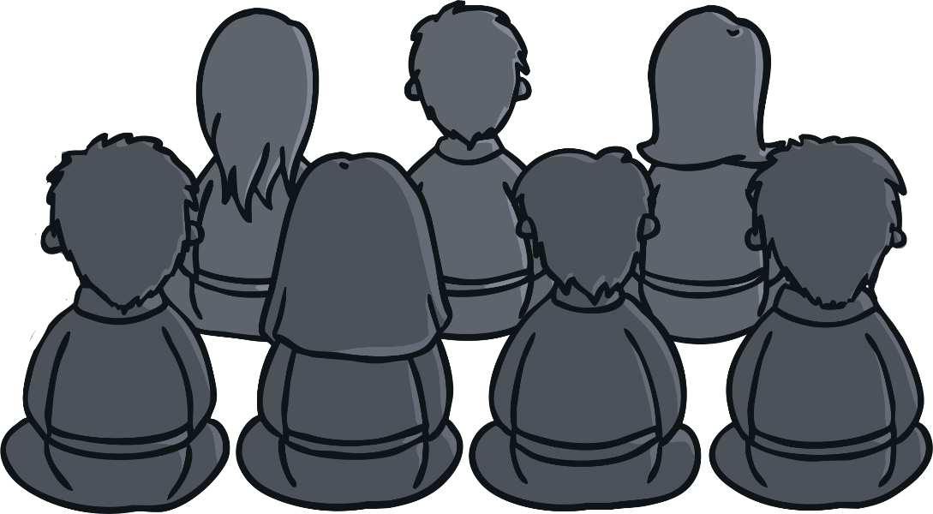
Teach
Kit and Sam found themselves in a jungle at the back of a group of people. Everyone was watching a baby elephant and listening to a lady speak. “This is our new baby elephant. He is an orphan, so we are looking after him until he is old enough to be released.”

Slide 11


Teach
After she had finished talking, the lady came over to Kit and Sam and held out her hand. “Hi there,” she said smiling. “Sorry I did not see you at the beginning. Welcome to Thailand!

Slide 12

Teach
Thanks for volunteering to help out with our elephants. Here is everything you need to know.” She handed Kit and Sam a piece of paper with lots of writing on.

Slide 13



Teach
Oops! The jungle is hot and when they have a cool drink, Kit and Sam accidentally spill some water on the information sheet! Can you fill in the letters that are missing?
X
They are all ‘ph’ words or this week’s common exception words.
Click me for Kit’s teaching tips!

Slide 14



Teach
Turn phones off.
Do not take photos.
Elephants are timid so be quiet.
Feed the elephants lots of different food.
Do not run because you might trip.
Check

Slide 15

The ‘To Do’ List
Practise
Kit and Sam are also given a ‘to do’ list.
Look at the picture and fill in the missing word.
X
This is a great whiteboard activity.
Click me for Kit’s teaching tips!

Slide 16


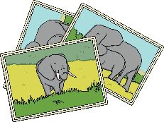
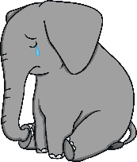
Practise
To Do
Feed all the elephants.
Take a register of all the elephants you can see. The names on the register are in the same order as the alphabet.
Look at the photos of our elephants if you are not sure which is which.
Check that the new baby orphan elephant is okay.
To Do
Feed all the s.
Take a register of all the elephants you can see. The names on the register are in the same order as the .
Look at the s of our elephants if you are not sure which is which.
Check that the new baby elephant is okay.
Check

Slide 17
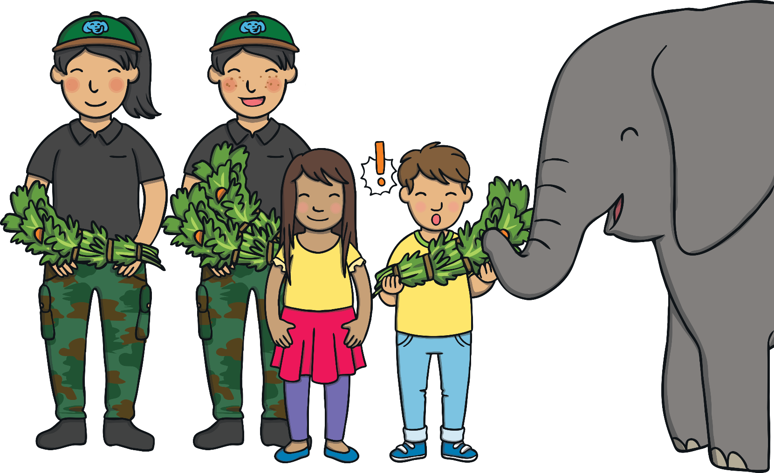
Apply
Kit, Sam and the other volunteers began by feeding the elephants. “Did you know that elephants eat up to one hundred and sixty-nine kilograms of food per day?” said one of the other volunteers to Kit.

Slide 18
Apply
“Wow!” said Kit, looking at the bundle of leaves he was feeding the elephants. “That is a lot of leaves!”

Slide 19


Sentence Time
Apply
Kit and Sam are trying to take the register to see which elephants are there. They are not sure what some of their names are. What do Kit and Sam need to do? Write a sentence to match.

Slide 20

Apply
We need to look at the photos of the different elephants because we are not sure of their names.
Sound Buttons On/Off
Show

Slide 21
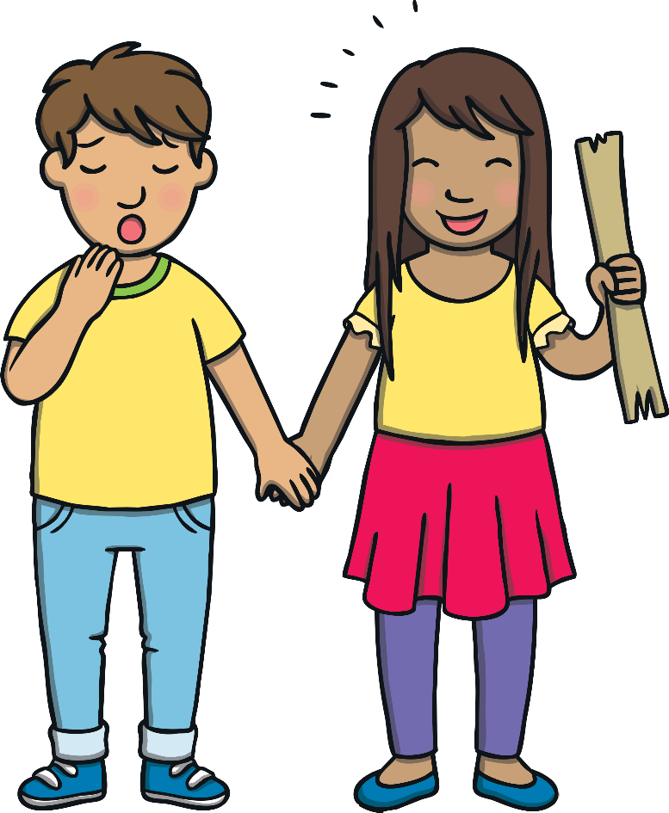
Apply
Kit and Sam had worked their way through their ‘to do’ list. “Let’s go for a rest,” yawned Kit as he sat down with a bump.
“No way!” said Sam, pulling Kit to his feet. “We have seen your elephants but I still need to go and visit my dolphins.”

Slide 22
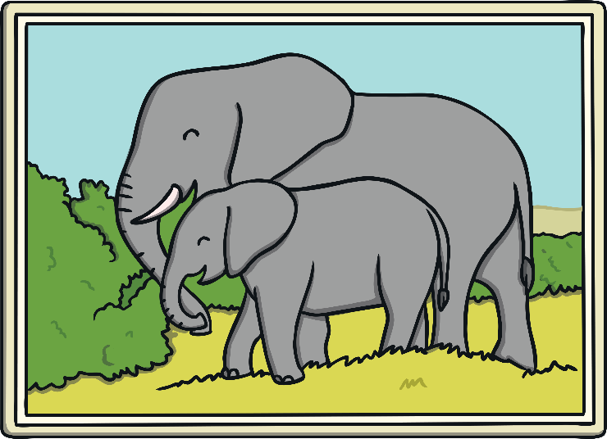
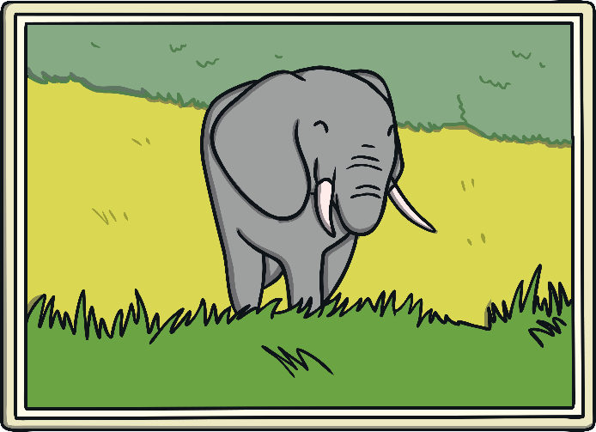
Today, we have learnt…
aw
saying /or/
The adventure continues next lesson!

