Slide 2

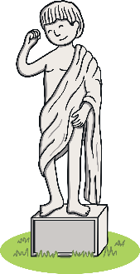



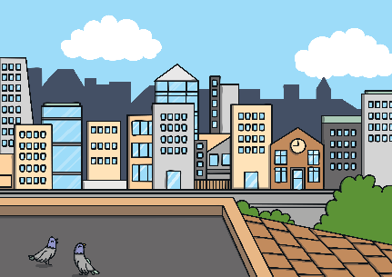






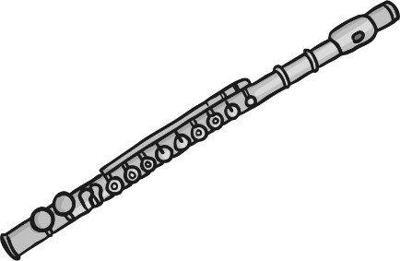
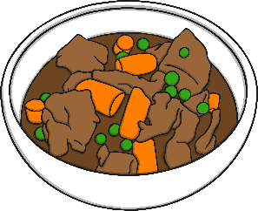


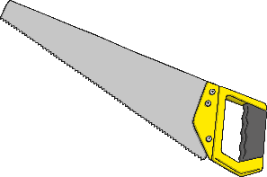
Revisit and Review
Let’s practise Sam’s Sounds and Common Exception Words!
y
ue
c
ir
g
u_e
ow
oe
ew
au
u_e
ue
wh
ew
ph
aw
house
many
coming
because
Monday
any
once
eyes
friends
different
please
Wednesday
laughed
Tuesday
lived
Thursday
work
also

Slide 3

Teach
Today, we are learning to read words that
contain ph saying /f/.

Slide 4

Teach
Let’s practise reading some of this week’s focus words that contain the ph sound.
photo
microphone
graph
orphan

Slide 5


Teach
Watch the magic pencil write the words.
Can you join in?

Slide 6


Teach
photo
Play

Slide 7
Teach
microphone
Play

Slide 8
Teach
graph
Play

Slide 9
Teach
orphan
Play

Slide 10
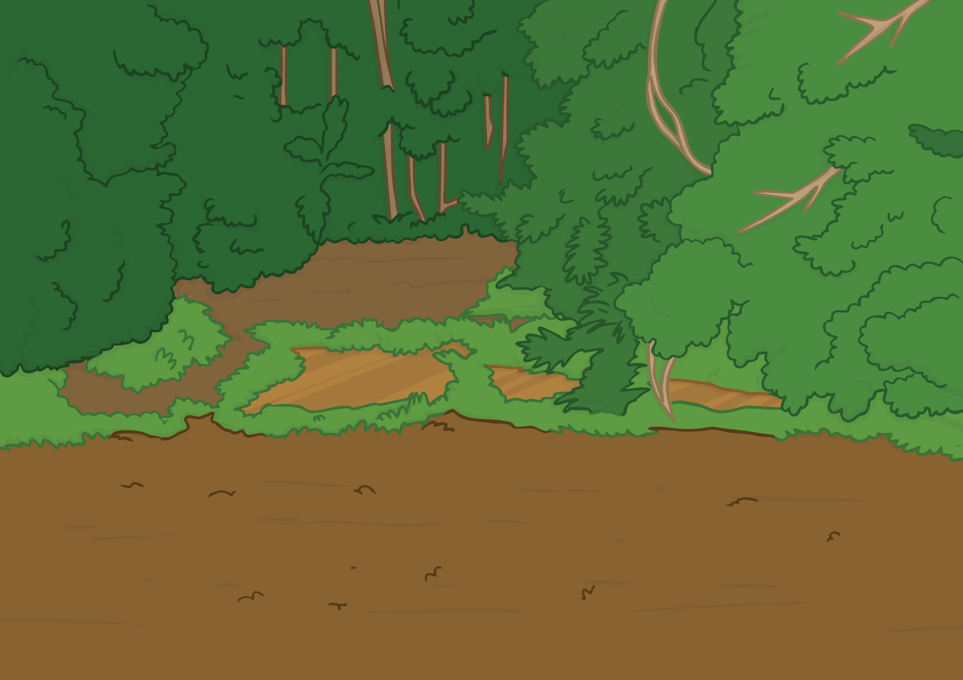
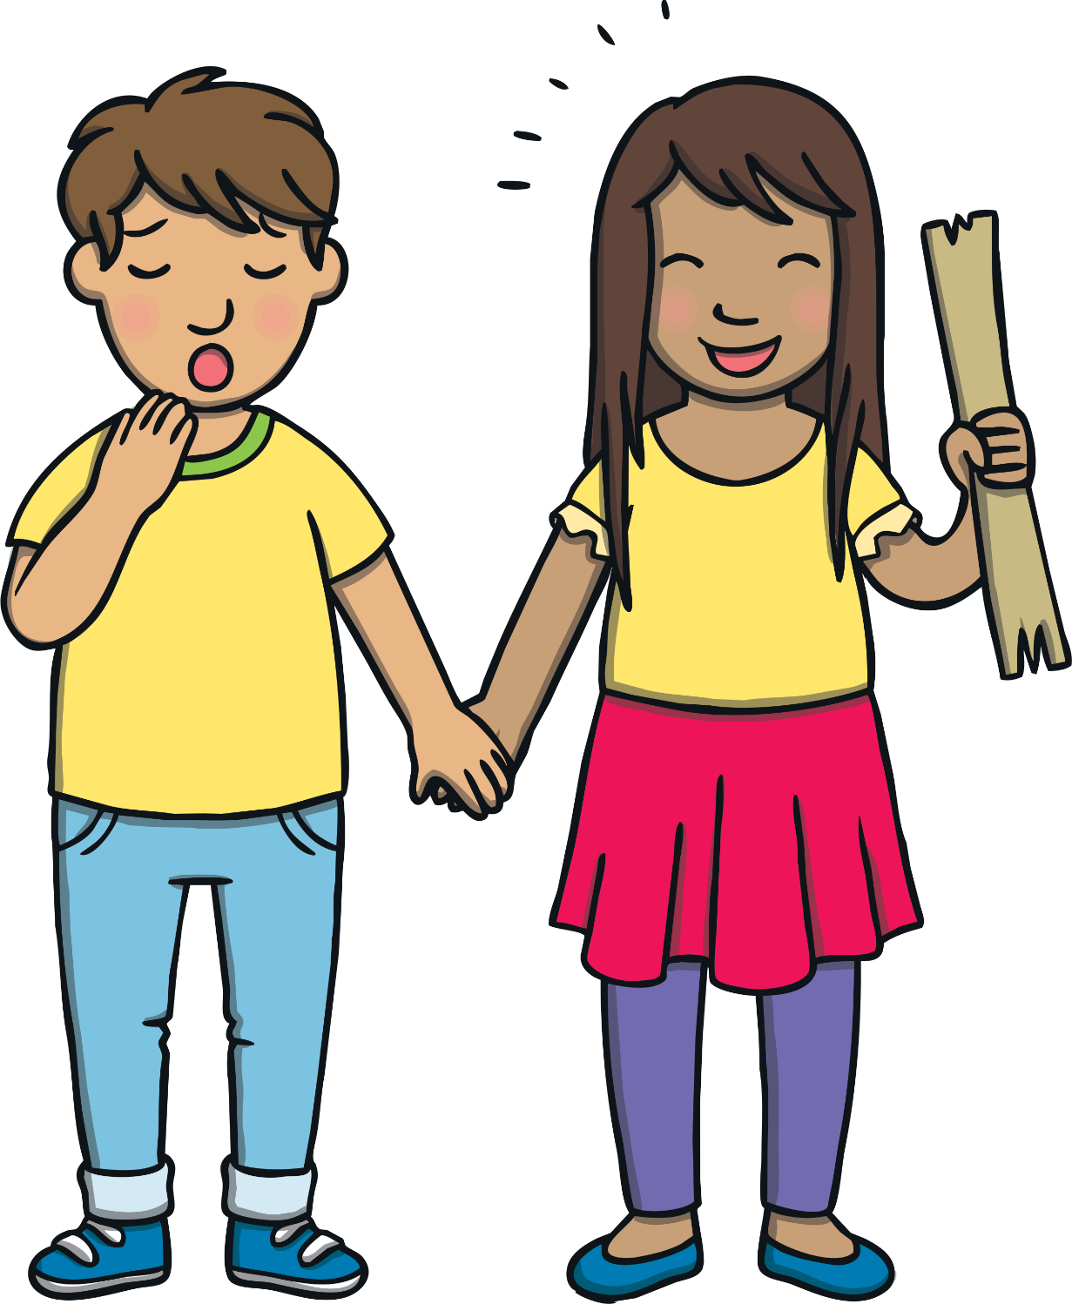
Teach
Kit and Sam had had a fantastic time visiting the elephants and were now on their way to visit some dolphins. “I wonder where the magic map will take us this time,” said Sam, excitedly.

Slide 11
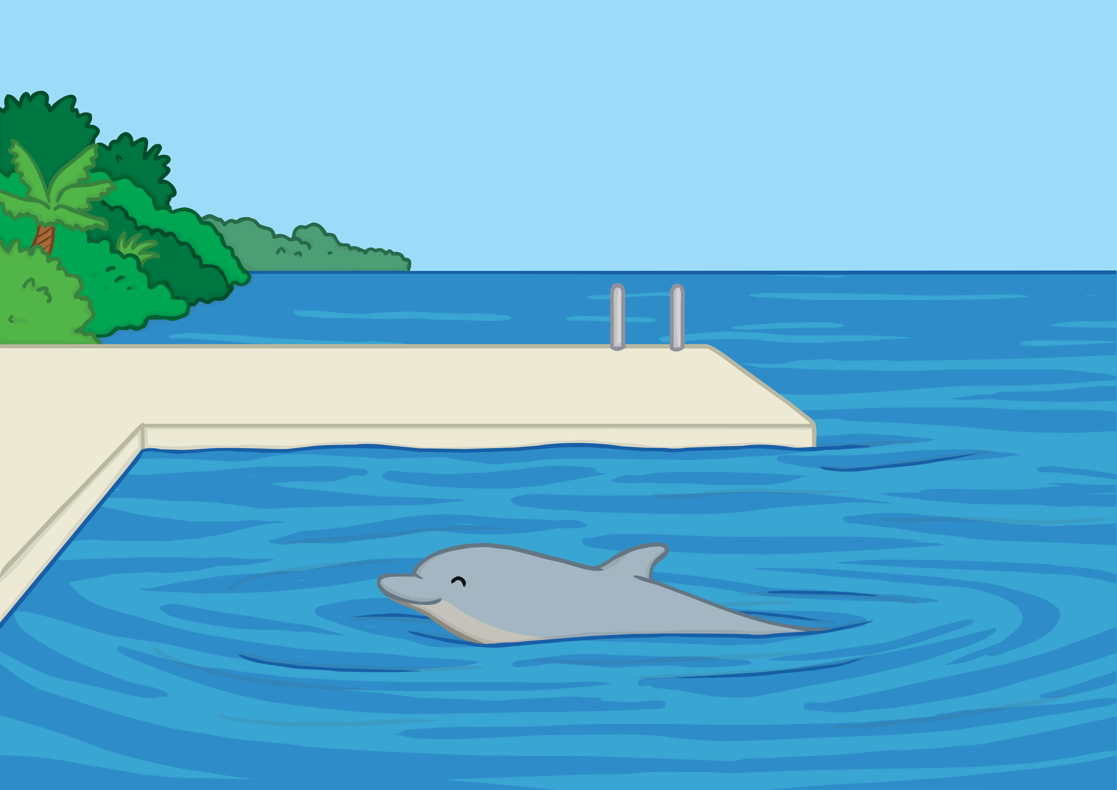


Teach
Kit and Sam found themselves standing on a jetty in a beautiful bay. As they looked around, a dolphin suddenly popped up from under the water.

Slide 12
Teach
“Hello!” said Sam, giggling. “Quick Kit, take a photo of this cheeky dolphin.”

Slide 13

Teach
As they were photographing the dolphin, a lady with a clipboard walked over. “Hi there,” she said cheerfully. “Welcome to Florida Bay. I’m Steph. I guess you two are here to help us with our research.”
“Er,” said Sam, looking unsure.
“Great!” said the lady. “Come with me and we will get started.”

Slide 14

Steph the Scientist
Teach
As they walk, Steph marks some things off a list on the clipboard.
Click the speech bubble and write down what she says.

Slide 15


Teach
Click here
photo
microphone
graph
orphan
Answers

Slide 16
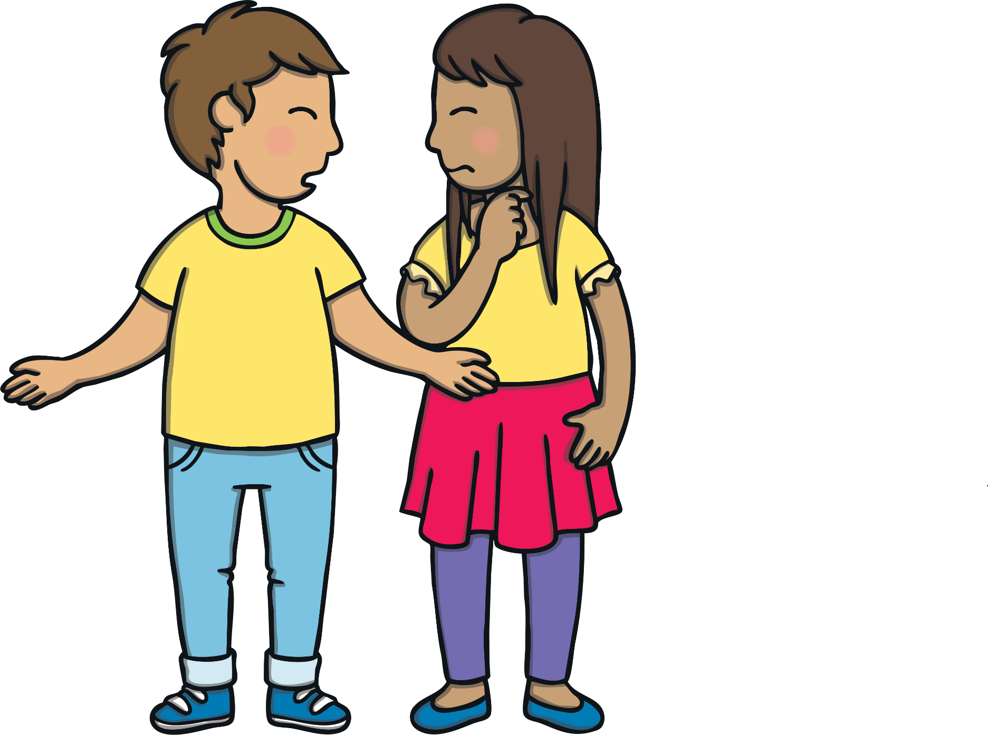
Equipment Check
Practise
Steph shows Kit and Sam around the storage room containing
all the equipment that they will need.
Write down everything you see that has ph in it.

Slide 17
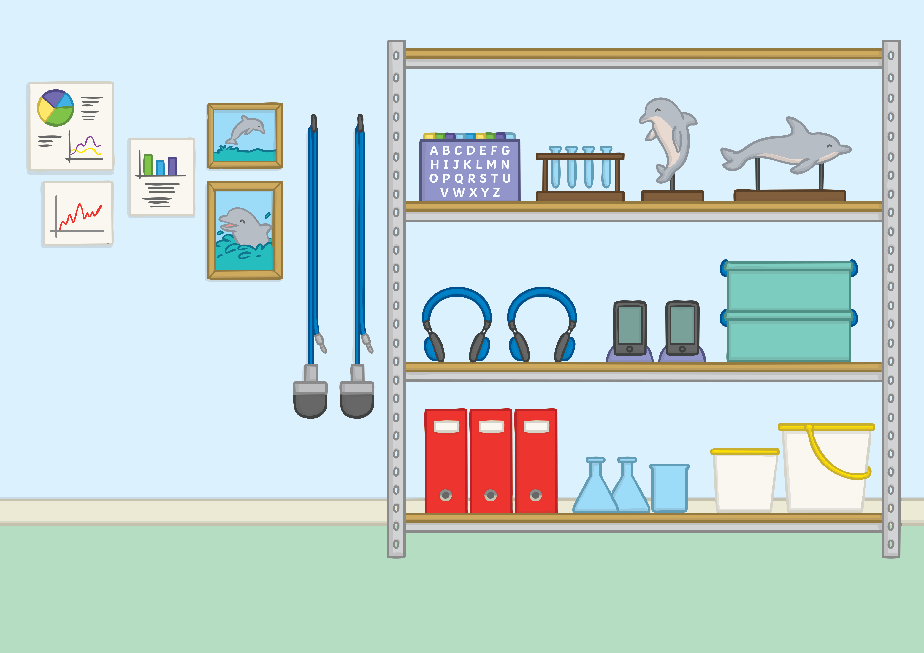
Practise
graphs
alphabet
dolphin
photos
phones
microphones
Check

Slide 18
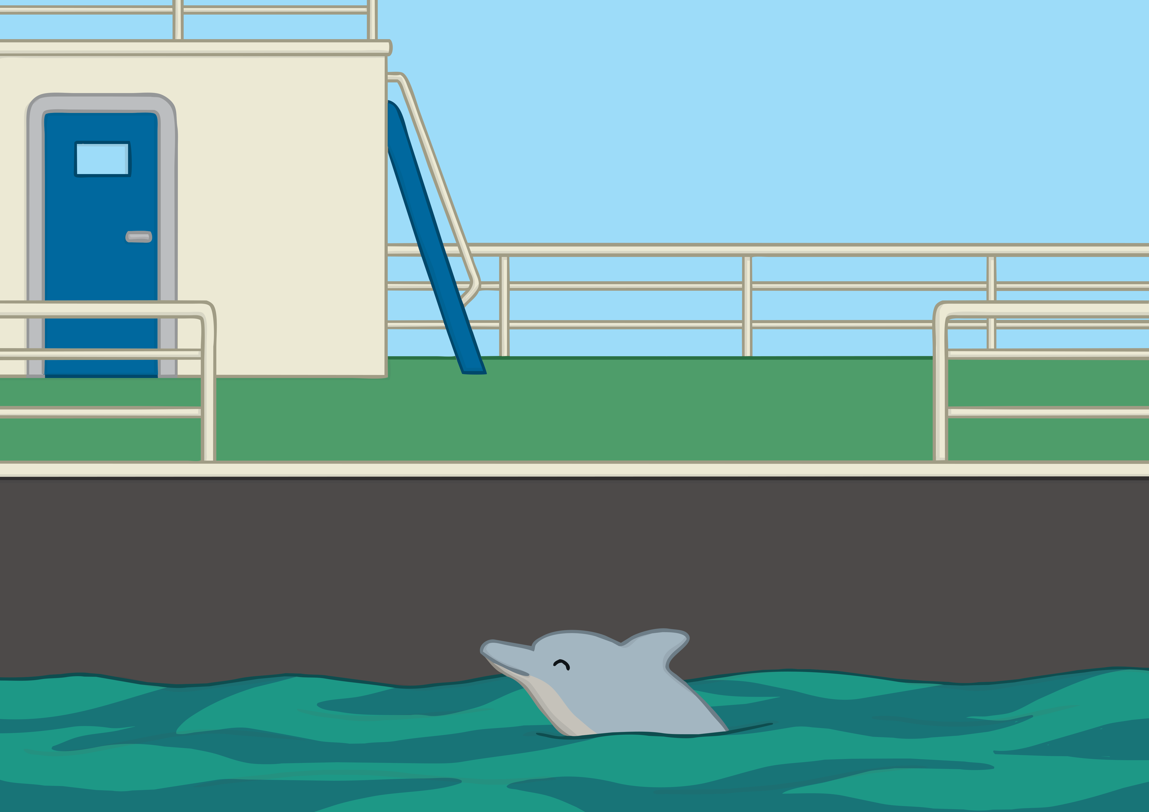


Apply
Before long, Kit, Sam and Steph were on a dolphin research boat, heading out to sea. “We need to collect information about the dolphins, then we can make graphs to show what we found,” said Steph.

Slide 19
Apply
“Kit, could you take photos of any dolphins that you see please?”

Slide 20

Sentence Time
Apply
What does Steph ask Sam to do? Write a sentence to match.

Slide 21


Apply
Hold the microphone
in the sea to hear
the dolphins!
Sound Buttons On/Off
Show

Slide 22


Apply
“Wow!” cried Sam. “I can hear the dolphins through this microphone!”
Steph smiled. “It is called chattering. Just like when we talk to each other, it seems that dolphins do, too.”
“Amazing,” said Sam. “I can’t wait to write all about them!”

Slide 23

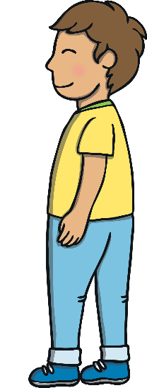
Apply
Kit and Sam were sad when their boat trip came to an end. “Thank you so much for your help today,” said Steph. “I’m going to go and use all this information to help me make some graphs. We will use what we found out to help keep the dolphins safe.”
“You have helped us a lot too, so thank you” smiled Sam. “Come on, Kit. We should go back and get writing our projects.”

Slide 24

Today, we have learnt…
ph
saying /f/
The adventure continues next lesson!

