Slide 1






Guidance for Video/Audio in PowerPoints
1. Open the folder and copy all the files.
2. Paste the copied files into a new folder.
3. Open the PowerPoint file, enable editing and enter presentation mode (start the slide show).
Please note the embedded audio may not be compatible with early versions of PowerPoint.
You may wish to delete this slide before beginning the presentation.

Slide 3









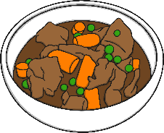
Revisit and Review
Let’s practise Sam’s Sounds and Common Exception Words!
au
ue
y
oe
ow
ir
wh
aw
ew
any
different
laughed
because
please
friend
house
many
horse
work
lived
once
also
eyes

Slide 4

Teach
This week, we are learning to spell the common exception words work and house.
Watch the magic pencil write the words. Can you join in?

Slide 5


Teach
work
Play

Slide 6
Teach
house
Play

Slide 7

Teach
Today, we are learning to write words that contain wh saying /w/.

Slide 8
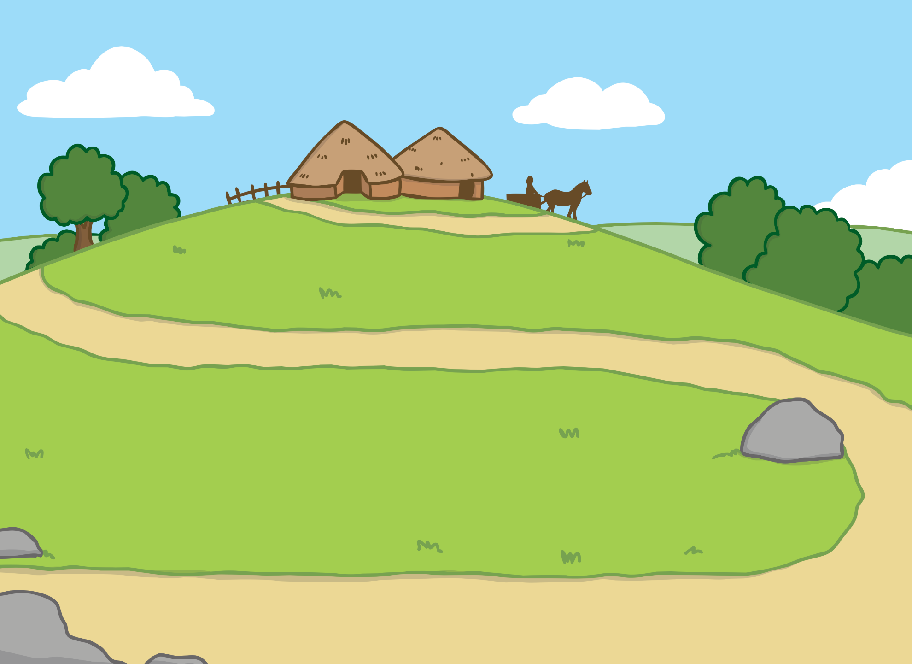
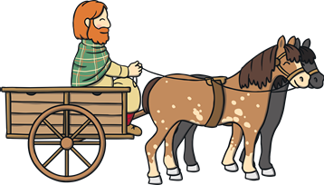



Teach
Ben and the white dog ran around the lady with the long dress. “Calm down, boys!” said the lady. Then, the man from the cart called out something. Immediately, the dog ran to him.

Slide 9
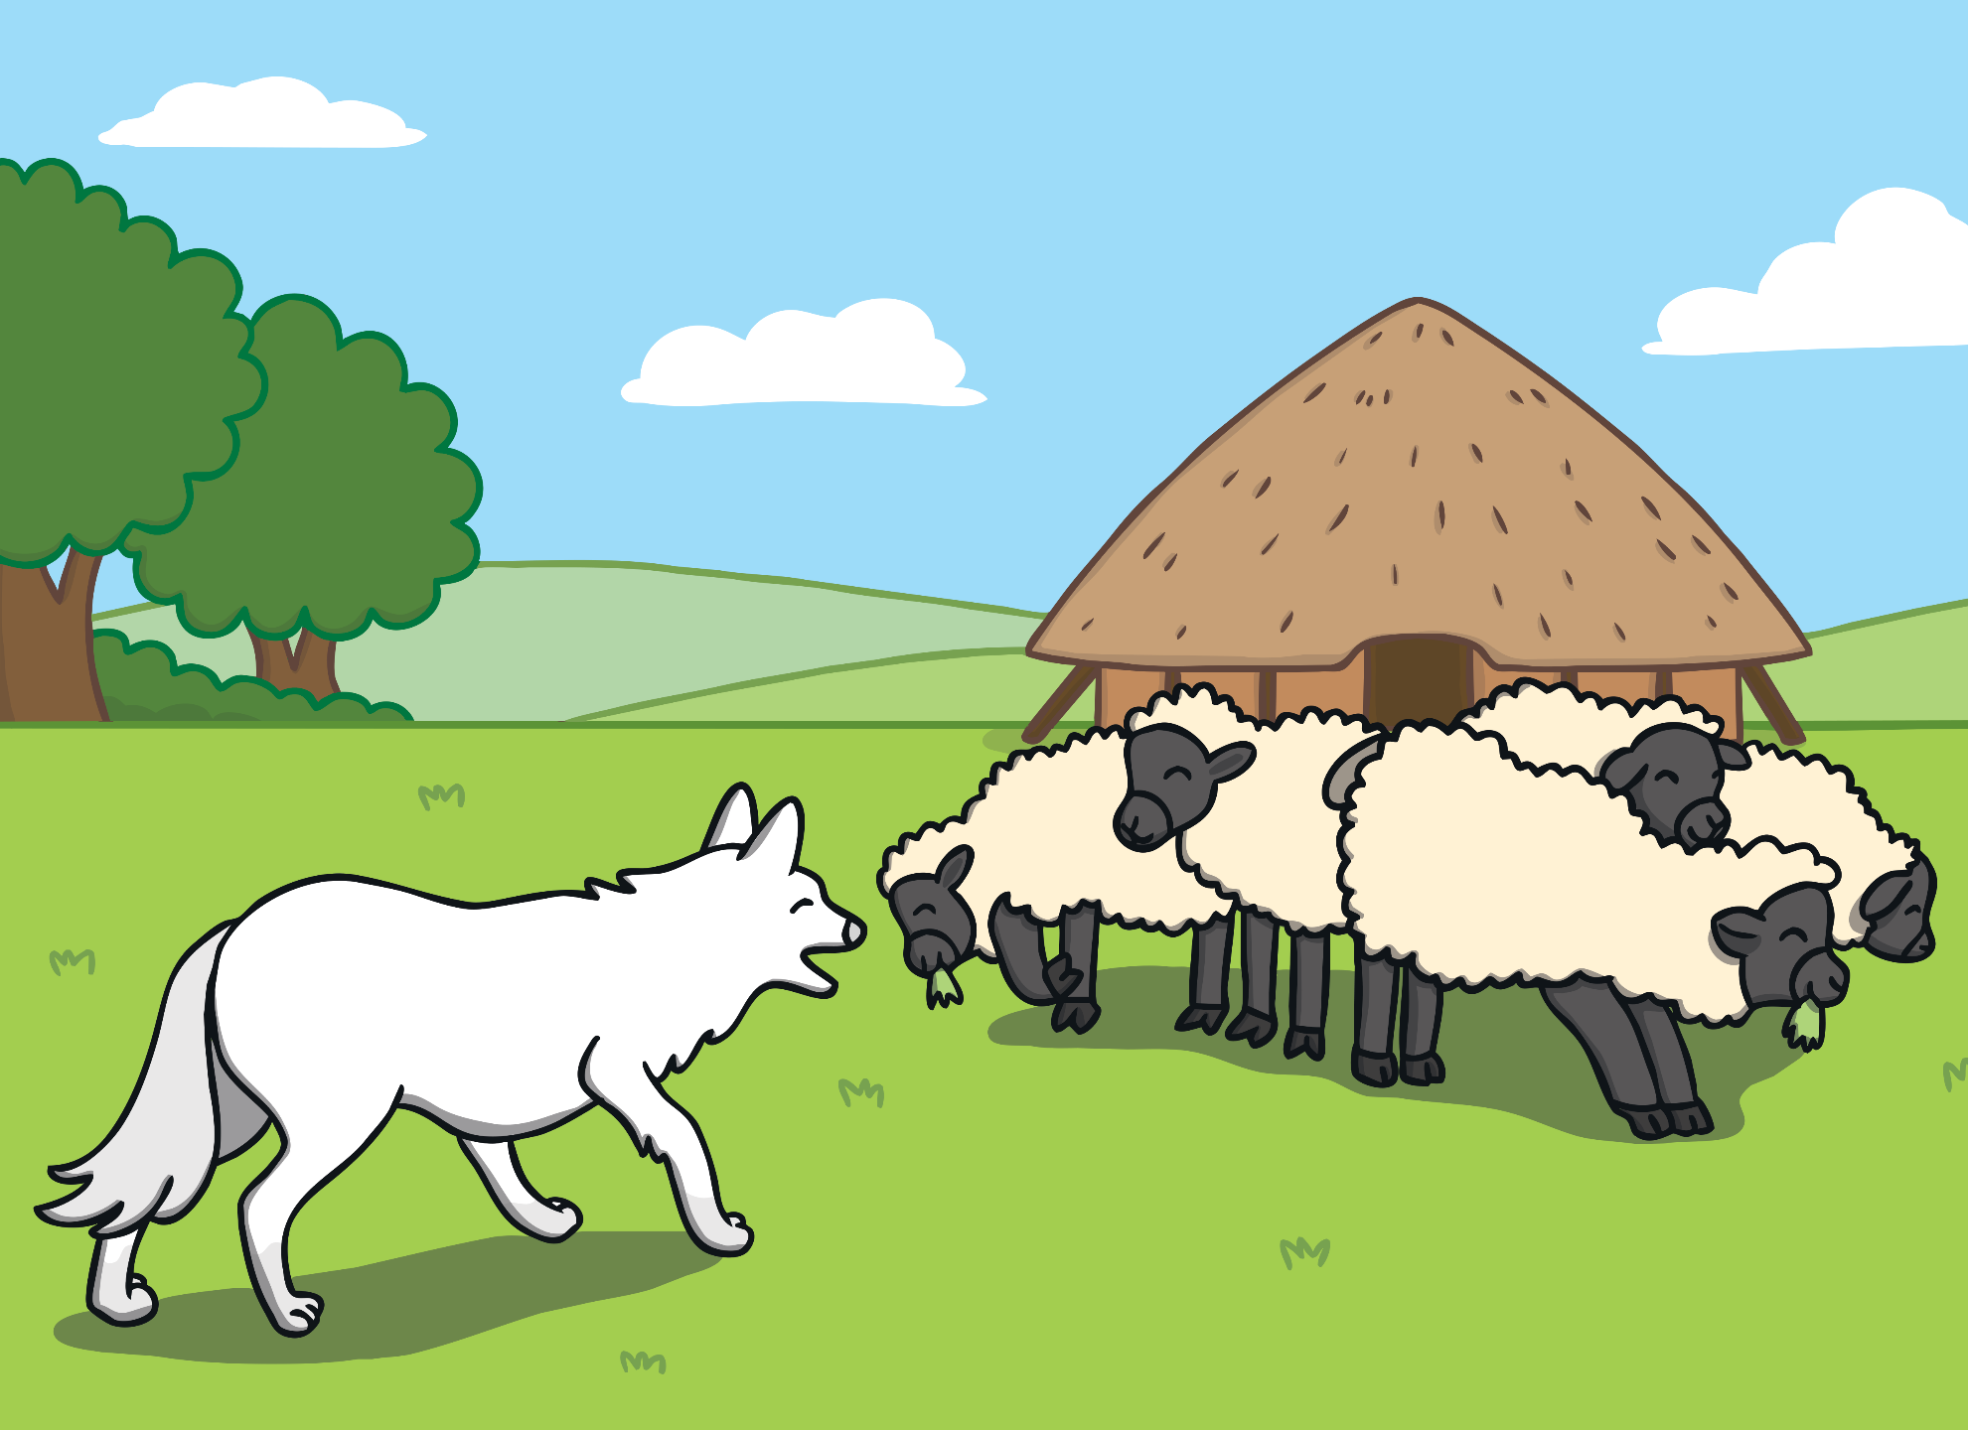
Teach
For a while, Ben watched what the white dog was doing. Then, Ben decided to follow him and join in. The dog was busy rounding up a flock of sheep. Ben thought chasing sheep would be fun!

Slide 10

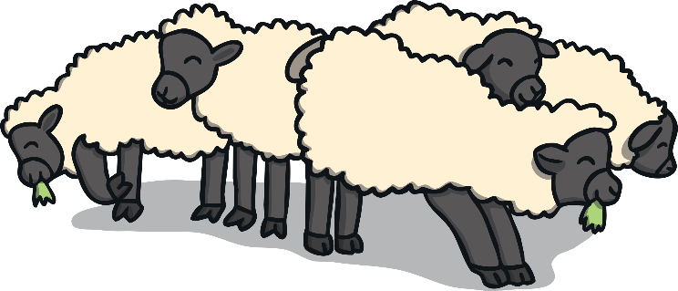


Teach
Ben enjoyed helping round up the sheep. He loved being outside in the fresh air. However, he soon got tired. Being a working dog on a farm was hard work. When Ben saw the lady in the long dress approach him, he stopped and stared at her.

Slide 11


Dress Patterns
Teach
Ben notices a pattern on the ladies dress. It looks a bit like jumbled up letters. Rearrange the jumbled letters to make real words.
Write down the words.
X
The answers will all be ‘wh’ words. You can remind the children that ‘wh’ usually goes at the beginning of the word.
Click me for Kit’s teaching tips!

Slide 12

Teach
wh ff i
whiff
i p wh
whip
s k i wh
whisk
ir wh l
whirl
Click on the lady to check if you correctly spelt the words.

Slide 13

Ben’s Thoughts
Practise
Ben starts to relax for a moment with his mind drifting off. Write down what Ben is thinking about.
X
This is a great whiteboard activity.
Click me for Kit’s teaching tips!

Slide 14



Practise
wheel
Check

Slide 15

Practise
wheat
Show

Slide 16

Practise
white whale
Show

Slide 17

Practise
wheelchair
Show

Slide 18
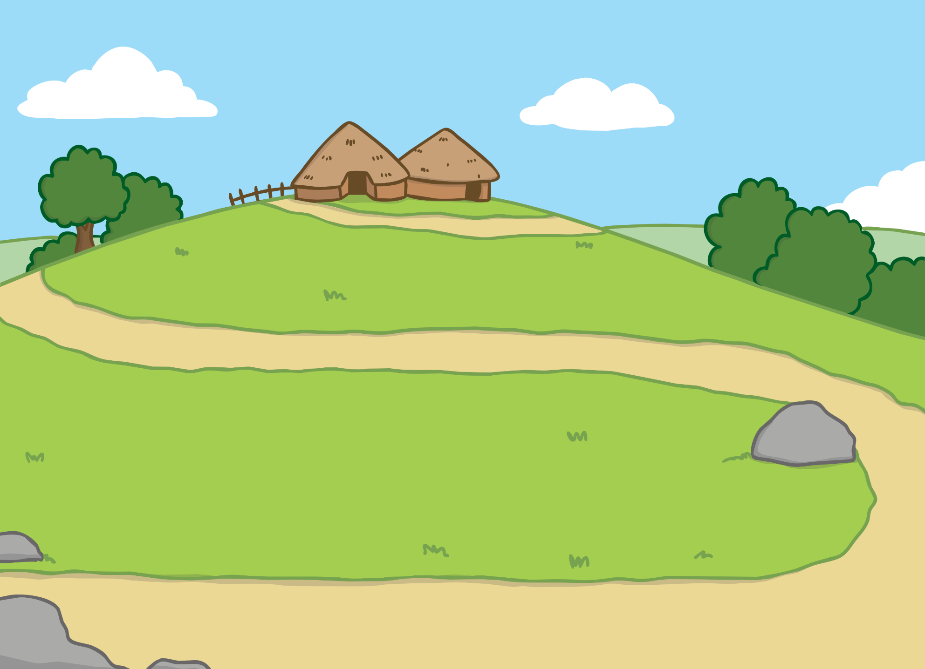
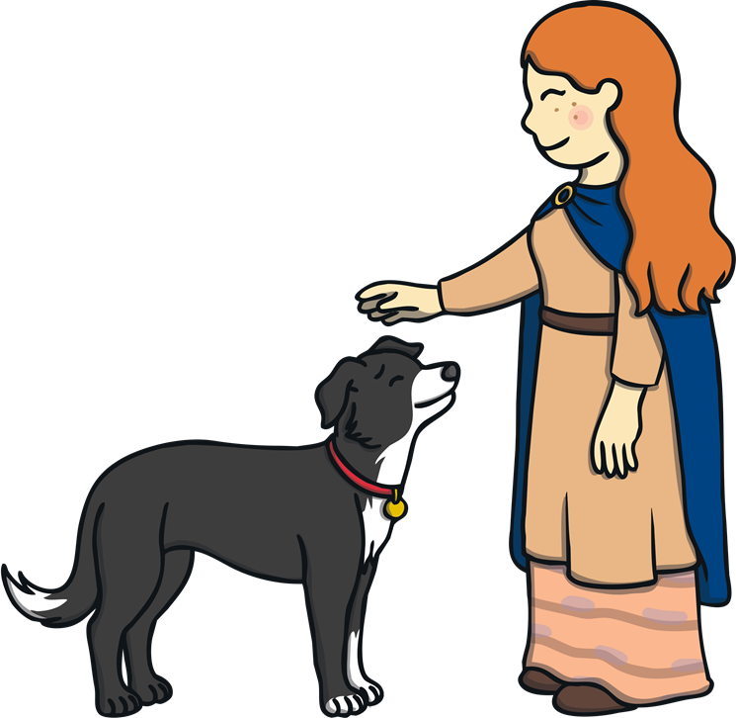
Apply
The lady looked down at Ben and patted his head. “I think you are a tired dog after all of that work,” she said. “Let’s go and get some water to cool you down.”

Slide 19

Sentence Time
Apply
Ben is a very tired and thirsty dog. What is he hoping the lady will give him? Look at the picture and write a sentence to match.

Slide 20
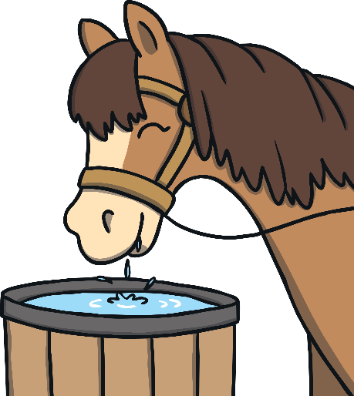

Apply
I hope she lets me have a big bucket of water like a horse has.
Sound Buttons On/Off
Show

Slide 21

Apply
Ben was so relieved to have a drink. While he was drinking, he heard lots of loud banging in the background. Quickly, Ben turned around. ‘What was that?’ he wondered.

Slide 22
Today, we have learnt…
wh
saying /w/
The adventure continues next lesson!

