Slide 2

Revisit and Review
Let’s revisit last week’s focus words…
I’ll say them and you write them down!

Slide 3


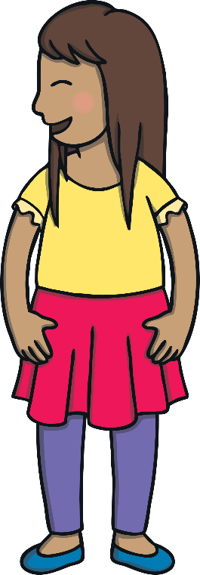



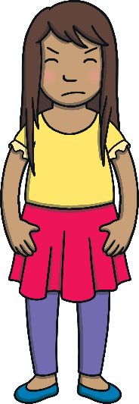
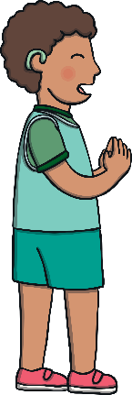
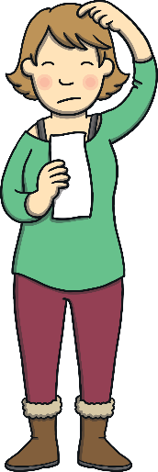

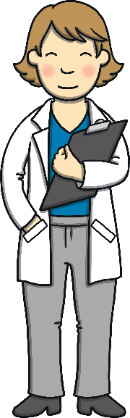


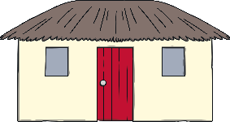
Revisit and Review

Slide 4
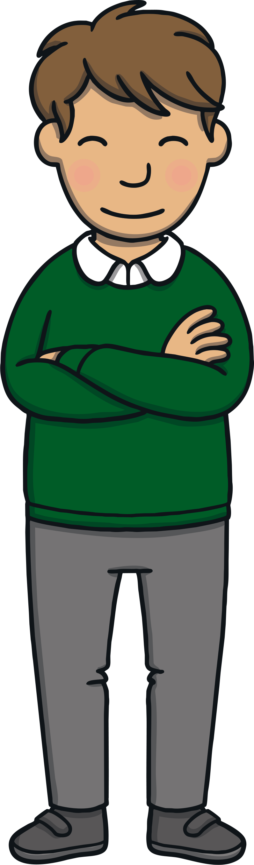
Teach
Here are this week’s focus words for reading…
Monday
Tuesday

Slide 5
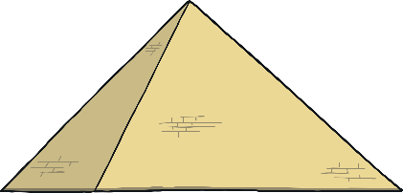

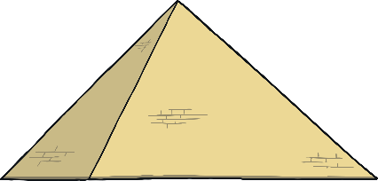

Hidden Gems
Practise
Click on the pyramids to reveal the common exception words and gems.
Tuesday
Monday
Tuesday
Tuesday
Monday
Monday

Slide 6
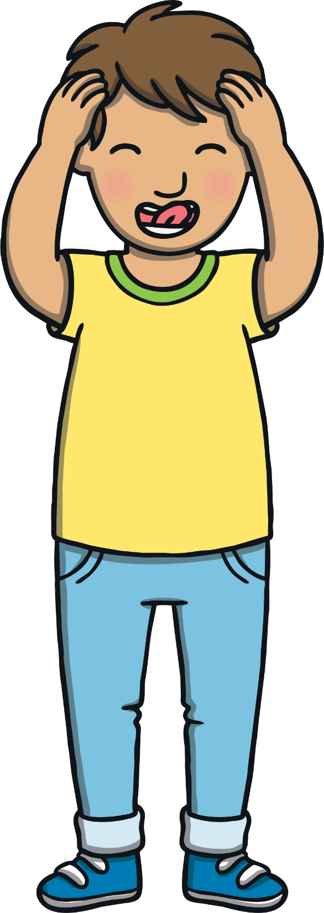

Teach
Today, we are learning to read words
that contain g saying /j/.
When the grapheme ‘g’ is before an ‘e’, ‘i’ or ‘y’, its sound is soft and it makes the /j/ sound.
X
Click me for Kit’s teaching tips!

Slide 7
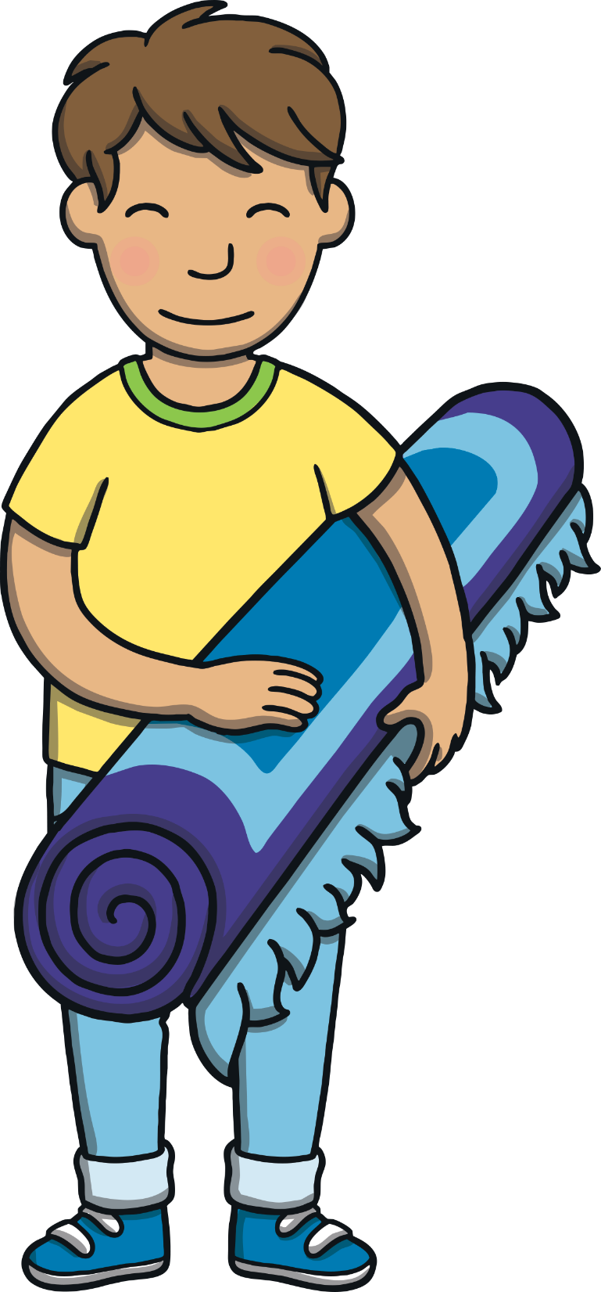
Teach
Sometimes, g makes a /j/ sound.
Let’s say these examples:
gem
magic
ginger

Slide 8
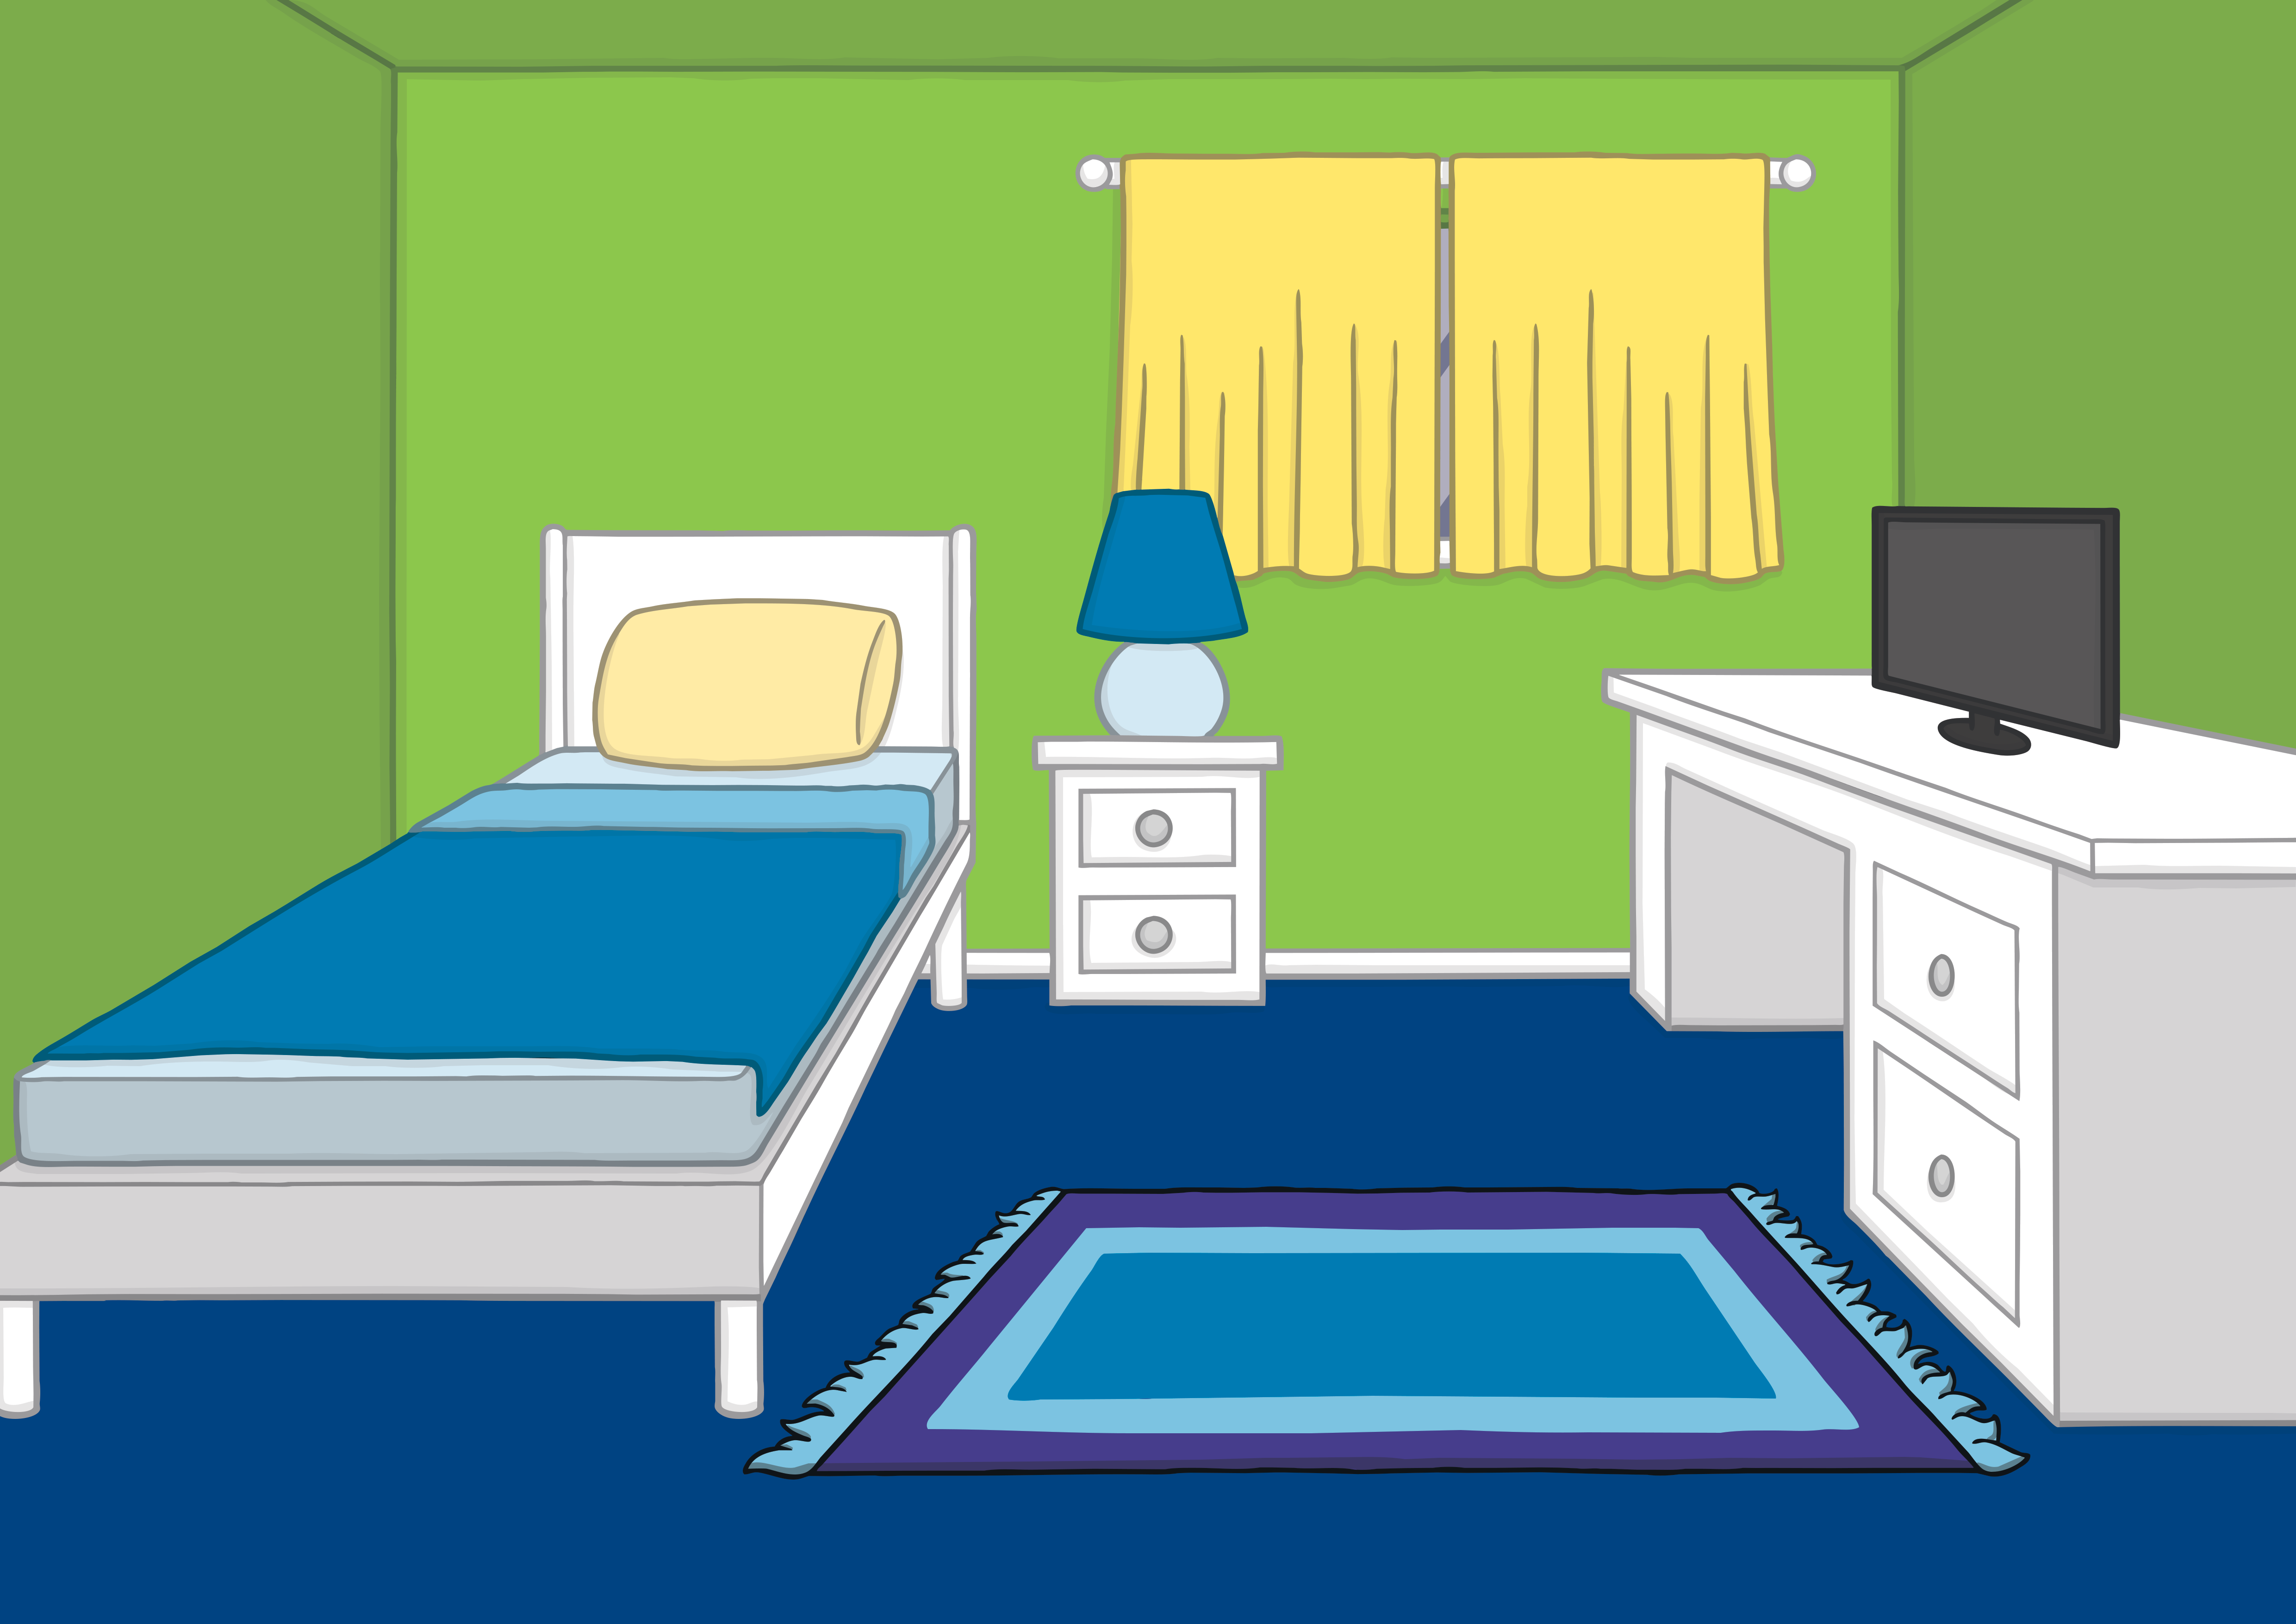
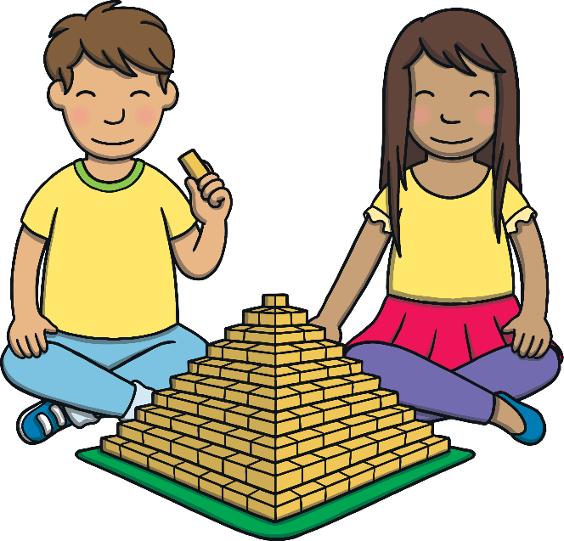
Teach
Kit and Sam were building pyramids out of bricks in Kit’s bedroom. They were making an Egyptian scene. “Our scene looks great!” said Sam.

Slide 9
Teach
“It does,” said Kit. “I wish we could go and see the pyramids in Egypt for real.” Kit and Sam smiled at each other.
“Let’s get the magic map!” they said.

Slide 10
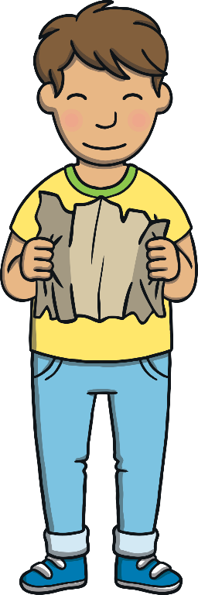

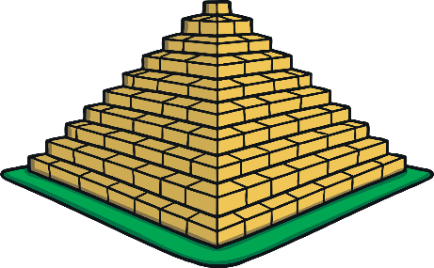
Teach
Kit opened the magic map. “To Egypt!” he sh outed. The bedroom rug became a magic flying carpet and the room began to fade around them…

Slide 11
Teach
Kit and Sam are off on a magic carpet adventure! Can you read the g saying /j/ words on these flying carpets and click the matching picture?

Slide 12
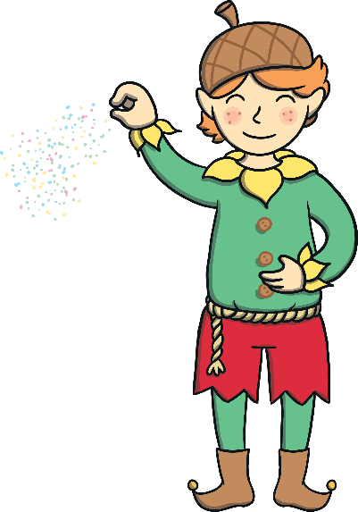



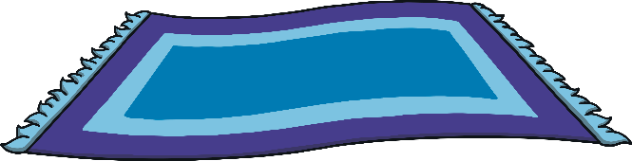
Teach
magic

Slide 13
Teach
ginger

Slide 14
Teach
gem

Slide 15
Teach
danger

Slide 16
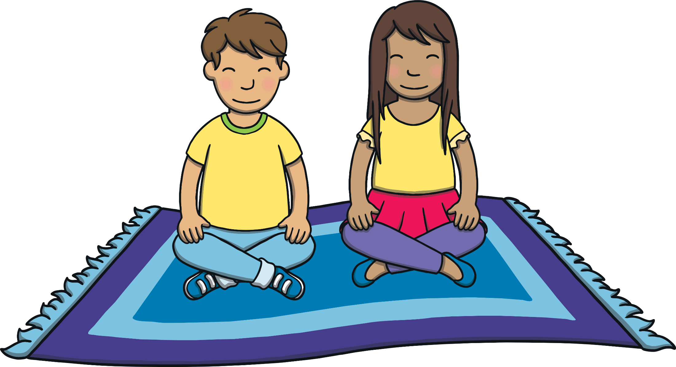
g I Spy
Practise
Kit and Sam are flying over Egypt.
Can you spot any g words as they go?

Slide 17



Practise
ginger
magic
gel
huge
age
general
germ
gist
giant
gerbil

Slide 18
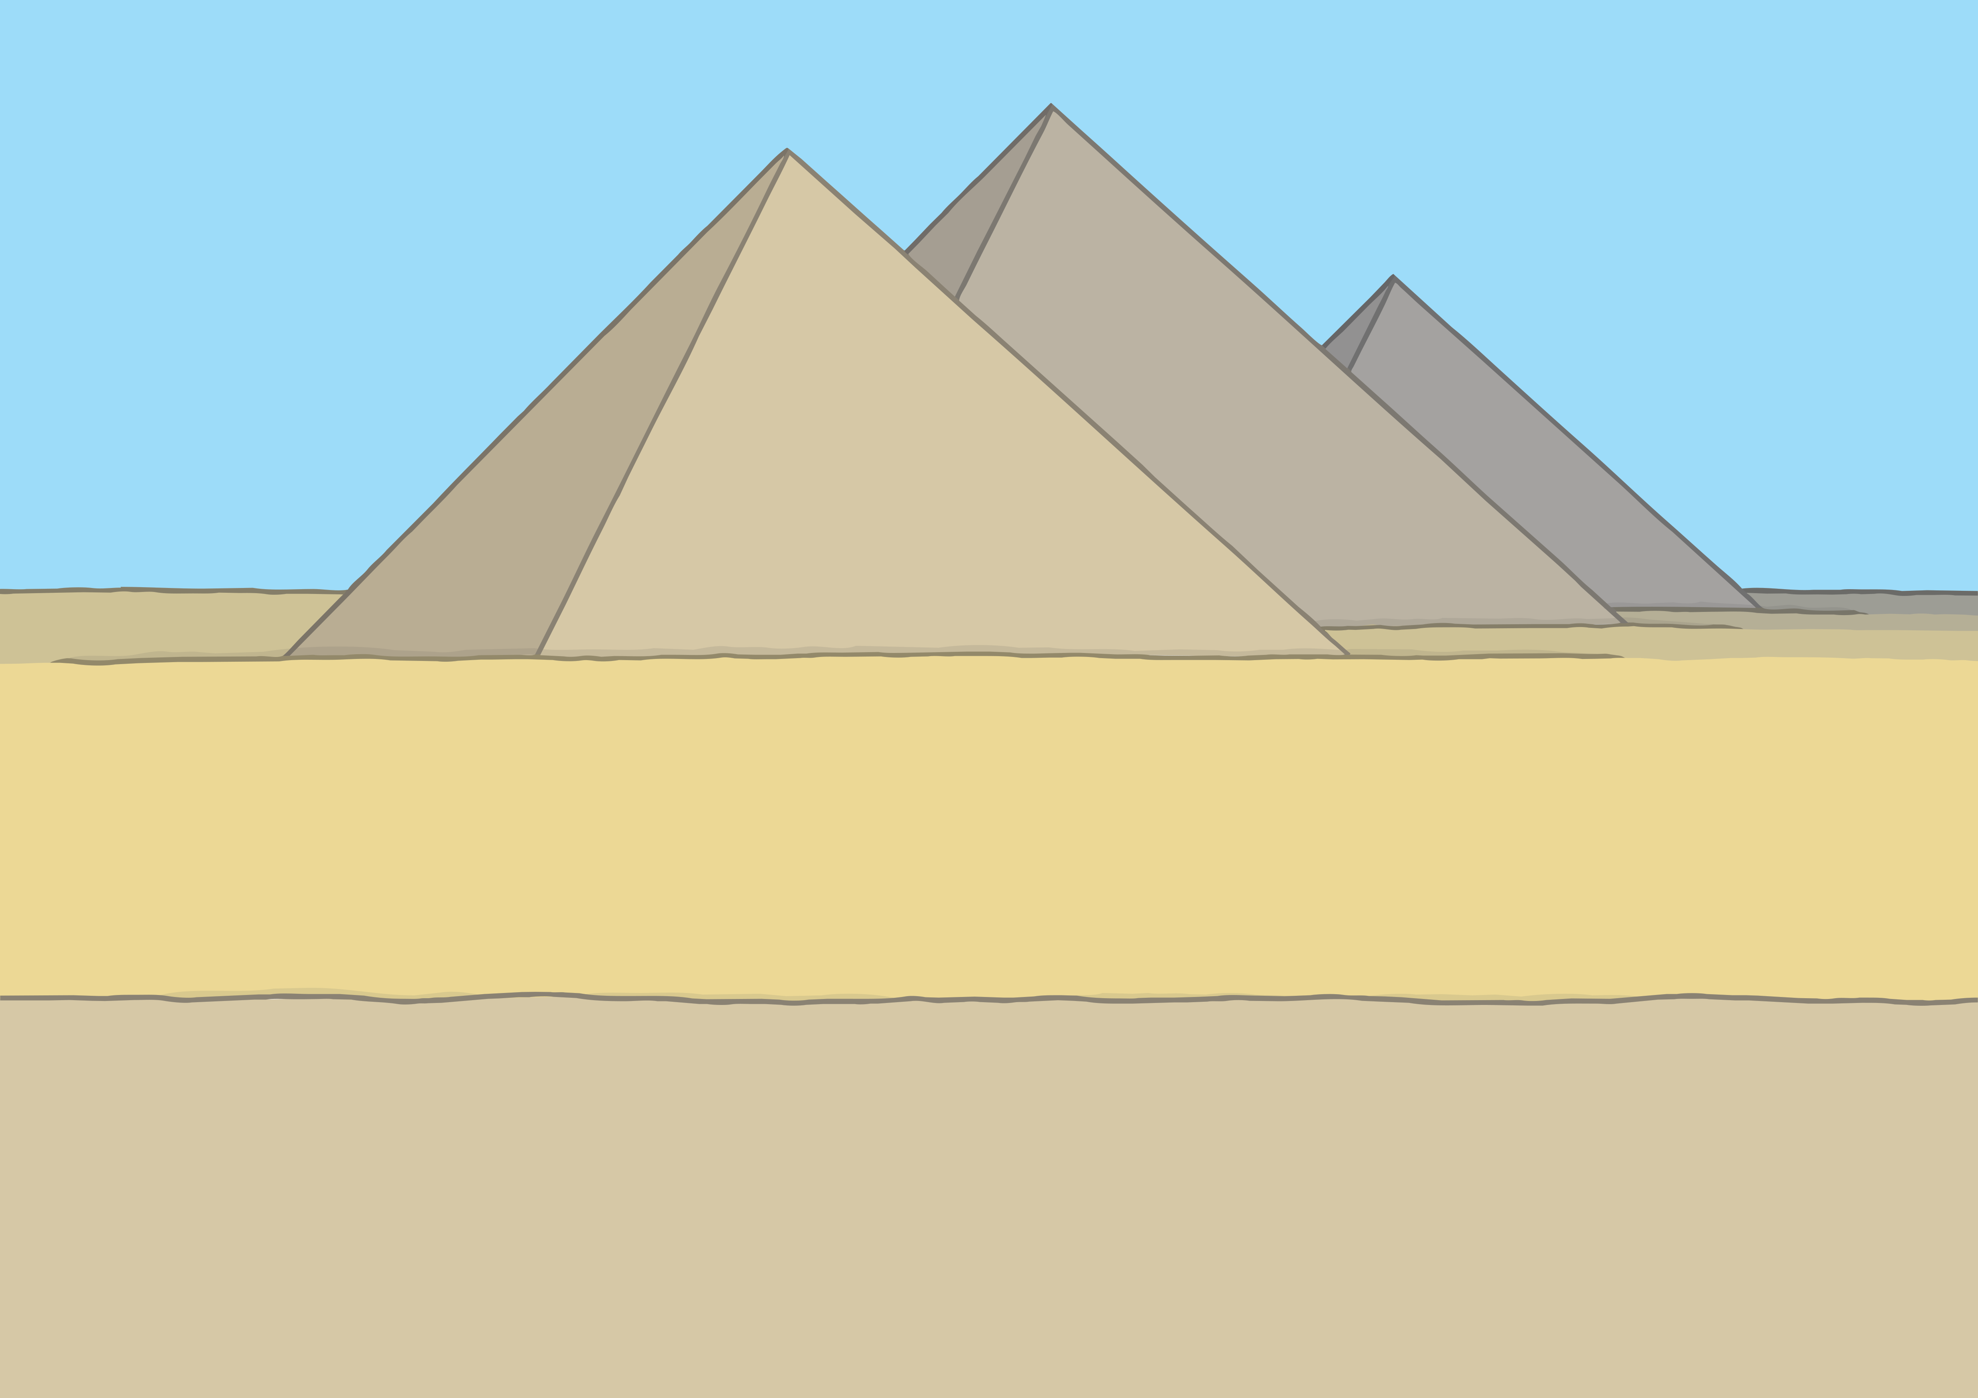

Apply
“Let’s take a look around,” said Kit, rolling up the magic carpet.
“Good plan,” said Sam. “Hmm... it’s very qu iet. Where are all the people?”

Slide 19
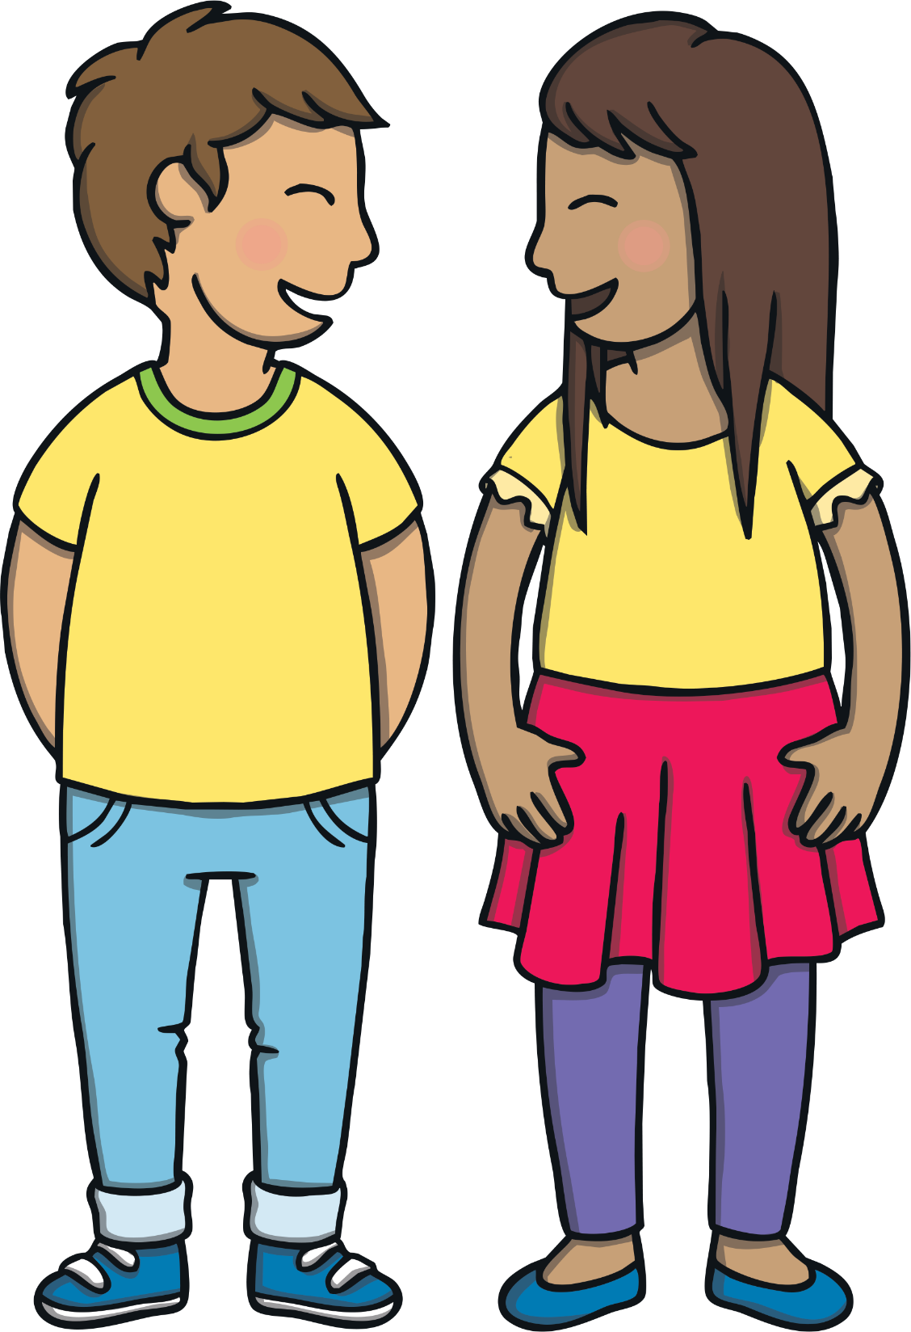
Sentence Time
Apply
Sam is wondering where all the people are. What does she whisper to Kit? Read the sentence then click ‘Show’ to reveal the answer!

Slide 20
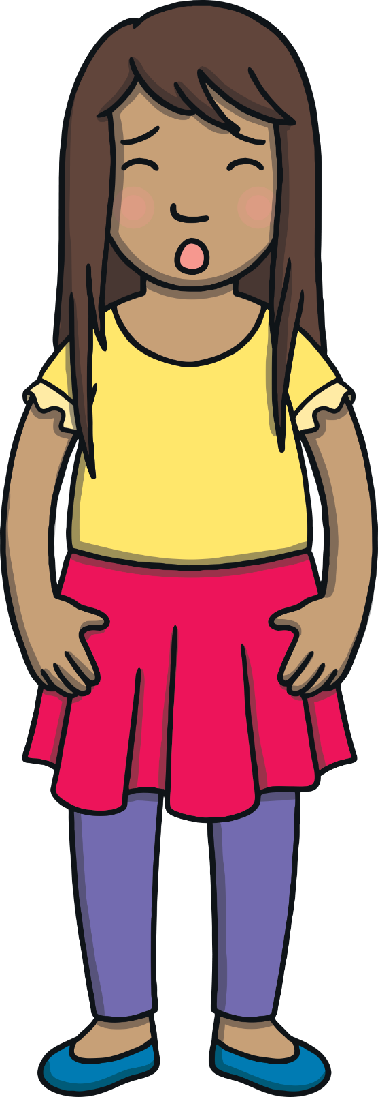

Apply
I hope we are not in any
danger in this huge desert!
Sound Buttons On/Off
Show

Slide 21
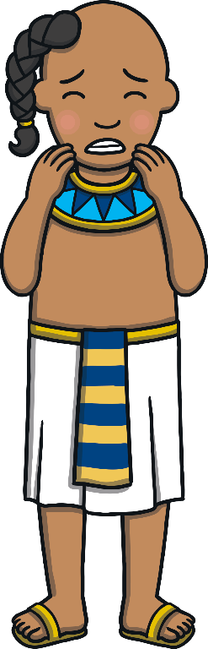


Apply
Suddenly, a boy in Egyptian clothes came running towards them. He looked scared.
“Who is this…?” said Kit.

Slide 22

Today, we have learnt…
g
saying /j/
The adventure continues next lesson!

