Slide 2

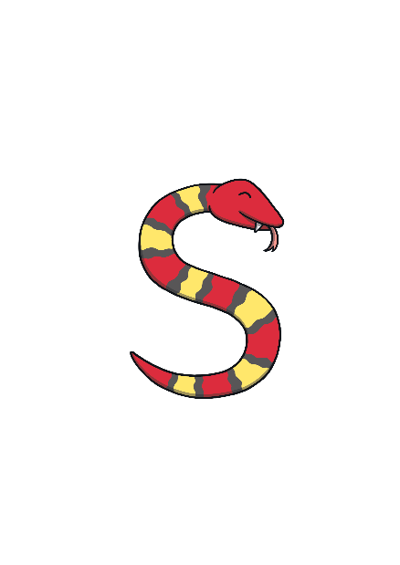



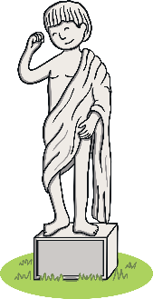




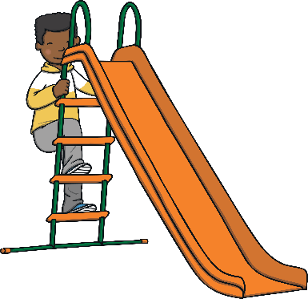

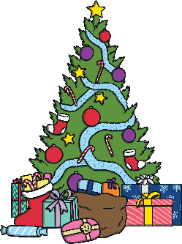




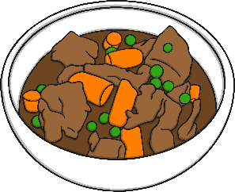



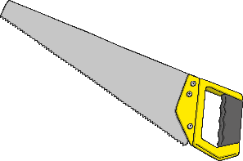

Revisit and Review
Let’s practise Sam’s Sounds and Common Exception Words!
oy
y
au
ir
e_e
oe
i_e
o_e
ue
ay
u_e
ou
a_e
ue
wh
ew
ie
ch
aw
ew
ow
ea
house
many
friend
coming
laughed
because
Monday
any
once
eyes
different
please
Tuesday
lived

Slide 3

Teach
Today, we are learning to read words that
contain g saying /j/.

Slide 4

Teach
Let’s practise reading some of this week’s focus words that contain the g sound.
gem
magic
giant
ginger

Slide 5

Teach
Now, let’s write them with the magic pencil…

Slide 6


Teach
gem
Play

Slide 7
Teach
magic
Play

Slide 8
Teach
giant
Play

Slide 9
Teach
ginger
Play

Slide 10
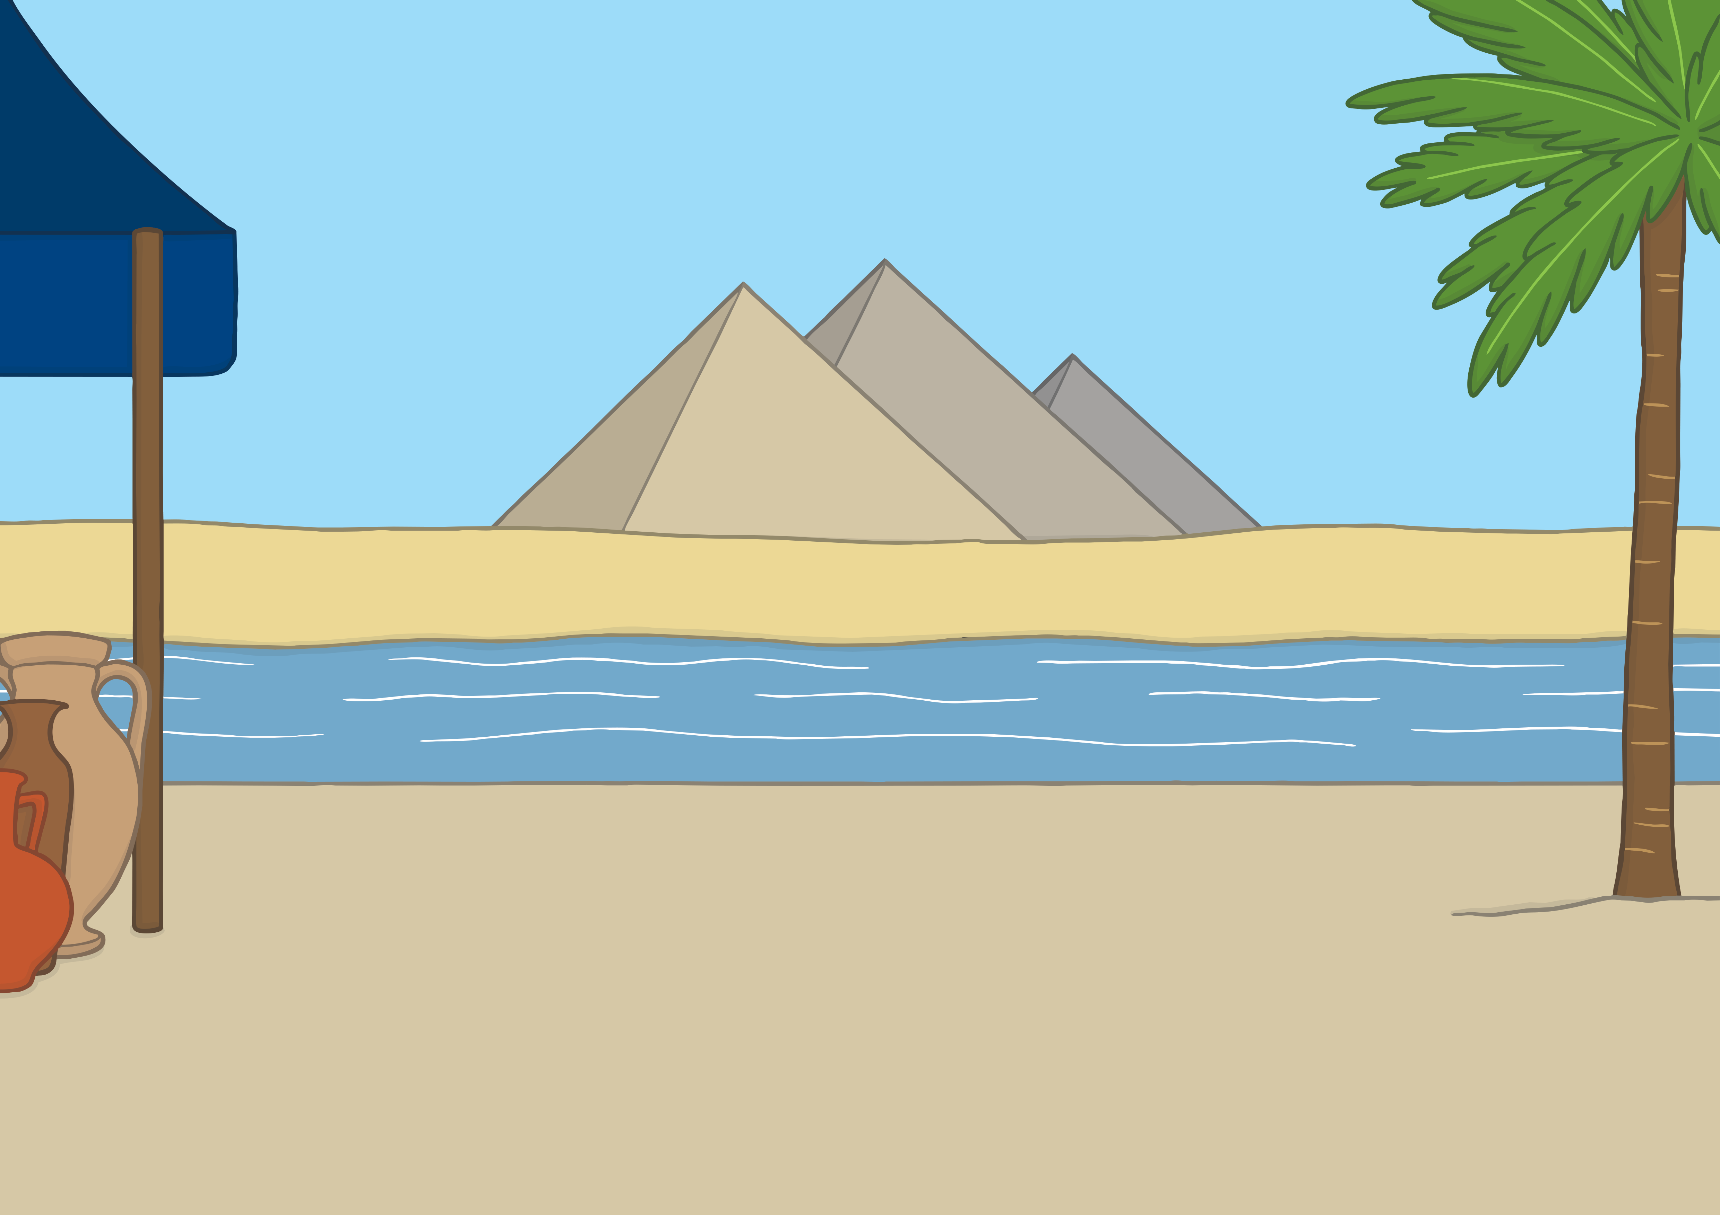



Teach
Kit and Sam had used their map to travel to Egypt on a magic carpet. They met an Egyptian boy.
“I need your help!” he said.

Slide 11
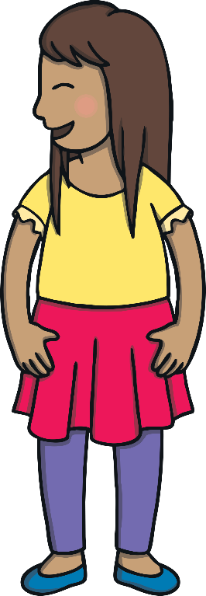

Teach
“What is the matter?” asked Sam.
“I am Prince Asim and my wicked uncle has stolen my family’s most precious gemstone.”

Slide 12

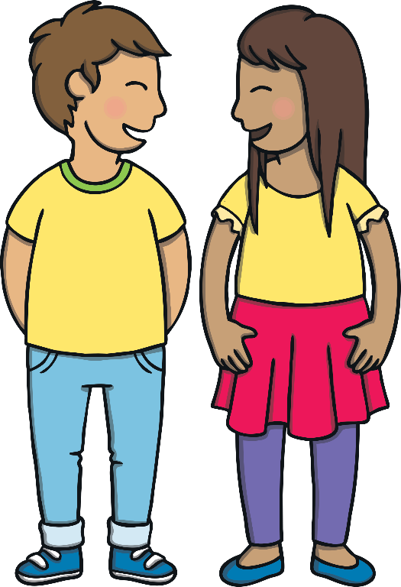

Teach
“If we do not get the gem back, a giant will awaken!” explained Prince Asim. Kit and Sam agreed to help. “We must solve clues.” said Asim.

Slide 13
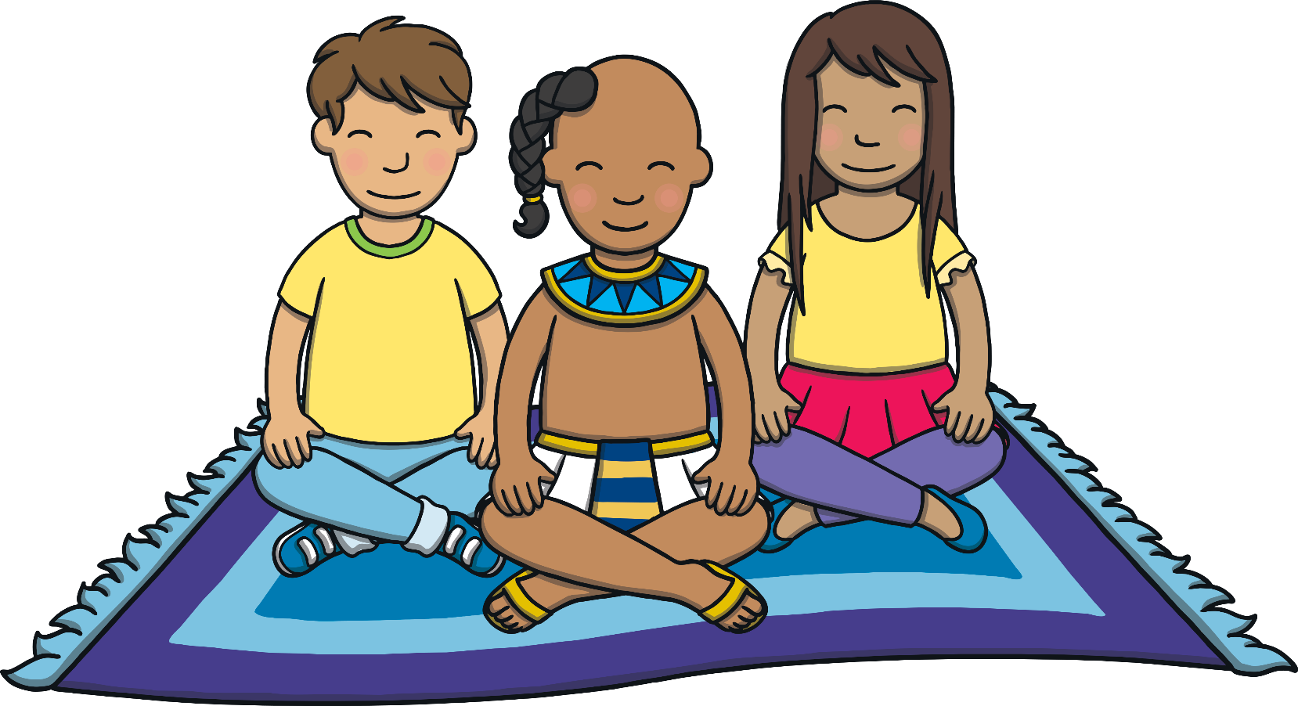
Teach
Kit, Sam and Asim jump onto the magic carpet. Can you spot any objects that have g in their name and write them down?

Slide 14
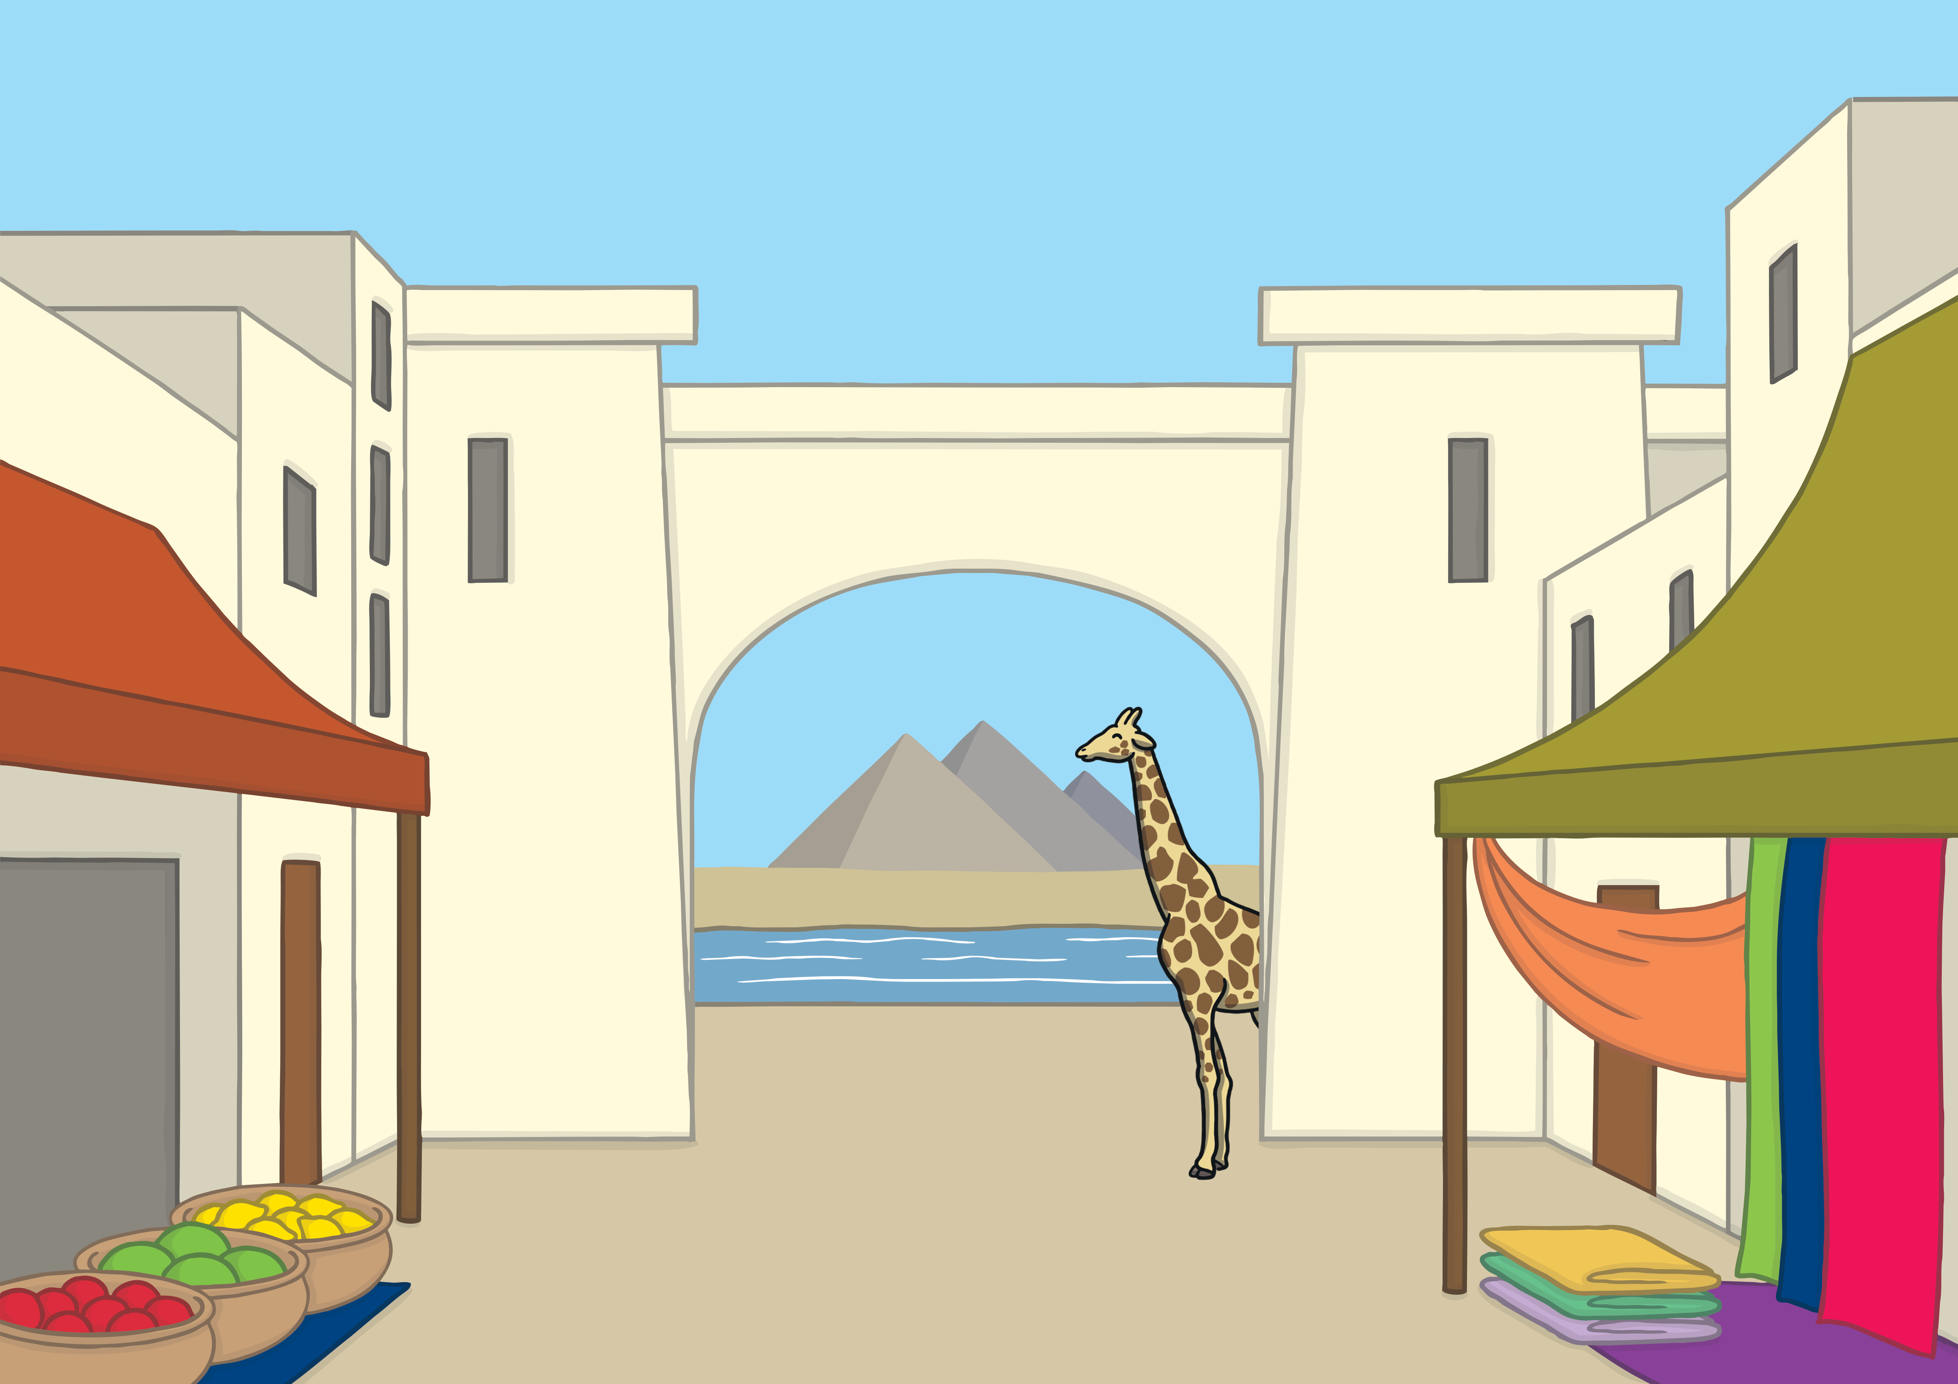







Teach
Check
magic carpet
giraffe
ginger cat
cage
gerbil
gel

Slide 15
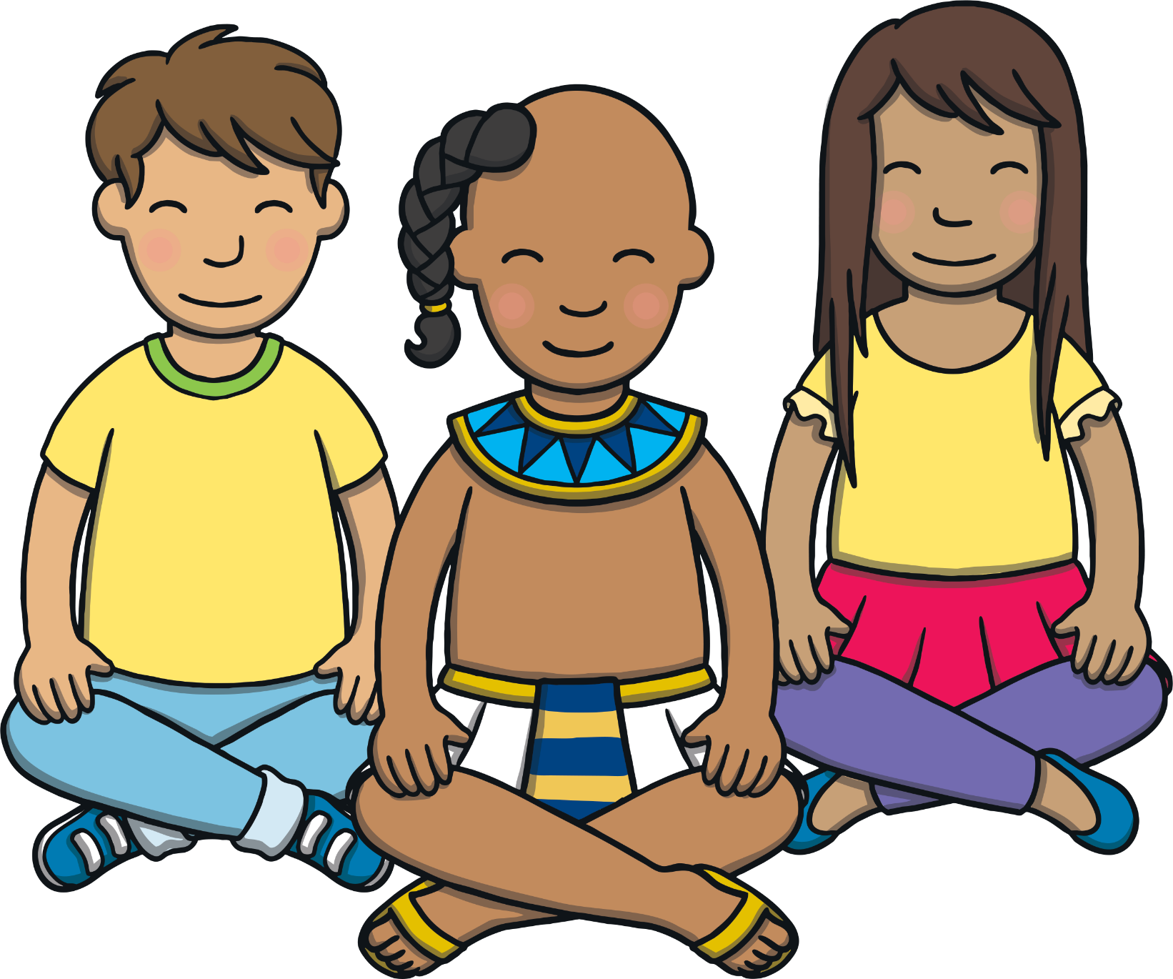
Pyramid Word Build
Practise
Kit, Sam and Asim need to solve a puzzle.
They must build pyramids that contain g saying /j/ words before the sand timer runs out to get their first clue.

Slide 16
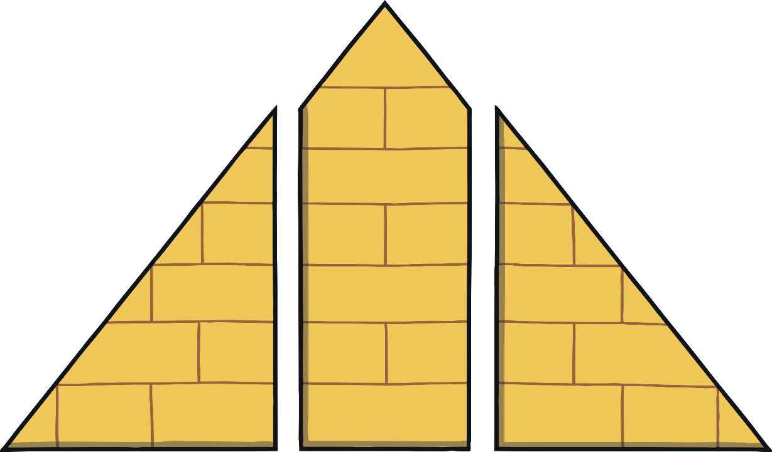
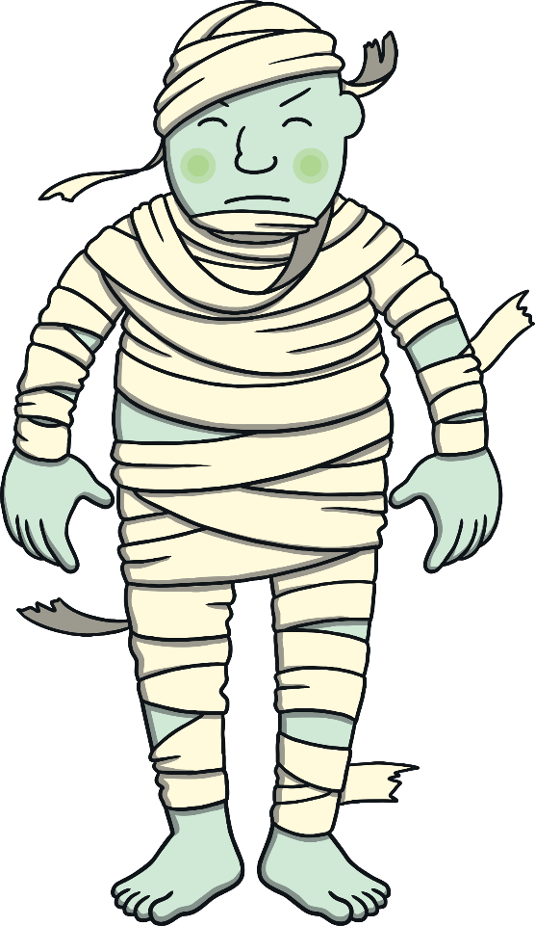

Practise
ia
g
nt
g
ia
nt
5
11
10
7
6
15
9
12
2
3
4
0
1
8
13
14
Check

Slide 17


Practise
g
e
g
l
e
l
5
11
10
7
6
15
9
12
2
3
4
0
1
8
13
14
Check

Slide 18
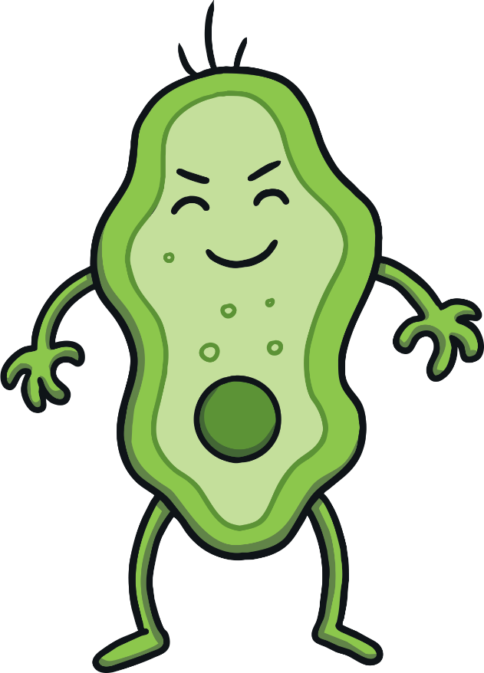
Practise
m
er
g
g
er
m
5
11
10
7
6
15
9
12
2
3
4
0
1
8
13
14
Check

Slide 19

Practise
m
g
e
g
e
m
5
11
10
7
6
15
9
12
2
3
4
0
1
8
13
14
Check

Slide 20

Practise
c
e
c
ag
e
ag
5
11
10
7
6
15
9
12
2
3
4
0
1
8
13
14
Check

Slide 21
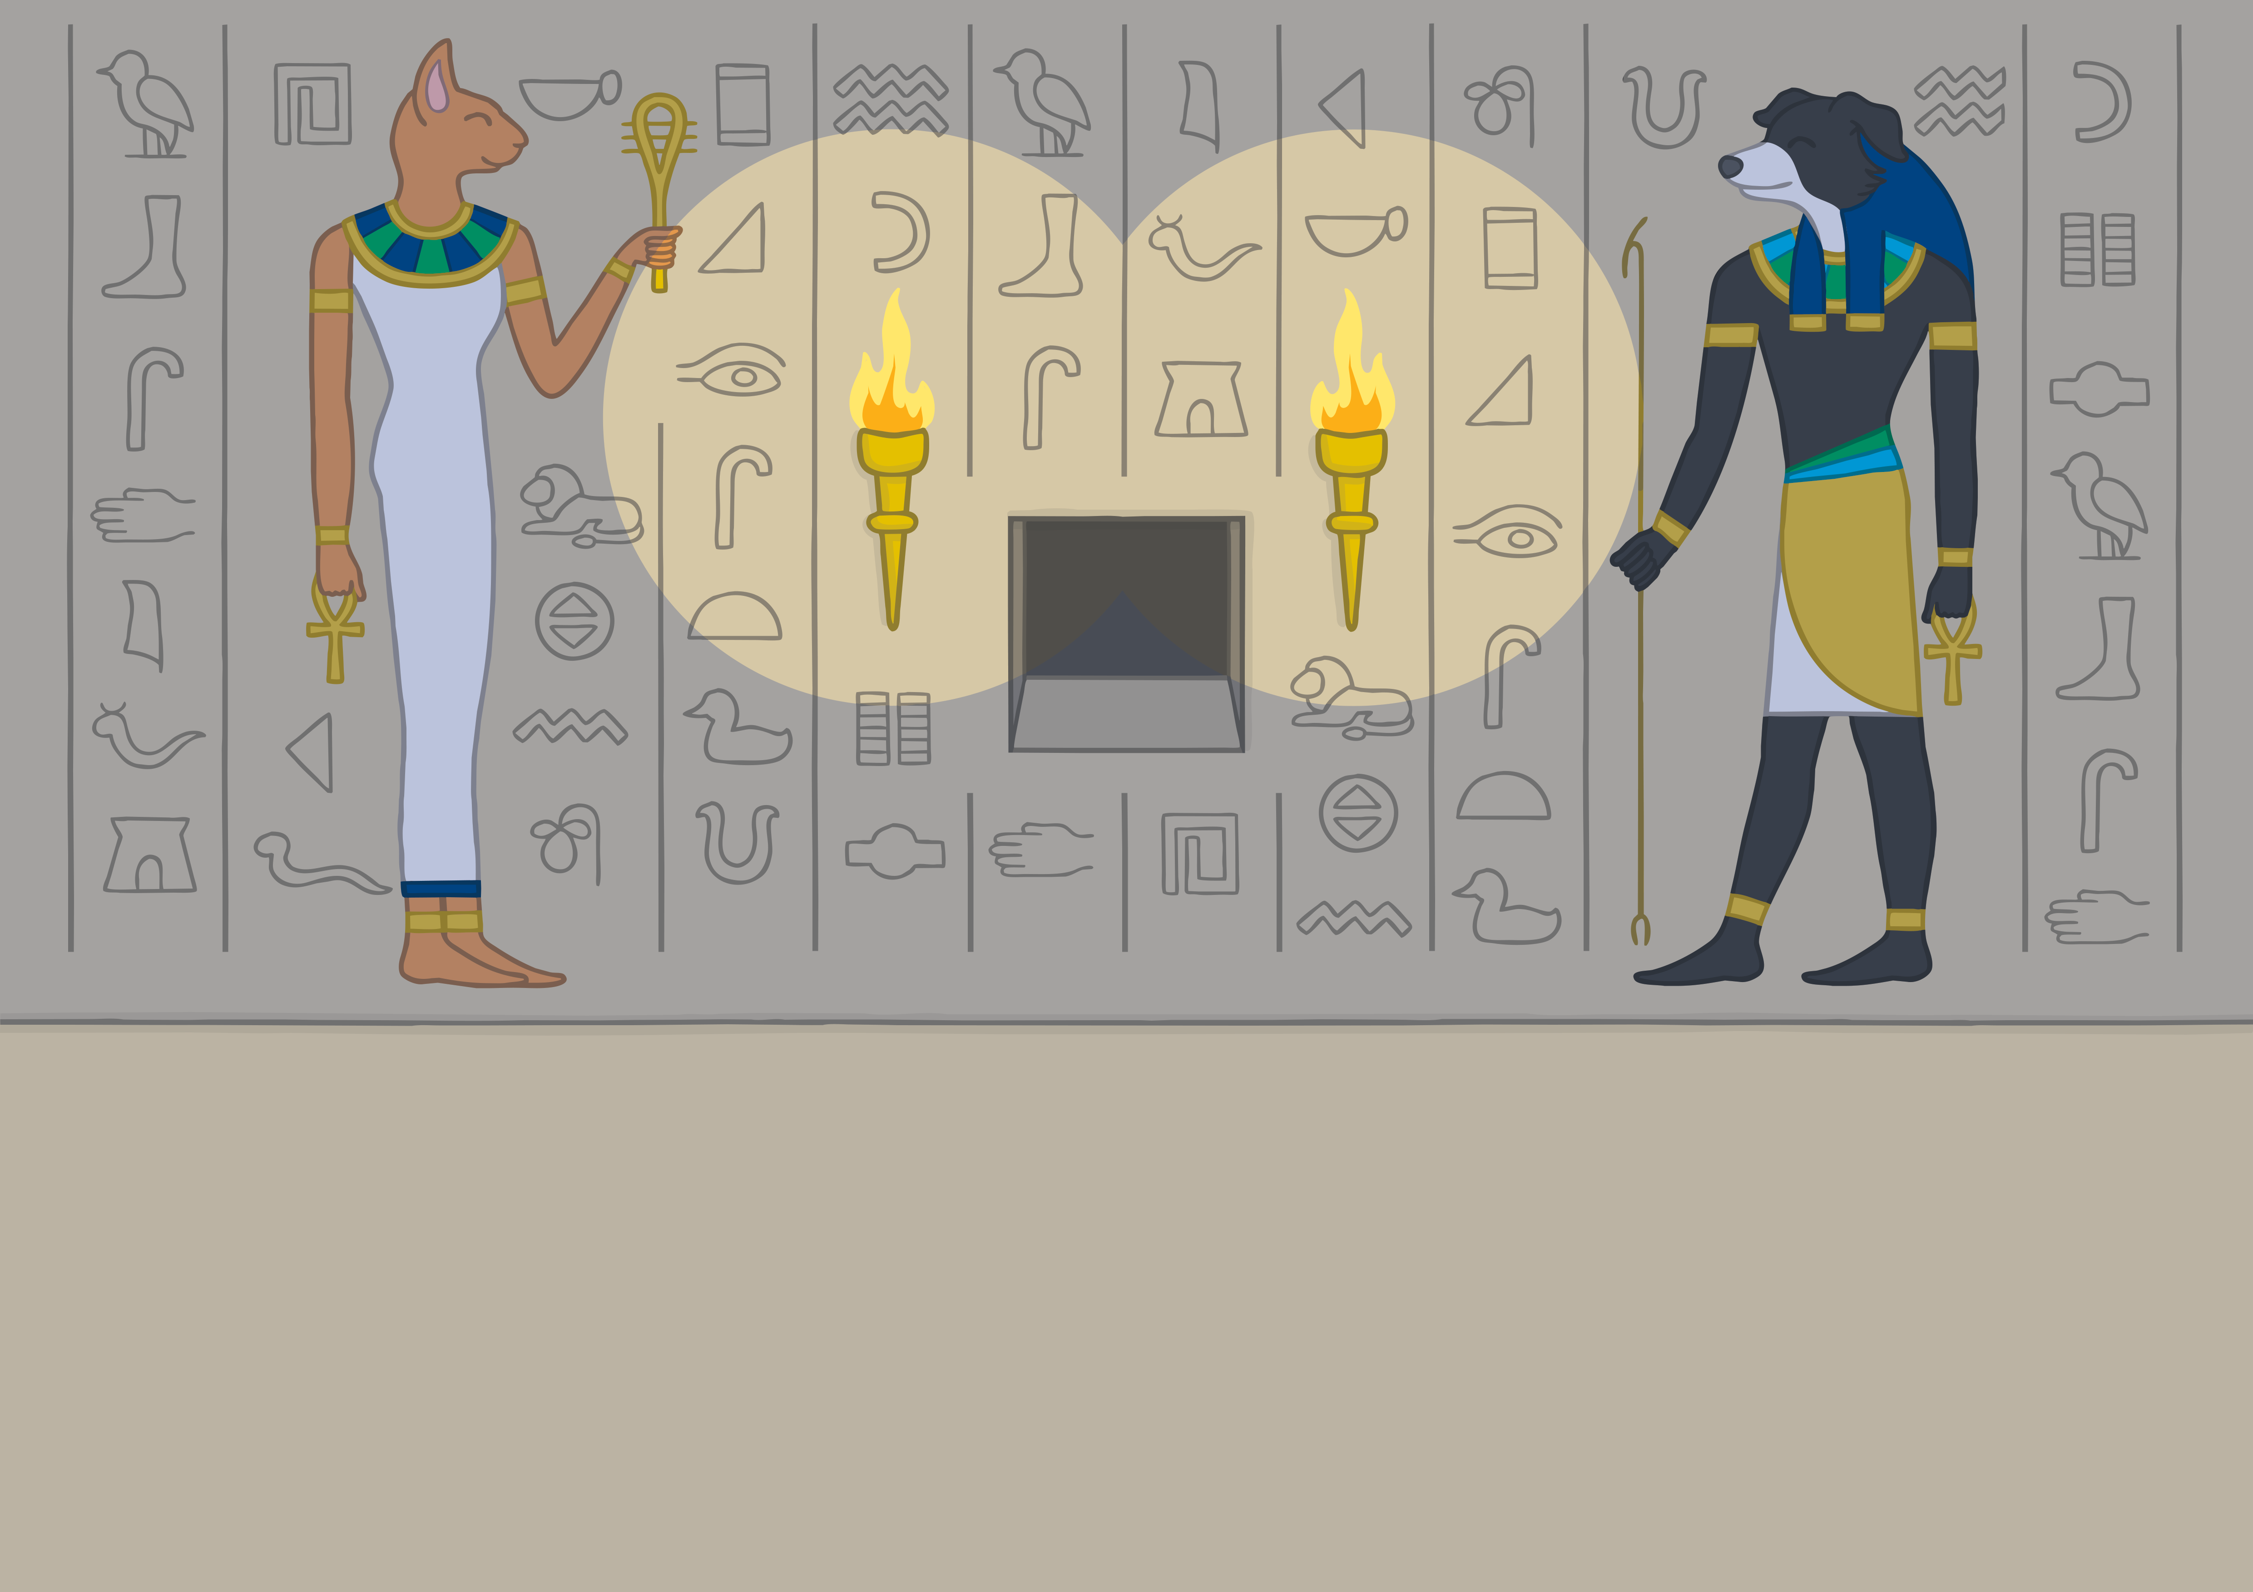
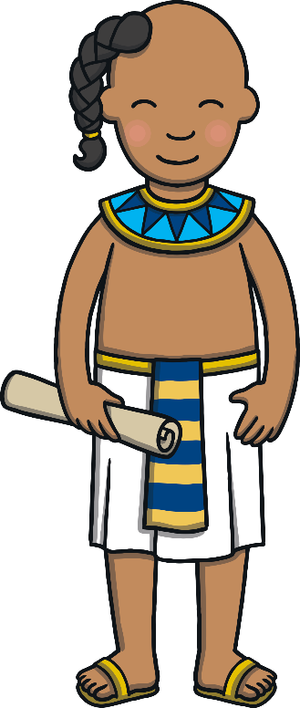



Apply
They finished the last pyramid just as the last grain of sand slipped through the timer. A scroll appeared from a secret hole in the wall.

Slide 22
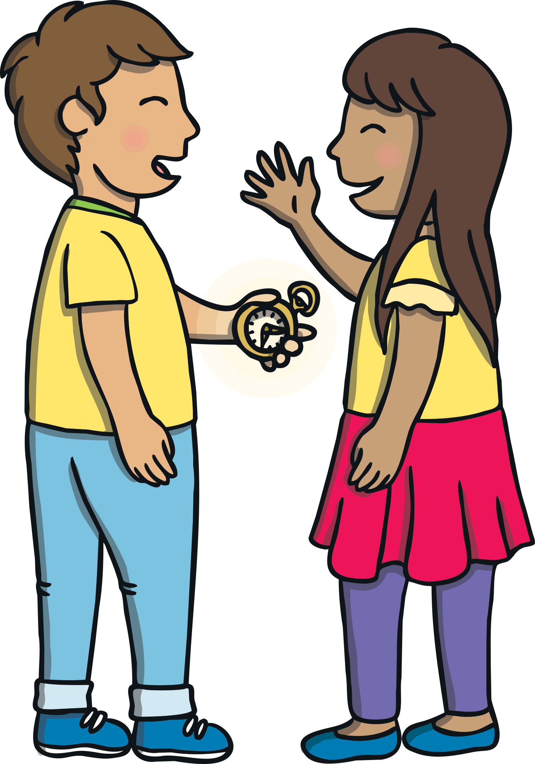
Sentence Time
Apply
What is the clue written on the scroll?
Look at the picture and write a sentence to match.

Slide 23

Apply
To find the gem, you must
look for the ginger cat.
Sound Buttons On/Off
Show

Slide 24


Apply
“The ginger cat? What does that mean?” said Prince Asim.
“Hmm… maybe we have to follow the ginger cat to find the next clue,” said Sam.

Slide 25

Today, we have learnt…
g
saying /j/
The adventure continues next lesson!

