Slide 2




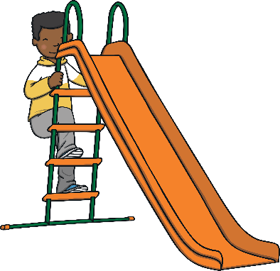








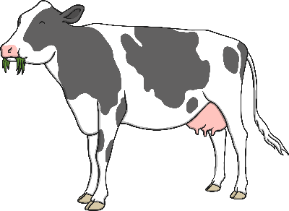








Revisit and Review
Let’s practise Sam’s Sounds and Common Exception Words!
ay
au
oy
o_e
ir
a_e
ch
-y
ue
ow
oe
i_e
aw
ph
wh
ie
ew
u_e
e_e
ou
ea
please
any
laughed
different
because
Monday
Tuesday
also
many
eyes
friend
coming
once
lived

Slide 3


Teach
This week, we are learning to spell the common exception words many and laughed.
Watch the magic pencil write the words. Can you join in?

Slide 4


Teach
m
a
n
y
Play

Slide 5
Teach
l
a
u
g
h
e
d
Play

Slide 6



Teach
Today, we are learning to read words
that contain c saying /s/.

Slide 7




Teach
Sometimes, c makes an /s/ sound.
Let’s say these examples:
city
slice
X
When the grapheme ‘c’ is before an
‘e’, ‘i’ or ‘y’, its sound is soft and it makes the /s/ sound.
face
Click me for Kit’s teaching tips!

Slide 8

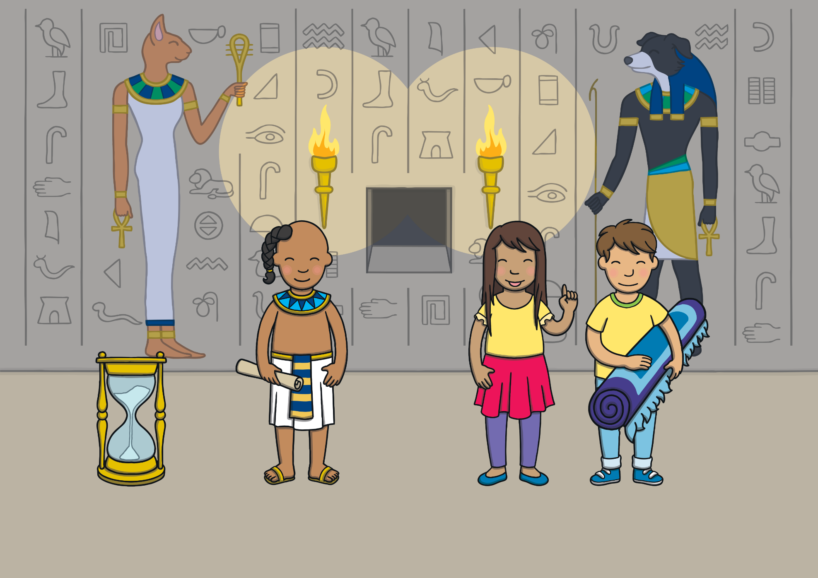
Teach
Kit, Sam and Prince Asim needed to follow a ginger cat to find the next clue that would lead them to the missing gem.
“Let’s go outside,” said Sam.

Slide 9
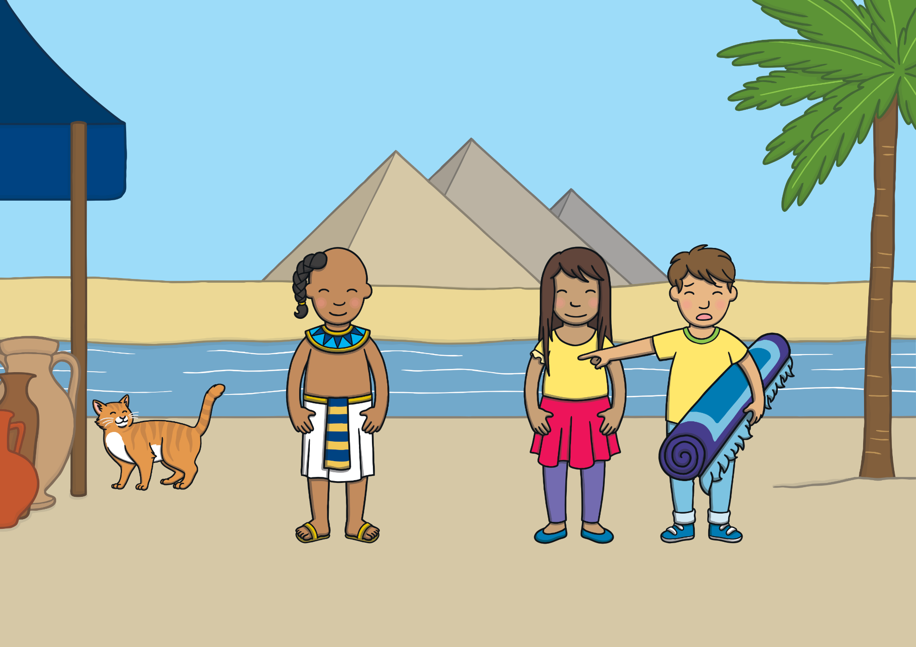
Teach
“Look!” said Kit. “There is a ginger cat!” The cat spotted them and ran off down a narrow alley. “Quick, foll ow it!” said Prince Asim.

Slide 10
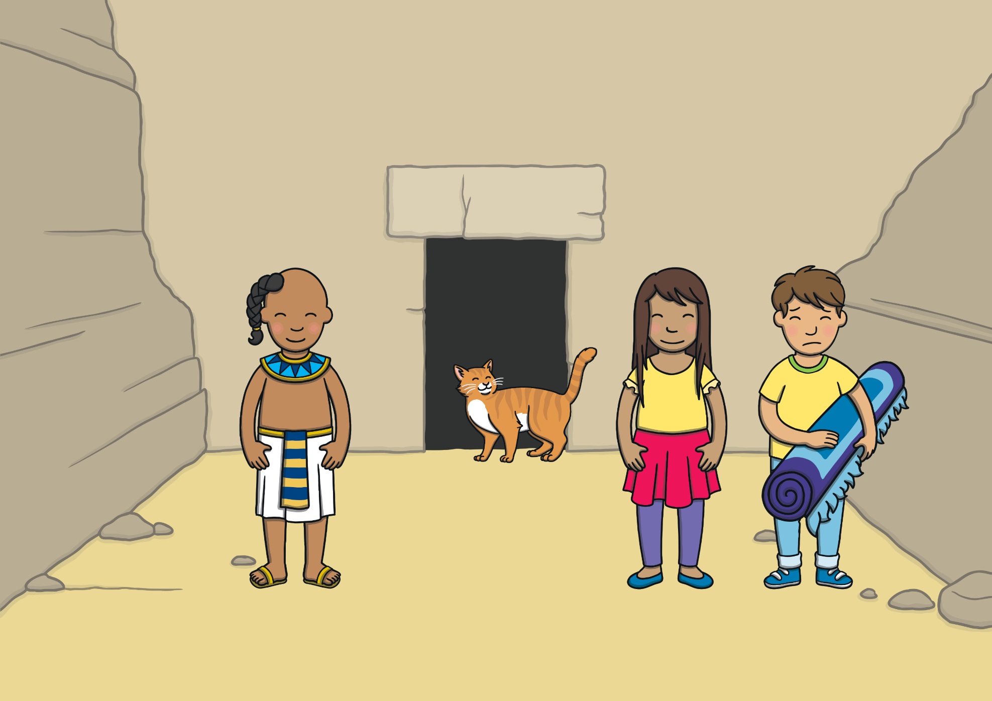
Teach
They followed the ginger cat to a door in the wall. The cat went inside. “The next clue must be in here,” said Sam as they walked towards the door.

Slide 11
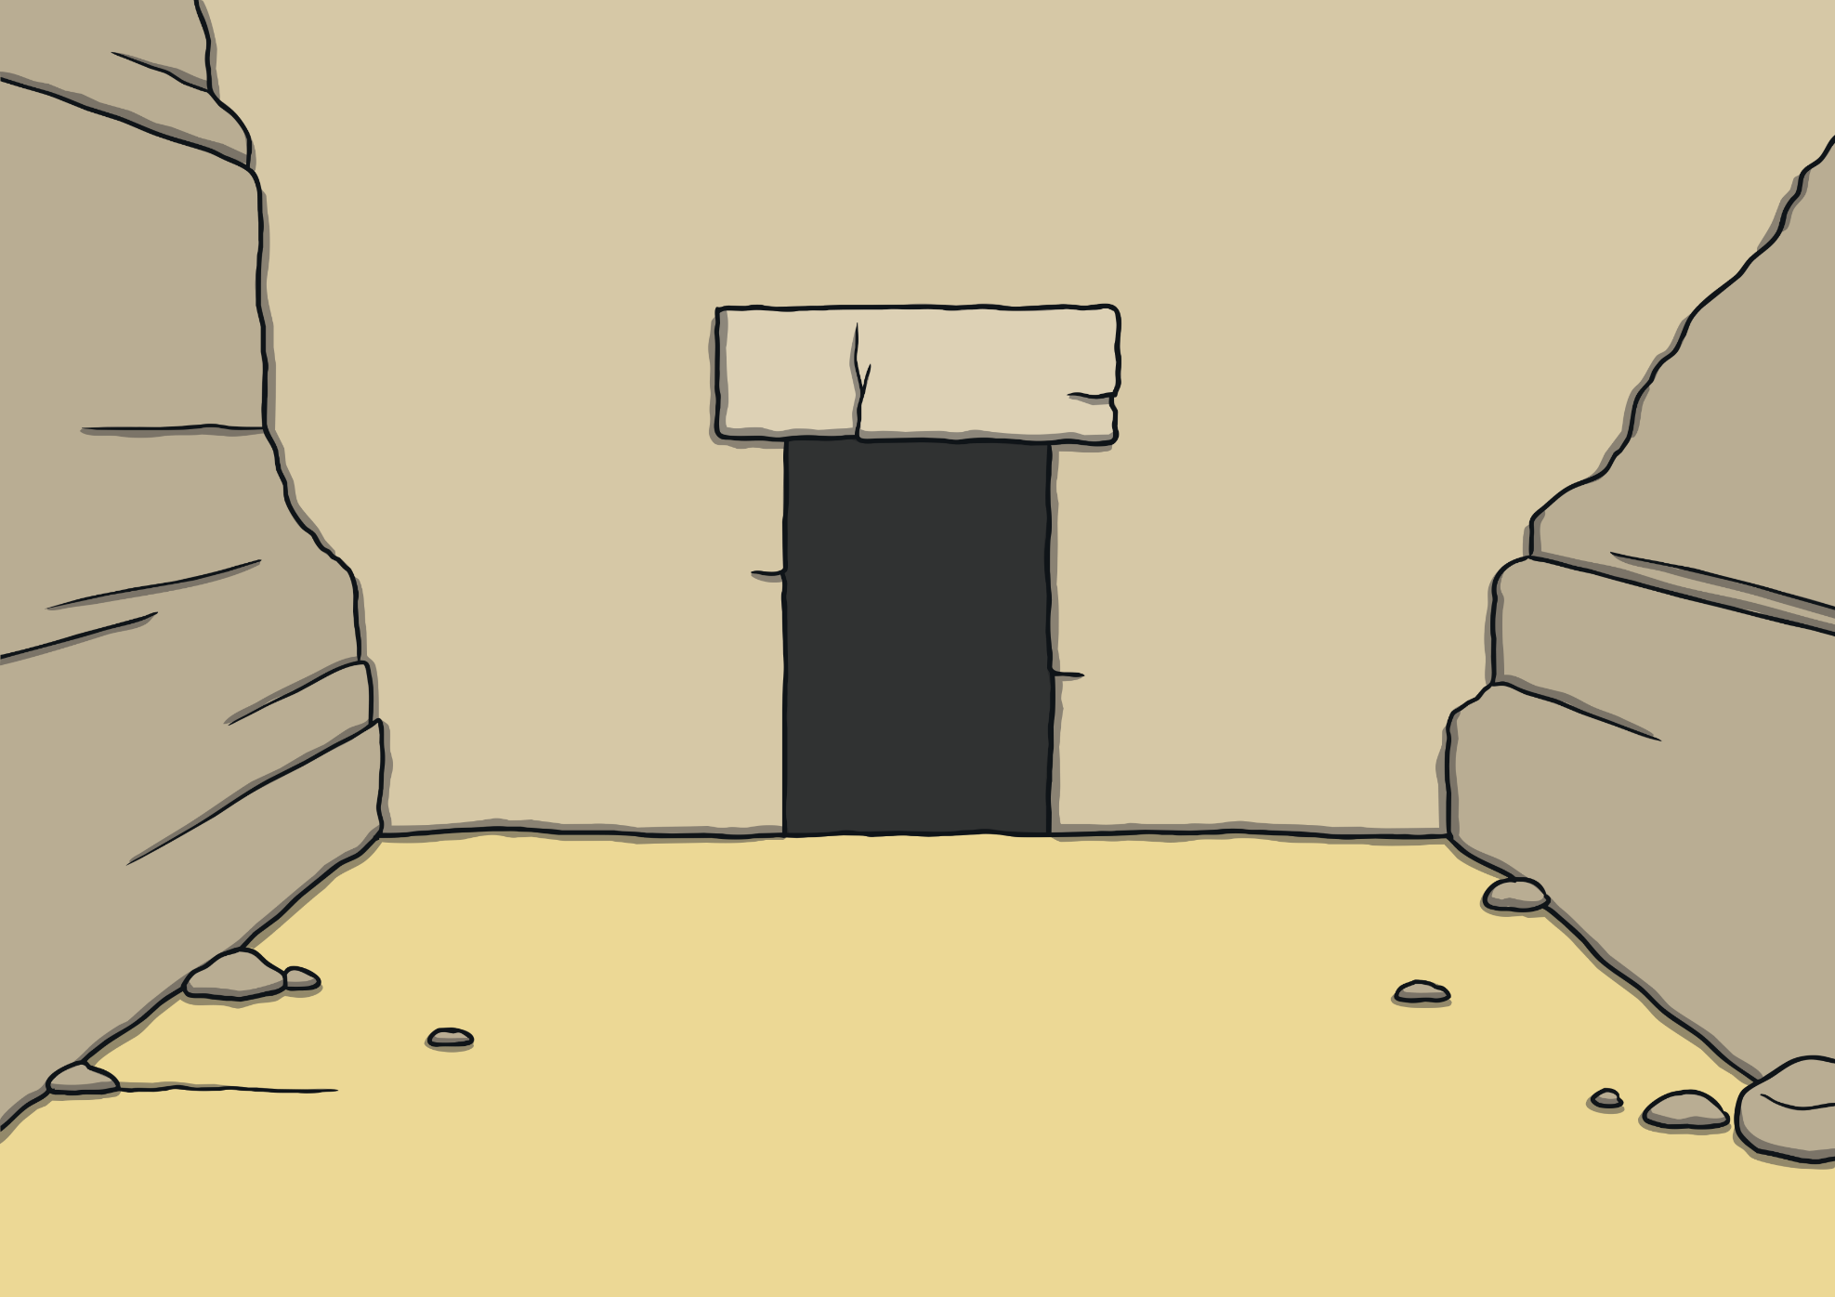

Teach
Can you spot any c words on the walls?
cell
central
space
December
brace
rice
ice
city
face

Slide 12

c Cup Sort
Practise
To get the next clue, Kit, Sam and Asim must sort the jewelled cups
into c saying /c/ and c saying /s/ words.

Slide 13
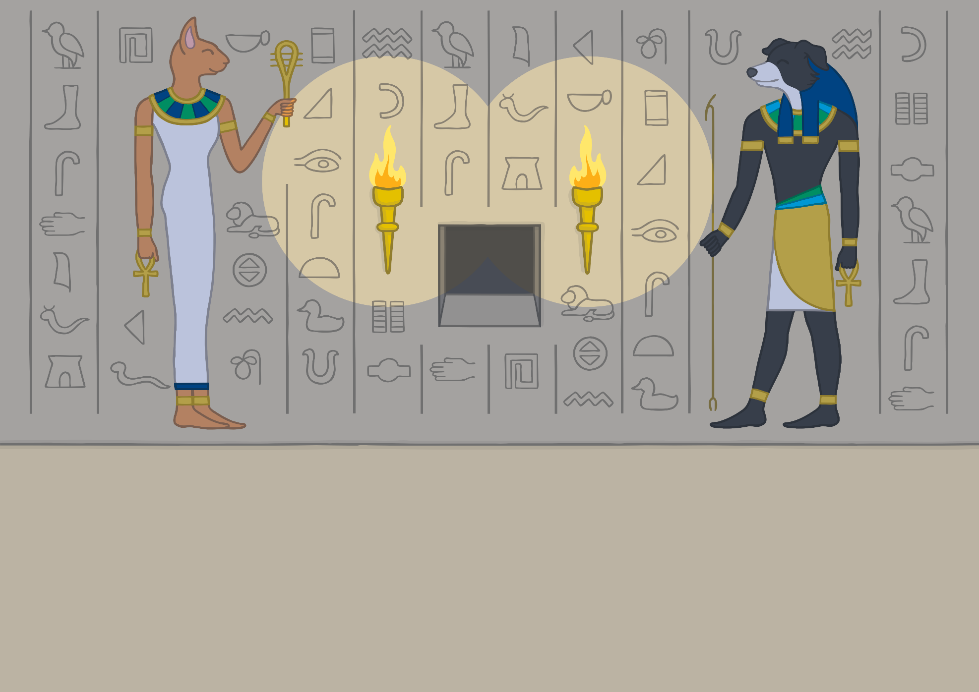


Practise
/c/
/s/
cell
city
icy
central
cent
crack
code
cold
clever
card

Slide 14
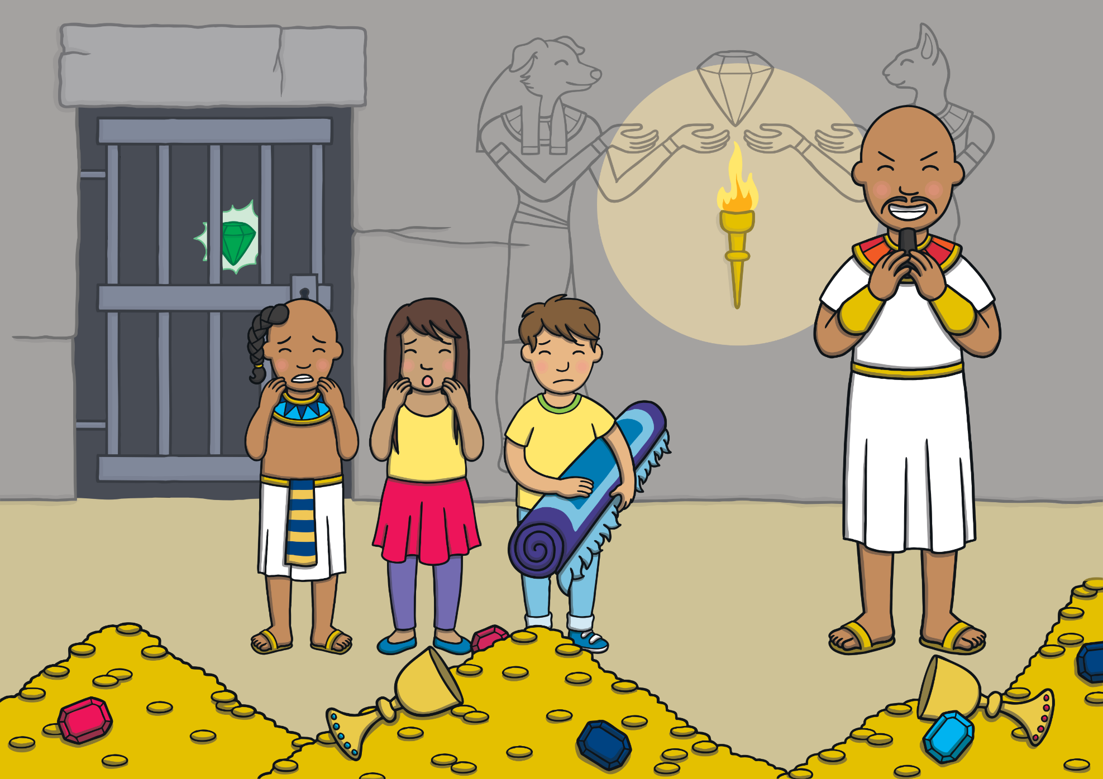
Apply
They finished and a wall moved to reveal the gem behind the bars of a cell. But just as Asim reached out to open the cell door, his wicked uncle came in!

Slide 15
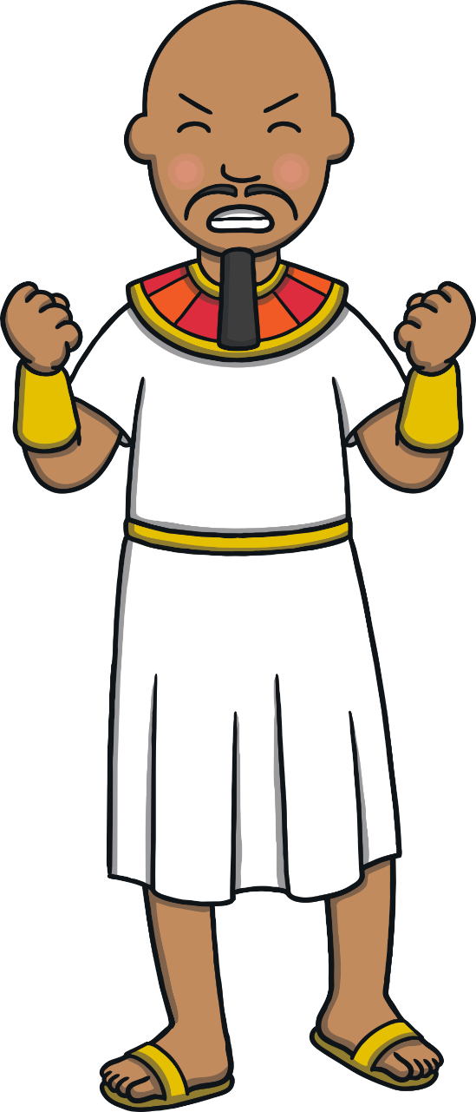



Sentence Time
Apply
What will Prince Asim’s wicked uncle do?
Read the sentence then click ‘Show’ to reveal the answer!

Slide 16
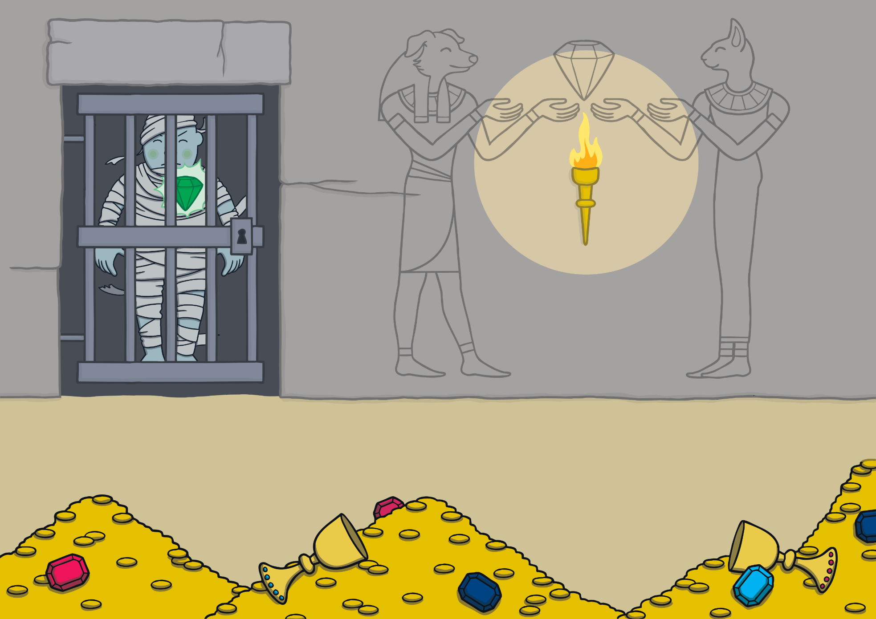
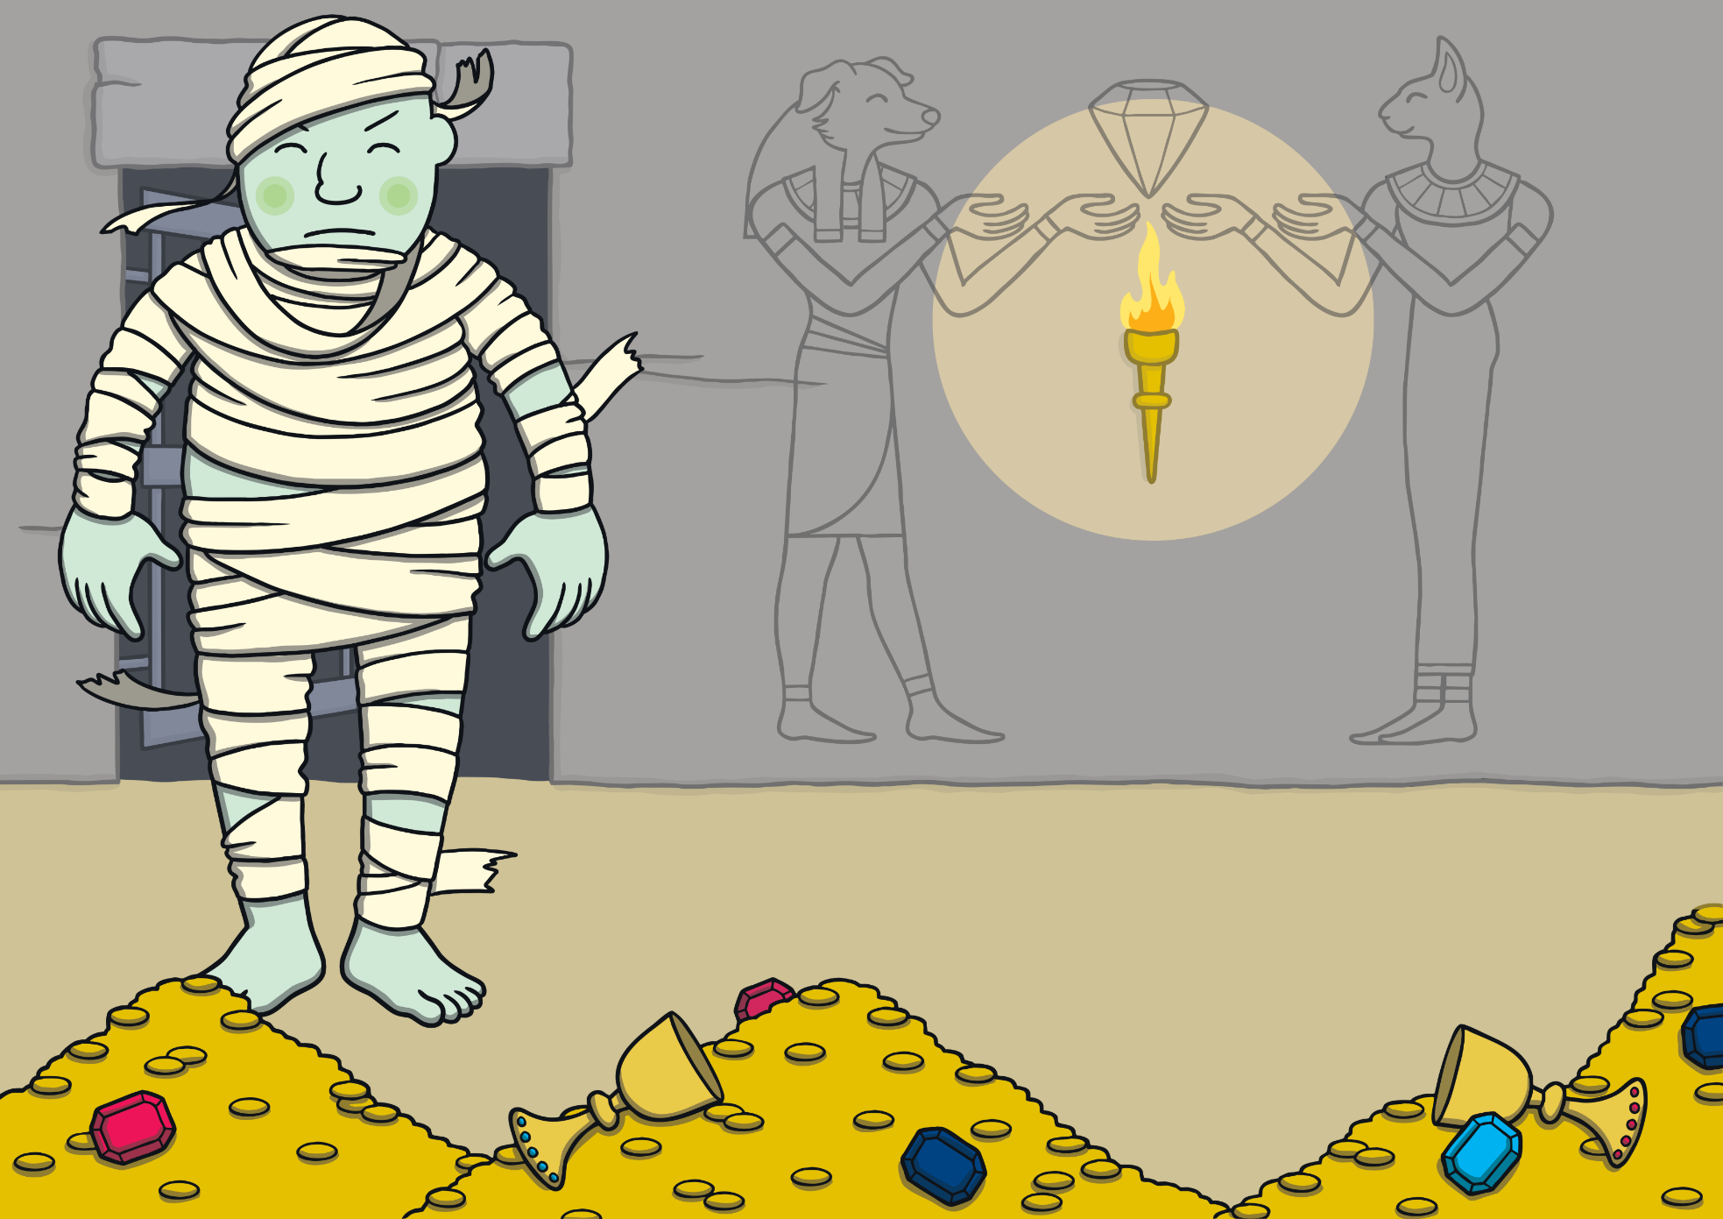
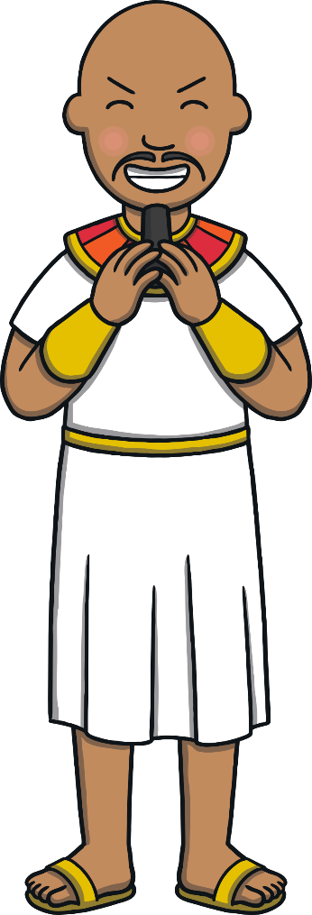




Apply
Sound Buttons On/Off
Show
“I will let the giant out of the cell,” he laughed.

Slide 17
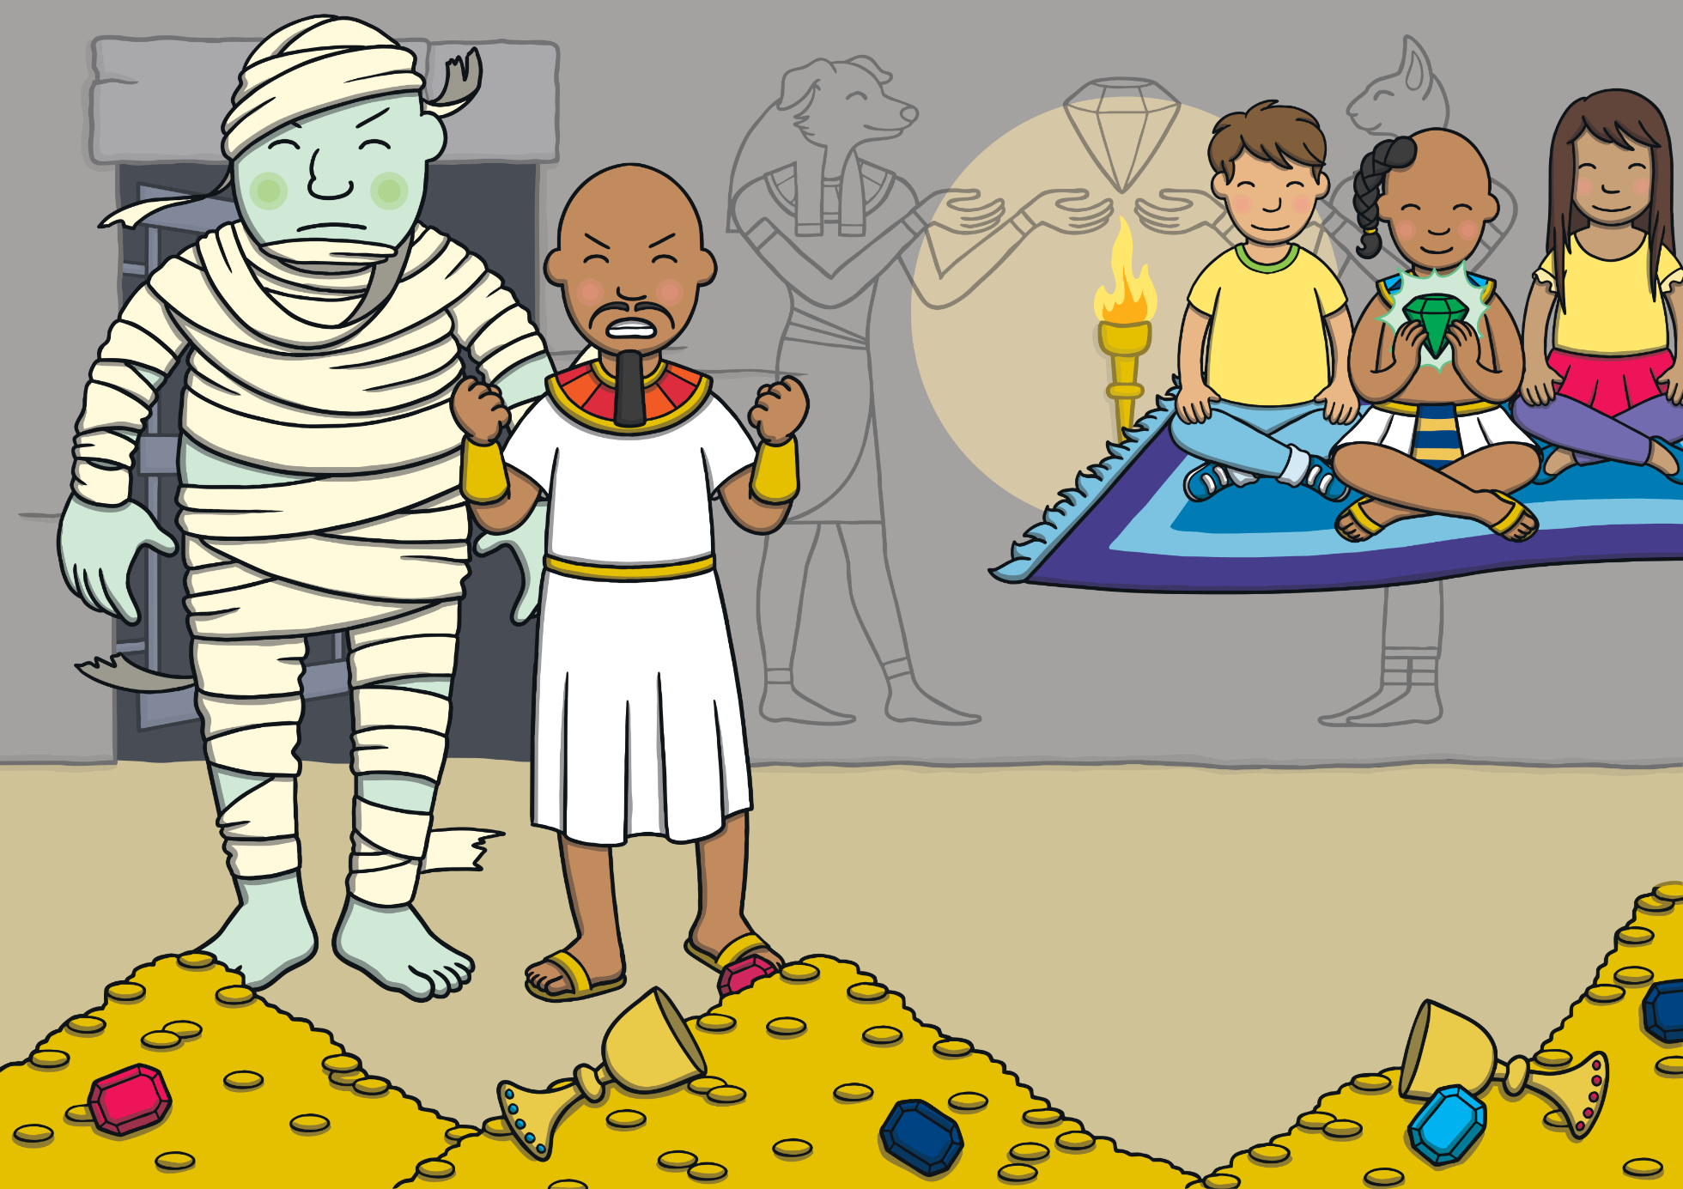
Apply
As the giant came out, Prince Asim grabbed the gem from the cell. Sam unrolled the magic carpet and they flew out of the door as fast as they could!

Slide 18


Today, we have learnt…
c
saying /s/
The adventure continues next lesson!

