Slide 2





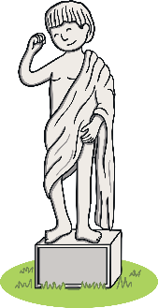




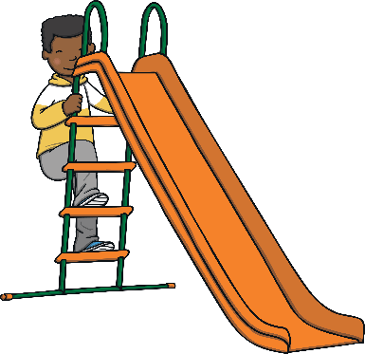






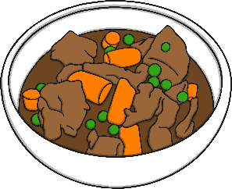



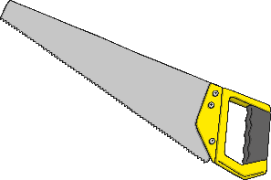

Revisit and Review
Let’s practise Sam’s Sounds and Common Exception Words!
oy
y
au
ir
e_e
oe
i_e
o_e
ue
ay
u_e
ou
a_e
ue
wh
ew
ie
ch
aw
ew
ow
ea
house
many
coming
laughed
because
Monday
any
once
eyes
different
please
also
friend
Tuesday
lived

Slide 3

Teach
Today, we are learning to write words
that contain c saying /s/.

Slide 4
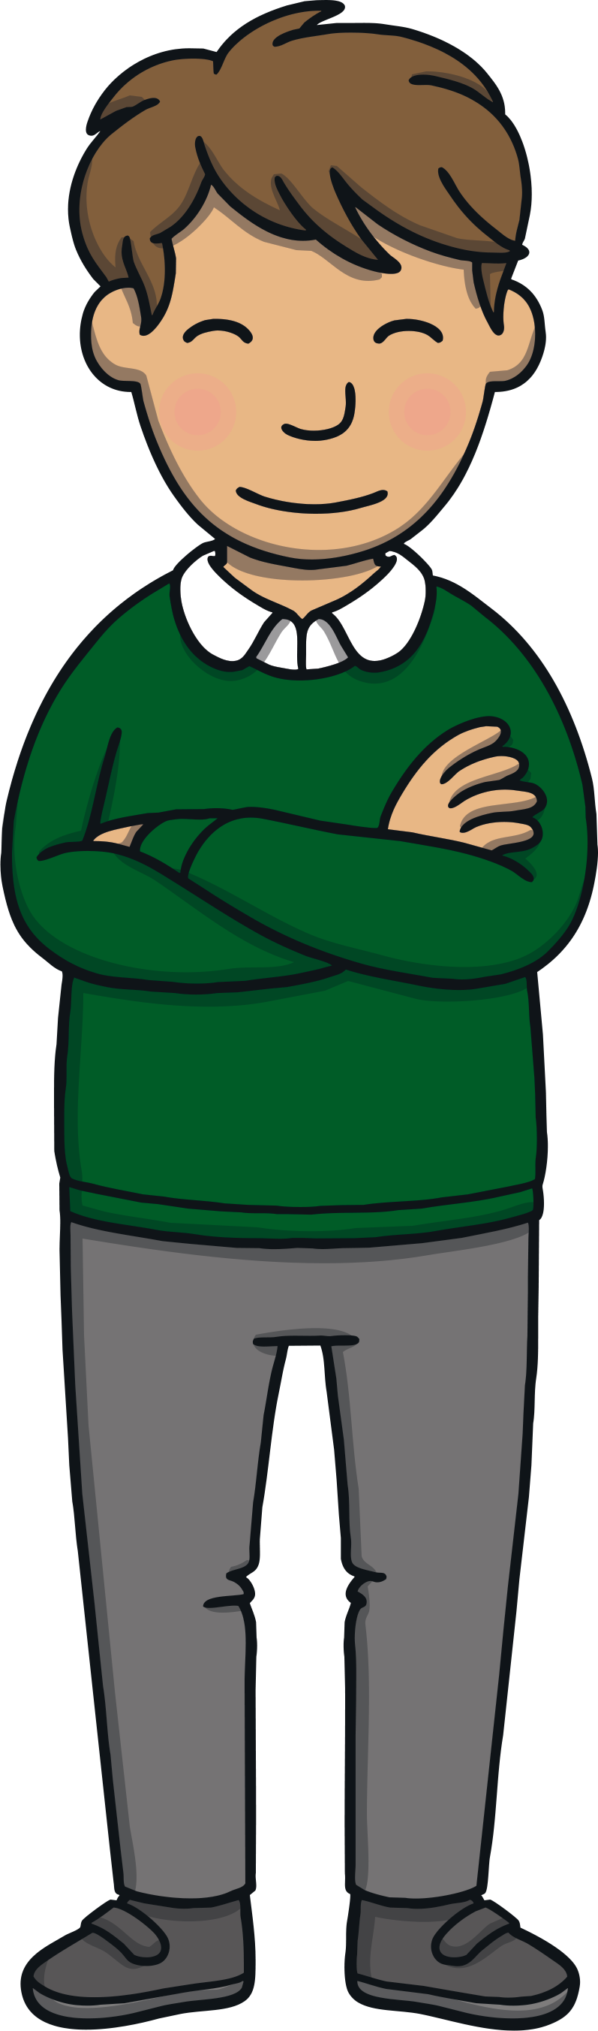
Teach
Let’s practise reading some of this week’s focus words that contain the c sound.
cell
city
face
slice

Slide 5


Teach
Watch the magic pencil write the words.
Can you join in?

Slide 6


Teach
cell
Play

Slide 7
Teach
city
Play

Slide 8
Teach
face
Play

Slide 9
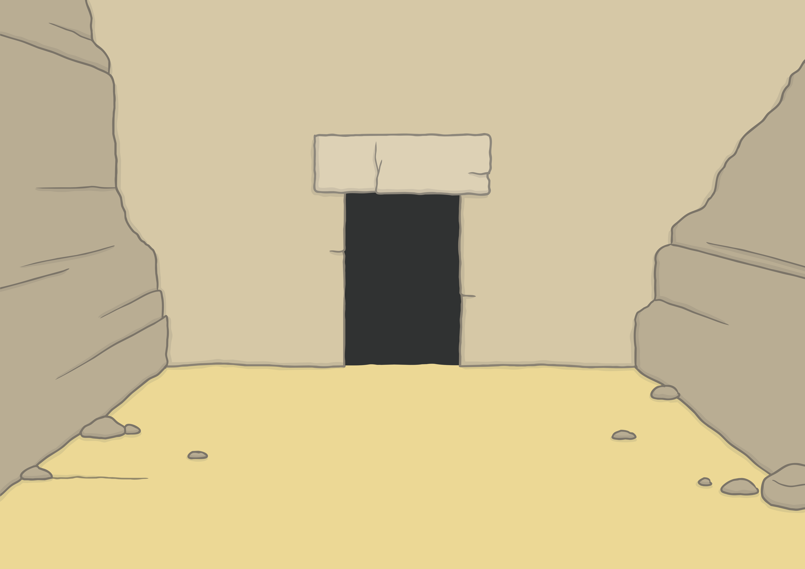
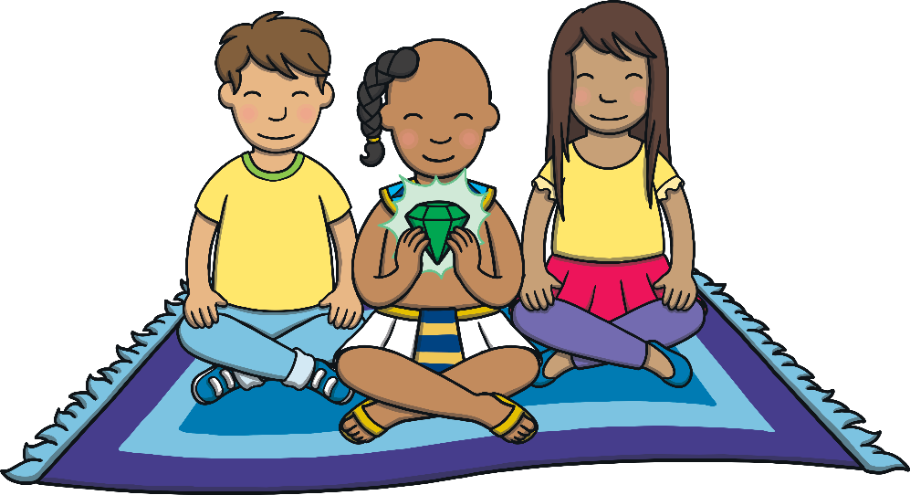
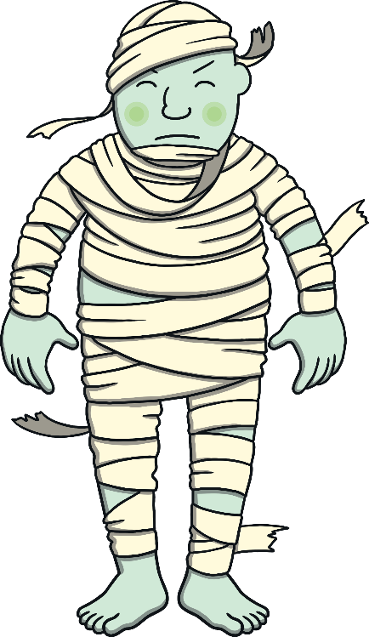
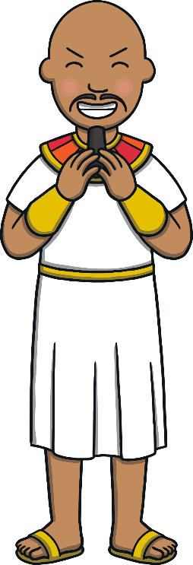
Teach
Kit, Sam and Prince Asim had escaped with the gemstone but Asim’s wicked uncle and the giant were chasing them!

Slide 10
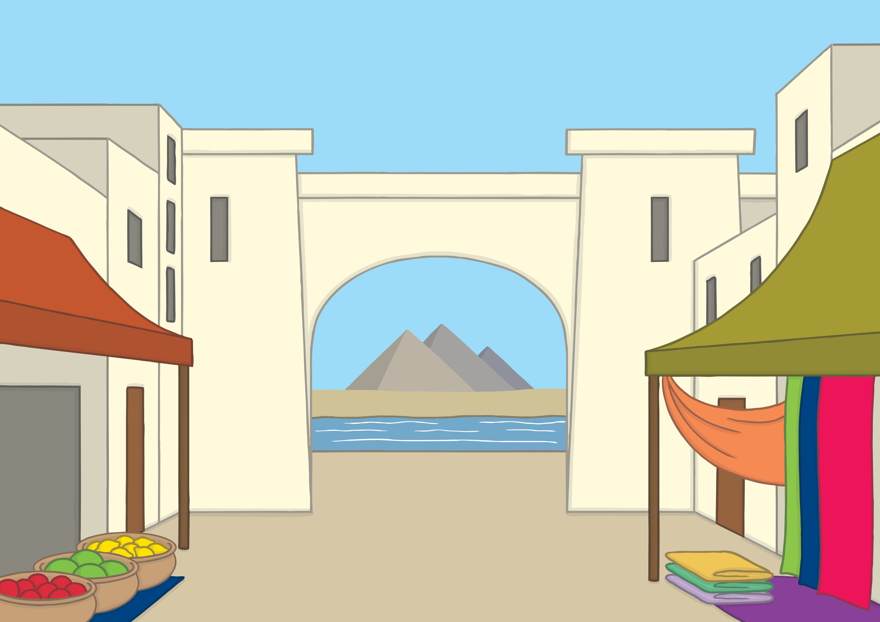

Teach
They flew over the city and headed to the central square. “We need to get the gem back to my palace,” shouted Prince Asim.

Slide 11
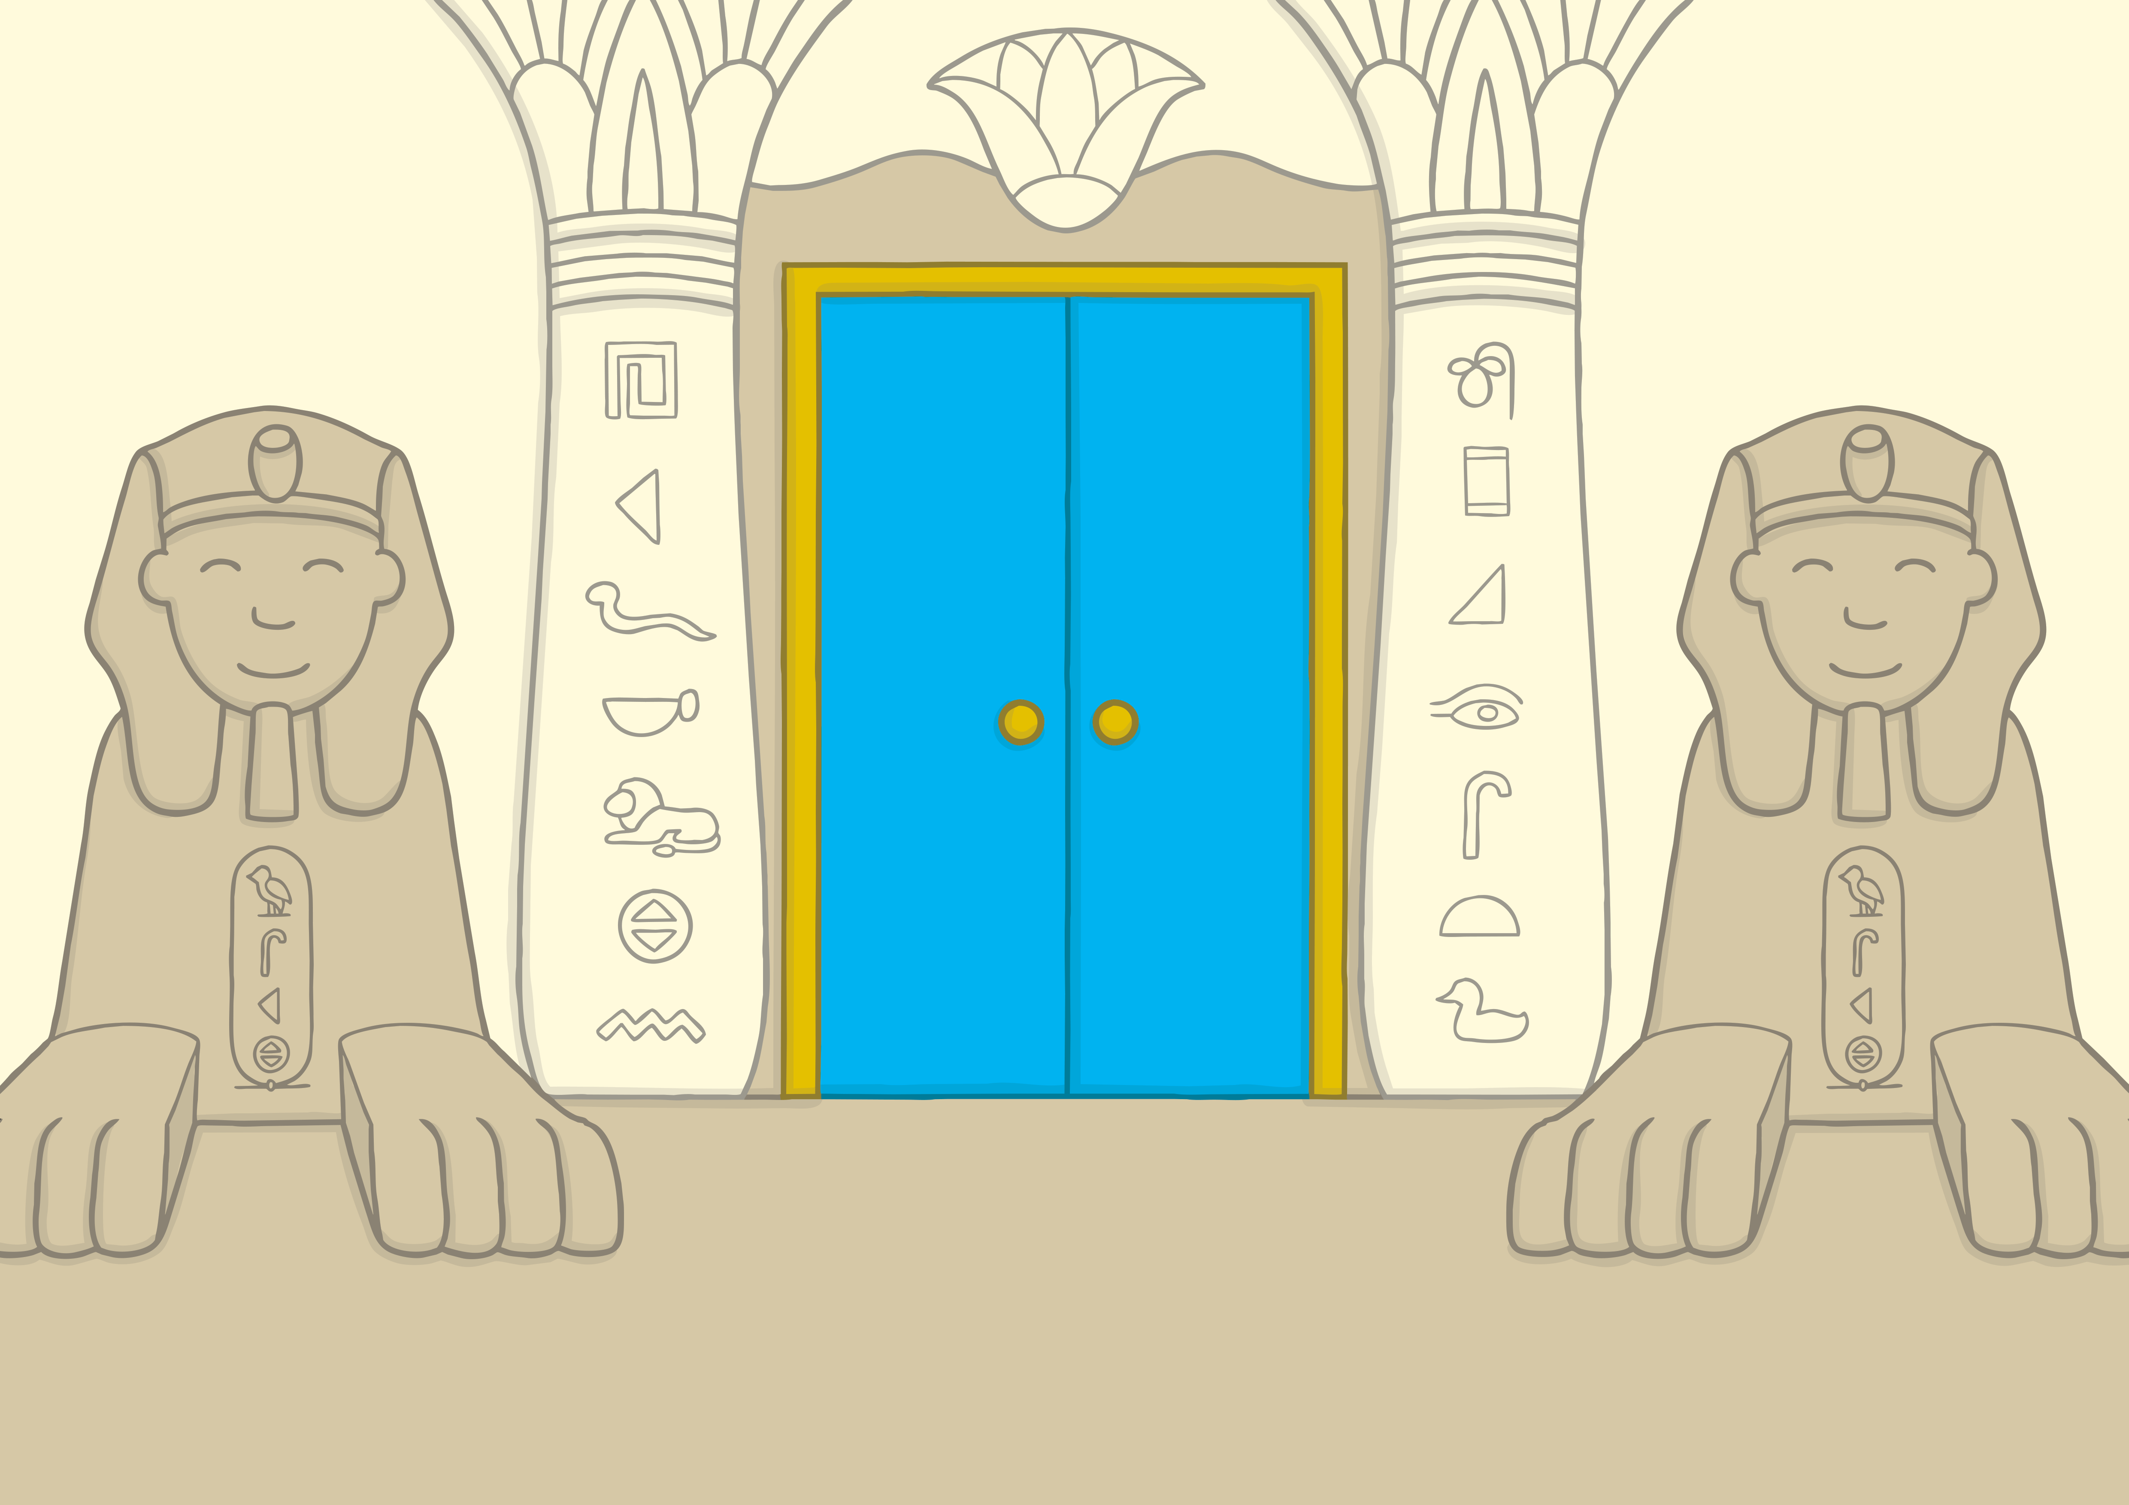

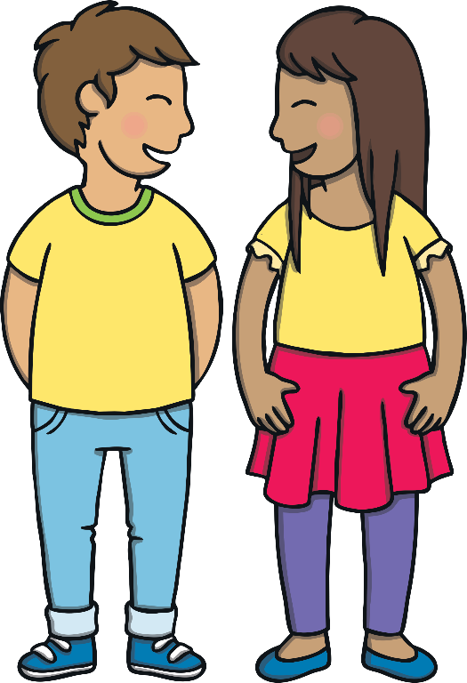
Teach
Soon, they arrived at the palace. “We just need to find my mum and dad and give the gem to them. Then, we will be safe!” said Prince Asim.

Slide 12
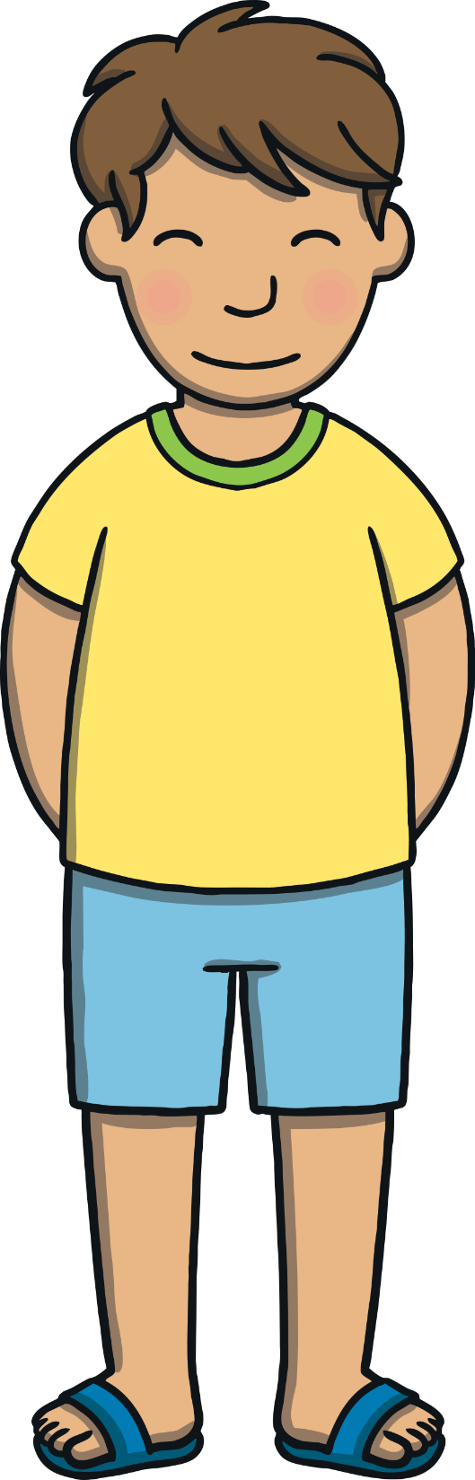
Passwords
Teach
On each palace door is a password.
Can you help work out the passwords and write them down?
Hint: They are all c saying /s/ words.

Slide 13
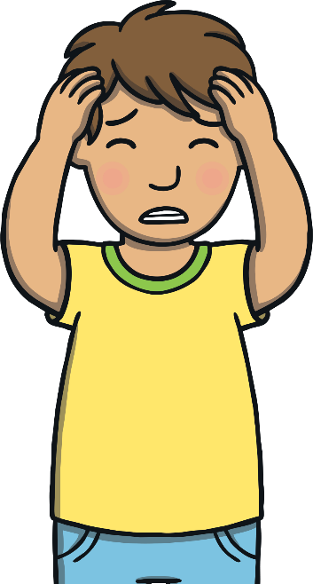



Teach
fa_e
face
i_e
ice
_ity
city
c_ll
cell
r_ce
race
Check

Slide 14

c Cell Build
Practise
Kit, Sam and Asim are inside the palace. Now, they just need to stop Asim’s uncle and the giant! Help the children build a cell for his uncle and the giant out of c words.

Slide 15
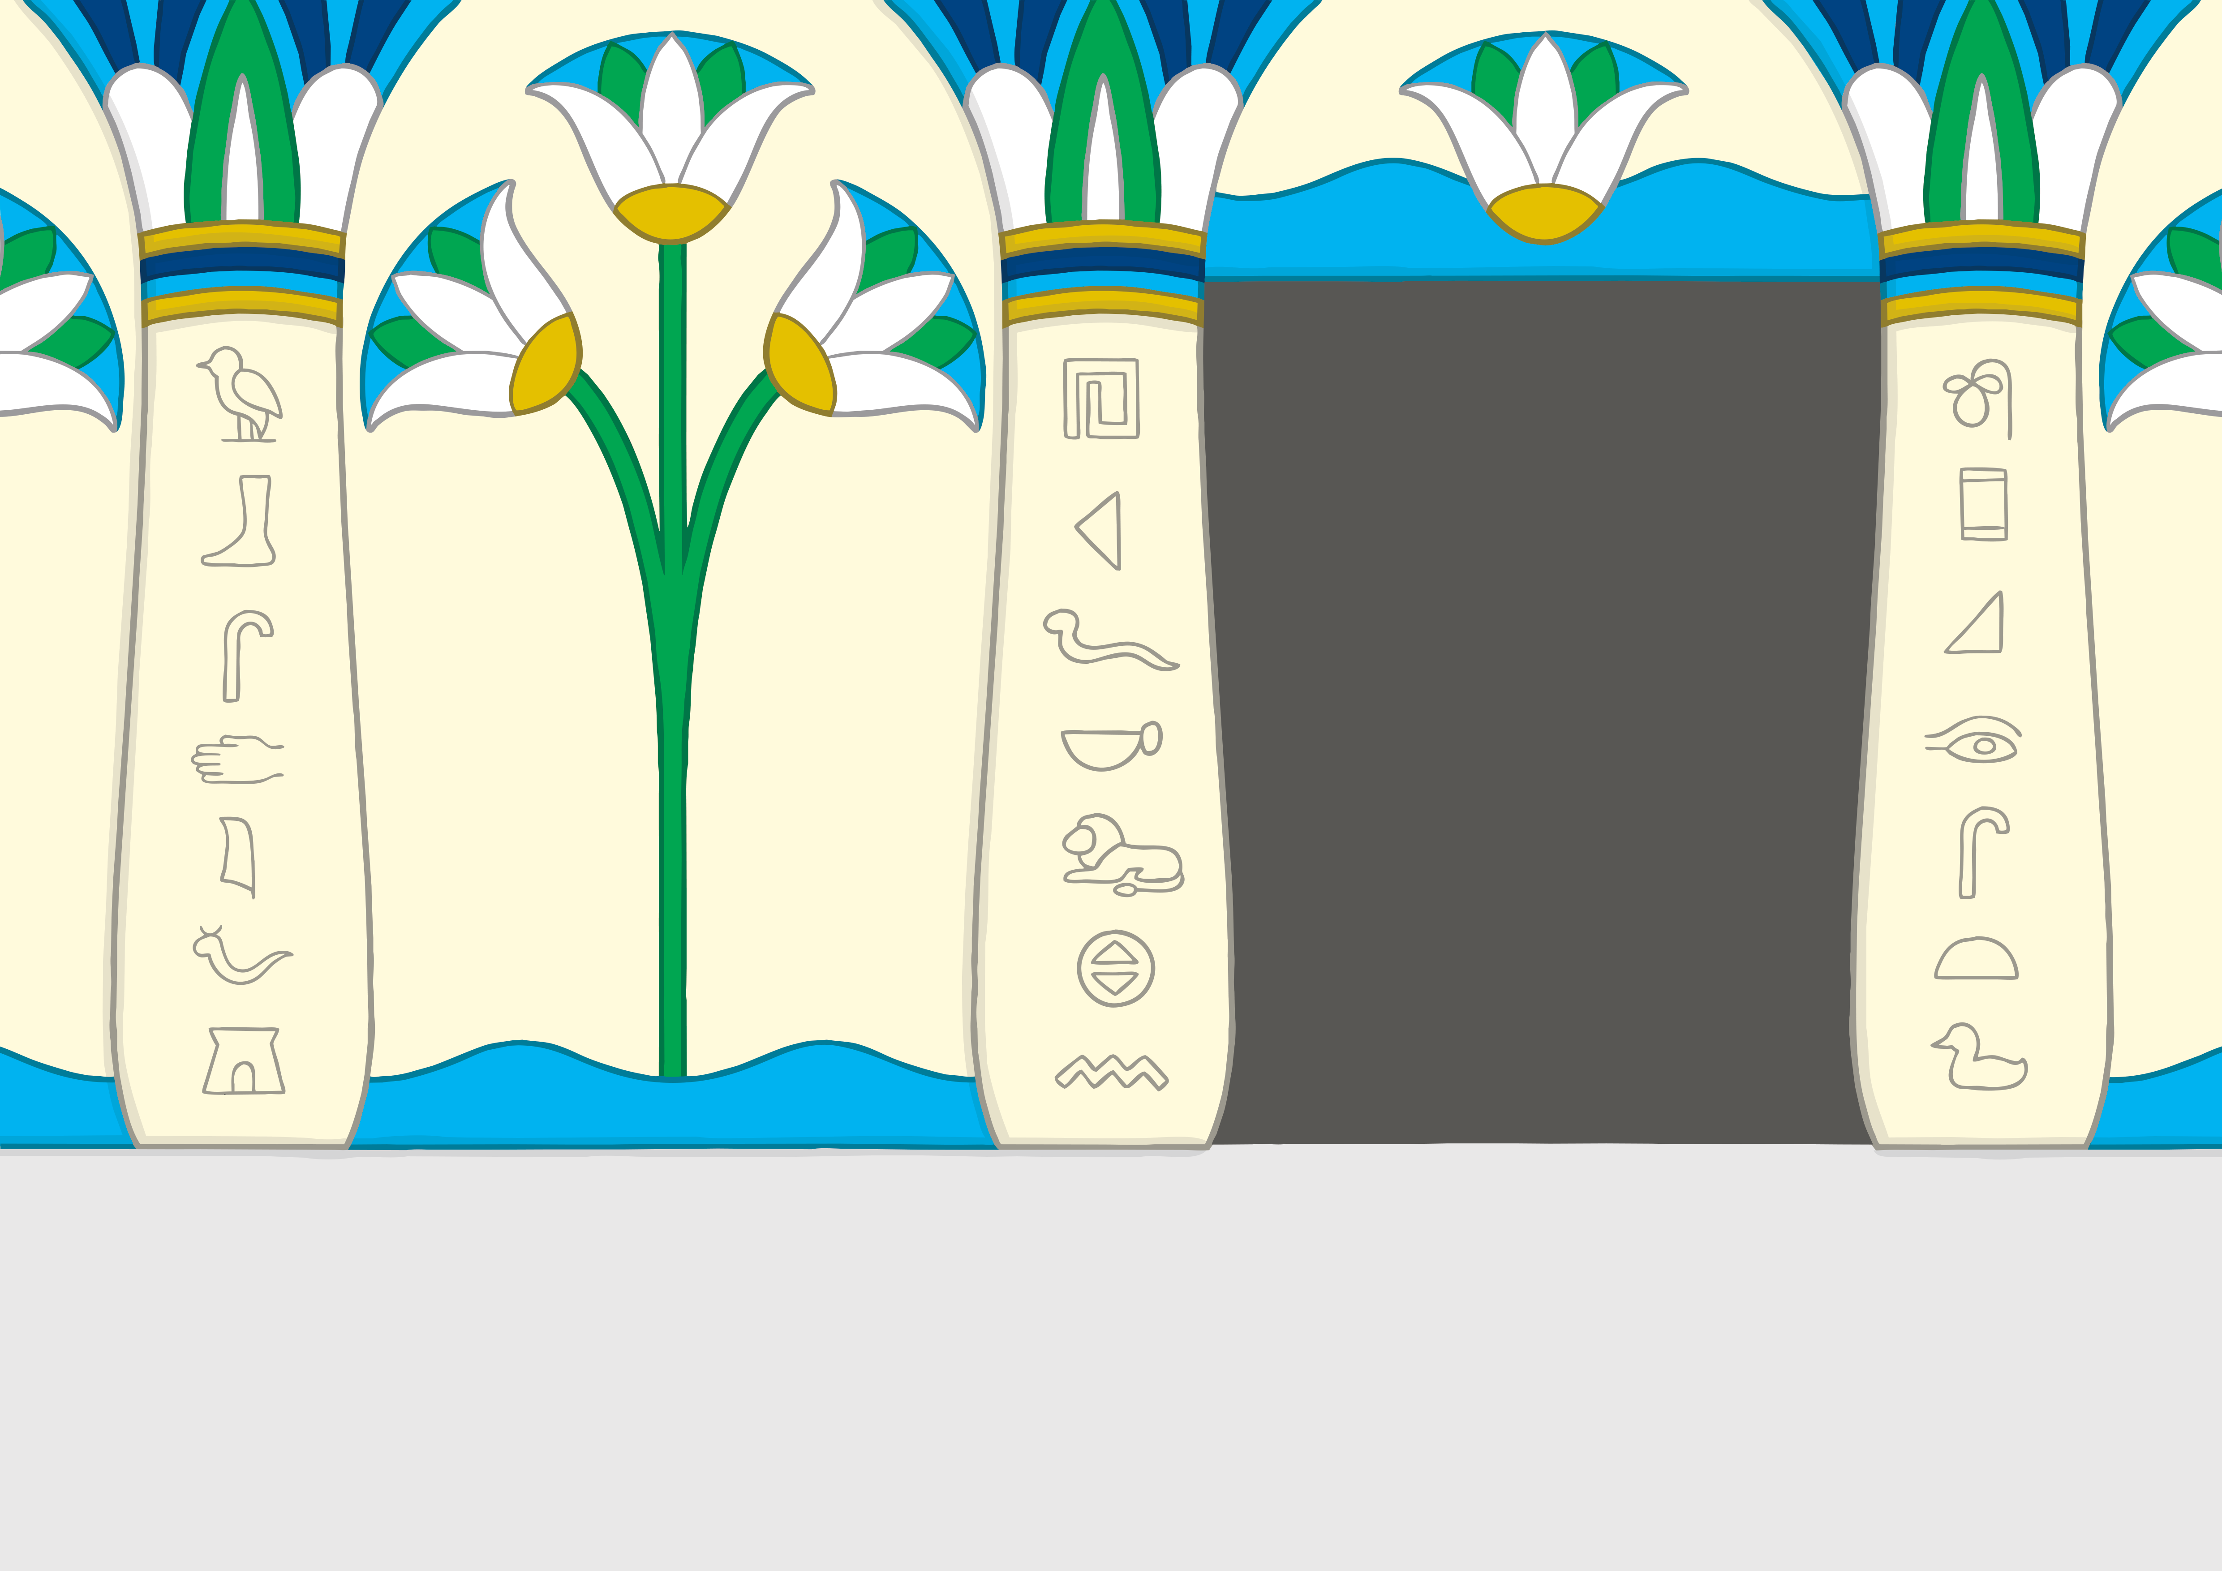


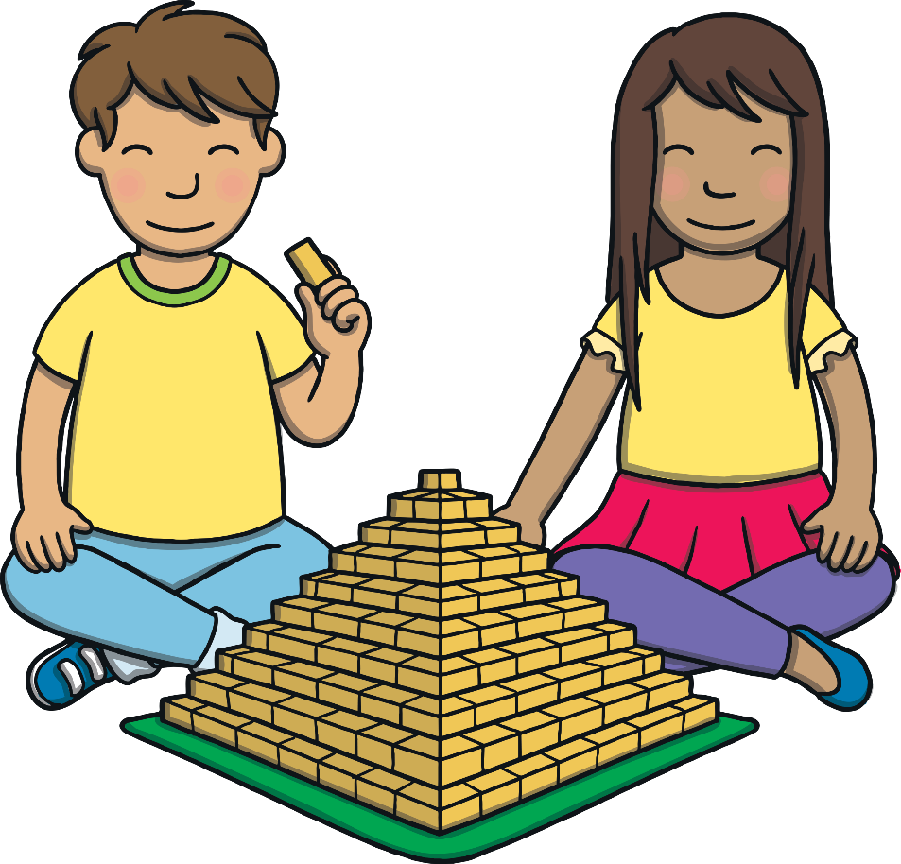
Practise
ci
ty
ty
cess
id
ri
ce
cent
sp
suc
ac
cent
ac
suc
cess
ace
ri
ac
id
ac
ce
sp
ace
ci

Slide 16
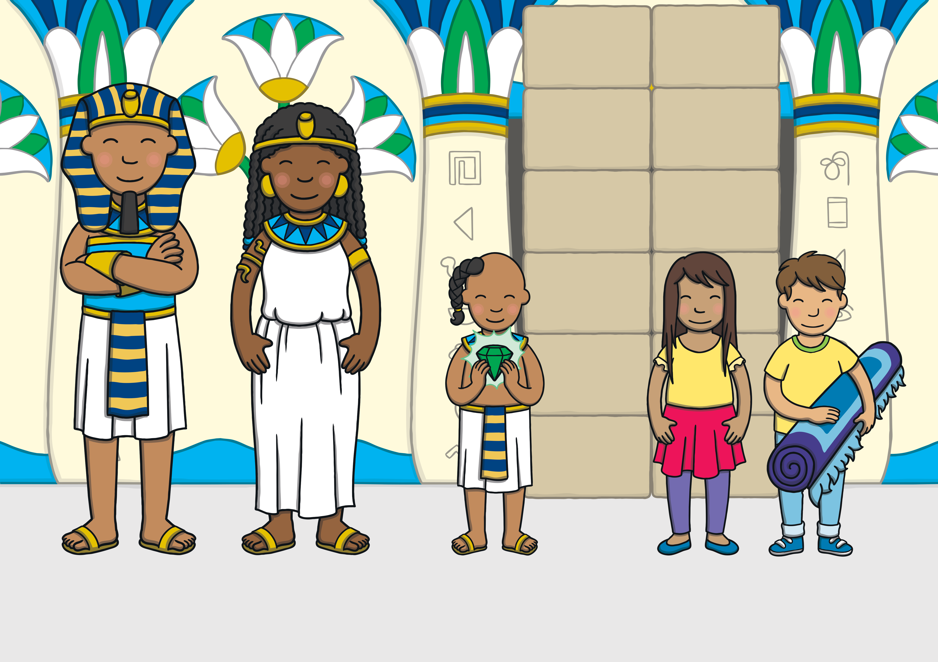
Apply
Prince Asim handed the gem back to his mum and dad. “Well done children,” said Asim’s mum. “You have saved the kingdom. Now, as for your uncle…”

Slide 17
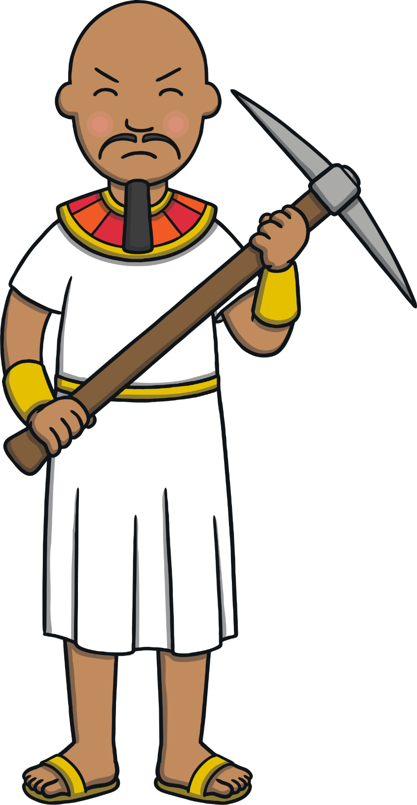
Sentence Time
Apply
What will happen to Prince Asim’s wicked uncle?
Look at the picture and write a sentence to match.

Slide 18

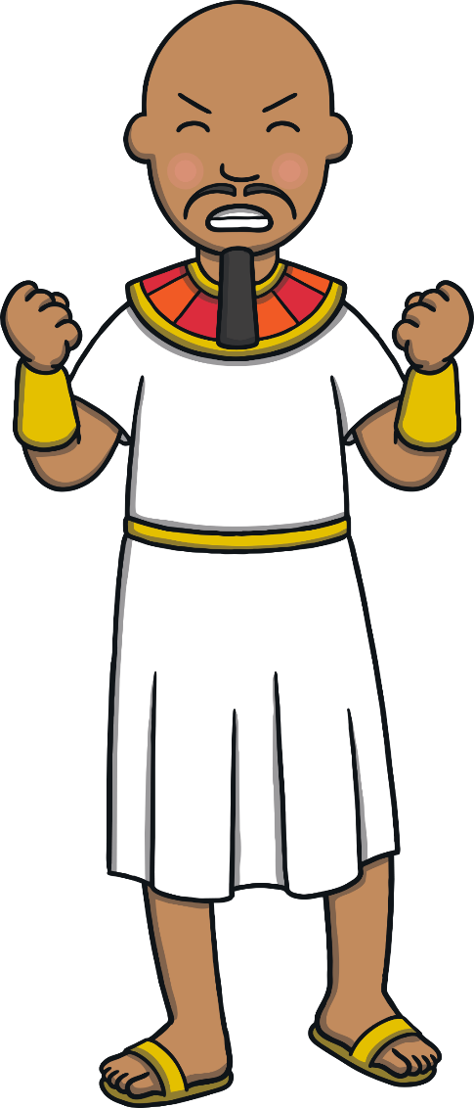

Apply
He will go in a cell
with the giant for many years.
Sound Buttons On/Off
Show

Slide 19
Apply
“Thank you for all of your help, Kit and Sam,” said Prince Asim.
“It was a pleasure. We loved meeting you!” said Kit. Then, the room began to fade.

Slide 20
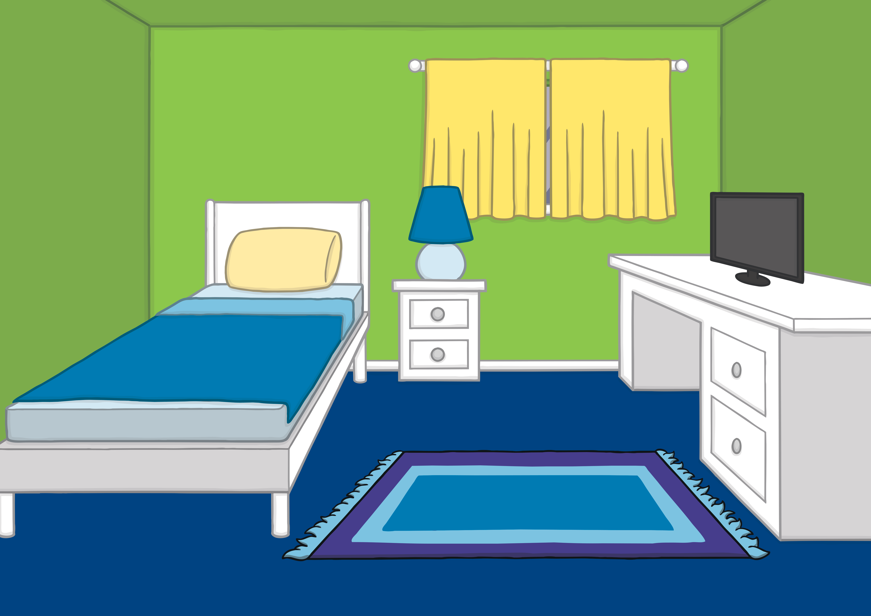
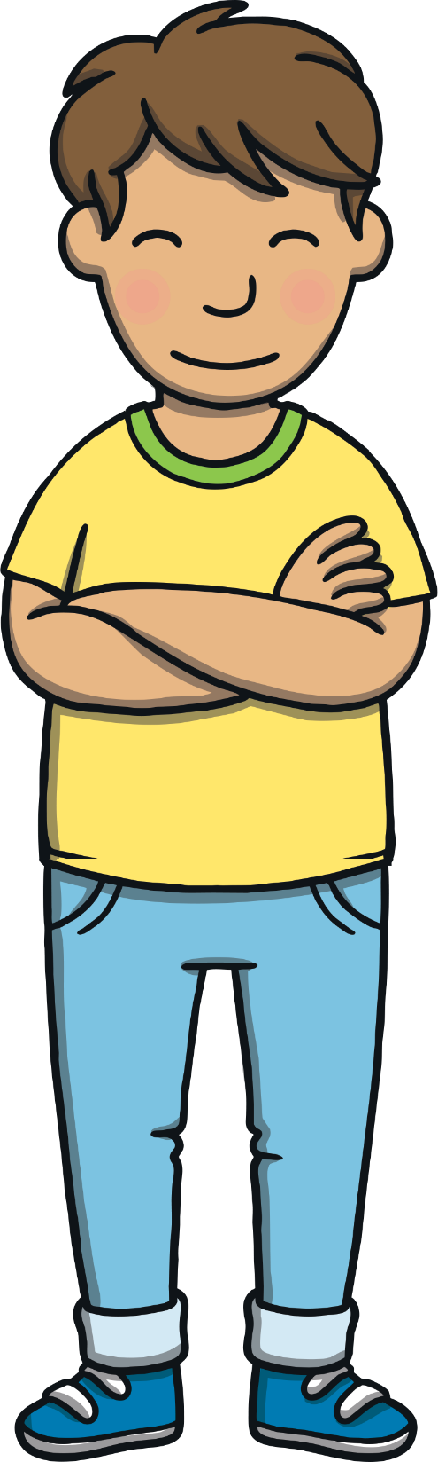

Apply
Kit and Sam found themselves back in Kit’s bedroom. “What a great adventure that was!” said Kit.
“It was,” agreed Sam. “I can’t wait for our next one.”

Slide 21

Today, we have learnt…
c
saying /s/
The adventure continues next lesson!

