Slide 2





Revisit and Review
Let’s practise Sam’s Sounds and Common Exception Words!
two
Mrs
their
could
should
oh
Mr
would
ea
oy
ay
ie

Slide 3
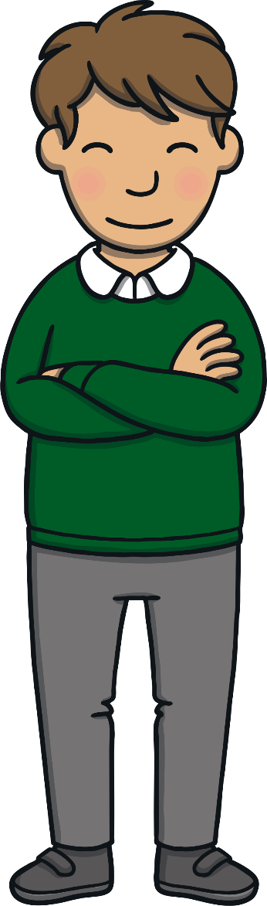
Teach
This week we are learning to spell the common exception words were and there.
Watch the magic pencil write the words. Can you join in?

Slide 4


Teach
were
Play

Slide 5
Teach
there
Play

Slide 6
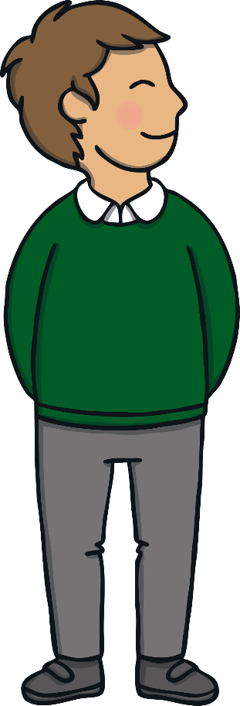
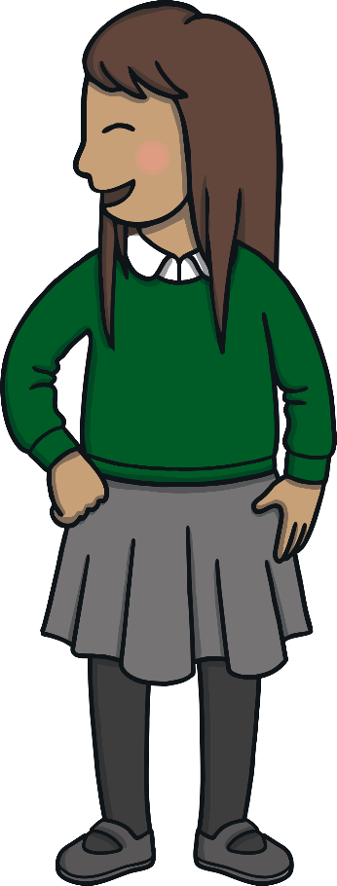
Teach
Today, we are learning to write words that contain ea.

Slide 7
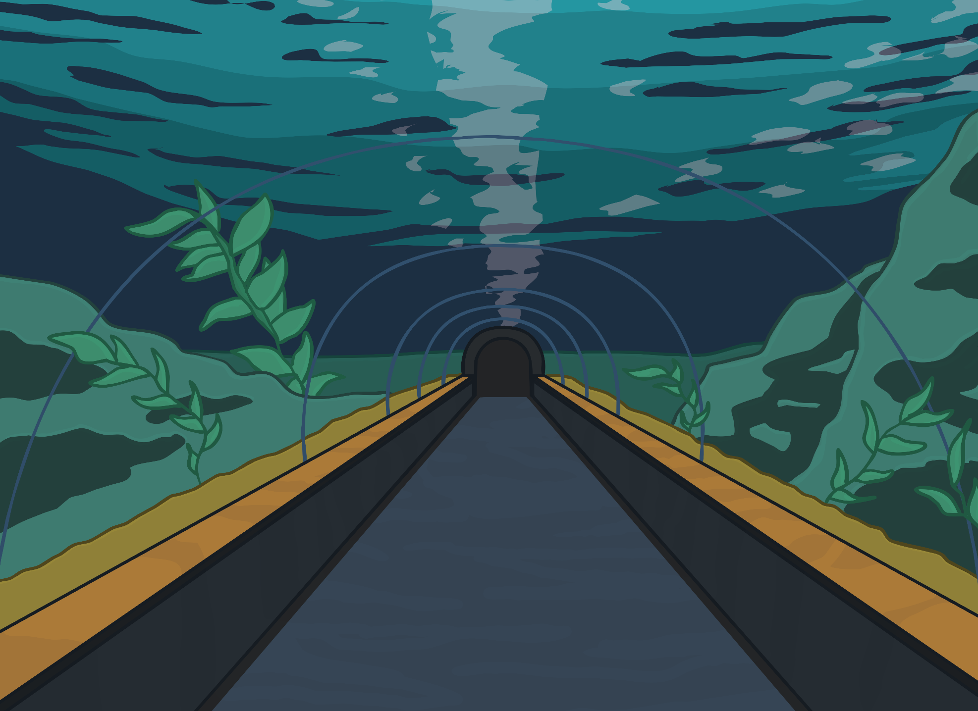
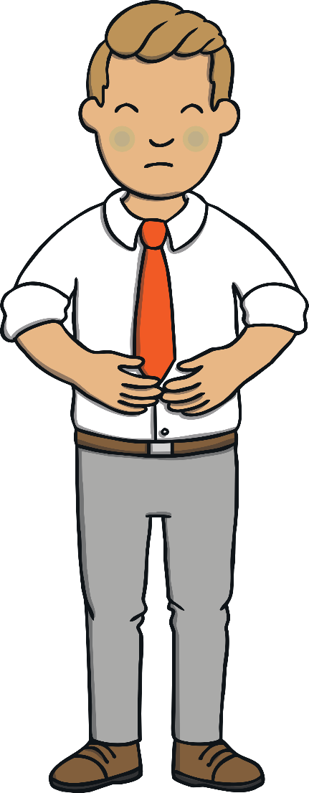
Teach
As the class walked through the aquarium, Kit asked Mr Adams if he was okay. Mr Adams had turned a pale green colour since the word sharks was mentioned!

Slide 8
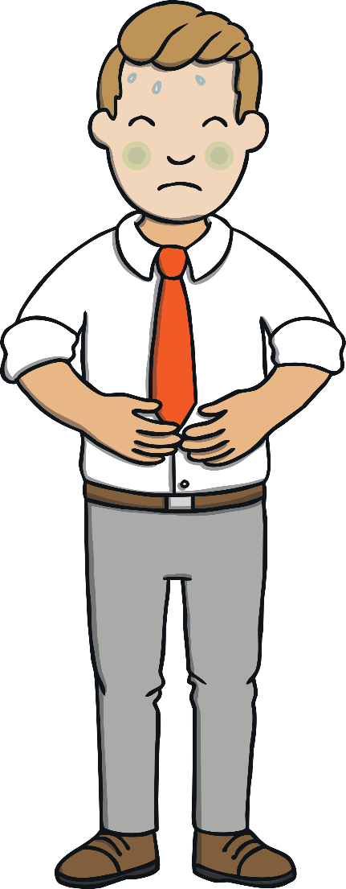
Teach
“I am fine, thanks,” explained Mr Adams. “I forgot sharks were so big!”

Slide 9
Teach
“I think sharks are awesome!” said Kit. “Whale sharks are the biggest. They are four times larger than an elephant! I told you I knew lots of facts.”

Slide 10
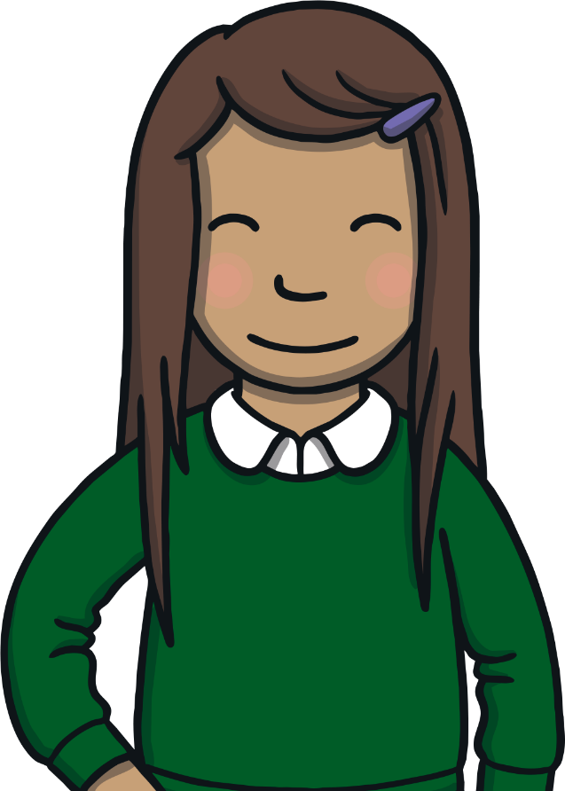
Teach
Sam is busy looking at a poster about sharks. Unfortunately, some of the print on the poster is smudged and only parts of the words can be read. Can you work out what the words are and write them down?
Hint: They are all ea words

Slide 11
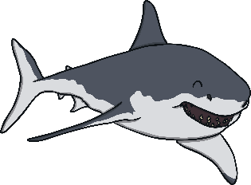
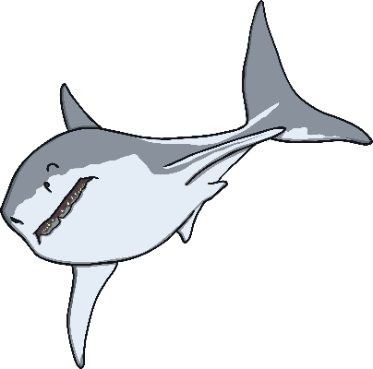
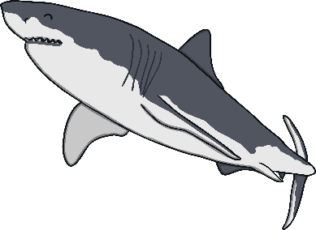
Teach
Sharks
s .
r d.
s t
h p
w k

Slide 12





Practise
ea and ee Shark Sort
Kit and Sam notice that the sharks are all huddled together. Help sort them into two groups. Write a list of the sharks that belong in each group.
X
This is a great whiteboard activity.
Click me for Kit’s teaching tips!

Slide 13


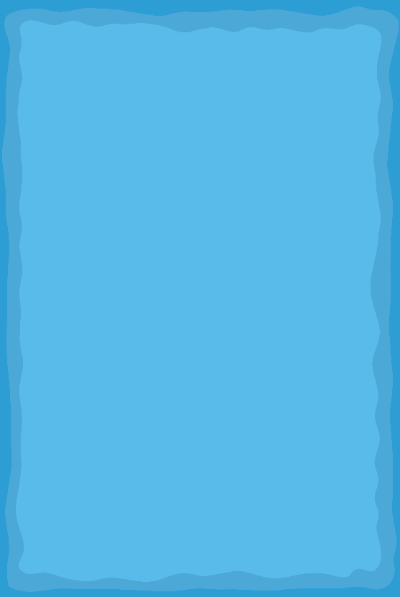
Practise
ea
ee
sea
sea

Slide 14

Practise
ea
ee
sea
see
see

Slide 15
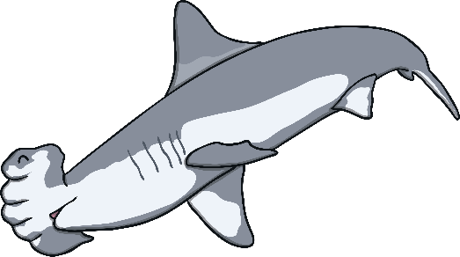
Practise
ea
ee
sea
see
peach
peach

Slide 16
Practise
ea
ee
sea
see
leaf
peach
leaf

Slide 17
Practise
ea
ee
sea
see
meet
peach
meet
leaf

Slide 18
Practise
ea
ee
sea
see
peach
beach
meet
leaf
beach

Slide 19
Practise
ea
ee
sea
see
week
meet
peach
leaf
week
beach

Slide 20
Practise
ea
ee
sea
see
seem
meet
peach
leaf
week
beach
seem

Slide 21
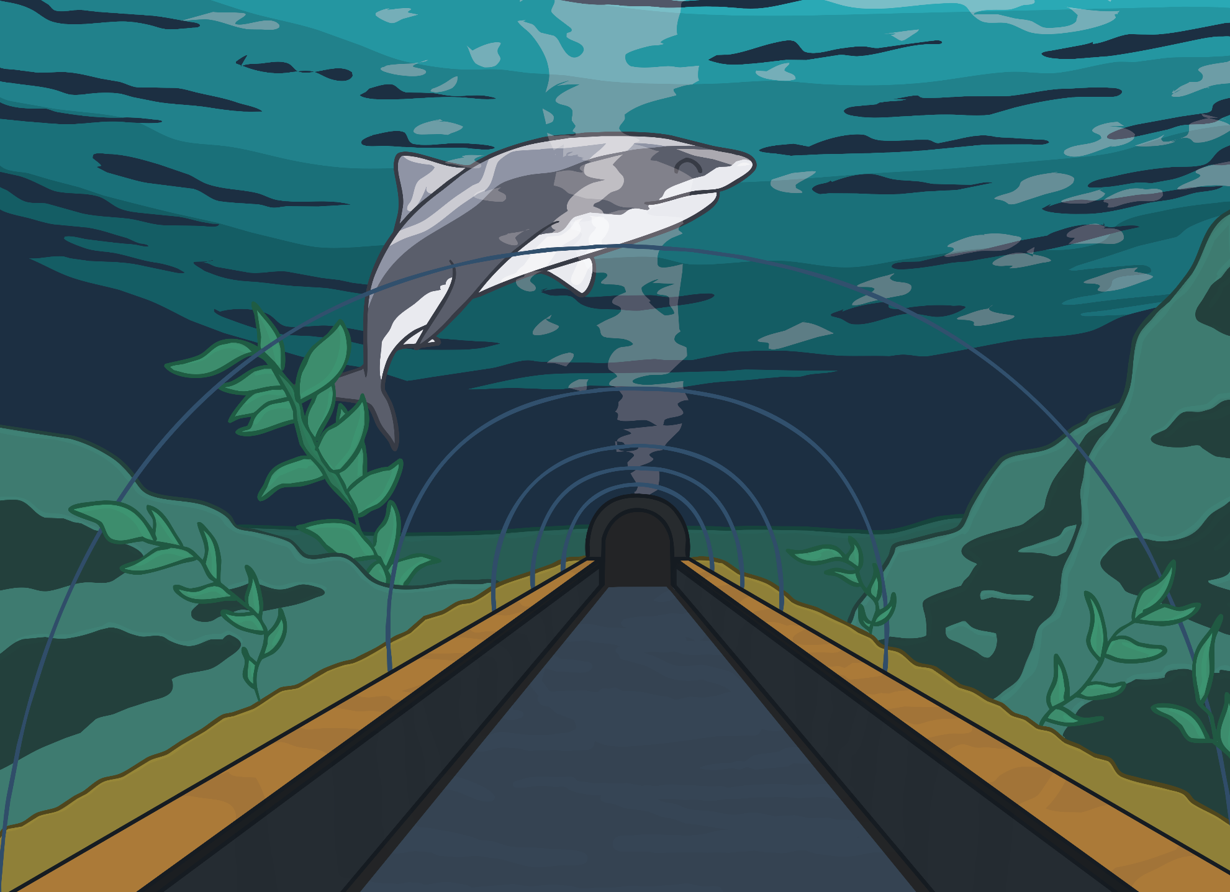
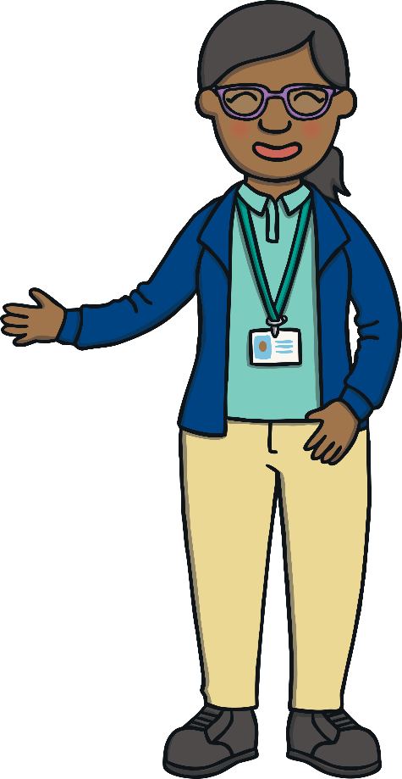
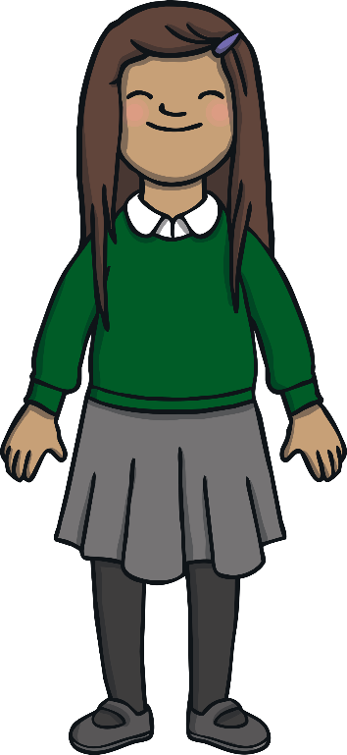
Apply
“Sharks come in all shapes and sizes,” explained Mrs Pillay as they arrived at the Ocean Tunnel. “Wow!” shouted Sam as she gazed up.

Slide 22

Sentence Time
Apply
What is Sam thinking? Look at the picture and write a sentence to match.

Slide 23


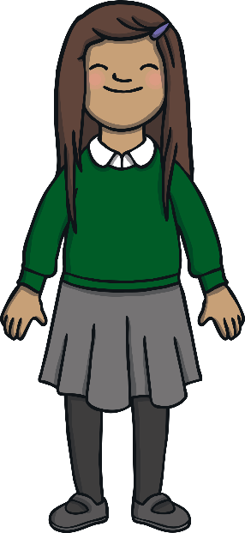

Apply
There are lots of big sharks!
Sound Buttons On/Off
Show

Slide 24
Apply
Sam turned to Mr Adams and Mrs Pillay. “They are magnificent sharks!” said Sam, amazed. Mr Adams nodded his head but did not say a word. He wondered, where will we go next?

Slide 25
Today, we have learnt…
ea
saying /ee/
The adventure continues next lesson!

